Slide 1

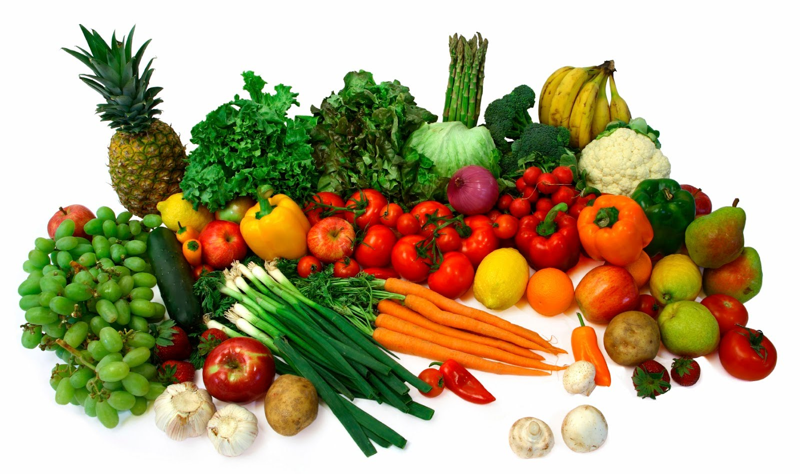
AGRICULTURAL
Nguyen Van Tan

Slide 2
CONTENT
Company presentation
Project presentation
Technical presentation and achievements
Demonstration
Working environment
Conclusion

Slide 3
CONTENT
Company presentation
Working environment
Demonstration
Technical presentation and achievements
Project presentation
Conclusion

Slide 4
COMPANY PRESENTATION
HT Active
Information
Service
Technology
Contact

Slide 5
PROJECT PRESENTATION

