Slide 1
Medical Image Segmentation utilizing Federated Learning
Presented by
Tanni Das
Graduate Research Assistant
Video Processing Lab
Gachon University, Korea

Slide 2
Contents
Motivation
Previous works
Proposal
References

Slide 3
Motivation
Medical image segmentation requires a lot of diverse dataset
In federated learning paradigm, data privacy is a target issue
So, the direct inter-client data share is discouraged
As a result, due to lack of data model generalization becomes tough
Some researches show various way to share data in inter-institutional mode by having privacy
Having this kind of work, maximum researches focus on only data sharing protocol not in model development which can tackle generalization problem
In my research, I will try to fill this gap

Slide 4
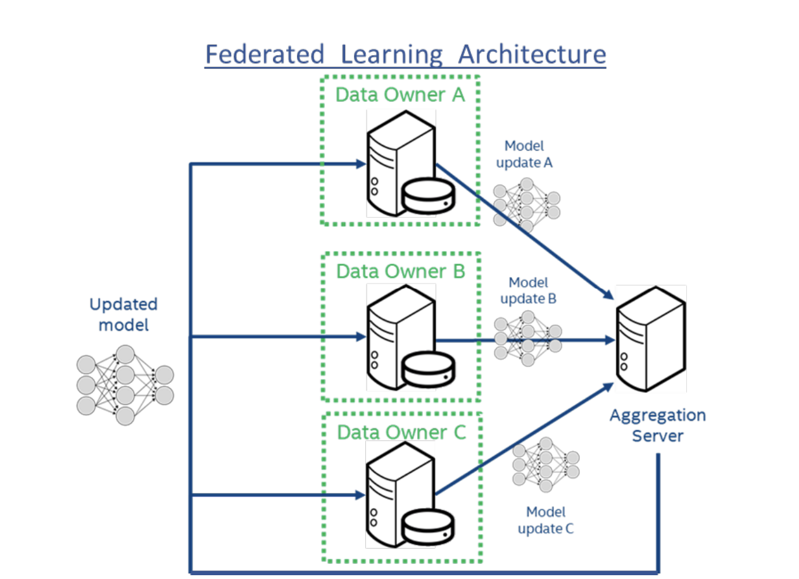
Previous Works
Sheller et. al. [1] suggested a very basic way to use segmentation model in a federated learning way. But in their model no scheme for protected data sharing is proposed

Slide 5
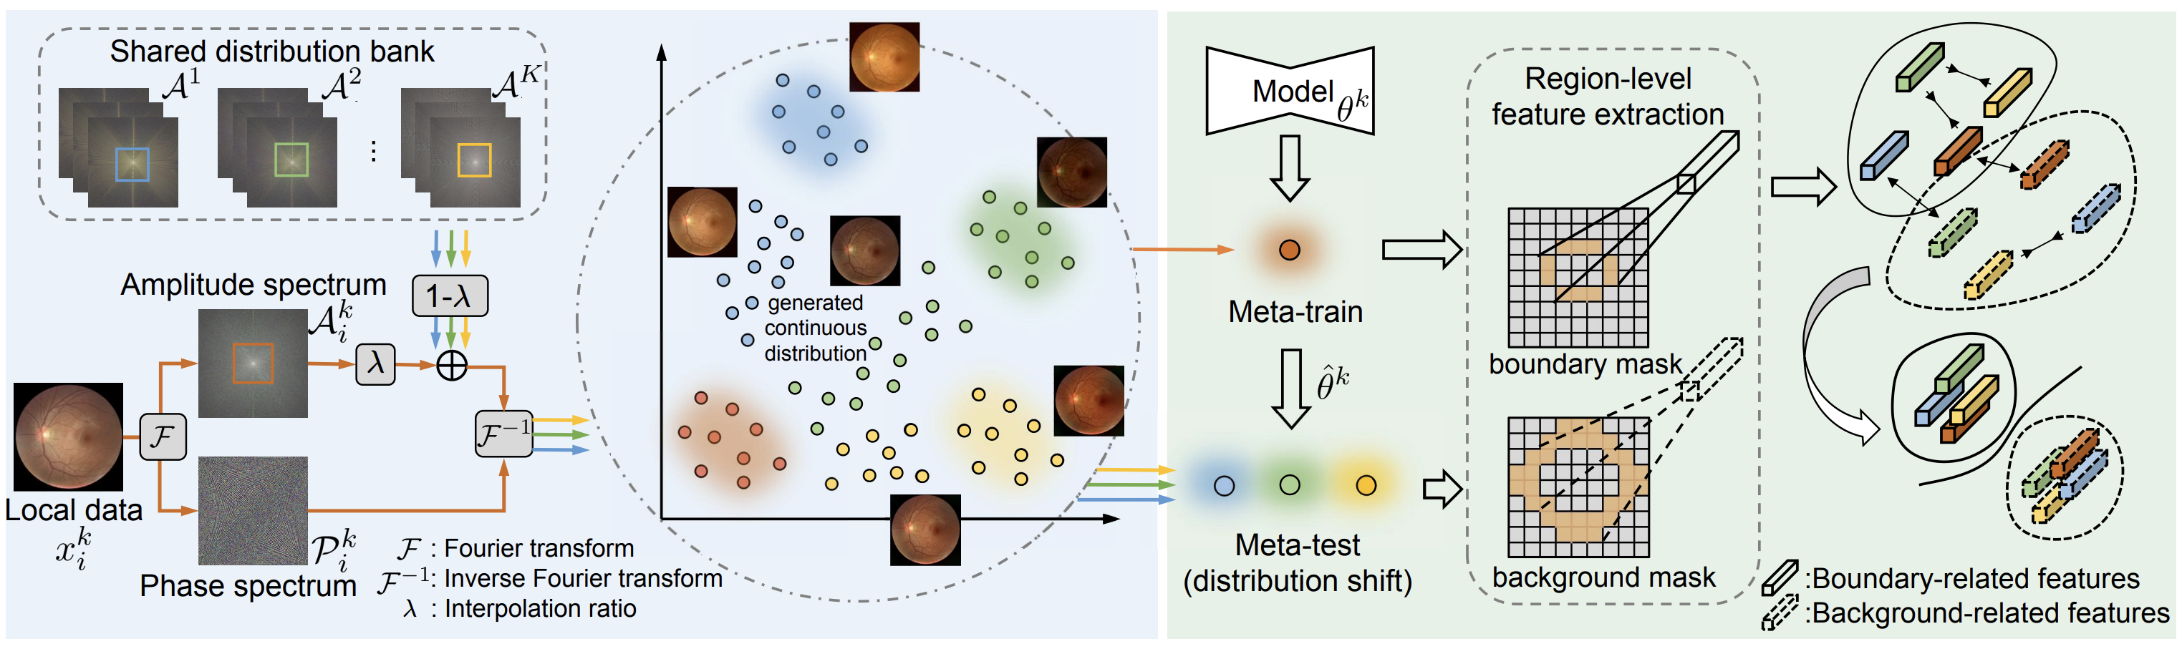
Previous Works
Liu et. al. [2] proposed a frequency domain based data sharing scheme and implemented in medical image segmentation

Slide 6
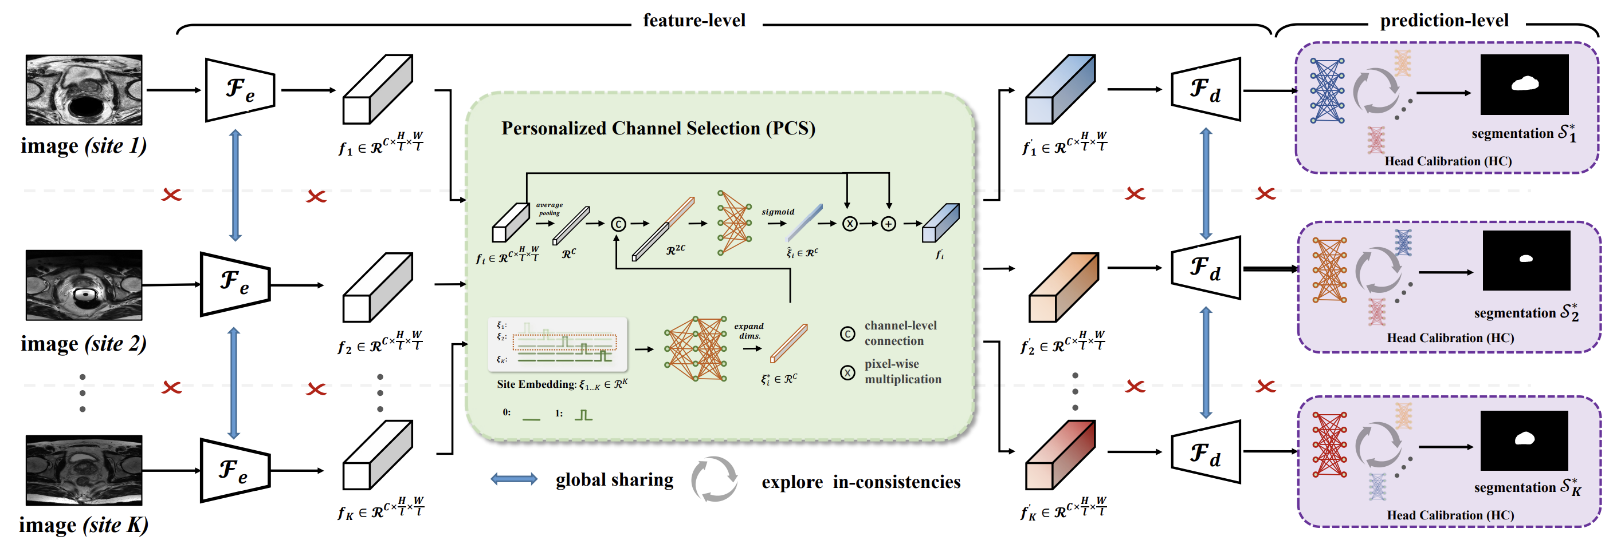
Previous Works
Wang et. al. [3] proposed a method where federated learning works in two steps: feature level and prediction level

Slide 7
My proposal
In order to make a generalized medical image segmentation model, previous efforts are made into data sharing
But deep learning model design also contributes to be a generalized model
So, my target will be to develop an efficient CNN model from the previous ideas of U-net, U-net++, and attention U-net etc.

Slide 8
References
[1] M. J. Sheller, G. A. Reina, B. Edwards, J. Martin, and S. Bakas, “Multi-Institutional Deep Learning Modeling Without Sharing Patient Data: A Feasibility Study on Brain Tumor Segmentation.” arXiv, Oct. 22, 2018. doi: 10.48550/arXiv.1810.04304.
[2] Q. Liu, C. Chen, J. Qin, Q. Dou, and P.-A. Heng, “FedDG: Federated Domain Generalization on Medical Image Segmentation via Episodic Learning in Continuous Frequency Space.” arXiv, Mar. 10, 2021. doi: 10.48550/arXiv.2103.06030.
[3] J. Wang, Y. Jin, and L. Wang, “Personalizing Federated Medical Image Segmentation via Local Calibration.” arXiv, Jul. 11, 2022. doi: 10.48550/arXiv.2207.04655.

Slide 9
Thank You

