Slide 1

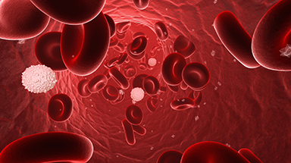
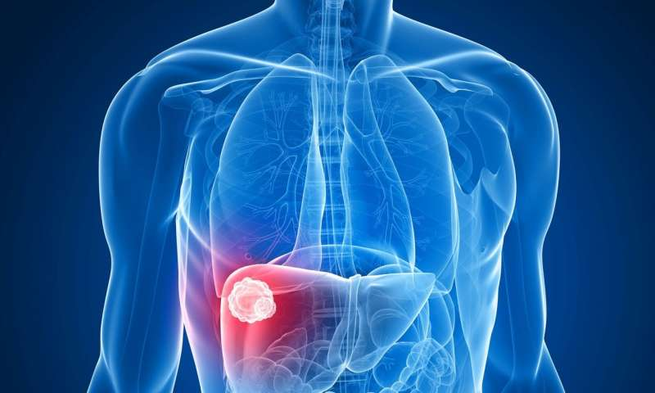
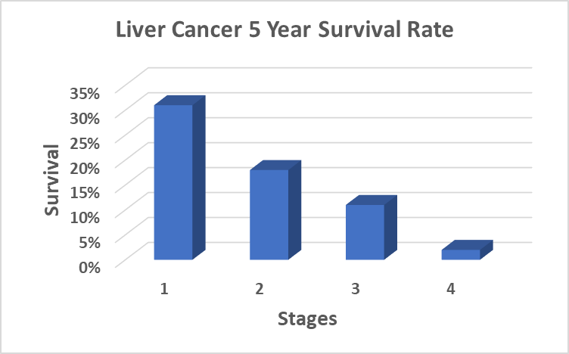
Detect early warning signs
INSIGHT FELLOW
Tannistha Maiti

Slide 2
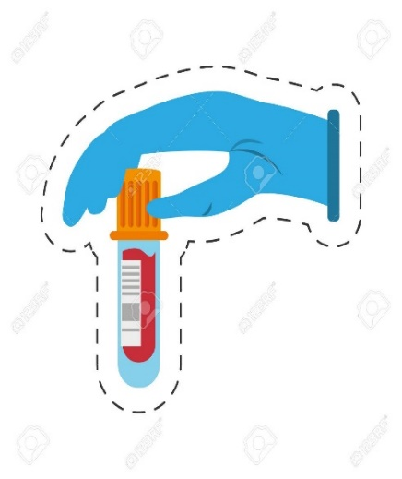

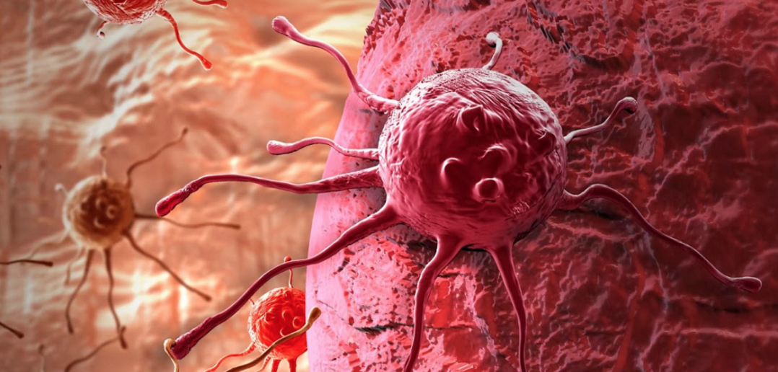
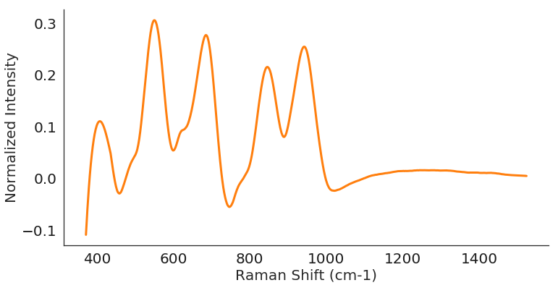
PRODUCT
Raman spectroscopy
1. DETECT
2. CLASSIFY
Fed it to LIVE-r: EARLY DETECTION

Slide 3
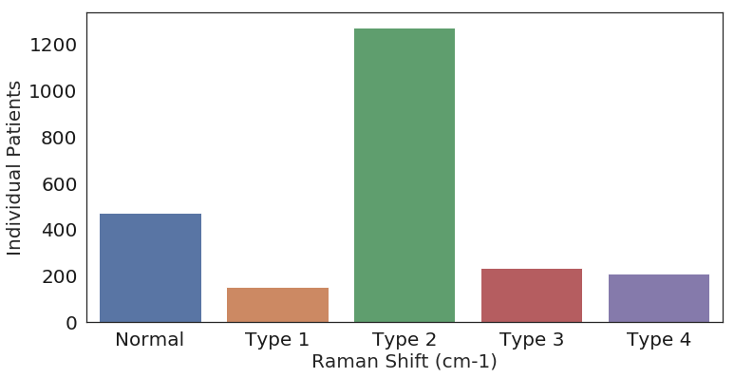

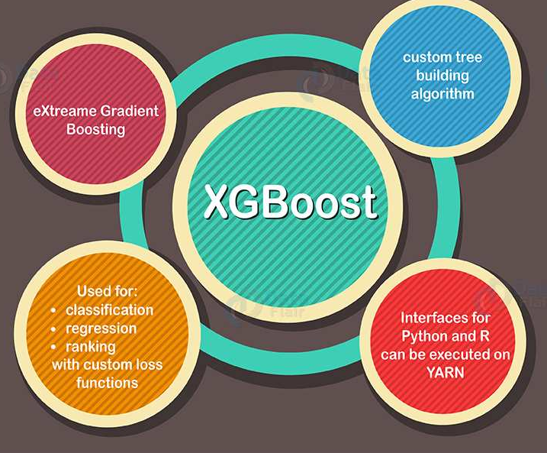
MODEL
Multiclass Classification
Precision of “Type 2”: 80%
Precision of “Normal”: 75%
Binary Classification
Accuracy: 91%

Slide 4
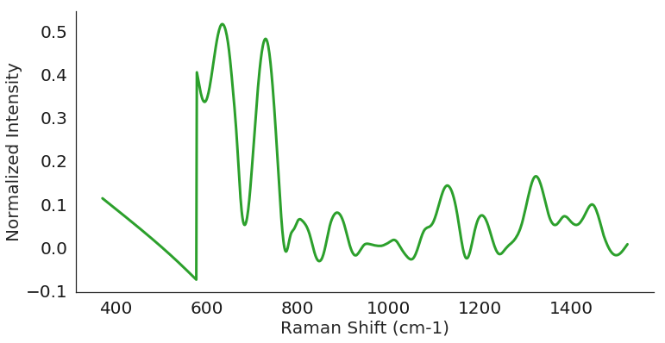
RAMAN SPECTROSCOPY
NORMAL
Δx
DISEASED

Slide 5
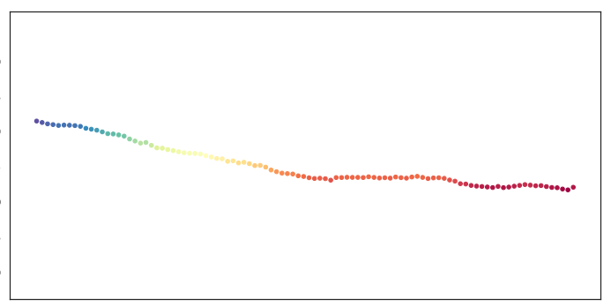
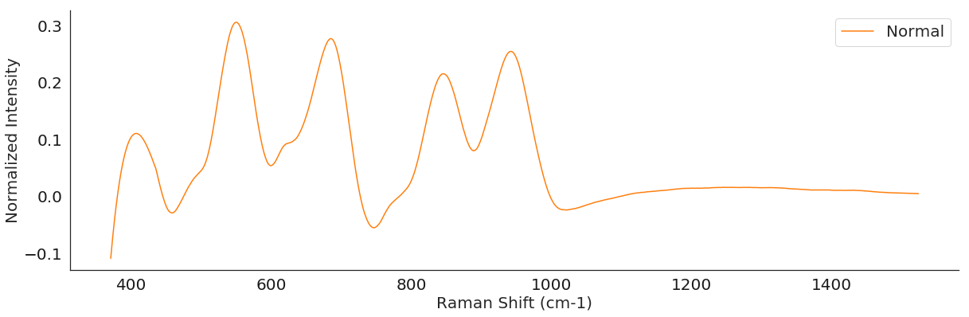
FEATURES
Features
Features

Slide 6
CHALLENGES

Slide 7

WEB APPLICATION

Slide 8
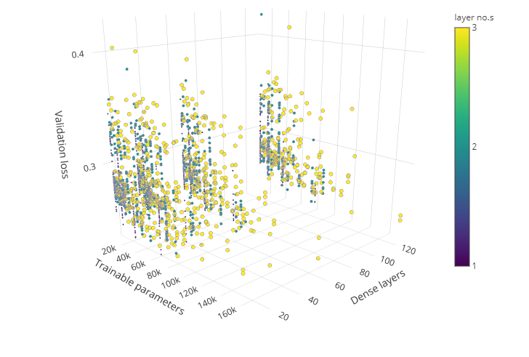



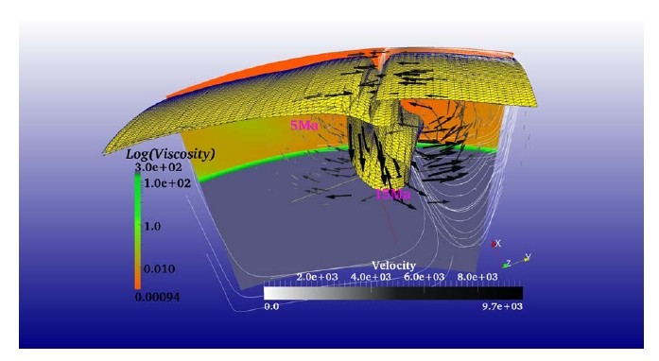

WHO I AM
Laura Urbisci
PhD and MA from UC Santa Barbara
Insight Data Science Fellow

