Slide 1
SAMSUNG PRISM GENAI HACKATHON 2026-27 · THEME 05 · INTERRUPTIBLE REAL-TIME AGENTS
DUET
FDB-V3 · ALL 100 REAL RECORDINGS
0.81
Pass@1, strict:
every tool, every
argument, no extras
A full-duplex voice agent that acts on what you mean,
not on what you said first.
DUET
0.81
GPT-Realtime
0.60
PLANS EARLY · COMMITS LATE · ACTS ONCE
Gemini Live 3.1
0.54
Baselines: FDB-v3 paper. DUET: our reported run.
01 HEAR
02 WAIT
03 CHECK
04 ACT ONCE
05 ANSWER
every word advances
the epoch
turn closed and the
user quiet for a hold
a plan made on changed
words is dropped
the ledger never runs
an action twice
spoken from the tool
results, never guessed
Team SE7EN · SRM Institute of Science and Technology · SRM_SE7EN
Tanmay Singh · Pranjal · Naman
Gemma 4 26B-A4B · LiveKit Agents · faster-whisper · Kokoro-82M · one command to reproduce
github.com/tannnmayy/DUET-SAMSUNGPRISM-HACKATHON-TEAM-SE7EN

Slide 2
THE PROBLEM, IN OUR WORDS
02 / 08
The failure isn't hearing the correction. It's acting before it arrives.
A real Full-Duplex-Bench recording (travel_19), with the times from DUET's own trace of the reported run.
The user
SELF-CORRECTION ITEMS · PASS@1
…flights to Rome.
…June 1st.
Sorry.
DUET
No, wait… Milan instead.
Well, wait… actually June 3rd.
0.88
Acting on every
closed turn
search_flights(Milan, June 1) ✗ stale
GPT-Realtime
search_flights(Milan, June 3)
0.59
Two calls: the extra, stale one fails the item under strict Pass@1.
“One moment.”
Gemini Live 3.1
0.35
DUET
plans dropped: new words
Gemma plans on the final words (4.8 s)
Whisper→GPT-4o
search_flights(Milan, June 3) ✓ once
0.18
The spoken answer followed at 38 s: “a flight to Milan on June 3rd for 450 dollars.”
DUET: 15 of 17 items in our run. Baselines: the FDB-v3 paper. The paper names the cause: “models commit intermediate parameters before the correction arrives.”
5 s
10 s
15 s
20 s
25 s
STAY RESPONSIVE
WORK ASYNCHRONOUSLY
RECOVER CLEANLY
“One moment.” as soon as the user is clearly done and the thinker is still working. Every one of the 100 conversations answered.
Speech recognition, synthesis, model calls and tools all run off the audio loop. The user can talk over the agent at any time.
A plan built on words the user has changed never runs; an action never runs twice. 0% interruptions in the reported run.
DUET · Team SE7EN, SRM (SRM_SE7EN) · Samsung PRISM GenAI Hackathon 2026-27 · Theme 05
github.com/tannnmayy/DUET-SAMSUNGPRISM-HACKATHON-TEAM-SE7EN

Slide 3
SOLUTION AND ARCHITECTURE
03 / 08
Two minds and a referee: every action leaves through one guarded exit
The model decides what should happen. Deterministic code decides whether, and when, it may happen.
LIVEKIT
ROOM
EARS · local
COORDINATOR
open
request
THINKER · Gemma 4
GOOGLE API
audio
words ·
turn closed
Silero VAD → faster-whisper large-v3-turbo (GPU)
LiveKit turn detector: has the turn ended?
Epochs
new words void every older plan
Reads everything said since its last spoken answer, plans the tool calls, speaks once with the results.
gemma-4-26b-a4b-it
key pool · token budget · backup requests
WebRTC audio, both ways.
The benchmark's runner, or a Galaxy phone, on the other side.
proposed
call
Commit gate
no action until the turn has closed and the user is quiet
the answer, with the facts
Idempotency ledger
an action never runs twice
TOOLS
committed
call, once
VOICE · local
ON ONE GPU
cover
the wait
The benchmark's 12 APIs (its own mock, unmodified), or the phone's tools in DUET for Galaxy.
Failure policy
reads retried once, writes never re-sent
Fast voice: “One moment.” after 1.6 s of quiet; never a value or a result.
Kokoro-82M speech (GPU).
Speech models only: 2.9 GB at peak, of Samsung's 48 GB. The language model runs at Google.
result
agent audio out
Every tool call in the benchmark and on the phone takes this one path, so the same guarantees hold everywhere: a correction always wins, and nothing is done twice.
DUET · Team SE7EN, SRM (SRM_SE7EN) · Samsung PRISM GenAI Hackathon 2026-27 · Theme 05
github.com/tannnmayy/DUET-SAMSUNGPRISM-HACKATHON-TEAM-SE7EN

Slide 4
INNOVATION: THE COORDINATOR
04 / 08
Plans early, commits late, acts once
Each proposed action travels a small state machine. Only the path to Done ever touches the outside world.
Epochs
Planned
Held
Ledger
Running
Every plan carries the epoch of the words it was made on. New words void it, even after the newer turn has closed. A cough brings no words: it delays an action, never cancels it.
from the thinker
at the commit gate
seen this exact call?
executed once
waits while the user speaks, or while words may still arrive
Commit gate
A tool runs only after the turn closes and the user is quiet for 1.1 s; 1.8 s after a revision (“no wait”); 2.2 s when the sentence is left open (“and…”).
Dropped
Not repeated
Done
new words since the plan
answered from the ledger
result to the thinker
Idempotency ledger
An identical call already made in the conversation is answered from the ledger, so a booking survives a barge-in and never happens twice.
Running can also end in:
A read failed
retried once, then the thinker is told
A write timed out
outcome unknown: never re-sent; the user is told and offered a human
Keep listening
“The order number is…”: the thinker says nothing and does nothing until the user has been quiet for 2.5 s.
Why it matters for Pass@1: the score is strict, so one stale or duplicated call fails the item. In the reported run, 33 model calls were abandoned mid-flight because the user's new words had already overtaken their plan.
DUET · Team SE7EN, SRM (SRM_SE7EN) · Samsung PRISM GenAI Hackathon 2026-27 · Theme 05
github.com/tannnmayy/DUET-SAMSUNGPRISM-HACKATHON-TEAM-SE7EN

Slide 5
TOOLS, TECH STACK AND ENGINEERING
05 / 08
Built to survive someone else's machine and someone else's API key
Samsung re-runs our script; only that run counts. So every model call is defended, and every version is pinned.
EVERY MODEL CALL · duet_voice/gemma_api.py
TECH STACK
ONE COMMAND
1 Book the call on the key with the most room: 15,000 of Google's 16,000 input tokens a minute per key
Voice framework
bash reproduce.sh
LiveKit Agents 1.8.3 (custom agent)
2 Rate-limited (429): rest that key for the delay Google asks, try the next
Installs Python 3.11 and every package from lock files (uv)
Benchmark commit, data SHA-256, LiveKit checksum pinned
Preflight tests every key before anything runs
Official runner, then the three official evaluations
Dockerfile runs the same script
Language model
Gemma 4 26B-A4B-it · Google API · temperature 1.0, top-p 0.95, top-k 64, seed 7
3 Server error (500, 503, 504): retry in 0.3 to 0.7 s
Speech in
faster-whisper large-v3-turbo @ 0a363e9 · Silero VAD · LiveKit turn detector
4 No answer after 6 s: send a backup to another key (at most 4 in flight); the first answer wins
Speech out
5 28 s deadline per call, inside the recording's 30 s window
Kokoro-82M @ f3ff357, voice af_heart
TRUST
Benchmark
75 unit tests
A test fails if any benchmark answer appears in the agent
A trace of every conversation; one log line per model call
IN THE REPORTED RUN
Full-Duplex-Bench v3 @ 3e799c4: runner, mock tools and evaluations unmodified
220
3.3 s
221
109
Extension
calls answered
median answer
transient errors retried
backups sent
Capacitor Android app · LiveKit Cloud · RPC duet.tool
DUET · Team SE7EN, SRM (SRM_SE7EN) · Samsung PRISM GenAI Hackathon 2026-27 · Theme 05
github.com/tannnmayy/DUET-SAMSUNGPRISM-HACKATHON-TEAM-SE7EN

Slide 6
RESULTS
06 / 08
Full-Duplex-Bench v3: 0.81 Pass@1 on all 100 real recordings
Streamed in real time through the benchmark's own runner; scored by its own evaluation scripts.
System | Pass@1 | Tool F1 | Arg. acc. | Response | Turn-take | Key info | Interrupts
DUET · Gemma 4 26B-A4B | 0.81 | 0.915 | 0.850 | 0.730 | 100% | 14.4 s | 0%
GPT-Realtime | 0.600 | 0.876 | 0.680 | 0.792 | 96.0% | 6.9 s | 13.5%
Gemini Live 3.1 | 0.540 | 0.817 | 0.588 | 0.718 | 78.0% | 4.3 s | 19.2%
Whisper → GPT-4o → TTS | 0.450 | 0.803 | 0.562 | 0.600 | 100% | 10.1 s | 33.0%
THE 25 EXACT-MATCH MISSES
8 Format only
right tool and value, other wording
7 Heard wrong
spelled codes the recognizer misheard
3 Provider stalls
Google answered nothing for 28 s
Green: best in its column. Baselines: FDB-v3 paper. Response: response quality. Key info: time to the answer's key facts.
3 Conditional
expected answer contradicts the mock data
BY DISFLUENCY · PASS@1
BY TOOLS EXPECTED · DIFFICULTY
False start
0.92
1 tool
0.88
2 Not passable
expected value never spoken, or not the one said
Self-correction
0.88
2 tools
0.72
2 Judgement
DUET asked instead of acting
Filler
0.83
3 tools
0.62
Hesitation
0.80
Easy
0.86
How it was scored. The judge was Gemma 4 standing in for gpt-4o, with the official prompts unchanged. With no judge at all, by exact match, DUET passes 75 of 100. Samsung's re-run uses gpt-4o.
Pause
0.72
Medium
0.88
None
0.68
Hard
0.67
DUET · Team SE7EN, SRM (SRM_SE7EN) · Samsung PRISM GenAI Hackathon 2026-27 · Theme 05
github.com/tannnmayy/DUET-SAMSUNGPRISM-HACKATHON-TEAM-SE7EN

Slide 7
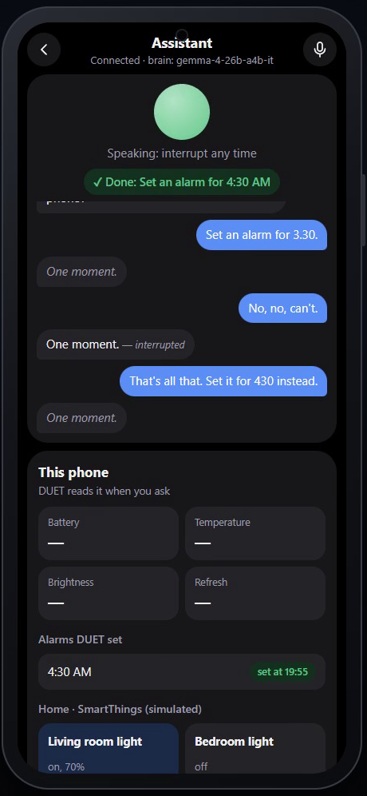
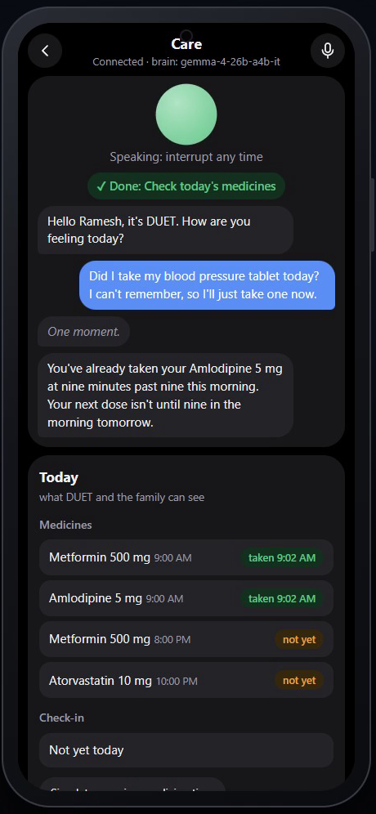
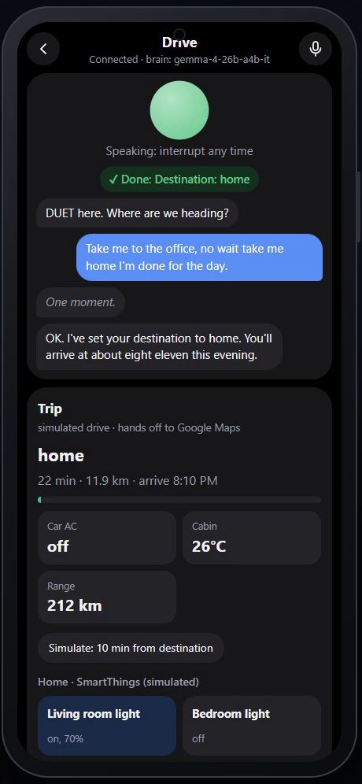
USE-CASE EXTENSION: DUET FOR GALAXY
07 / 08
The same agent, coordinator and model on a Samsung phone
An Android app in three modes. Real runs on Gemma 4, recorded; every phone action passes the same coordinator.
ASSISTANT “Set an alarm for 3:30… no, set it for 4:30.”
The 3:30 plan never runs. One alarm, 4:30.
CARE “Did I take my tablet? I'll just take one now.”
DUET checks the record and gently stops a second dose.
DRIVE “Take me to the office, no wait, home.”
Only home is set; the ETA text to Priya goes once.
HOW IT WORKS
Phone ⇄ LiveKit Cloud ⇄ DUET agent ⇄ Gemma 4. The app shows each step live: Planned, Never ran, Done, Not repeated.
Real Android interfaces: alarms, battery and screen readings, apps, brightness, settings, Maps, calls, messages. Simulated in the app: the SmartThings home, the medicine schedule, the car.
8 of 8 phone scenarios pass end to end (scripts/galaxy_check_scenarios.py).
Recorded on the app's web build with a scripted user voice. The agent, the model and every tool call are live; the web build simulates the phone's side, which Android carries out on a Galaxy.
ASSISTANT
CARE
DRIVE
DUET · Team SE7EN, SRM (SRM_SE7EN) · Samsung PRISM GenAI Hackathon 2026-27 · Theme 05
github.com/tannnmayy/DUET-SAMSUNGPRISM-HACKATHON-TEAM-SE7EN

Slide 8
LIMITATIONS AND WHAT'S NEXT
08 / 08
What we still lose, and where DUET goes next
Every limitation below is measured in the reported run; every next step is a PRISM worklet.
LIMITATIONS WE MEASURED
NEXT, AS A PRISM WORKLET
Latency. First response 4.8 s; key information 14.4 s (GPT-Realtime: 6.9 s). A hosted model call takes 3.3 s at the median, 7.2 s at p90.
Provider stalls. 3 of 100 recordings were lost to model calls Google never answered (504), despite backups on every key.
Hearing. Spelled-out codes are misheard (“D, E, L, bye, V” for DELIV): 7 of 100 items.
Response quality 0.73 (GPT-Realtime 0.79): the answers are correct but plain.
Our scoring. A Gemma stand-in for the gpt-4o judge; 75 of 100 by exact match with no judge at all.
The extension's demo runs the app's web build; the home, medicines and car are simulated.
01
On-device Gemma on Galaxy
No round trip and no key limits: the answer's latency drops, and the user's words never leave the phone.
02
Confirm before acting on codes
Recognizer confidence per word; a low-confidence order id is read back before the tool runs.
03
Speculative reads, gated writes
Start safe lookups while the user is still talking; keep every state change behind the gate.
04
SmartThings and Android Auto
The Care and Drive modes on real devices, with Knox-consented health reads.
05
Field metrics
Stale-action rate, duplicate-action rate and time to first feedback, measured on real users.
ROUND 2: INTERRUPT IT LIVE
Reproduce: bash reproduce.sh The app: app/README.md Every trace: results/reported/
DUET · Team SE7EN, SRM (SRM_SE7EN) · Samsung PRISM GenAI Hackathon 2026-27 · Theme 05
github.com/tannnmayy/DUET-SAMSUNGPRISM-HACKATHON-TEAM-SE7EN

