Slide 1
Internship Report
Tannu Singh • 07.30.2019

Slide 2
Overview
ETL
Optimized ETL process in SQL (attrition model)
Data Engineering
Cleaned, organized, normalized, transformed, and prepared different datasets
Prediction of donations
Predicted the likelihood of donations by donors in next month, next quater, and next year.

Slide 3
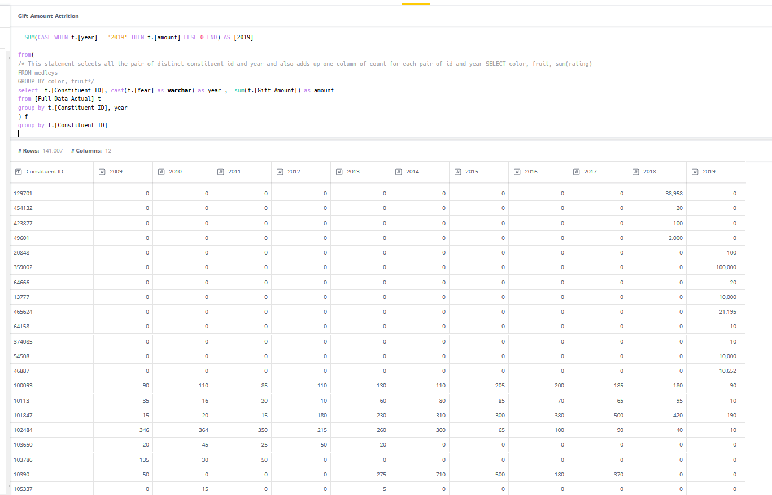
ETL Optimization
Accomplishment
Optimized the transformation stage of ETL process
The execution time decreased from 10 minutes to 10 seconds. The built time decreased from 50 minutes to 1 minute.

Slide 4
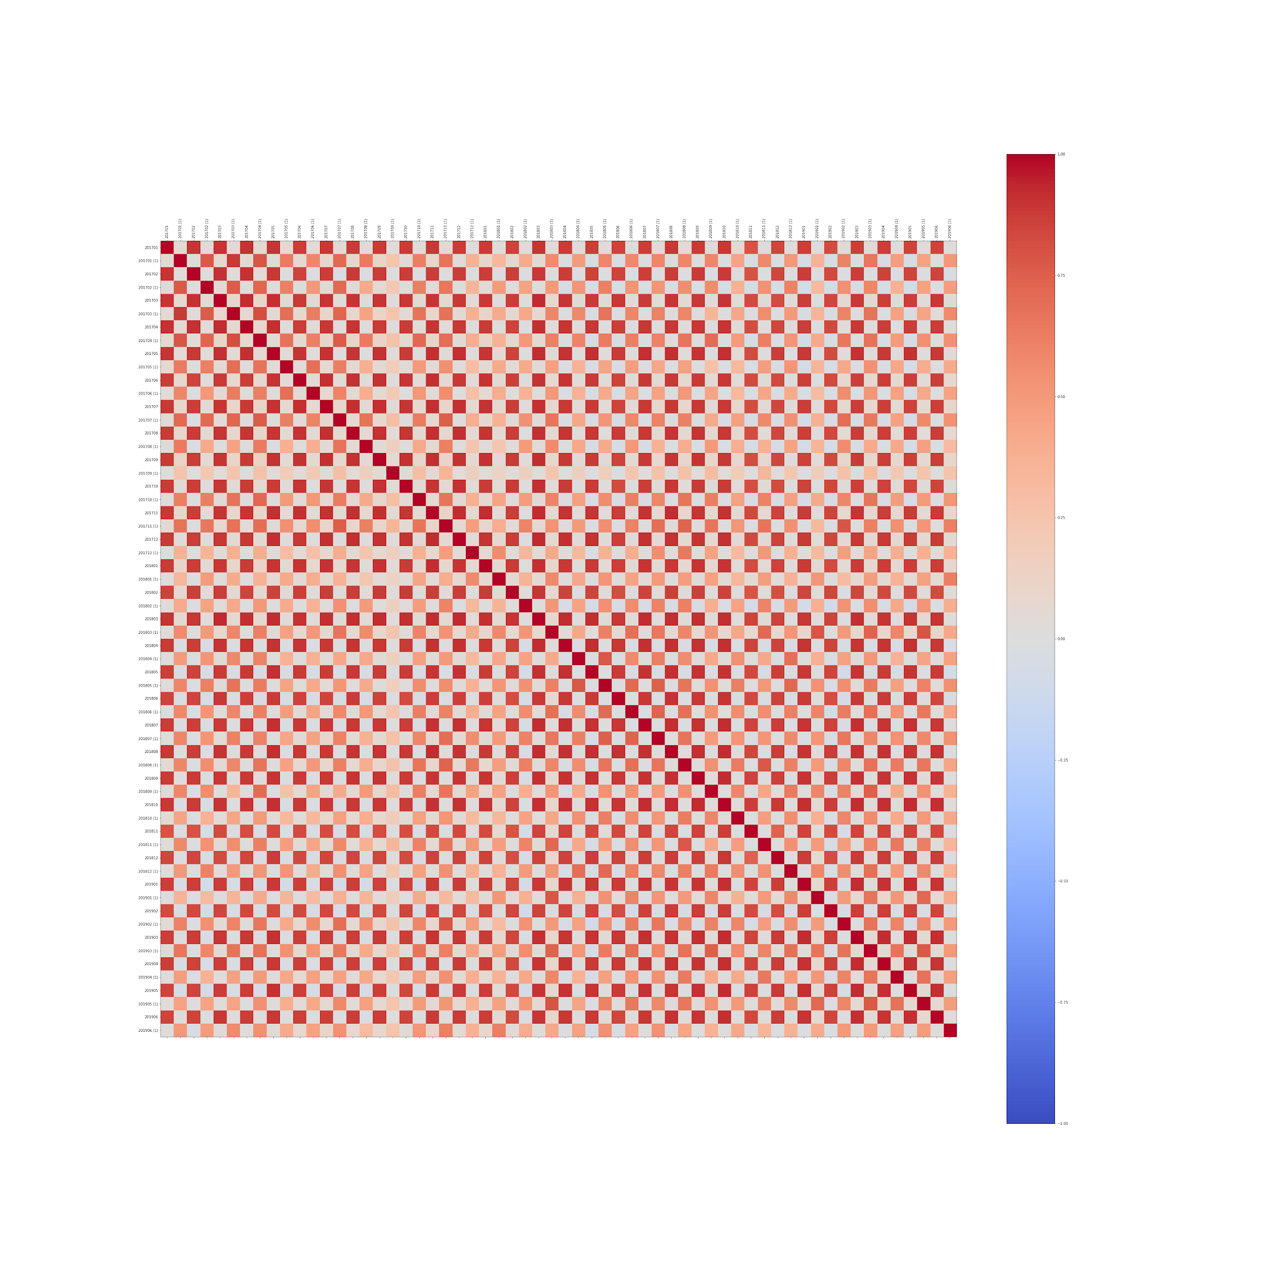
Data Engineering
Accomplishment
Found correlation between columns in the dataset
Performed Category encoding ( One hot encoding ) to convert categorical data into numbers for normalization.

Slide 5
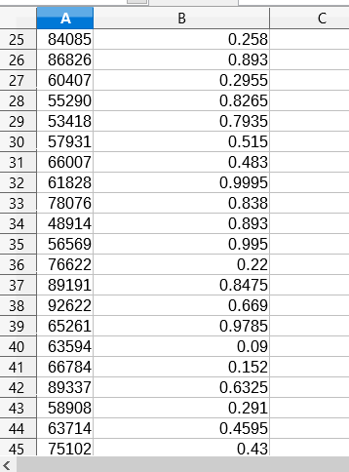
Prediction of Donations
Accomplishment
Predicted the donation class of ‘0’ or ‘1’ by using the donor’s donation behaviour, frequency, amount and attrition.

Slide 6
Filtering out all the deceased donors and also the donors who have started donating recently
Normalize the data and balance the classes
Build model using MLP, Ensemble Random Forest, logistic, and SVM.
Filtering
Features
Normalize
Correlation
Modeling
Creating month difference, span, persistability, avg donation
Find correlation and remove columns which does have high correlation

Slide 7
Next steps
Facebook Page Connector
Testing various services of companies who are providing facebook connector. Creating dashboard using facebook connector and data
Test the prediction model
On 3rd August we will get the data for month of July. Testing the accuracy on data for this month
Working on other client projects
Will work on data as the requirement comes.

Slide 8
Thank You
Questions?

