Slide 1
IBM University Engagement Project Submission
“Exploring the Power of Agentic AI with IBM Granite and LangFlow”

Slide 2

Project Tile – [Write your project title here]
Domain of Project – [ like Agriculture / Education / Healthcare / … ]
Student Name | Recent Passport Photo | Email ID | Mobile number [WhatsApp]
TANNU |  | tannuhry@gmail.com | 7818032157

Slide 3
Problem Statement -
Problem Statement: LearnMate - Agentic AI for Personalized Course Pathways
The Challenge
Students often struggle to choose the right learning path because of too many online courses and lack of personalized guidance. They are unsure what to learn, where to start, and how to reach their career goals.
The Objective
Build an AI-powered LearnMate Agent that understands a student’s interests, current skills, skill level, study time, and goals to create a personalized course roadmap.
Personalized Roadmaps - Recommend learning paths based on goals, skills, timeline, and preferences.
Skill Assessment - Identify whether the student is Beginner, Intermediate, or Advanced..
Skill Level Detection - Identify Beginner, Intermediate, or Advanced level.
Adaptive Learning Plan - Update the roadmap based on progress and changing preferences.
Multi-Agent System -
Goal Agent - Understands what the student wants to learn or become.
Skill Agent - Checks current skills and level.
Roadmap Agent - Creates the personalized learning path.
Progress Agent - Tracks learning progress and updates the plan.

Slide 4
Technology Used
Tech Stack (Mandatory)
Use any one of the following approaches:
LangFlow + IBM watsonx.ai + Granite Models
IBM Cloud Agentic Lab with IBM Granite Models
Replicate with LangChain + RAG + IBM Granite Models
I used LangFlow + IBM watsonx.ai + Granite Models

Slide 5
Proposed Solution -
Proposed Solution: AI-Powered LearnMate Agent
The proposed solution is a multi-agent AI-powered LearnMate system built using LangFlow, IBM watsonx.ai, and Granite Models to provide personalized course pathways for students.
The system interacts with students step by step to understand their career goal, current skills, skill level, study hours, timeline, and learning preference. Based on this information, Granite models generate a personalized learning roadmap with topics, projects, milestones, and weekly study plans.
The system consists of four key agents:
Goal Understanding Agent - Identifies what the student wants to learn or become.
Skill Assessment Agent - Understands current skills and classifies the student as Beginner, Intermediate, or Advanced.
Roadmap Generation Agent - Creates a personalized course pathway based on the student’s answers.
Progress Tracking Agent - Tracks learning progress and updates the roadmap when needed.
The solution also includes a simple dashboard to show the roadmap, weekly plan, milestones, progress, and skill gaps.
LangFlow is used to manage the workflow, while IBM watsonx.ai and Granite models power reasoning, personalization, and roadmap generation.

Slide 6
Langflow component Used -
Chat Input - Interface where students enter their goals, skills, study time, timeline, and learning preferences.
Prompt Template - Structures the interview flow and gives instructions to the AI for asking step-by-step questions and generating the roadmap.
Message History - Stores and retrieves previous chat messages so the AI remembers earlier answers.
Language Model - Processes the prompt and generates personalized learning guidance using IBM Granite.
Name of IBM Granite Model - ibm/granite-8b-code-instruct
Chat Output - Displays AI-generated responses such as questions, personalized roadmap, weekly plan, milestones, and progress guidance.

Slide 7
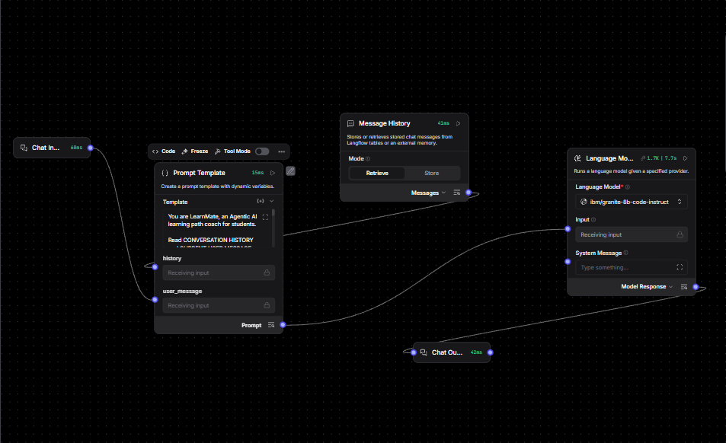
Langflow workflow -

Slide 8
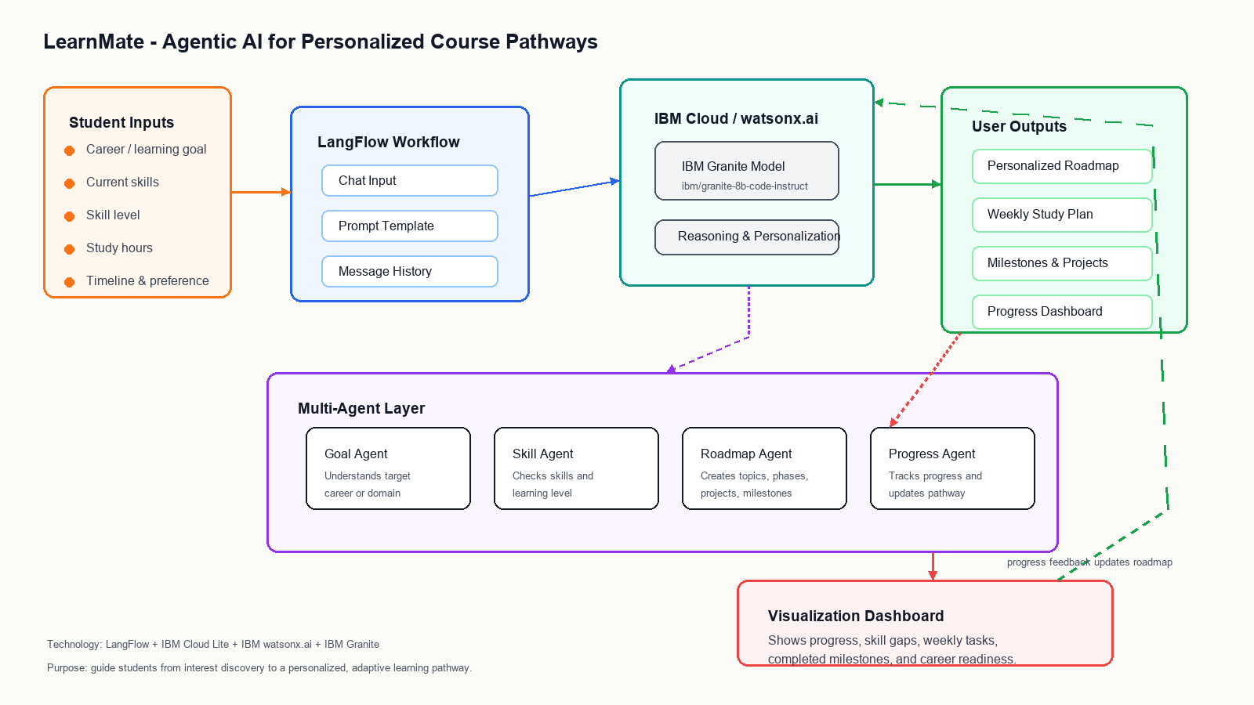
Architecture blueprint

Slide 9

Role of Agentic AI in the solution
Role of Agentic AI in Nutrition Agent
Agentic AI enables the Nutrition Agent to function as an intelligent, autonomous system rather than a simple chatbot. Using IBM watsonx.ai and IBM Granite models, it coordinates multiple specialized agents to deliver personalized nutrition guidance.
Each agent performs a specific role—such as retrieving nutritional data, generating diet plans, providing health advice, and analyzing food logs—while working collaboratively. This multi-agent approach ensures efficient task execution and accurate results.
Agentic AI also brings context awareness, understanding user details like age, health conditions, and fitness goals to generate tailored recommendations. It supports real-time adaptation, continuously updating suggestions based on user inputs like daily meals.
Additionally, agents communicate with each other, enabling better decision-making and improved outcomes.
Overall, Agentic AI makes the system proactive, personalized, and goal-driven, acting like a smart digital nutritionist that helps users maintain a healthy lifestyle.

Slide 10
Technology Used
Langflow – Used to design and manage the LearnMate AI workflow visually.
IBM Granite Model – Used for natural language understanding, skill assessment, and personalized roadmap generation.
IBM Cloud Lite – Provides the cloud infrastructure to run and manage the LearnMate application.
IBM watsonx.ai – Used to access and deploy IBM Granite models for AI-powered recommendations.

Slide 11
Novelty and Uniqueness
Agentic AI Approach – Interacts with students and collects information step-by-step before making recommendations.
Personalized Learning Paths – Generates customized roadmaps based on career goals, skills, and study time.
Skill Assessment – Identifies the student's current level and suggests suitable learning plans.
Dynamic Roadmap Generation – Provides structured learning plans, projects, and milestones.
Career-Focused Guidance – Supports multiple domains such as Frontend Development, UI/UX Design, and Cybersecurity.
IBM Granite Powered – Uses IBM Granite models through IBM watsonx.ai for intelligent recommendations.
Scalable Solution – Built using Langflow, IBM watsonx.ai, and IBM Cloud Lite.

Slide 12
Git Hub Link
Please test and Paste the working Github URL – https://github.com/tannu97/learnmate-agentic-ai
Youtube vedio : https://youtu.be/ClUXAJdLvPw
Make sure you have Uploaded following three files into your github repository 1) app.json file , 2) yourproblemstatement.pdf file 3) your projectpresntation.pptx file 4)any other files
·
·
·

Slide 13
Future Scope
Progress Tracking & Adaptive Learning The system can track student progress and automatically update learning roadmaps based on completed skills and performance.
2. RAG-Based Course Recommendations Integration with RAG and educational resources can provide more accurate, up-to-date, and personalized course recommendations.
·
·
·

Slide 14


