Slide 1
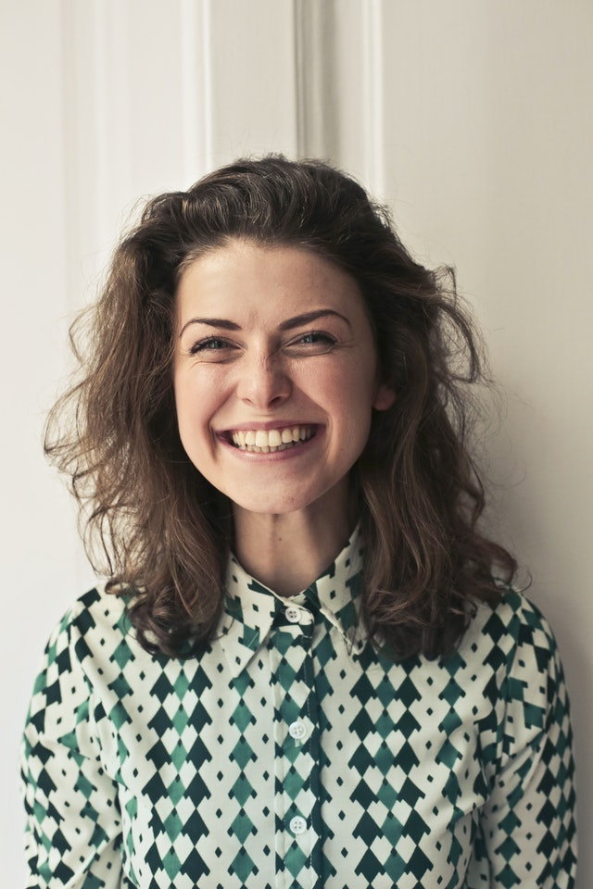
Catherine
Behaviours
27 year old female.
Does all of her shopping online.
Has multiple bank accounts.
Is tech savvy and comfortable using online financial applications.
Uses various electronic devices of different sizes.
Primarily uses her phone for web browsing.
Demographic information
Needs and goals
Married with 2 young children.
CS graduate working in Software Develepment.
£35k income.
Has lots of transactions over various accounts and needs to view them in a single place.
Is comfortable using financial applications so she would appreciate more advanced features like sorting transactions by date, type and merchant.
Uses her mobile frequently so requires a site that is usable in that format.
Notes:
When naming your proto-persona, keep it real. The goal is to empathise with them, and if their name is Bilbo Baggins it’s rather hard.
Remember to download only non-watermarked, free-to-use photographs. Use Creative Commons search in Google or Flickr to find such photos. Make these appear and feel 'real'.
When establishing basic characteristics, keep it short and simple. Who are they?
Demographic information should be relevant to the project. Think of all aspects that might affect how people interact with your product. Think of the following first:
Where do they work/what they do?
What’s their relationship status? Do they have children?
How much do they earn — and is this relevant?
What’s their level of familiarity with digital technologies?
Add your own.
Behaviours are simply things that they do. Keep it relevant to the project.
Needs and goals — this is what they want from the product and your organisation.

Slide 2

Dave
Behaviours
25 year old male.
Checks his online bank balances regularly.
Finds it difficult to keep track of upcoming bills.
Regularly receives bank charges for late payments.
Demographic information
Needs and goals
Single with no dependents.
Full-time student.
No regular income, casual worker only.
Receives regular late payment charges so needs to receive notifications when his balance is low.
Is uncomfortable with technology so needs a simple user interface that displays the essential information clearly.
Finds it difficult to keep track of where he is spending so would find sorting transactions by type useful.
Notes:
When naming your proto-persona, keep it real. The goal is to empathise with them, and if their name is Bilbo Baggins it’s rather hard.
Remember to download only non-watermarked, free-to-use photographs. Use Creative Commons search in Google or Flickr to find such photos. Make these appear and feel 'real'.
When establishing basic characteristics, keep it short and simple. Who are they?
Demographic information should be relevant to the project. Think of all aspects that might affect how people interact with your product. Think of the following first:
Where do they work/what they do?
What’s their relationship status? Do they have children?
How much do they earn — and is this relevant?
What’s their level of familiarity with digital technologies?
Add your own.
Behaviours are simply things that they do. Keep it relevant to the project.
Needs and goals — this is what they want from the product and your organisation.

