Slide 1
Knowledge-Grounded Pre-Training for Data-to-Text Generation
Chen et al., 2020
EMNLP 2020 – Main Conference
Presented by Gaetano Manzo, Oct 12, 2022

Slide 2
The goal is to enhance data-2-text generation

Slide 3
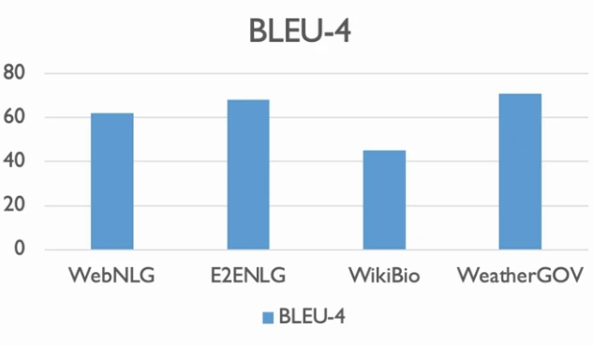
The goal is to enhance data-to-text generation
BLEU: a Method for Automatic Evaluation of Machine Translation (Papineni et al., 2002)
Notes:
**Diverse Forms of Structured Knowledge**- E2ENLG: generate response from dialog act- WebNLG: generate description from RDF triples- WikiBio: generate biography from info-box- TOTTO: generate sentences from multi-row table

Slide 4
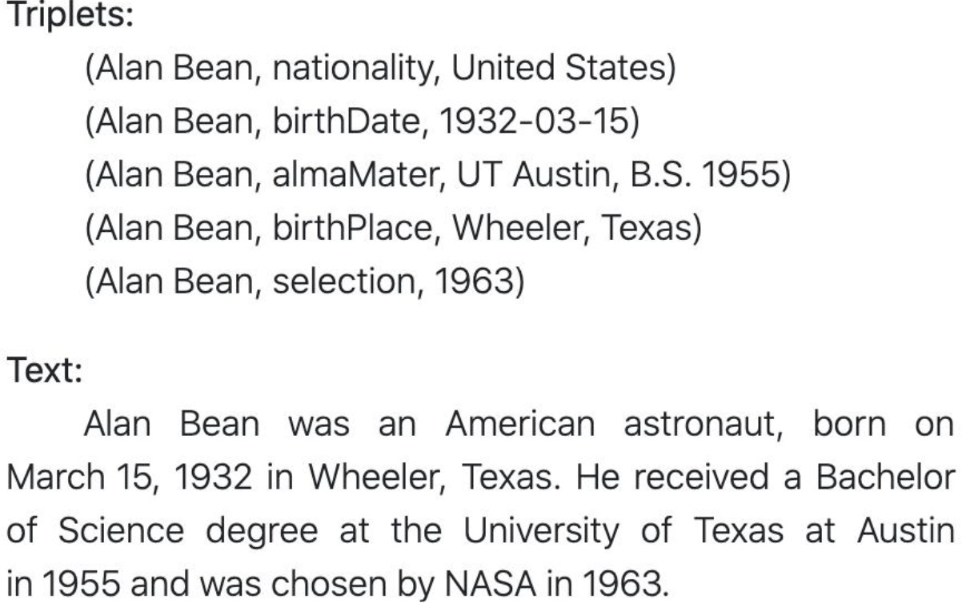
The goal is to enhance data-to-text generation
BLEU: a Method for Automatic Evaluation of Machine Translation (Papineni et al., 2002)
Notes:
Example of Resource Description Framework RDF triples

Slide 5
The goal is to enhance data-to-text generation
Meaning Representation:
name[The Eagle],
eatType[coffee shop],
food[French],
priceRange[moderate],
customerRating[3/5],
area[riverside],
kidsFriendly[yes],
near[Burger King]
Text:
The three star coffee shop, The Eagle, gives families a mid-priced dining experience featuring a variety of wines and cheeses. Find The Eagle near Burger King.
BLEU: a Method for Automatic Evaluation of Machine Translation (Papineni et al., 2002)

Slide 6
Limitation 1: no unified models to solve data-to-text generation
Meaning Representation:
name[The Eagle],
eatType[coffee shop],
food[French],
priceRange[moderate],
customerRating[3/5],
area[riverside],
kidsFriendly[yes],
near[Burger King]
Text:
The three star coffee shop, The Eagle, gives families a mid-priced dining experience featuring a variety of wines and cheeses. Find The Eagle near Burger King.

Slide 7
Limitation 2: different models have weak generalization
no entities
..
Specific vocabulary
unseen relations
..
..
..

Slide 8

Limitation 3: not suitable for few-shot settings
rely on large amount of annotation

Slide 9
Contributions
KGPT
KGText
TUNING
model
dataset
method

Slide 10
Contributions
KGPT
KGText
TUNING
model
dataset
method

Slide 11
KGPT
Unify knowledge triples, attribute-value pairs, info box, tables into a unified graph representation
node → entity/value/topic
edge → relation/attribute/table header
6

Slide 12
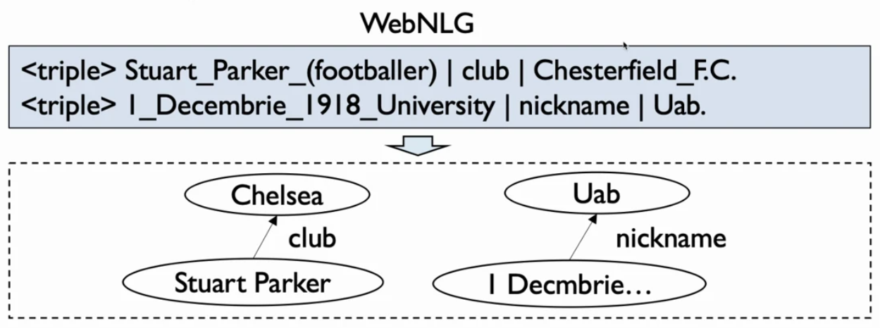
KGPT
Unify knowledge triples, attribute-value pairs, info box, tables into unified graph representation
6

Slide 13
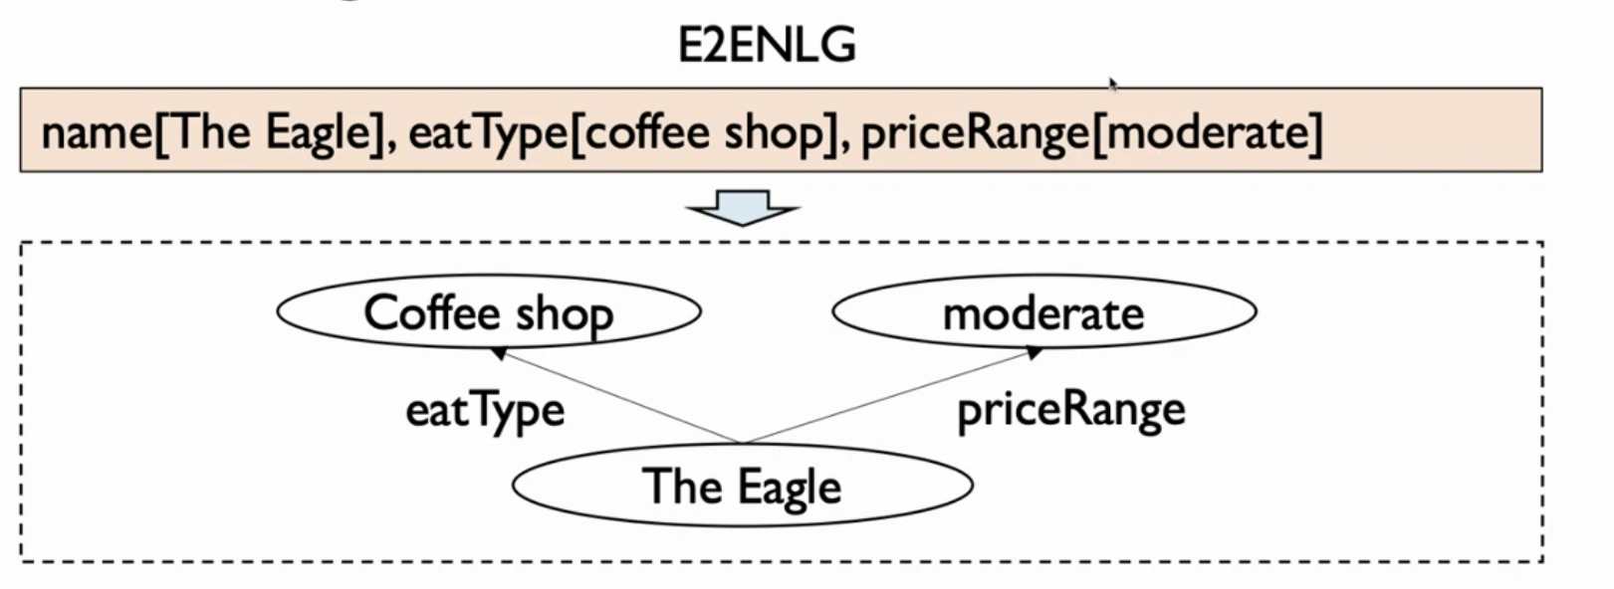
KGPT
Unify knowledge triples, attribute-value pairs, info box, tables into unified graph representation
7

Slide 14
KGPT
Data-2-text generation tasks modeled as graph-to-text problem
GNN-based Encoder
→ Transformer Decoder

Slide 15
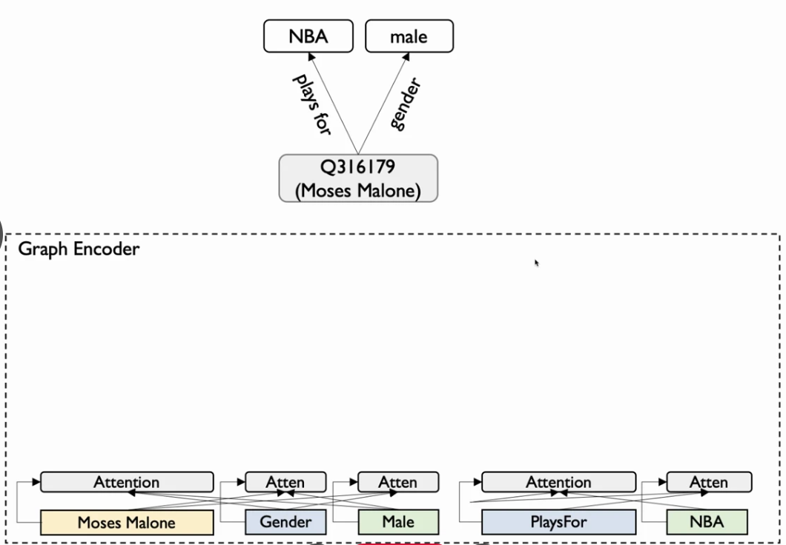
KGPT
GNN-based Encoder
8

Slide 16
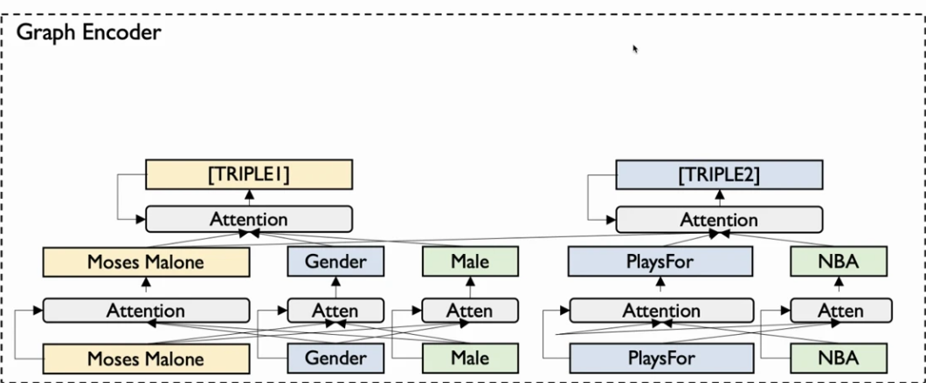
KGPT
GNN-based Encoder
8

Slide 17
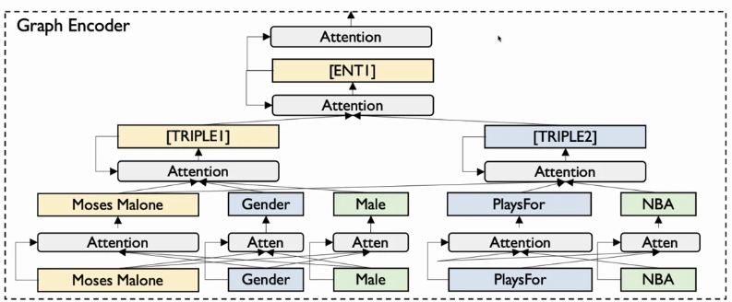
KGPT
GNN-based Encoder
8

Slide 18
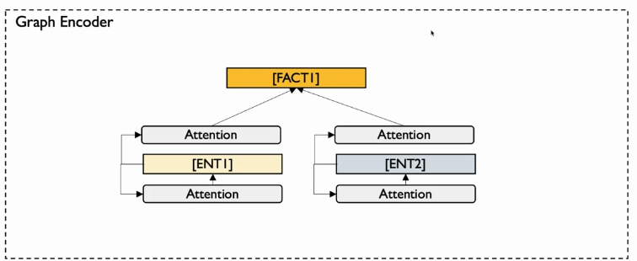
KGPT
GNN-based Encoder
8

Slide 19
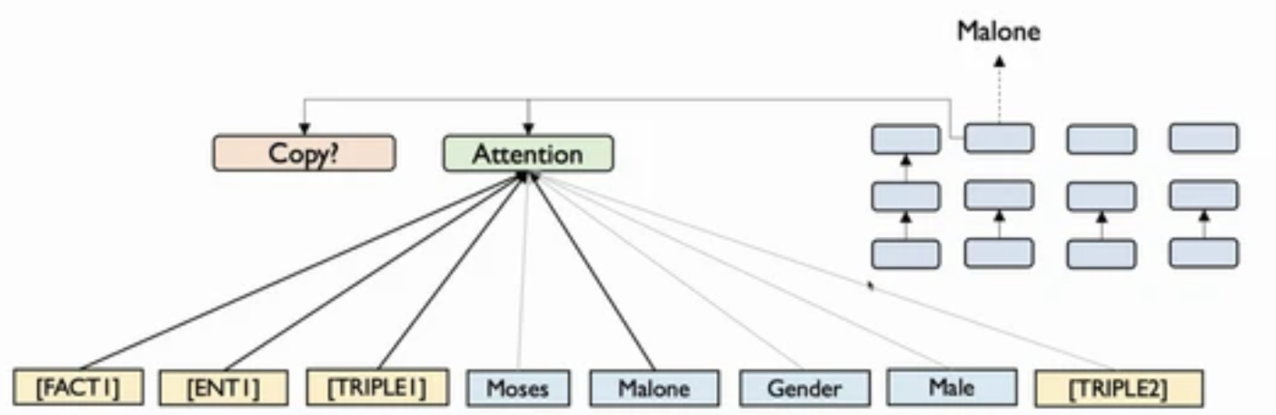
KGPT
Transformer Decoder
9

Slide 20
Contributions
KGPT
KGText
TUNING
model
dataset
method

Slide 21
Contributions
KGText
KGPT
TUNING
model
dataset
method

Slide 22
KGText
Pretrain a large model on a knowledge-grounded text corpus
Construct Pseudo Graph-to-Text pair
Data Selection
10

Slide 23
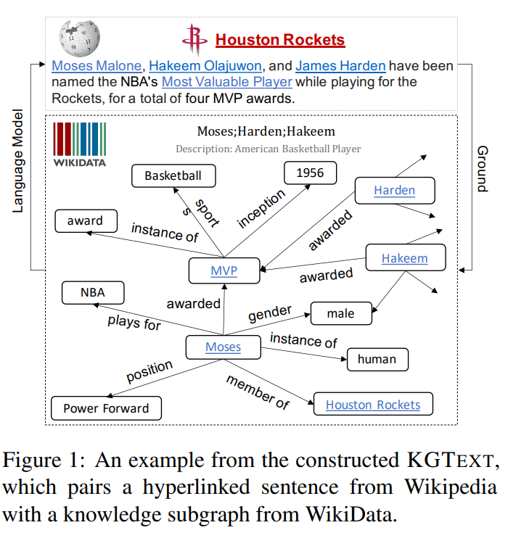
KGText
Construct Pseudo Graph-to-Text pair
10

Slide 24
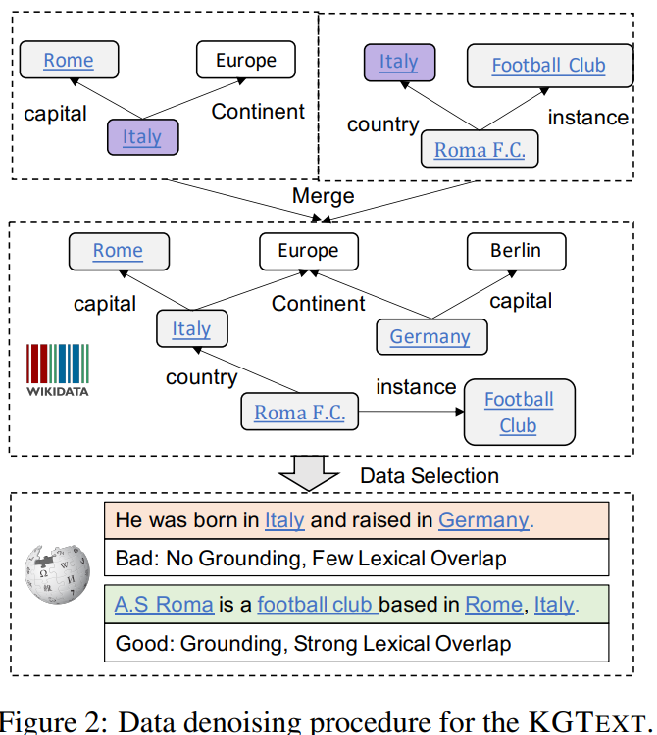
KGText
Construct Pseudo Graph-to-Text pair
10

Slide 25

KGText
Data Selection
11

Slide 26
Contributions
KGPT
KGText
TUNING
model
dataset
method

Slide 27
Contributions
TUNING
KGPT
KGText
model
dataset
method

Slide 28
TUNING
Fine-tuning on the downstream data-to-text task with only a few examples
Pre-training the model on the KGText database
Fine-tuning on the downstream task to solve individual problems
11

Slide 29
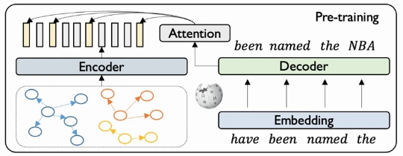
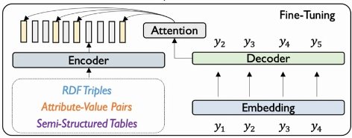
TUNING
11

Slide 30
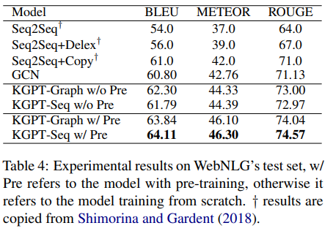
KGPT outperforms state-of-the-art data-to-text models

Slide 31
KGPT outperforms state-of-the-art data-to-text models

Slide 32
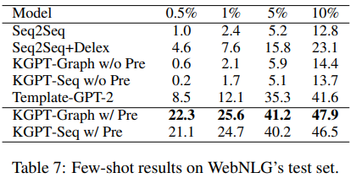
KGPT outperforms state-of-the-art data-to-text models

