Slide 1
CQRS command query responsibility segregation
Team yoda

Slide 2
What is CQRS?
CQRS stands for Command Query Responsibility Segregation.
It's a design pattern that separates the responsibilities for reading and writing data in a software application.
In essence, it distinguishes between commands that modify state and queries that retrieve state.

Slide 3
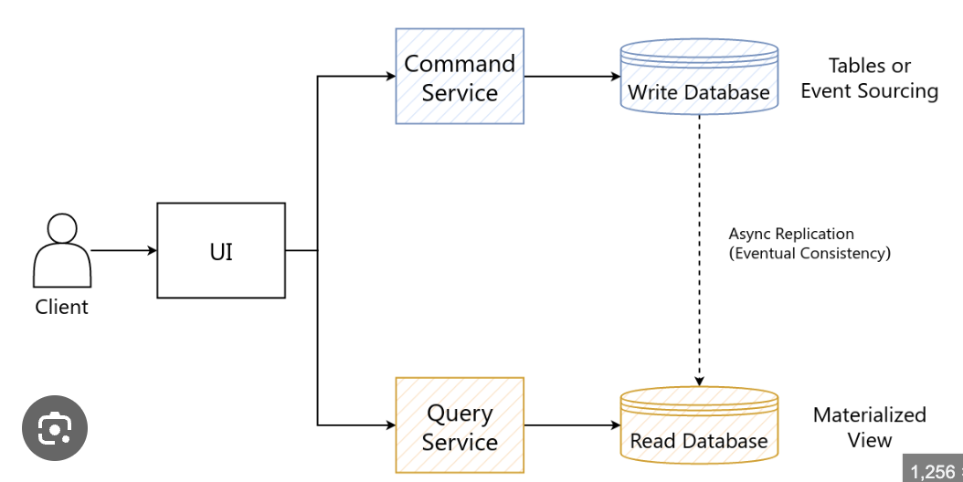
Overview

Slide 4
Key principles
Commands: Represent intentions to perform actions that change the application state.
Queries: Represent requests for information retrieval without modifying the state.
Responsibility Segregation: Separating read and write operations to optimize performance, scalability, and maintainability.

Slide 5
Benefist of CQRS
Scalability: Allows scaling read and write operations independently.
Performance: Optimizes read and write operations for specific use cases.
Flexibility: Facilitates the use of different data storage technologies for reads and writes.
Maintainability: Enhances code clarity and modularity by separating concerns.
Evolvability: Makes it easier to evolve the system over time by isolating changes to specific areas.

Slide 6
Challenges and considerations
Complexity: Introducing CQRS may add complexity to the system, especially in maintaining consistency between read and write models.
Learning curve: Development teams need to understand the principles and patterns of CQRS before implementing it effectively.
Operational overhead: Managing separate read and write models may require additional infrastructure and operational considerations.

Slide 7
Best practices
Start simple: Begin with small, well-defined bounded contexts to apply CQRS effectively.
Measure performance: Monitor and measure the performance impact of CQRS implementation to optimize accordingly.
Embrace event-driven architecture: Combine CQRS with event-driven principles to enhance scalability and flexibility.
Document decisions: Document the rationale behind adopting CQRS and communicate it effectively within the team.

Slide 8
Conclusions
CQRS is a powerful pattern for separating read and write concerns in software applications.
When implemented correctly, it can lead to improved scalability, performance, and maintainability.
Consider the specific requirements and trade-offs of your application before adopting CQRS.

Slide 9
Questions && Demo

