Slide 1

MongoDB Cluster
位鹏飞 2019-03

Slide 2
MongoDB
No SQL （document）
Language （JavaScript）
Replica Set & Sharding
Engine plugin

Slide 3
Replica set
Redundancy and Data Availability
Asynchronous Replication
Automatic Failover and rollback
Read Operations

Slide 4
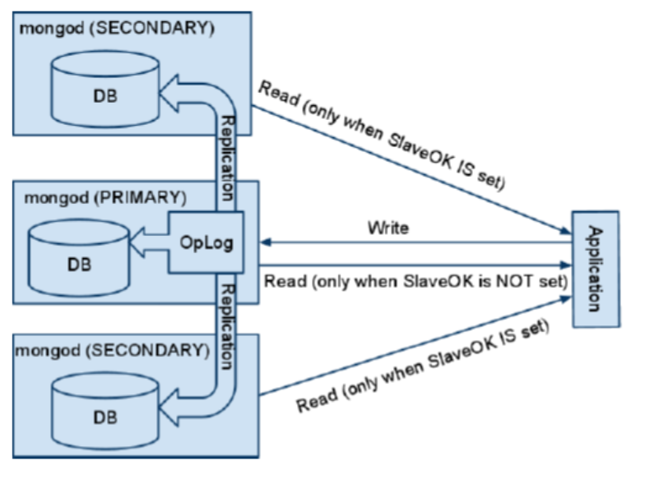
Replica set
Redundancy and Data Availability

Slide 5
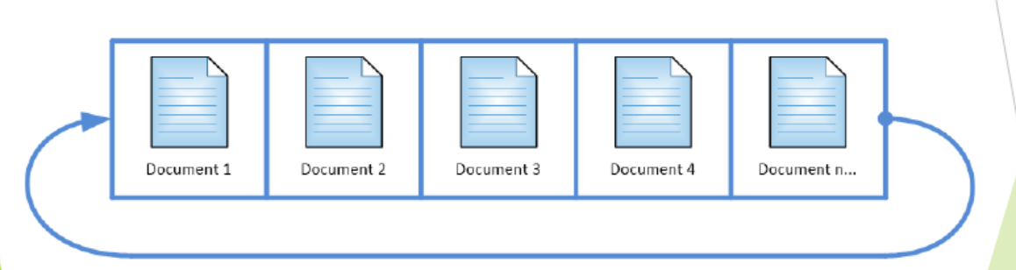
Capped Collection
Fixed size
• Circular
•Auto removal of oldest documents
• Insertion order
•queries do not need an index to return documents in insertion order
No indexes(default)
•higher insertion throughput

Slide 6
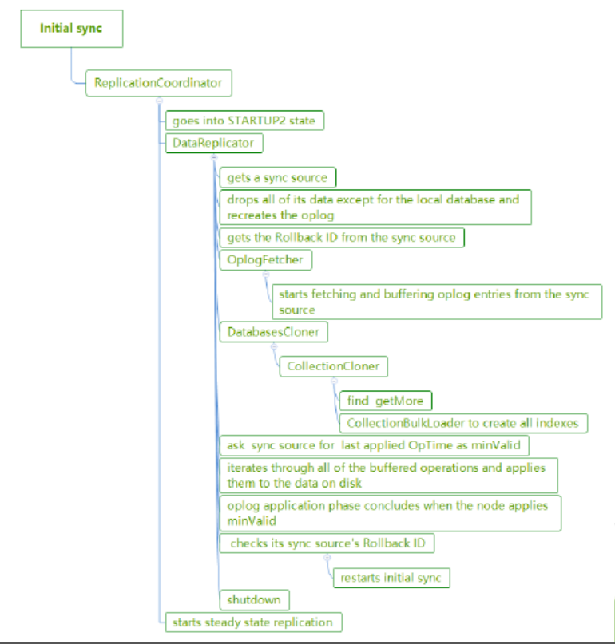
Sync - Initial Sync
Redundancy and Data Availability
Asynchronous Replication
Automatic Failover and rollback
Read Operations

Slide 7
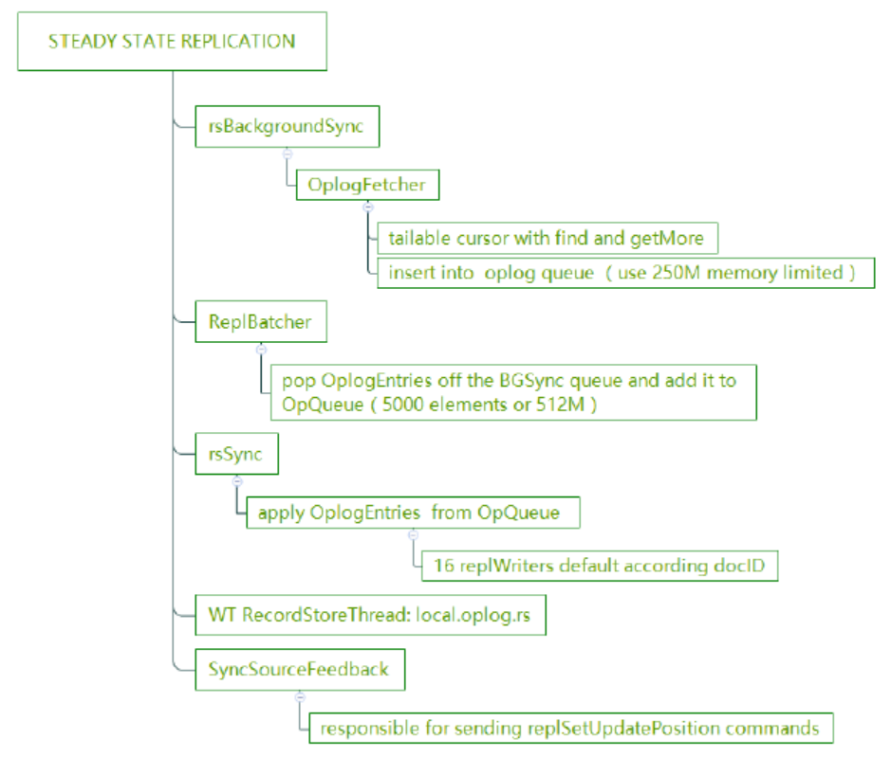
Sync - Secondary
Redundancy and Data Availability
Asynchronous Replication
Automatic Failover and rollback
Read Operations

Slide 8
Roles
Nodes roles
•Primary
the only member in the set that can accept write operations
•Secondary
•standard
•Hidden
•Priority 0
•Delayed
•Arbiter

Slide 9
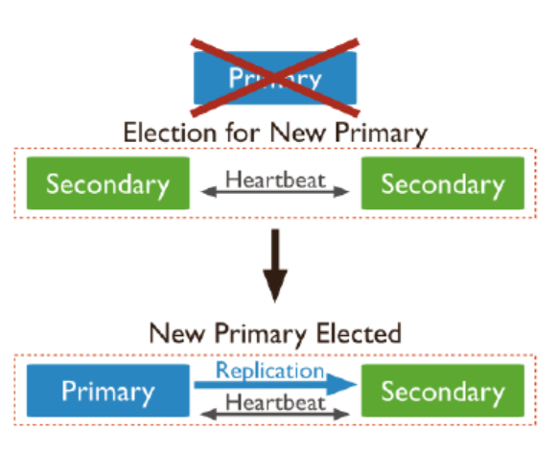
Election
• Adding a new node to the replica set
• initiating a replica set
using methods such as rs.stepDown()
or rs.reconfig()
the secondary members losing connectivity
to the primary for more than the configured
timeout (10 seconds by default)

Slide 10
Election
• Candidate Perspective
• dry-run stage
• real-run stage
• Voter Perspective
• checks term and updates its own term
• checks if it should grant a vote
Transitonto Primary
Notes:
dry-run stage
1.Send replSetRequestVotesto every node asking if that node would vote for it
2.If fails the dry-run election, it just continues acting as secondary.
3.If the node wins the dry-run election, it begins a real election.
real-run stage
1.Increase its term，votes for itself
2.Send replSetRequestVotesto every node asking if that node would vote for it
3.If received votes from a majority of nodes, including itself, the candidate wins the election.
Voter Perspective
Checks if it should grant a vote
①An older term
②Configversion do not match
③Replica set name don’t match
④Last commit OpTimeis older than voters
⑤Voter has already voted in this term （not in dry run election）
Transitonto Primary
1.notifies all nodes that it won the election
2.checks if it needs to catch up from the former primary
3.starts catch-up phase
1.sends a replSetGetStatusrequest to every other node to see the last applied OpTime
2.checks its last OpTimeis less than the newest last OpTime
3.starts a timer
4.ends
4.stops OplogFetcher
5.applies all of the oplogentries in its oplogbuffer
6.finishes step up phase
7.drops all temporary collections
8.logs “transition to primary complete”

Slide 11
Write concern
• Data unsafe
• J opinion
• w: "majority" implies j: true
• Tag set
• db.products.insert(
{ item: "envelopes", qty : 100,
type: "Clasp" },
{ writeConcern: { w: 2, wtimeout: 5000 }
}
)

Slide 12
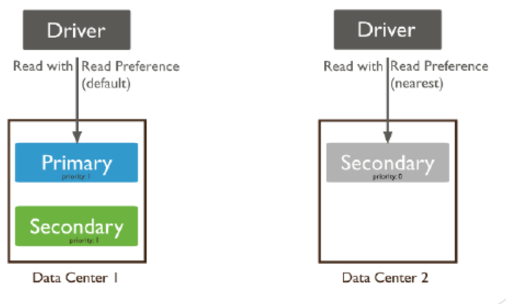
Read preference
• primary
• primaryPreferred
• secondary
• secondaryPreferred
• nearest

Slide 13
Read concern
"local"
• local
• available
• majority
• linearizable

Slide 14
Slow Query
执行计划中的TYPE类型
COLLSCAN #全表扫描 避免
IXSCAN #索引扫描 可以改进 选用更高效的索引
FETCH #根据索引去检索指定document
SHARD_MERGE #将各个分片返回数据进行merge 尽可能避免跨分片查询
SORT #表明在内存中进行了排序（与老版本的scanAndOrder:true一致） 排序要有index
LIMIT #使用limit限制返回数 要有限制 Limit+（Fetch+ixscan）最优
SKIP #使用skip进行跳过 避免不合理的skip
IDHACK #针对_id进行查询 推荐,_id 默认主键,查询速度快
SHARDING_FILTER #通过mongos对分片数据进行查询 SHARDING_FILTER+ixscan最优
COUNT #利用db.coll.explain().count()之类进行count运算
COUNTSCAN #count不使用Index进行count时的stage返回 避免 这种情况建议加索引
COUNT_SCAN #count使用了Index进行count时的stage返回 推荐
SUBPLA #未使用到索引的$or查询的stage返回 避免
TEXT #使用全文索引进行查询时候的stage返回
PROJECTION #限定返回字段时候stage的返回 选择需要的数据, 推荐PROJECTION+ixscan

Slide 15
Limits
http://git.n.xiaomi.com/dba/dba-docs/blob/master/xiaomi_mongodb_user_guide/mongodb-limits.md
或参考下面文档 的“使用限制部分”+ 开发规范
http://doc.dba.xiaomi.srv/mongodb/

Slide 16
谢谢！

