Slide 1
Using Deep Learning to Detect Multiple Cancers From a Blood Test
Tanay Patil
Gaurab Das

Slide 2
Cancer and Traditional Screening Tests
A disease that causes uncontrolled cell division
Metastasis: process of tumor spreading
Traditional screening tests are expensive, invasive, and limited to a single cancer type. Some conventional tests include -
Mammograms
Colonoscopies
Endoscopies
Cervical Cytology

Slide 3
Blood Tests and AccurateDetect
Our method relies on a simple blood test. This is much more beneficial because of the reasons listed below.
Non-invasive
Economical
Hassle-Free
Some other major projects that share the similar idea of testing through blood are-
HeiScreen: Breast cancer screening blood test
Detect-A: Detects 8 cancer types simultaneously

Slide 4
Detect-A
Blood test developed by Johns Hopkins
Data: 1817 individuals (1005 with clinically detected cancer, 812 healthy)
39 protein biomarker concentrations and omega score
Logistic model: only detects linear relationships
Cancer Type | Accuracy
Ovary | 98.15%
Liver | 97.73%
Pancreas | 72.04%
Upper GI (Esophagus/Stomach) | 70.80%
Colorectum | 64.95%
Lung | 58.65%
Breast | 33.49%

Slide 5
Machine Learning Flowchart
Training Data
Testing Data
Untrained Model
Trained Model
Classifications

Slide 6
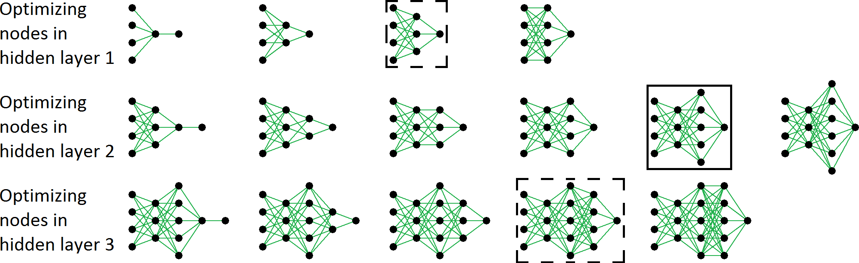
Adjusting Hyperparameters
Initial Hyper-parameters
CDNN
Improv-ement in Accuracy/ ROC?
Adjust Threshold
Final Model
Adjust Hyper-parameters
Grid Search: hyperparameter optimization method
start with small hyperparameter value
gradually increase until performance stops improving significantly
50%
62%
71%
69%
70%
75%
86%
90%
95%
92%
78%
82%
85%
89%
88%

Slide 7
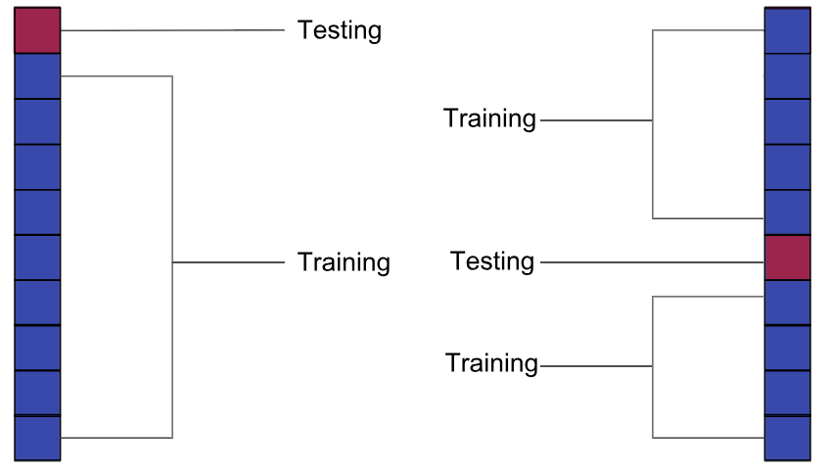
Data Splitting
Training Data
Testing Data
Untrained Model
Trained Model
Classifications
10-fold Cross Validation
9 partitions are used as training; 1 partition is used as testing
Batch-size: size of data inputted
Epochs: Iterations of data inputted

Slide 8
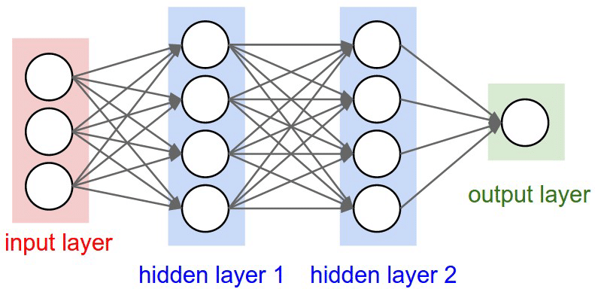
Neural Networks
Training Data
Testing Data
Untrained Model
Trained Model
Classifications
Computing systems designed to mimic the way the brain thinks
Structure: nodes and layers (input, hidden, output)

Slide 9



Passing Data Between Layers
Training Data
Testing Data
$$\overset{⃑}{a}$$
$$\overset{⃑}{b}$$
Untrained Model
Trained Model
Classifications
a1
b₁
$$b_{1}=w_{1,1}a_{1}+…+w_{1,3}a_{3}=\overset{⃑}{w}1・\overset{⃑}{a}$$
a₁
b1
a2
b₂
$$b_{2}=w_{2,1}a_{1}+…+w_{2,3}a_{3}=\overset{⃑}{w}2・\overset{⃑}{a}$$
$$W$$
a₂
b2
a3
b₃
$$b_{3}=w_{3,1}a_{1}+…+w_{3,3}a_{3}=\overset{⃑}{w}3・\overset{⃑}{a}$$
a₃
b3
a4
b₄
$$b_{4}=w_{4,1}a_{1}+…+w_{4,3}a_{3}=\overset{⃑}{w}4・\overset{⃑}{a}$$

Slide 10
Cost Function
Training Data
Testing Data
Untrained Model
Trained Model
Classifications
Model trains by minimizing a Cost Function
The error is measured, and the weights and biases are modified appropriately by using the backpropagation algorithm, in the attempt to minimize the cost function.
Binary Cross-Entropy: default cost function for classification problems

Slide 11
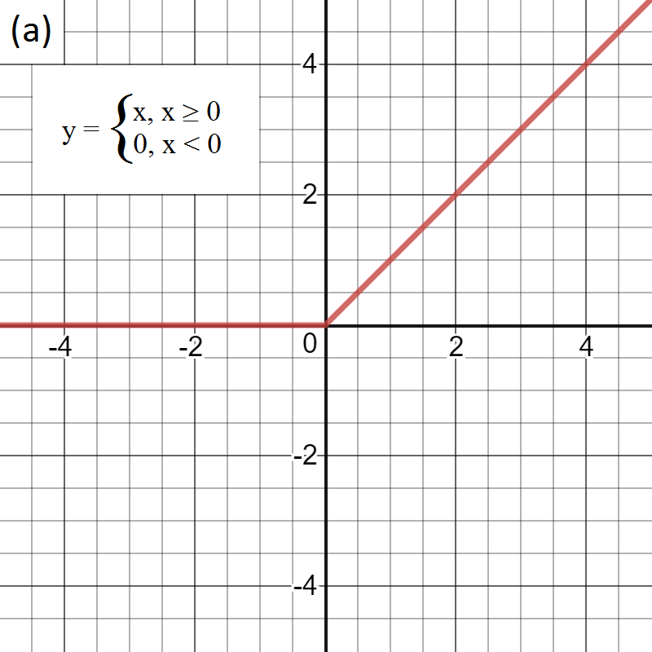
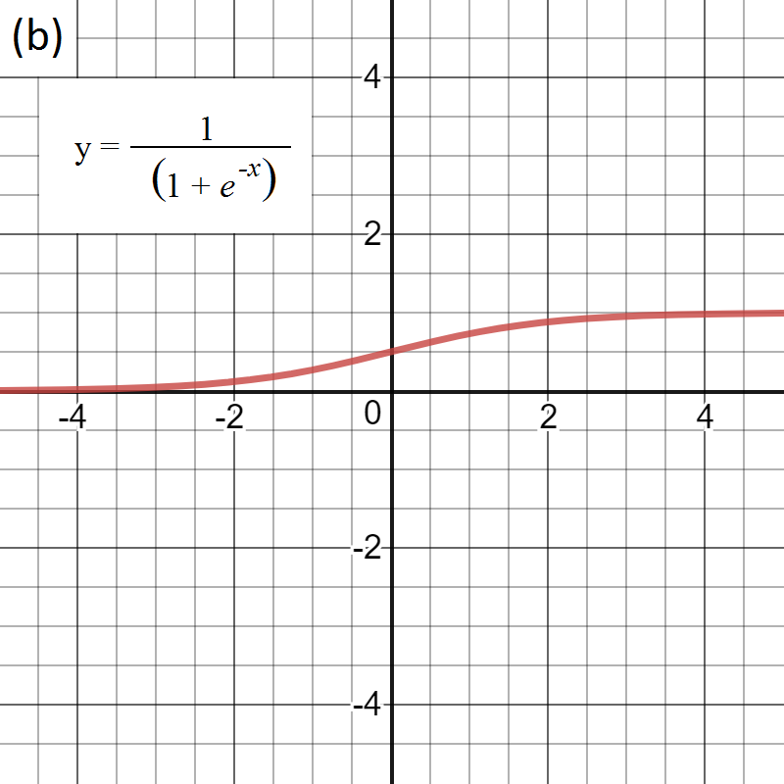
Activation Functions
Training Data
Testing Data
Creates nonlinear relationships by transforming data
Rectified Linear Unit (ReLU): commonly used in hidden layers
Sigmoid: default function for output layers in binary classification
Untrained Model
Trained Model
Classifications
ReLU
Sigmoid

Slide 12
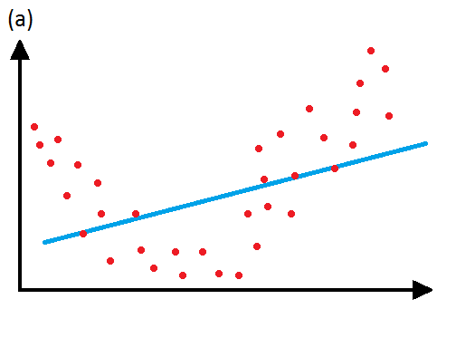
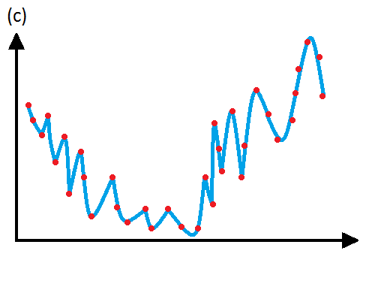
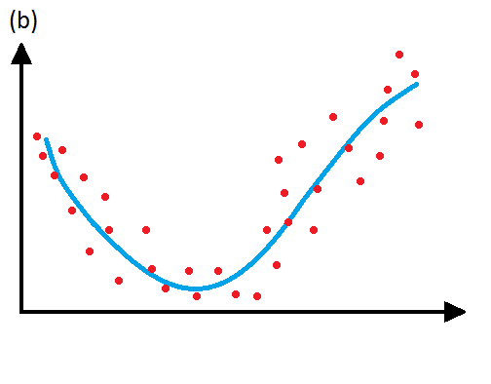
Under and Overfitting
Training Data
Testing Data
Untrained Model
Trained Model
Classifications
Underfitting: a model is not complex enough and does not fit the data well
Overfitting: model is too complex, misses general trend
Regularization: adds term to cost function to avoid complex models
Cost_{reg} = Cost + λ*(Regularization Term)
Underfit
Overfit
Good fit

Slide 13
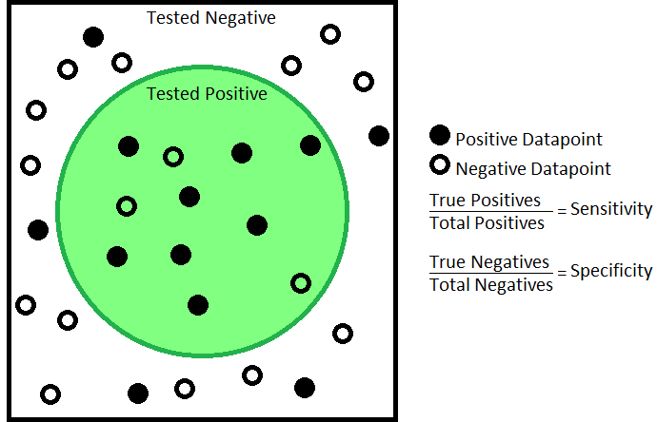
Sensitivity and Specificity
Training Data
Testing Data
Untrained Model
Trained Model
Classifications
Statistical measurements of performance
Sensitivity: true positive rate
Specificity: true negative rate
Cancer Positive
Cancer Negative
8/13 = 61.54%
13/16 = 81.25%

Slide 14
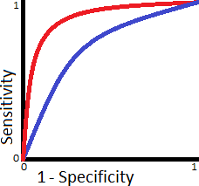
Receiver Operating Characteristic (ROC) Curves
Training Data
Testing Data
Untrained Model
Trained Model
Classifications
Parametric graph: true positive rate vs false positive rate
Models with larger area under the curve, can have their thresholds adjusted to increase specificity without significant sacrifice of sensitivity
Model 1
Model 2
True Positive Rate
False Positive Rate

Slide 15

Cancer Detecting Neural Network (AccurateDetect)
Used same dataset as Detect-A
Able to detect nonlinear relationships

Slide 16
AccurateDetect Construction
Initial Hyperparameters
AccurateDetect
Adjust Threshold
Final Model
Improvement in Accuracy/ ROC?
No
Yes
Adjust Hyperparameters

Slide 17
Initial Hyperparameters
Improvement in Accuracy/ AUC?
Initial Hyper-parameters
Accurate
Detect
Adjust Threshold
Final Model
Adjust Hyper-parameters
3 layer neural network: 1 input, 1 hidden, 1 output
Hidden layer: 5 nodes, λ = 0
Batch-size: 32
Epochs: 80
Threshold: 0.5

Slide 18
Training and Testing
Improv-ement in Accuracy/ ROC?
Initial Hyper-parameters
AccurateDetect
Adjust Threshold
Final Model
Adjust Hyper-parameters
Training Data
Testing Data
Untrained Model
Trained Model
Classifications

Slide 19
AccurateDetect Accuracy Optimization
Improv-ement in Accuracy/ ROC?
Initial Hyper-parameters
Accurate
Detect
Adjust Threshold
Final Model
Adjust Hyper-parameters
 | AccurateDetect | Detect-A | Difference
Median Accuracy | 95.58% | 70.80% | 24.78%
Sensitivity | 91.24% | 62.29% | 28.95%
Specificity | 90.76% | 99.14% | - 8.38%

Slide 20
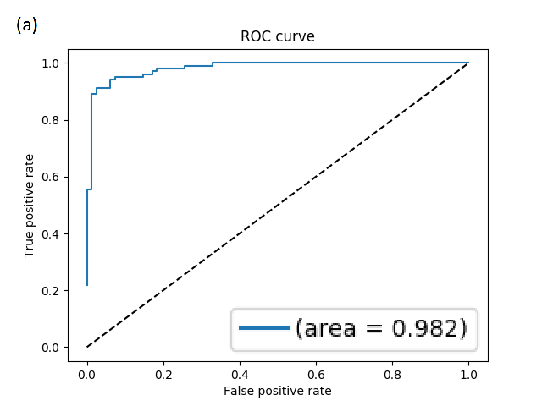
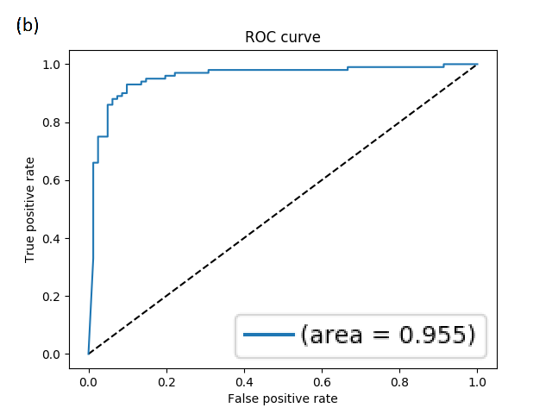
AccurateDetect ROC Optimization
Improv-ement in Accuracy/ ROC?
Initial Hyper-parameters
Accurate
Detect
Adjust Threshold
Final Model
Adjust Hyper-parameters

Slide 21
Optimized AccurateDetect Structure
Improv-ement in Accuracy/ ROC?
Initial Hyper-parameters
AccurateDetect
Adjust Threshold
Final Model
Adjust Hyper-parameters
Threshold: 0.96
4 layer neural network: 1 input, 2 hidden, 1 output
Hidden layer 1: 30 nodes, λ = 0
Hidden layer 2: 25 nodes, λ = 5x10⁻⁴
Batch-size: 32
Epochs: 150

Slide 22
AccurateDetect vs Detect-A
Improv-ement in Accuracy/ ROC?
Initial Hyper-parameters
AccurateDetect
Adjust Threshold
Final Model
Adjust Hyper-parameters
 | AccurateDetect | Detect-A | Difference
Mean Accuracy | 85.64% | 78.76% | 6.88%
Median Accuracy | 82.30% | 70.80% | 12.50%
Sensitivity | 74.83% | 62.29% | 12.54%
Specificity | 99.01% | 99.14% | - 0.13%

Slide 23
Individual Cancer Comparison
Improv-ement in Accuracy/ ROC?
Initial Hyper-parameters
AccurateDetect
Adjust Threshold
Final Model
Adjust Hyper-parameters
 | AccurateDetect Accuracy | Detect-A Accuracy | Difference
Lung | 83.65% | 58.65% | 25.00%
Breast | 52.63% | 33.49% | 19.14%
Upper GI | 82.30% | 70.80% | 11.50%
Colorectum | 76.29% | 64.95% | 11.34%
Liver | 100.00% | 97.73% | 2.27%
Pancreas | 74.19% | 72.04% | 2.15%
Ovary | 98.15% | 98.15% | 0.00%

Slide 24
Conclusions and Future Work
AccurateDetect matched or outperformed Detect-A.
Some cancer types exhibited more nonlinear relationships.
Using a different model for each cancer type may improve performance.
Expand AccurateDetect for multiclass classification to locate cancer.

Slide 25
References
Worldwide cancer statistics. (2018, November 14). Retrieved from https://www.cancerresearchuk.org/health-professional/cancer-statistics/worldwide-cancer
What Is Cancer? (2015, February 9). Retrieved from https://www.cancer.gov/about-cancer/understanding/what-is-cancer
J. D. Cohen et al., Science 10.1126/science.aar3247 (2018)
Survival Rates for Colorectal Cancer, by Stage. (2018, July 9). Retrieved from https://www.cancer.org/cancer/colon-rectal-cancer/detection-diagnosis-staging/survival-\\rates.html
Stöppler, M. C. (2018, April 10). Screening Tests for Cancer: Facts on Early Cancer Detection. Retrieved from https://www.medicinenet.com/cancer\_detection/article.htm\#cancer\_screening\_test\_facts
Machine Learning: What it is and why it matters. (n.d.). Retrieved from https://www.sas.com/en\_us/insights/analytics/machine-learning.html
KDnuggets. (2017, September). Retrieved from https://www.kdnuggets.com/2017/09/neural-network-foundations-explained-activation-\\function.html
Convolutional Neural Networks. (n.d.). Retrieved from http://cs231n.github.io/convolutional-networks/
Shin, D. (2017). Overfitting \& Regularization. Retrieved from http://dshincd.github.io/blog/regularization/
McDonald, C. (2017, November 27). Machine learning fundamentals (I): Cost functions and gradient descent. Retrieved from https://towardsdatascience.com/machine-learning-\\fundamentals-via-linear-regression-41a5d11f5220
Brownlee, J. (2018, May 21). A Gentle Introduction to k-fold Cross-Validation. Retrieved from https://machinelearningmastery.com/k-fold-cross-validation/
Basic Concepts and Definitions. (n.d.). Retrieved from http://gim.unmc.edu/dxtests/reviewof.htm
Schoonjans, F. (2018, November 09). ROC curve analysis with MedCalc. Retrieved from https://www.medcalc.org/manual/roc-curves.php
Cook, E., \& Lindsay, K. (2018, January 18). Single Blood Test Screens for Eight Cancer Types. Retrieved from https://www.hopkinsmedicine.org/news/newsroom/news-\\releases/single-blood-test-screens-for-eight-cancer-types

