Slide 1
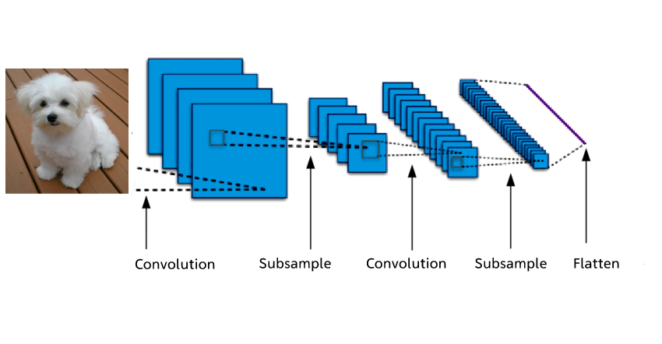
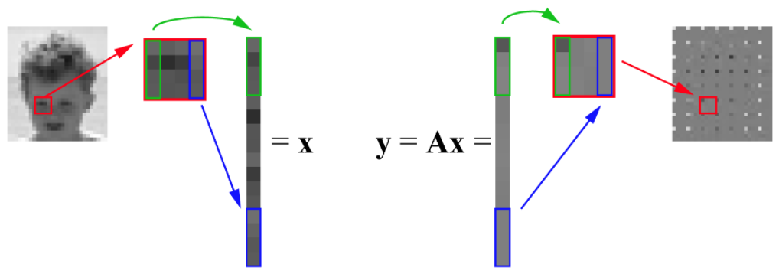
Introduction
Neural network
Image processing:
- Image denoting
- Image blurring
- Image restoration
Objectives:
Implement image reconstruction to build a bridge between image processing and various types of least squares problems (LASSO)
Train a learning-based model through solving some linear programming problems.
conventional methods revoking linear algebra

Slide 2
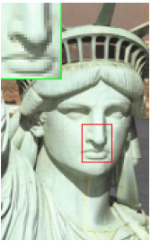
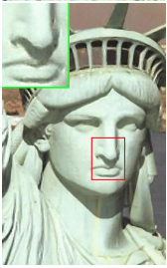
Background
Single-image super-resolution, based on sparse signal representation.
image patches can be well represented as a sparse linear combination of elements from an appropriately chosen over-complete dictionary
Procedure:
Low-resolution
High-resolution
①Recover from the downsampled signals
③jointly training two dictionaries for the low- and high-resolution image patches
②Sparse representation of the low-resolution input
④use the coefficients of this representation of low-resolution image to generate the high-resolution output

