Slide 1
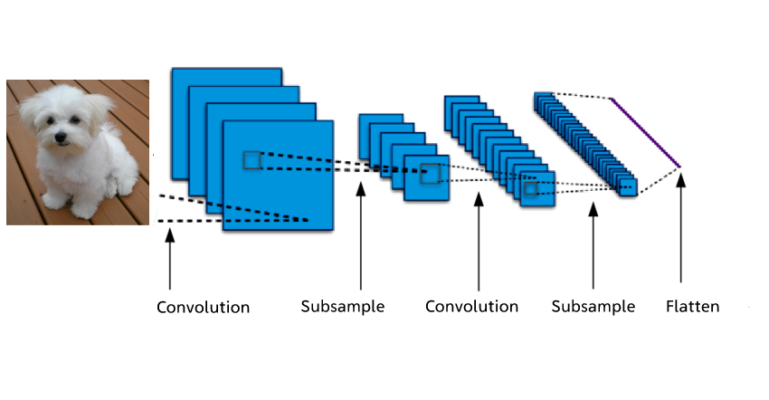
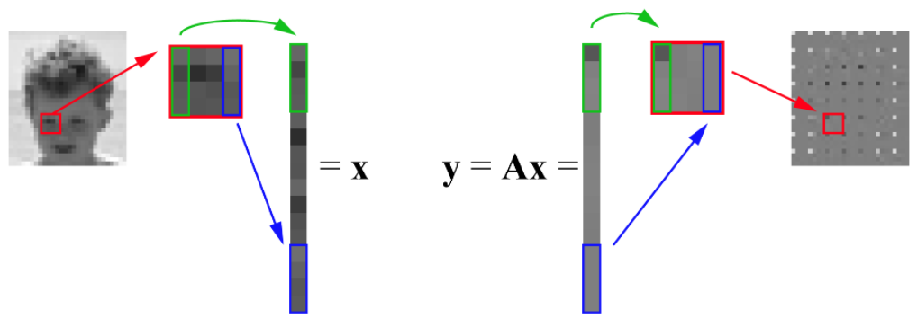
Introduction
Neural network
Image processing:
- Image denoting
- Image blurring
- Image restoration
Objectives:
Implement image reconstruction to build a bridge between image processing and various types of least squares problems (LASSO)
Train a learning-based model through solving some linear programming problems.
conventional methods revoking linear algebra

Slide 2
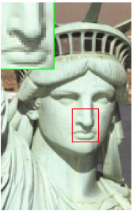
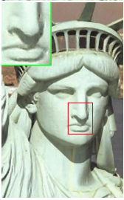
Background
Single-image super-resolution, based on sparse signal representation.
image patches can be well represented as a sparse linear combination of elements from an appropriately chosen over-complete dictionary
Procedure:
Low-resolution
High-resolution
①Recover from the downsampled signals
③jointly training two dictionaries for the low- and high-resolution image patches
②Sparse representation of the low-resolution input
④use the coefficients of this representation of low-resolution image to generate the high-resolution output

Slide 3
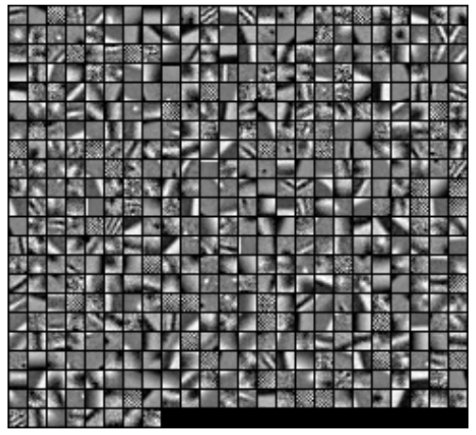
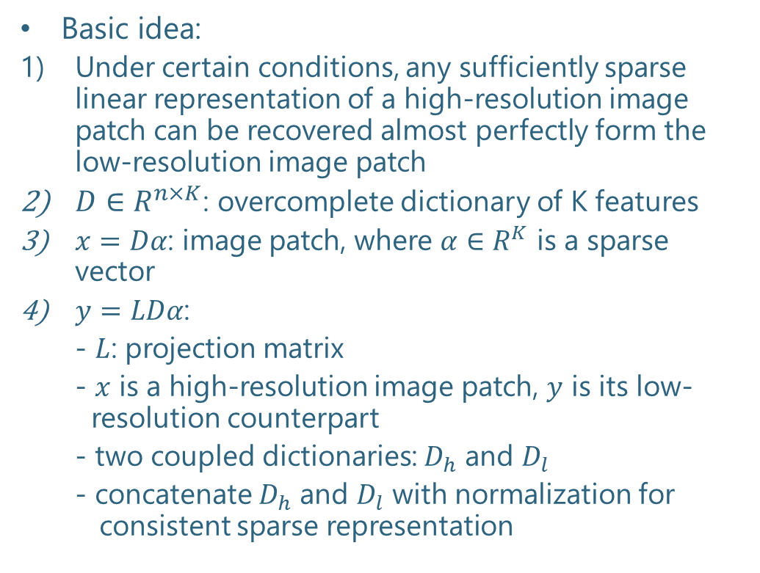
Image Super-Resolution via Sparse Representation
Basic idea:
Under certain conditions, any sufficiently sparse linear representation of a high-resolution image patch can be recovered almost perfectly form the low-resolution image patch
$D∈R^{n×K}$: overcomplete dictionary of K features
$x=Dα$: image patch, where $α∈R^{K}$ is a sparse vector
$y=LDα$:
- $L$: projection matrix
- $x$ is a high-resolution image patch, $y$ is its low- resolution counterpart
- two coupled dictionaries: $D_{h}$ and $D_{l}$
- concatenate $D_{h}$ and $D_{l}$ with normalization for consistent sparse representation
The high-resolution image patch dictionary trained using 100,000 high resolution and low-resolution image patch pairs sampled from the generic training images. (Yang, J., Wright, J., Huang, T. S., & Ma, Y. (2010))

