Slide 1
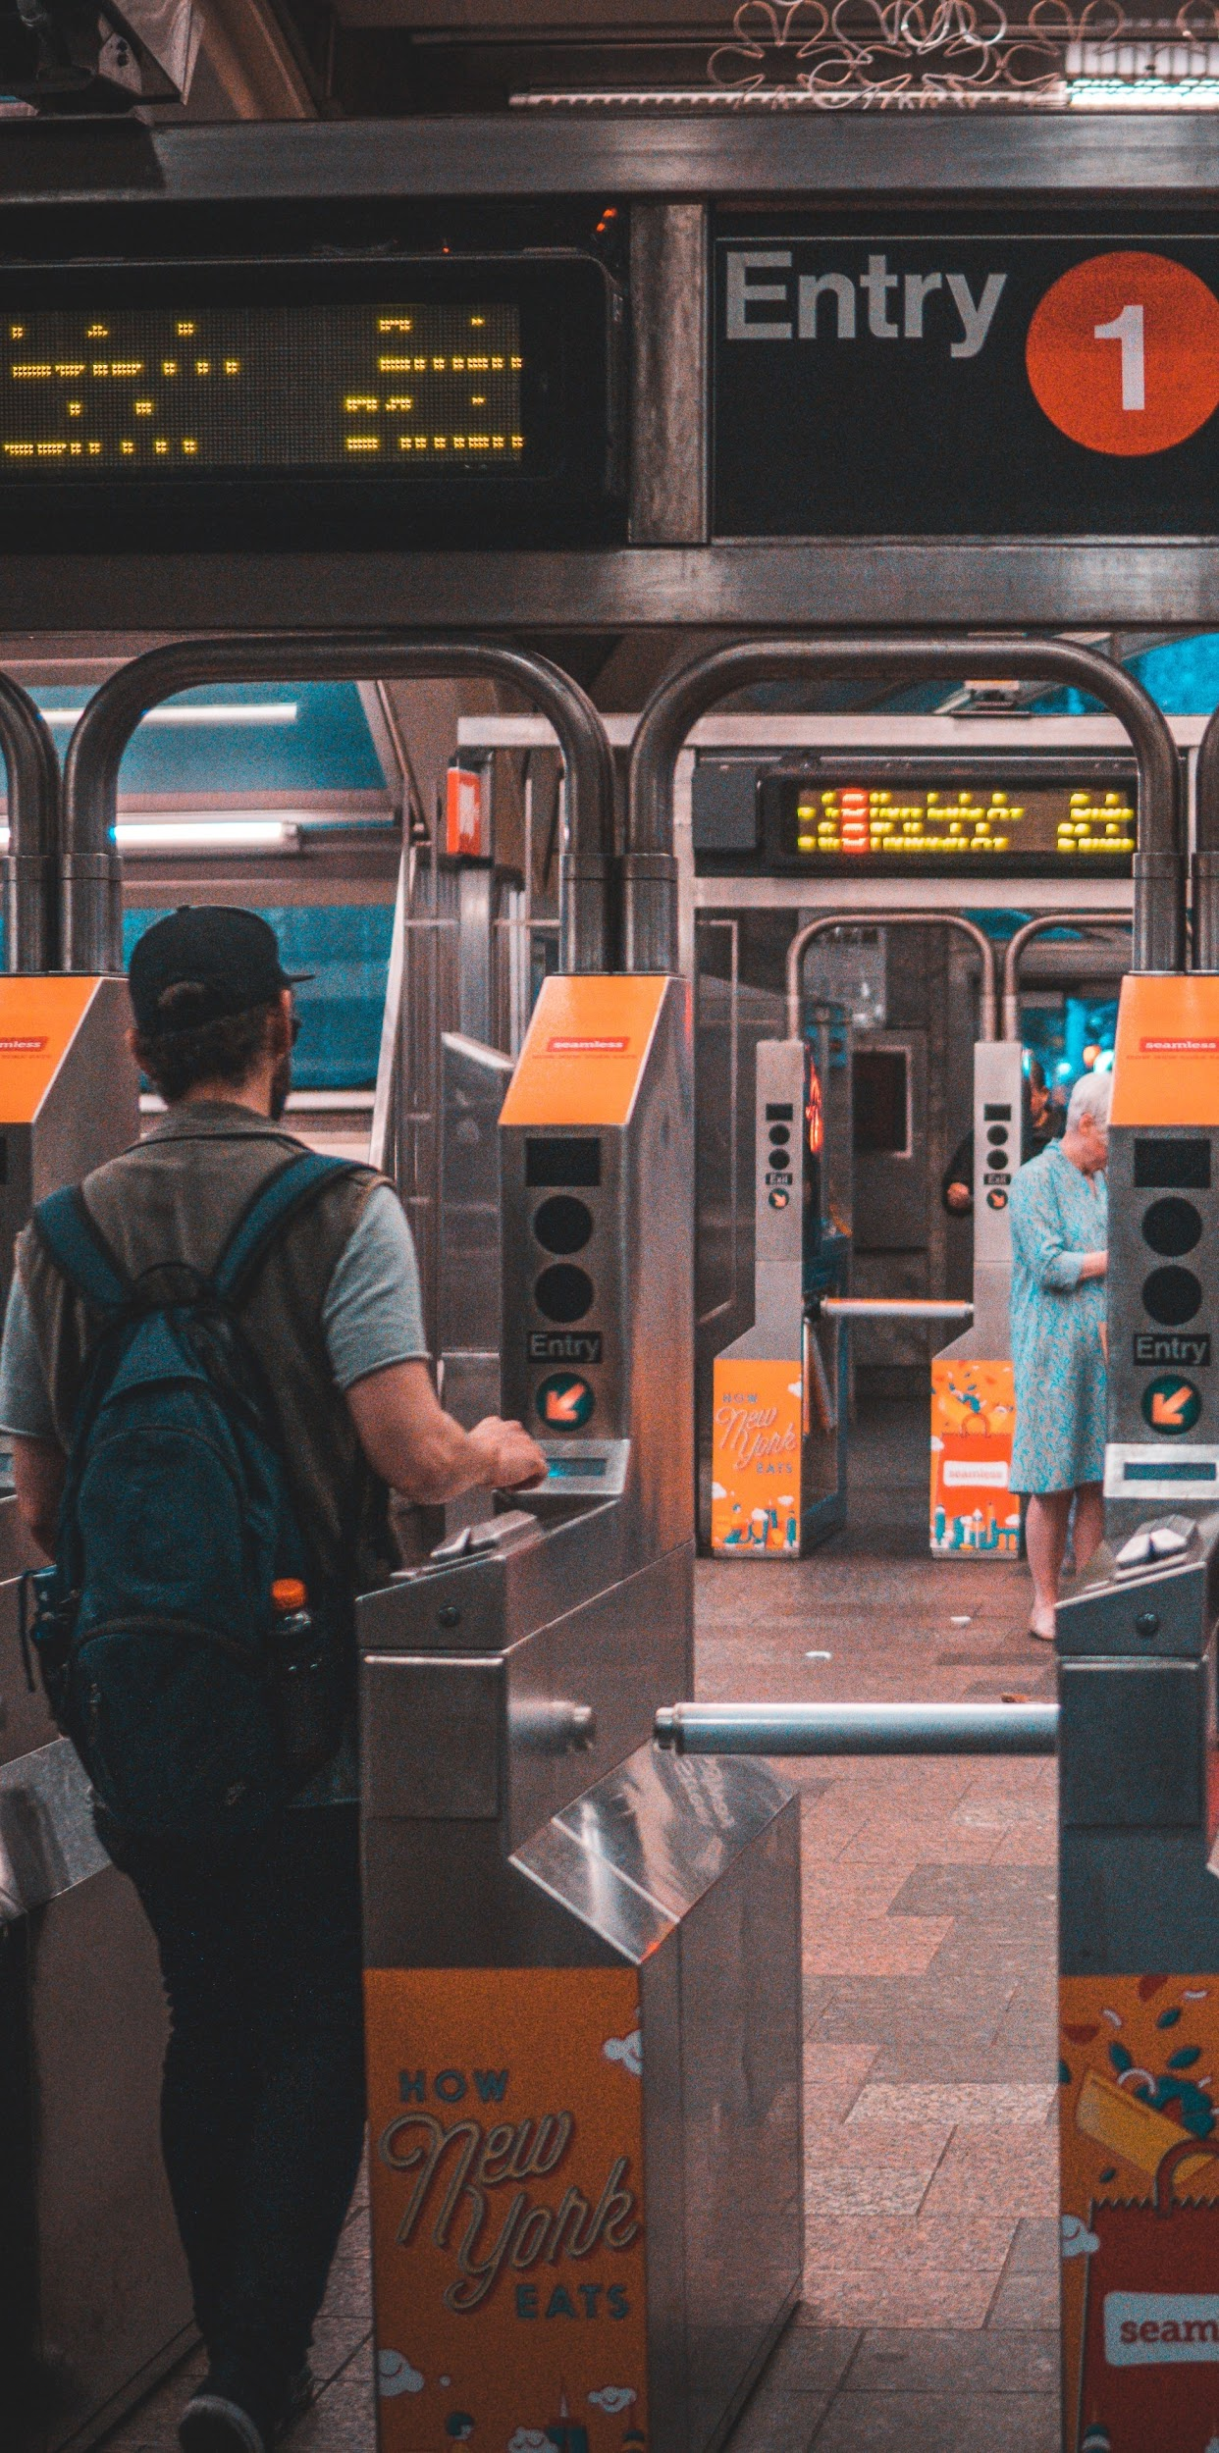
MTA Traffic Analysis for WTWY
Presented by: Alvin, Daniel, Xinni
As Project 1 of
Metis Data Science Bootcamp

Slide 2
Introduction
WomenTechWomenYes (WTWY) is holding an annual gala, and hopes to invite as many interested individuals as possible.
WTWY is intending to place street teams at the entrance to NYC subway stations to collect email addresses and give out free tickets.
Agenda: Apply data analytics on the MTA subway data on traffic flow to optimize placement of street teams to maximize engagements.

Slide 3
Methodology
Wrote a script to webscape weekly MTA turnstile data to analyze traffic.
Analyze turnstile data from the latest week 22/8/20 to 28/8/20.
 | C/A | UNIT | SCP | STATION | LINENAME | DIVISION | DATE | TIME | DESC | ENTRIES | EXITS
0 | A002 | R051 | 02-00-00 | 59 ST | NQR456W | BMT | 2020-08-22 | 00:00:00 | REGULAR | 7447810 | 2532191
1 | A002 | R051 | 02-00-00 | 59 ST | NQR456W | BMT | 2020-08-22 | 04:00:00 | REGULAR | 7447812 | 2532197
2 | A002 | R051 | 02-00-00 | 59 ST | NQR456W | BMT | 2020-08-22 | 08:00:00 | REGULAR | 7447824 | 2532208
3 | A002 | R051 | 02-00-00 | 59 ST | NQR456W | BMT | 2020-08-22 | 12:00:00 | REGULAR | 7447852 | 2532248
4 | A002 | R051 | 02-00-00 | 59 ST | NQR456W | BMT | 2020-08-22 | 16:00:00 | REGULAR | 7447937 | 2532276
217832 rows

Slide 4
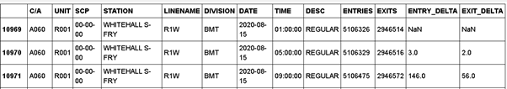
Methodology
Each turnstile has a unique combination of ‘UNIT’ and ‘SCP’ number.
Traffic at each time period is given by the difference between consecutive entry/exit serial numbers.

Slide 5
Data Preparation
Sort and look out for error datas those duplicates or outliers -
Dropped duplicate rows in the dataset.
 | C/A | UNIT | SCP | STATION | LINENAME | DIVISION | DATE | TIME | DESC | ENTRIES | EXITS
726085 | N400A | R359 | 2/6/01 | COURT SQ | EMG | IND | 22/8/20 | 3:59 | REGULAR | 4624908 | 934503
726086 | N400A | R359 | 2/6/01 | COURT SQ | EMG | IND | 22/8/20 | 4:00 | REGULAR | 4624908 | 934503
726087 | N400A | R359 | 2/6/01 | COURT SQ | EMG | IND | 22/8/20 | 4:00 | REGULAR | 4624908 | 934503
726088 | N400A | R359 | 2/6/01 | COURT SQ | EMG | IND | 22/8/20 | 4:02 | REGULAR | 4624908 | 934503
726089 | N400A | R359 | 2/6/01 | COURT SQ | EMG | IND | 22/8/20 | 4:03 | REGULAR | 4624908 | 934503

Slide 6
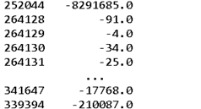

Data Preparation
Negative or More than 10,000.
Replace errors datas with mean values of the station before and after the error data timing.
Sum the change of entry and exit to get the total traffic for each timing

Slide 7
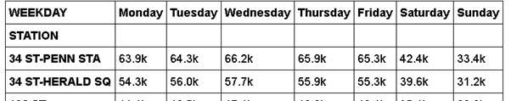
Data Preparation
Add weekday columns to the date and change the list to matrix by station & weekday
Change time to time format %H:%M:%S3 then group timings into 6 intervals of 4 hours each. (Eg. 12am-4-8-12pm-4-8-12am)

Slide 8
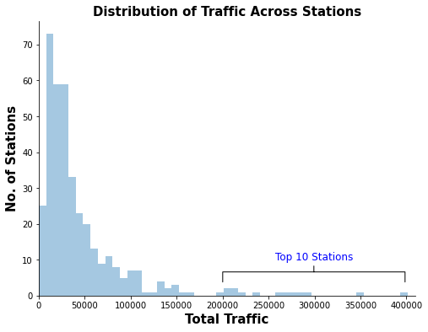
Results
Distribution of traffic is heavily right-skewed.
Top 10 stations in traffic are outliers in distributions.
Top 10 stations are probably in dense residential areas or close to city centre with a lot of human activities.

Slide 9
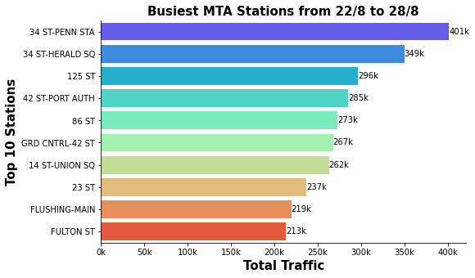
Results
Distribution of traffic across the top 10 stations.
34 St - Penn Station and 34 St - Herald Square station has notably more traffic than the rest.

Slide 10
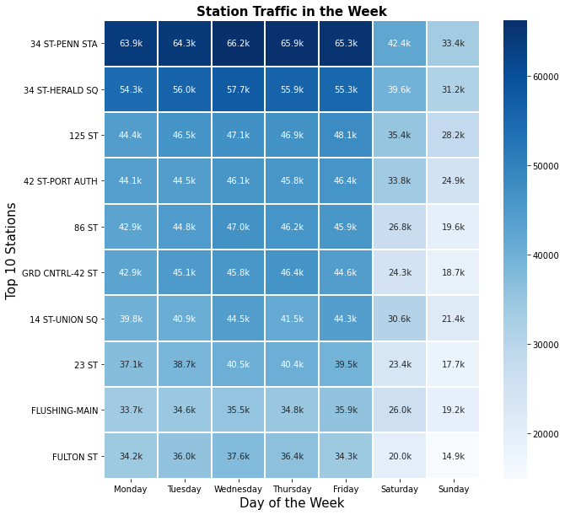
Results
Distribution of traffic across the week.
Trend shows that traffic on weekdays is generally more than weekends.

Slide 11
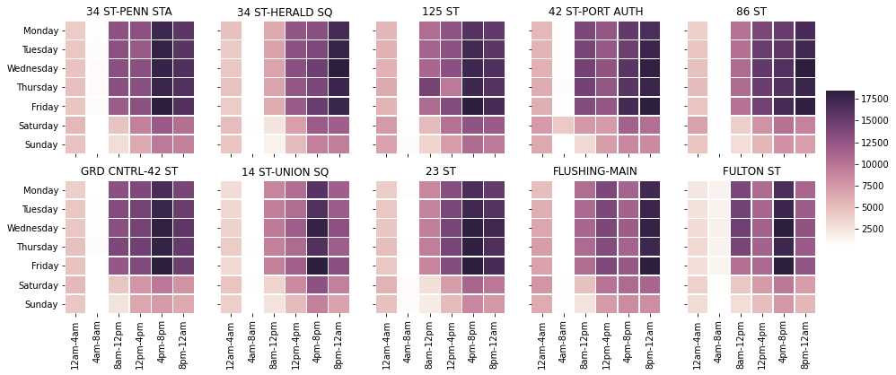
Results
Trend shows that traffic is heavier in the late afternoon and evening periods, even during weekdays.

Slide 12
Conclusion
Given limited manpower resources, WTWY should focus on sending street teams to the top 10 busiest MTA stations.
If time is a constraint, WTWY should focus on weekdays in the period of late afternoons to late evenings.
Morning period on weekdays can be avoided due to has less traffic (due to WFH), and commuters are busy reporting to work.

Slide 13
Future Work
Using our automated web scraping script on the MTA website, our team can quickly produce similar data insights for other date periods.
Generate other insights by analyzing trends based on total entries and total exit respectively.
Generate other visualizations such as using a choropleth map for the locations of MTA stations in NYC.
Possibility of including areas outside the MTA transit where there are more commercial and leisure activities taking place.

Slide 14
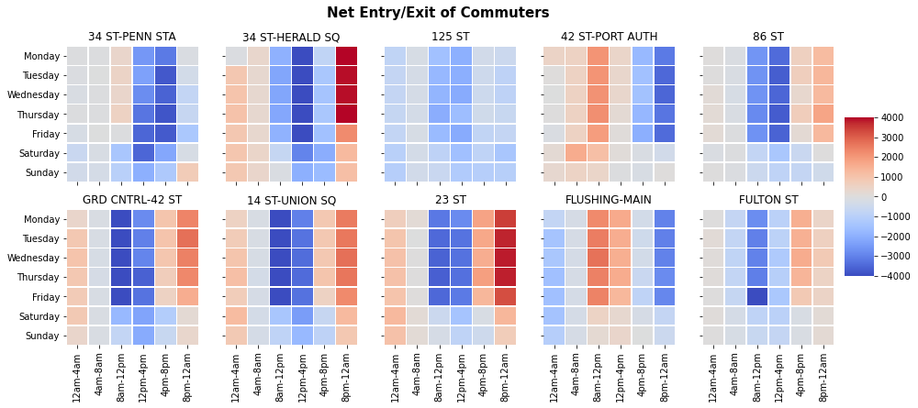
Appendix

Slide 15
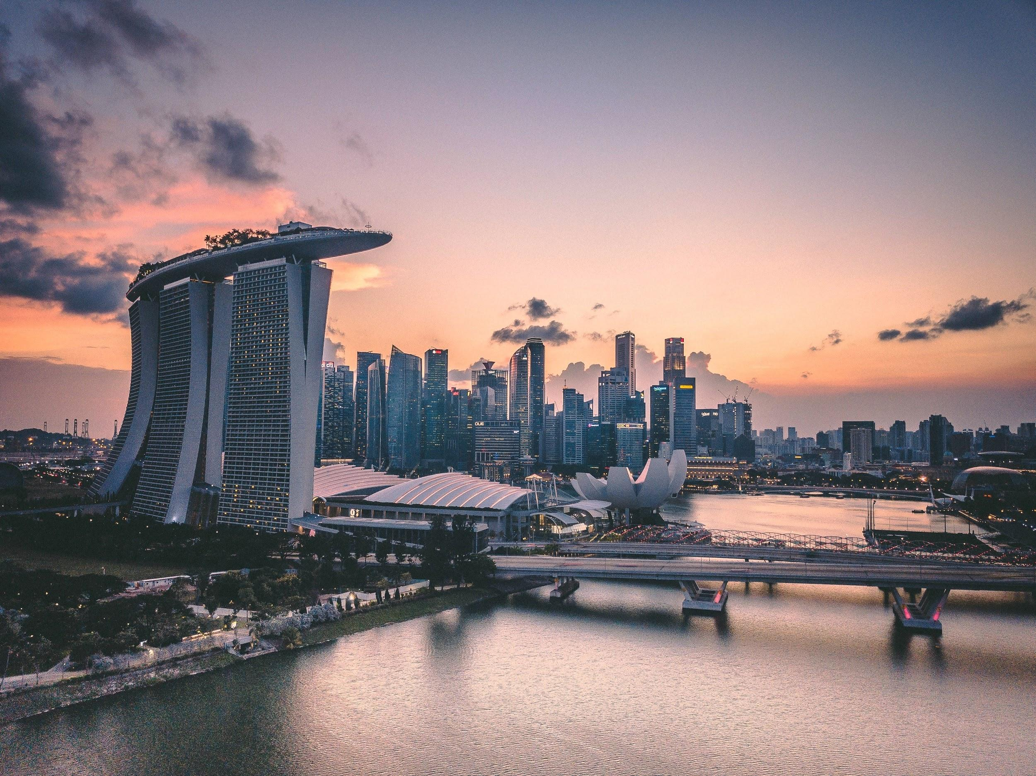
Thank You!

