Slide 1
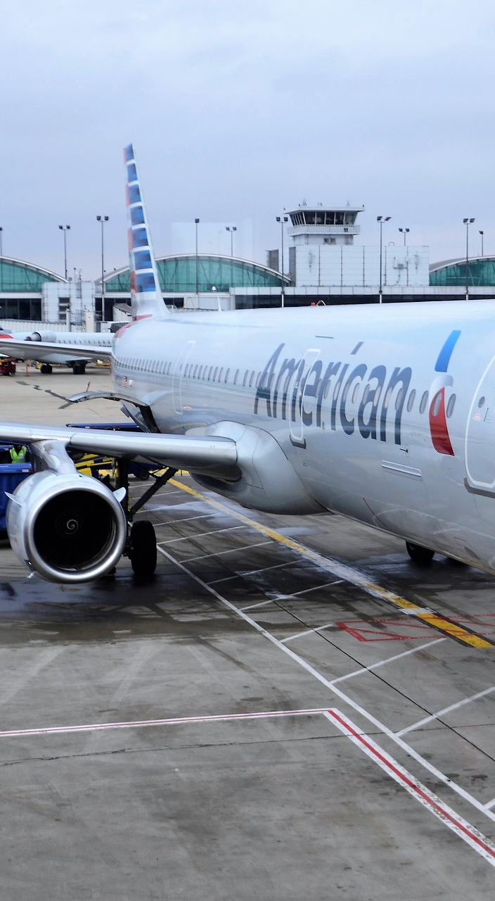

Predicting Satisfaction of Airline Passengers
As Project 3 on Classification of
Metis Data Science Bootcamp
Presenter: Tan Pengshi Alvin

Slide 2
1. Introduction
Obtained about 130k of flight satisfaction surveys from Kaggle.
Data is taken from passengers from a US airline.
Goal: Identify critical factors that ensure satisfaction.
Focus on Precision of the machine learning model.

Slide 3
2. EDA and Feature Selection
Target
 | Satisfaction | Gender | Customer Type | Age | Type Of Travel | Class | Flight Distance | Inflight Wifi Service | Departure/ Arrival Time Convenience | Ease Of Online Booking | Gate Location | Food And Drink | Online Boarding | Seat Comfort | Inflight Entertainment | On-board Service | Leg Room | Baggage Handling | Checkin Service | Inflight Service | Cleanliness | Total Delay
0 | Neutral/ Dissatisfied | Male | Returning Customer | 13 | Personal Travel | Economy | 460 | 3 | 4 | 3 | 1 | 5 | 3 | 5 | 5 | 4 | 3 | 4 | 4 | 5 | 5 | 43.0
1 | Neutral/ Dissatisfied | Male | First-time Customer | 25 | Business travel | Business | 235 | 3 | 2 | 3 | 3 | 1 | 3 | 1 | 1 | 1 | 5 | 3 | 1 | 4 | 1 | 7.0
2 | Neutral/ Dissatisfied | Female | Returning Customer | 25 | Business travel | Business | 562 | 2 | 5 | 5 | 5 | 2 | 2 | 2 | 2 | 2 | 5 | 3 | 1 | 4 | 2 | 20.0
3 | Satisfied | Male | Returning Customer | 61 | Business travel | Business | 214 | 3 | 3 | 3 | 3 | 4 | 5 | 5 | 3 | 3 | 4 | 4 | 3 | 3 | 3 | 0.0
4 | Neutral/ Dissatisfied | Female | Returning Customer | 26 | Personal Travel | Economy | 1180 | 3 | 4 | 2 | 1 | 1 | 2 | 1 | 1 | 3 | 4 | 4 | 4 | 4 | 1 | 0.0
... | ... | ... | ... | ... | ... | ... | ... | ... | ... | ... | ... | ... | ... | ... | ... | ... | ... | ... | ... | ... | ... | ...
69061 | Neutral/ Dissatisfied | Female | First-time Customer | 36 | Business travel | Economy | 432 | 1 | 5 | 1 | 3 | 4 | 1 | 4 | 4 | 5 | 2 | 5 | 2 | 3 | 4 | 0.0
69062 | Neutral/ Dissatisfied | Male | First-time Customer | 34 | Business travel | Business | 526 | 3 | 3 | 3 | 1 | 4 | 3 | 4 | 4 | 3 | 2 | 4 | 4 | 5 | 4 | 0.0
69063 | Neutral/ Dissatisfied | Female | Returning Customer | 17 | Personal Travel | Economy | 828 | 2 | 5 | 1 | 5 | 2 | 1 | 2 | 2 | 4 | 3 | 4 | 5 | 4 | 2 | 0.0
69064 | Satisfied | Male | Returning Customer | 14 | Business travel | Business | 1127 | 3 | 3 | 3 | 3 | 4 | 4 | 4 | 4 | 3 | 2 | 5 | 4 | 5 | 4 | 0.0
69065 | Neutral/ Dissatisfied | Female | Returning Customer | 42 | Personal Travel | Economy | 264 | 2 | 5 | 2 | 5 | 4 | 2 | 2 | 1 | 1 | 2 | 1 | 1 | 1 | 1 | 0.0

Slide 4
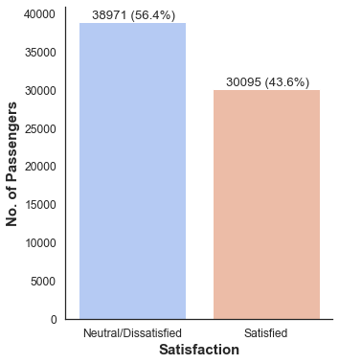
2. EDA and Feature Selection
Target classes are quite balanced.
‘Neutral/Dissatisfied’ does not necessarily mean dissatisfaction.

Slide 5
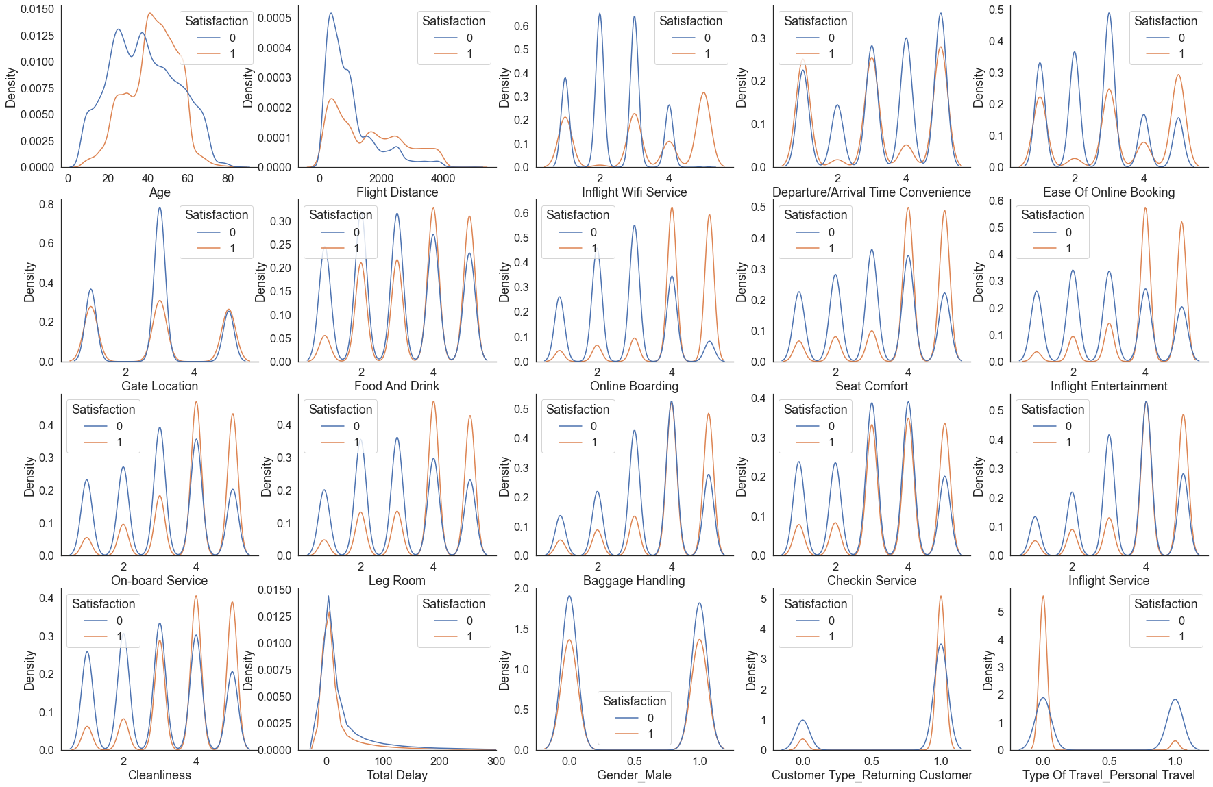
2. EDA and Feature Selection

Slide 6
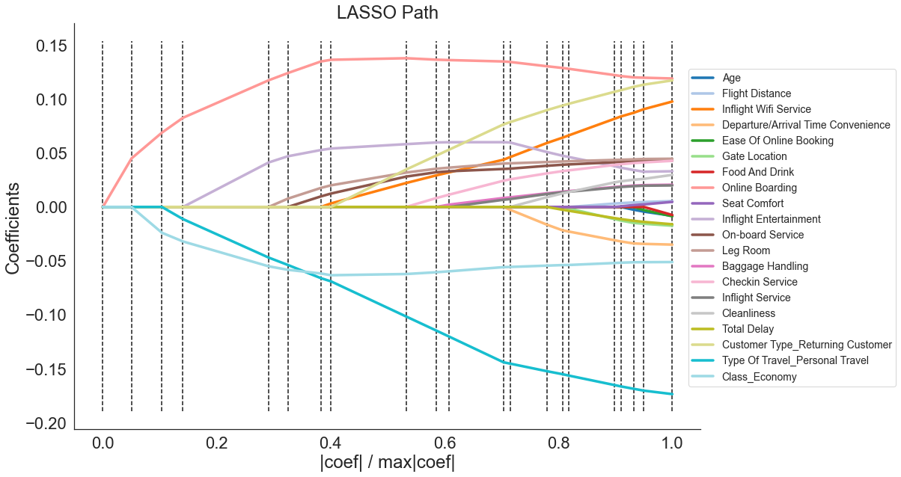
2. EDA and Feature Selection

Slide 7
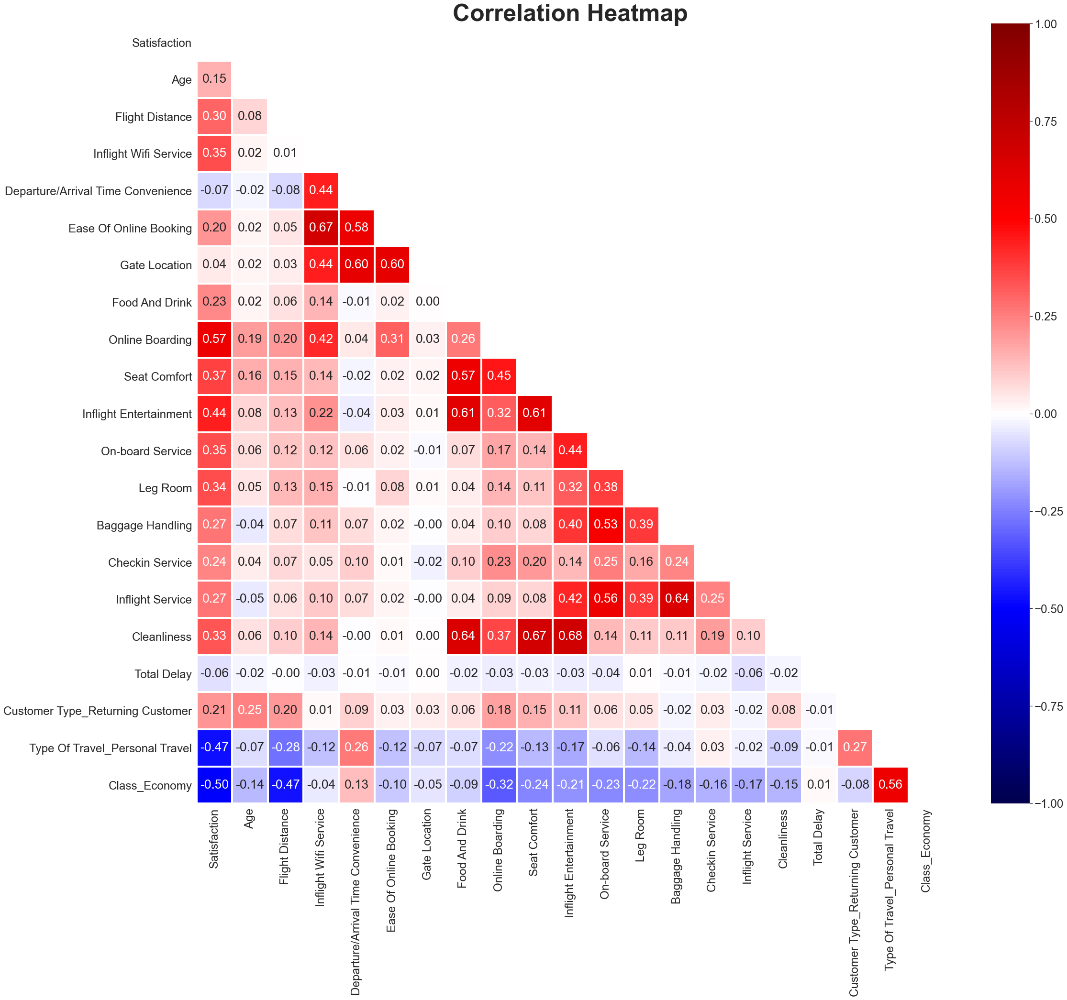
Final Feature Selection
Features to drop:
Gender
Age
Gate Location
Total Delay
Flight Distance
Departure/Arrival Time Convenience

Slide 8
3. Model Selection – 5 Fold CV
Determining Model Hyperparameters by 5-Fold CV:
Training Set (5-Fold CV)
Test Set
16% | 16% | 16% | 16% | 16% | 20%

Slide 9
3. Model Selection – 5 Fold CV
Determining Model Hyperparameters by 5-Fold CV:
- Optimum k for k-Nearest Neighbors: 7
- Optimum C for Logistic Regression: 0.04
- Optimum depth for Decision Trees: 12
- Optimum depth for Random Forest: 17
- Ensemble takes in all models with optimum hyperparameters.

Slide 10
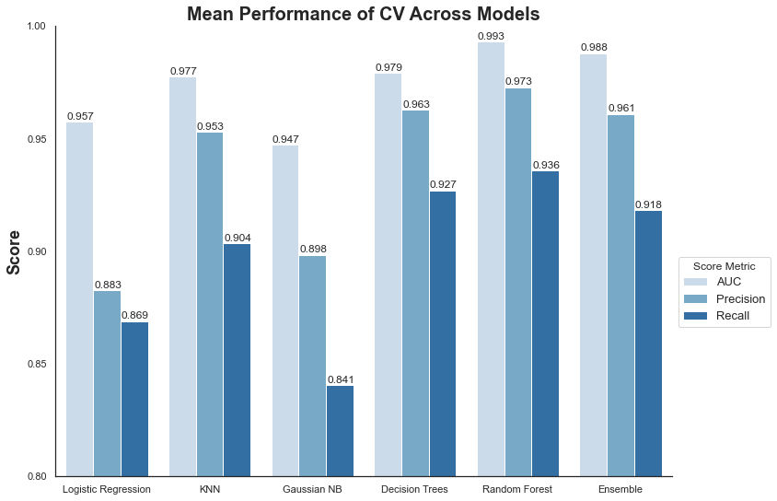
3. Model Selection – 5 Fold CV

Slide 11
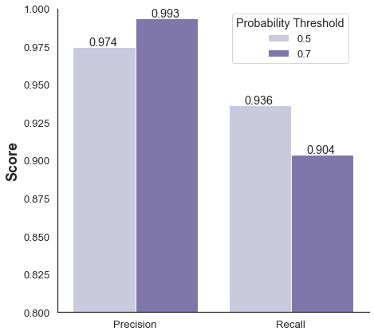
3. Model Selection – Simple CV
Training Set
Validation Set
Test Set
60% | 20% | 20%
Increase threshold from 0.5 to 0.7
Precision increase from 97% to 99%

Slide 12
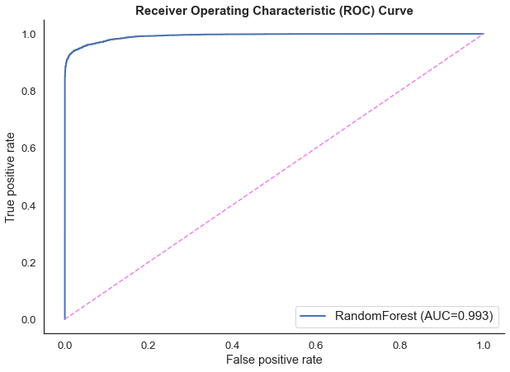
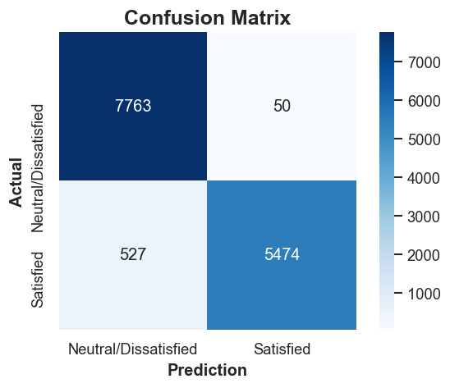
4. Model Evaluation – Test Set
PRECISION = 99.1%

Slide 13
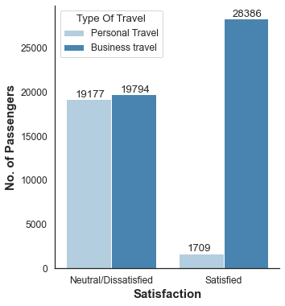
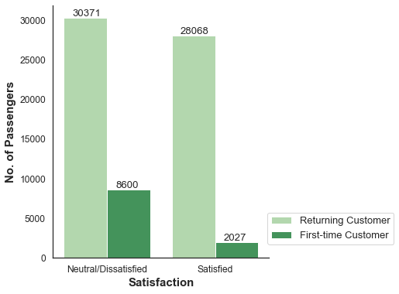
5. Business Problem
How to ensure satisfaction in first-time customers?

Slide 14
5. Business Problem
Economy Class & Personal Travel - First-time customers
Predicted Satisfaction | Inflight Wifi Service | Ease Of Online Booking | Food And Drink | Online Boarding | Seat Comfort | Inflight Entertainment | On-board Service | Leg Room | Baggage Handling | Checkin Service | Inflight Service | Cleanliness
Neutral/ Dissatisfied | 3 | 3 | 3 | 3 | 3 | 3 | 3 | 3 | 3 | 3 | 3 | 3
Satisfied | 5 | 3 | 3 | 3 | 3 | 3 | 3 | 3 | 3 | 3 | 3 | 3
Neutral/ Dissatisfied | 4 | 5 | 5 | 5 | 5 | 5 | 5 | 5 | 5 | 5 | 5 | 5
Neutral/ Dissatisfied | 3 | 5 | 5 | 5 | 5 | 5 | 5 | 5 | 5 | 5 | 5 | 5

Slide 15
5. Business Problem
Business Class & Business Travel - First-time customers
Predicted Satisfaction | Inflight Wifi Service | Ease Of Online Booking | Food And Drink | Online Boarding | Seat Comfort | Inflight Entertainment | On-board Service | Leg Room | Baggage Handling | Checkin Service | Inflight Service | Cleanliness
Neutral/ Dissatisfied | 3 | 3 | 3 | 3 | 3 | 3 | 3 | 3 | 3 | 3 | 3 | 3
Satisfied | 5 | 3 | 3 | 3 | 3 | 3 | 3 | 3 | 3 | 3 | 3 | 3
Satisfied | 3 | 5 | 5 | 5 | 5 | 5 | 5 | 5 | 5 | 5 | 5 | 5
Neutral/ Dissatisfied | 3 | 4 | 4 | 4 | 4 | 4 | 4 | 4 | 4 | 4 | 4 | 4
Satisfied | 3 | 5 | 4 | 4 | 4 | 4 | 4 | 4 | 4 | 4 | 4 | 4
Neutral/ Dissatisfied | 3 | 4 | 5 | 5 | 5 | 5 | 5 | 5 | 5 | 5 | 5 | 5

Slide 16
6. Conclusion & Future Work
Engineered a highly precise model that predicts satisfaction.
Airlines should highly focus on inflight wi-fi experience.
Ease of online booking is important for business customers.
In the future, collect even more data.
Apply neural networks for both high precision and recall.

Slide 17
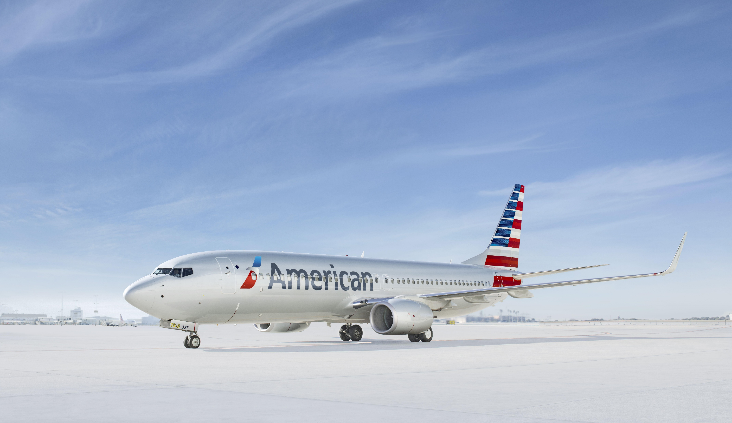

Follow me on:
LinkedIn: @tanpengshi
Medium: @tanpengshi
GitHub: @tanpengshi
Thank You!

