Slide 1
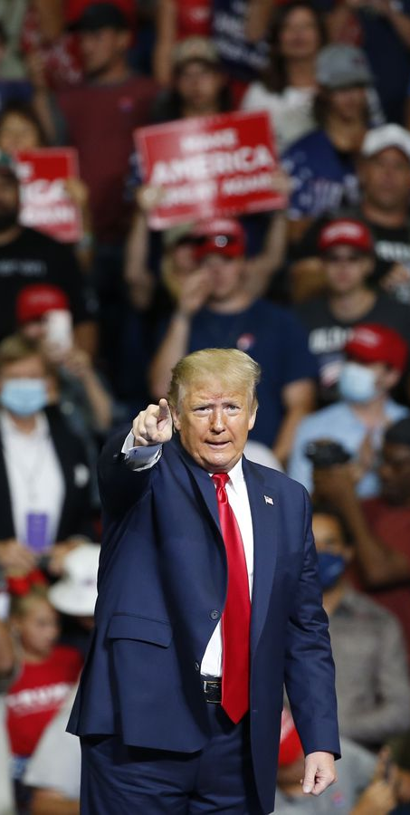

Strategic Analysis of Trump Rallies with NLP
As Project 4 on Classification of
Metis Data Science Bootcamp
Presenter: Tan Pengshi Alvin

Slide 2
Introduction
Strategic Data Scientist for Biden-Harris campaign.
Present insights and advice from the model.
Model: NLP Topic Modelling, Clustering and Time Series.
Web scraped about 100 rally transcripts from https://factba.se/

Slide 3











Python Tools

Slide 4
Text Pre-processing
'Hello, everybody. Hello, Orlando. Hello, Sanford. It's great to be with you. Thank you. It's great to be back. [Audience chants "USA"] That's a lot of people. You know our competitor, sleepy Joe, he had a rally today and practically nobody showed up. I don't know what's going on. Sleepy Joe, but it's great to be back in my home state, Florida to make my official return to the campaign trail. I am so energized by your prayers and humbled by your support. We've had such incredible support and here we are. It's you know, here we are. But we're going to finish, we're going to make this country greater than ever before. [Audience chants "We love you"] Thank you. Thank you. Thank you very much. Thank you very much. We've made tremendous progress. If you look at what we're doing with therapeutics and frankly, cures, we’ve made tremendous progress. And I said to my people, we are going to take whatever the hell they gave me and we're going to distribute it around to hospitals and everyone's going to have the same damn thing. We've all endured a lot together and we are doing better by far than we ever did in 2016. The enthusiasm is greater, the spirit is greater. We're going to have, if it's possible, an even greater and more important victory than we had just four years ago. And nobody ever said this fight was not going to be a hard one, but we will make it like you've never seen before. We are more successful now than we've ever been before, our military is rebuilt, take a look at what's going with their economy. I hate to say to the fake news, we're about to hit another stock market record, 401(k)s. Sleepy Joe Biden, not a nice guy, by the way, I have to be honest. He's not a nice guy.’

Slide 5
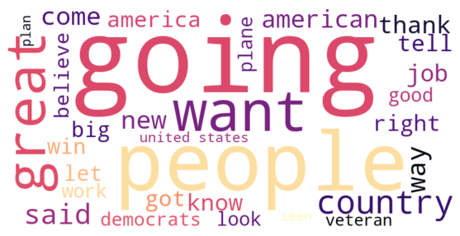
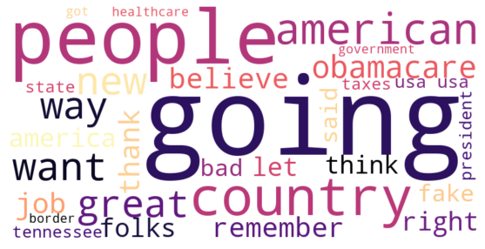
EDA – Trump’s Top 50 Words
Florida Rally, Feb 2017
Tennessee Rally, Mar 2017

Slide 6
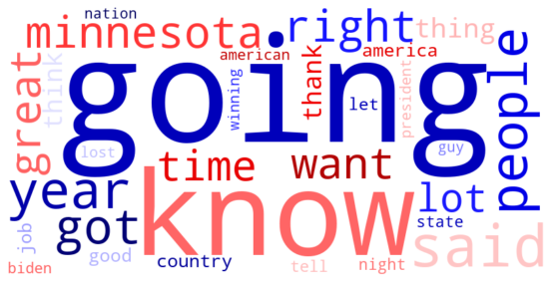
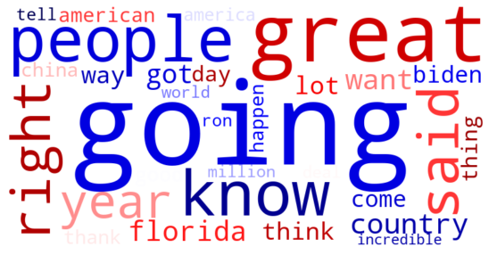
EDA – Trump’s Top 50 Words
Minnesota Rally, Sep 2020
Florida Rally, Oct 2020

Slide 7
Topic Modelling
Apply Count Vectorizer to quantize words of all transcripts
Reduce all features to components (topics) with NMF
Each rally will be given a set of scores based on components

Slide 8
Topic Modelling
Topic 1:
Achievements and Bragging
know, said, right, people, like, great, got, think, going, want, good, lot, years, president, guy, time, thing, look, won, sir, trump, love, way, big, billion, remember, come, let, money, million
Topic 2:
Plans and Appealing for Support
going, great, want, people, country, thank, vote, know, america, american, right, like, years, president, got, democrats, way, good, jobs, time, lot, need, think, said, come, new, state, job, let, love
Topic 3:
Attacking Political Adversaries
going, know, said, people, got, biden, great, like, right, want, think, years, joe, good, way, thank, china, remember, america, lot, country, let, thing, look, tell, win, guy, time, job, big

Slide 9
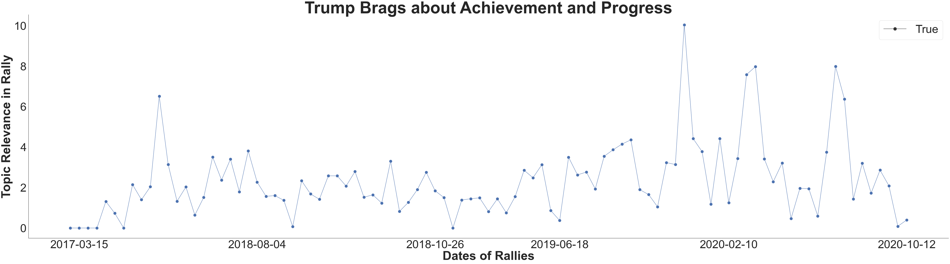
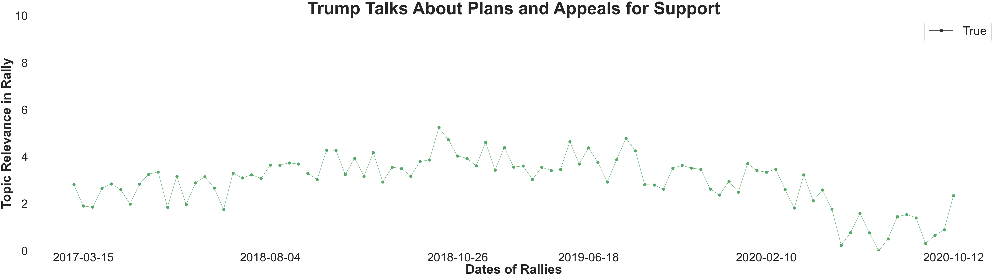
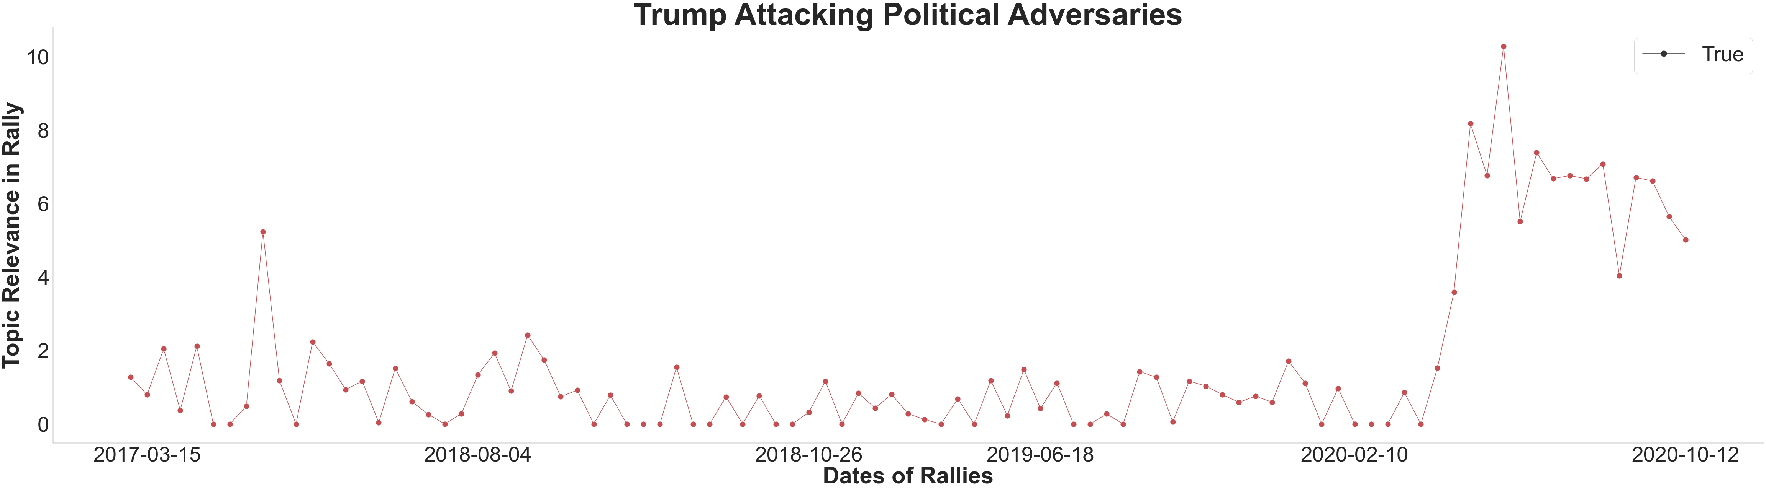
Shift in trend in topics closer to election
Less optimistic on plans and attacks more.

Slide 10
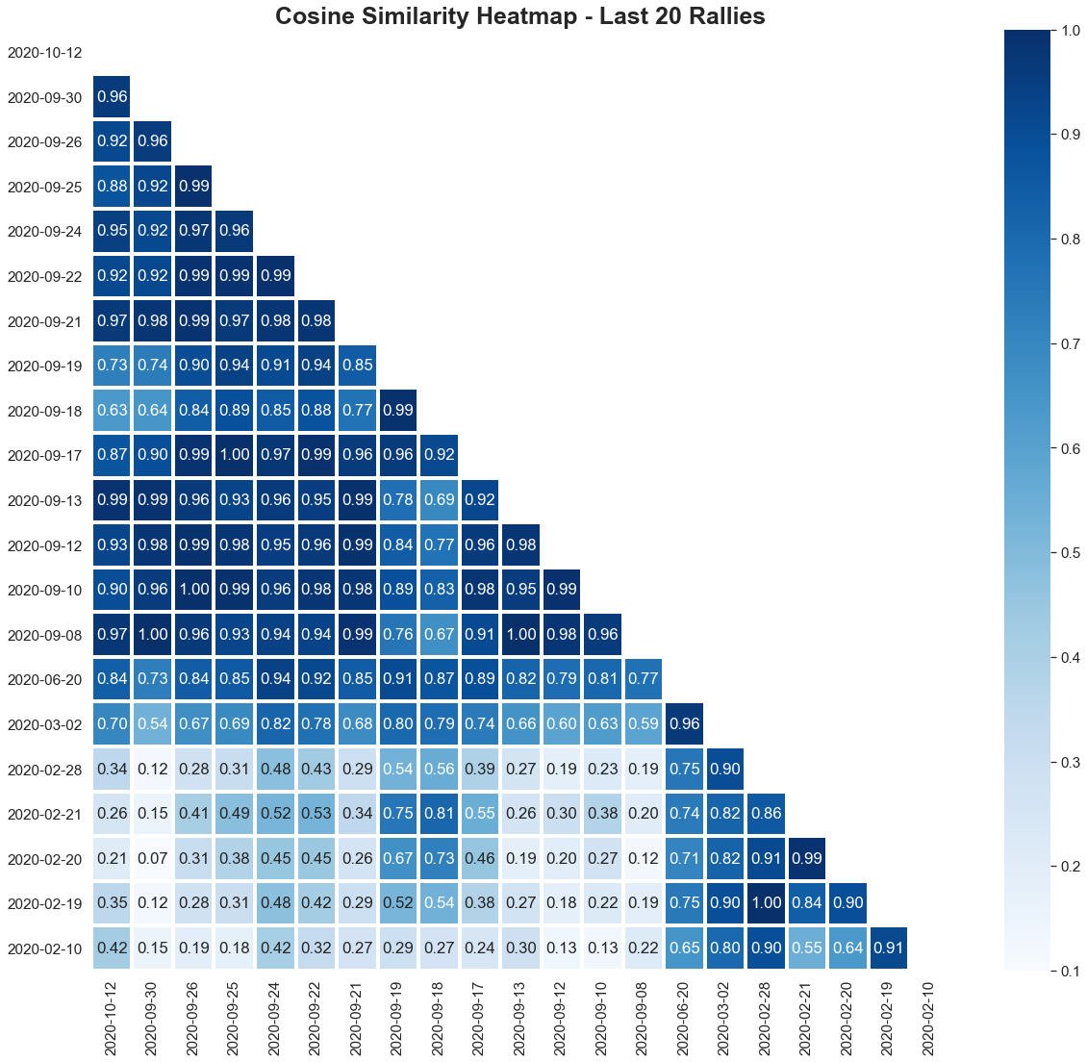
Justice Ginsburg dies 18 September
Biden crowned as Democratic nominee on 19 August
Sanders drops out 8 April
Covid-19 blows up on US in mid-March

Slide 11
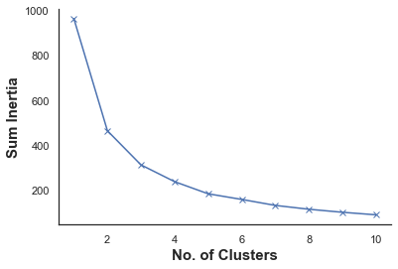
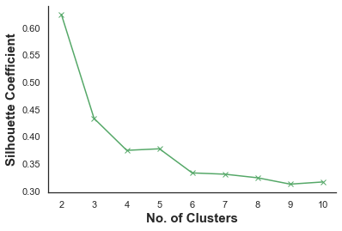
Clustering with K-means
Elbow?

Slide 12
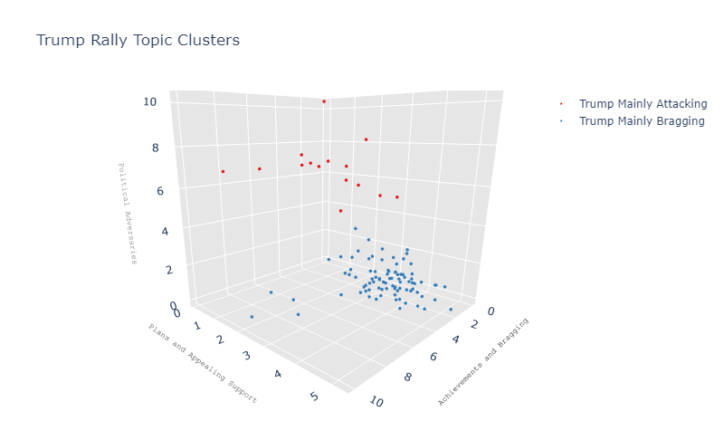
Clustering with K-means

Slide 13
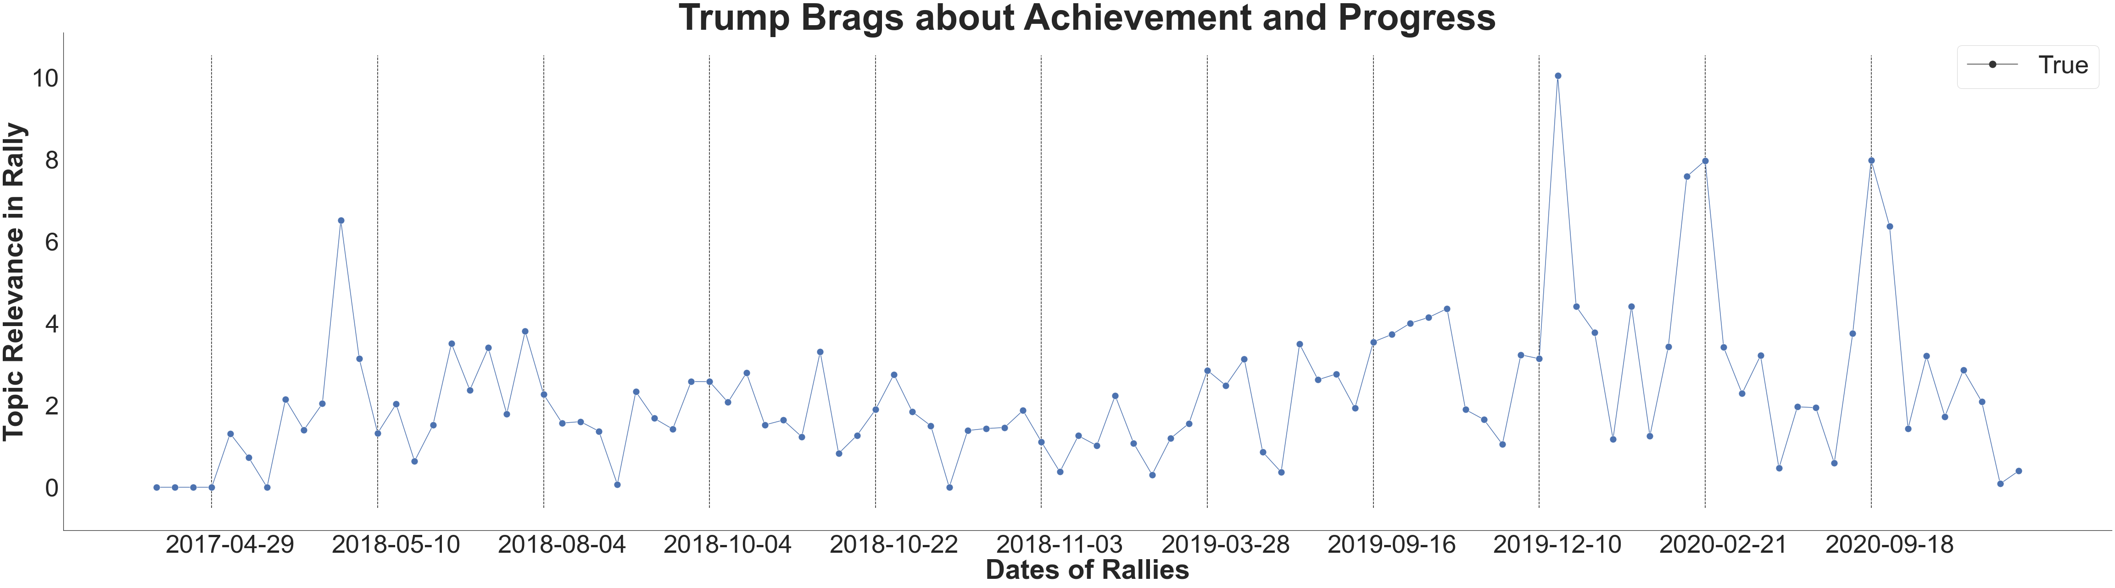
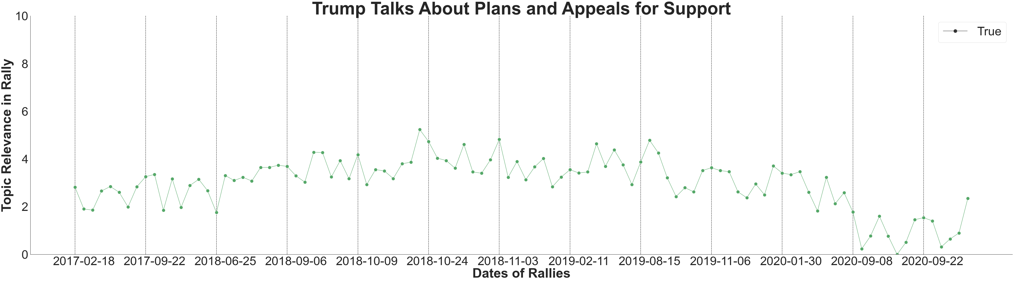
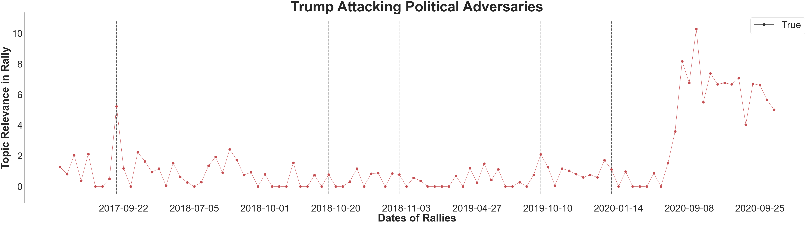
9 Rallies
Topics seem to follow periodic patterns
8 Rallies
Some topics follow trend patterns
Time Series is non-stationary
10 Rallies

Slide 14
Time Series with SARIMA
Training Set
Validation Set
Test Set
90% | 5% | 5%
After Grid Search on SARIMA Hyperparameters :
1. Achievements and Progress:
Period: 9
Trend: ‘n’
MAE = 1.77
2. Plans and Support:
Period: 8
Trend: ‘ct’
MAE = 0.60
3. Political Adversaries:
Period: 10
Trend: ‘ct’
MAE = 1.08

Slide 15
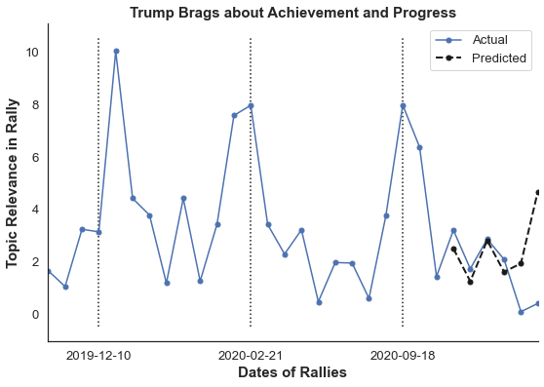
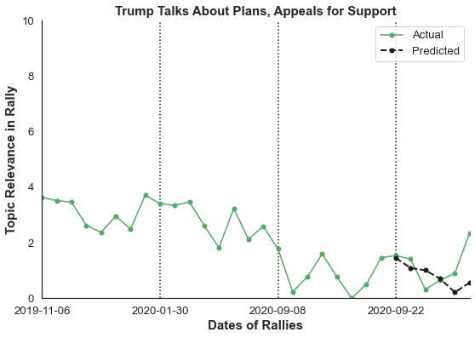
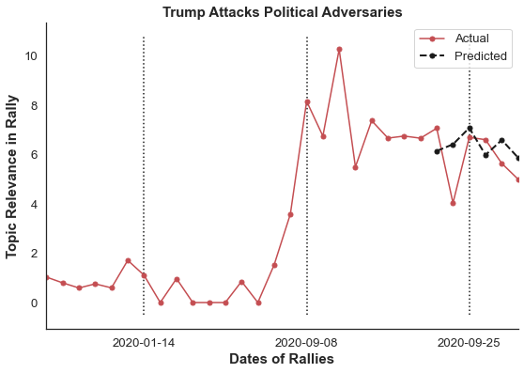
Model Evaluation
MAE = 1.30
MAE = 0.62
MAE = 1.03

Slide 16
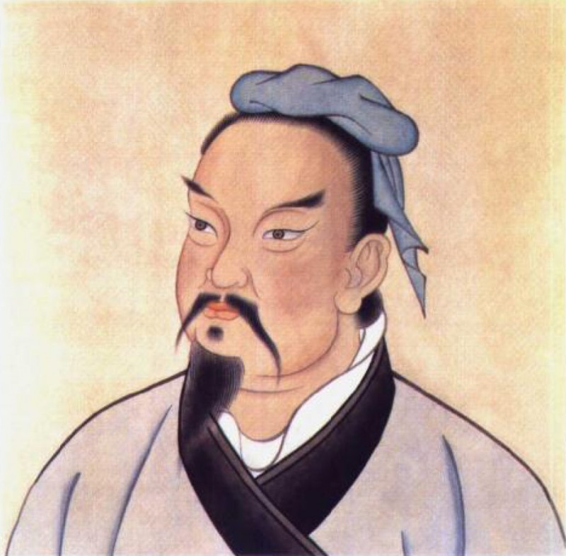
Strategy
“When strong, avoid them. If of high morale, depress them. Seem humble to fill them with conceit. If at ease, exhaust them. If united, separate them. Attack their weaknesses. Emerge to their surprise.” ― Sun Tzu

Slide 17
Strategy
Attack Trump more on periods when he is predicted to be less aggressive.
Appeal to the crowd and talks about plans when he is predicted to be more aggressive.
Play a game of cat and mouse.

Slide 18
Conclusion & Future Work
Completed exploratory data analysis on Trump’s rallies
Created a model on Trump’s topic trend for campaign strategy.
Future work may analyze Trump interviews and other speeches.
Neural networks may improve NLP and time series predictions.

Slide 19
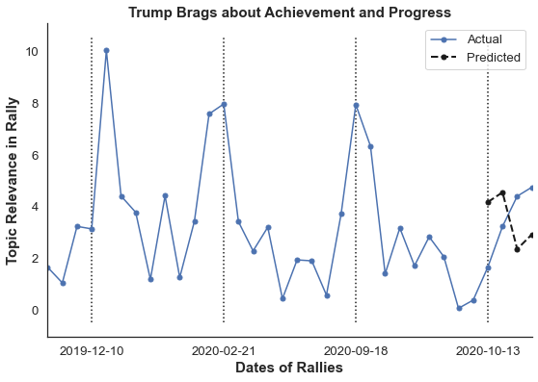
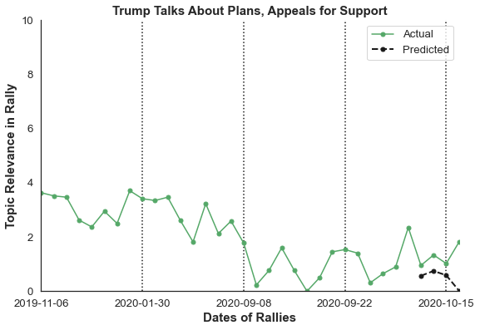
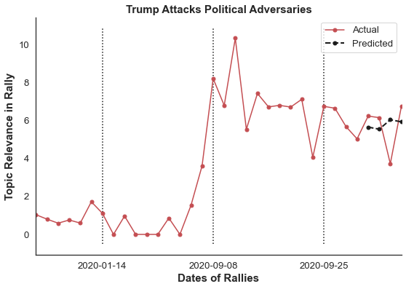
Appendix
MAE = 1.93
MAE = 0.80
MAE = 1.08

Slide 20
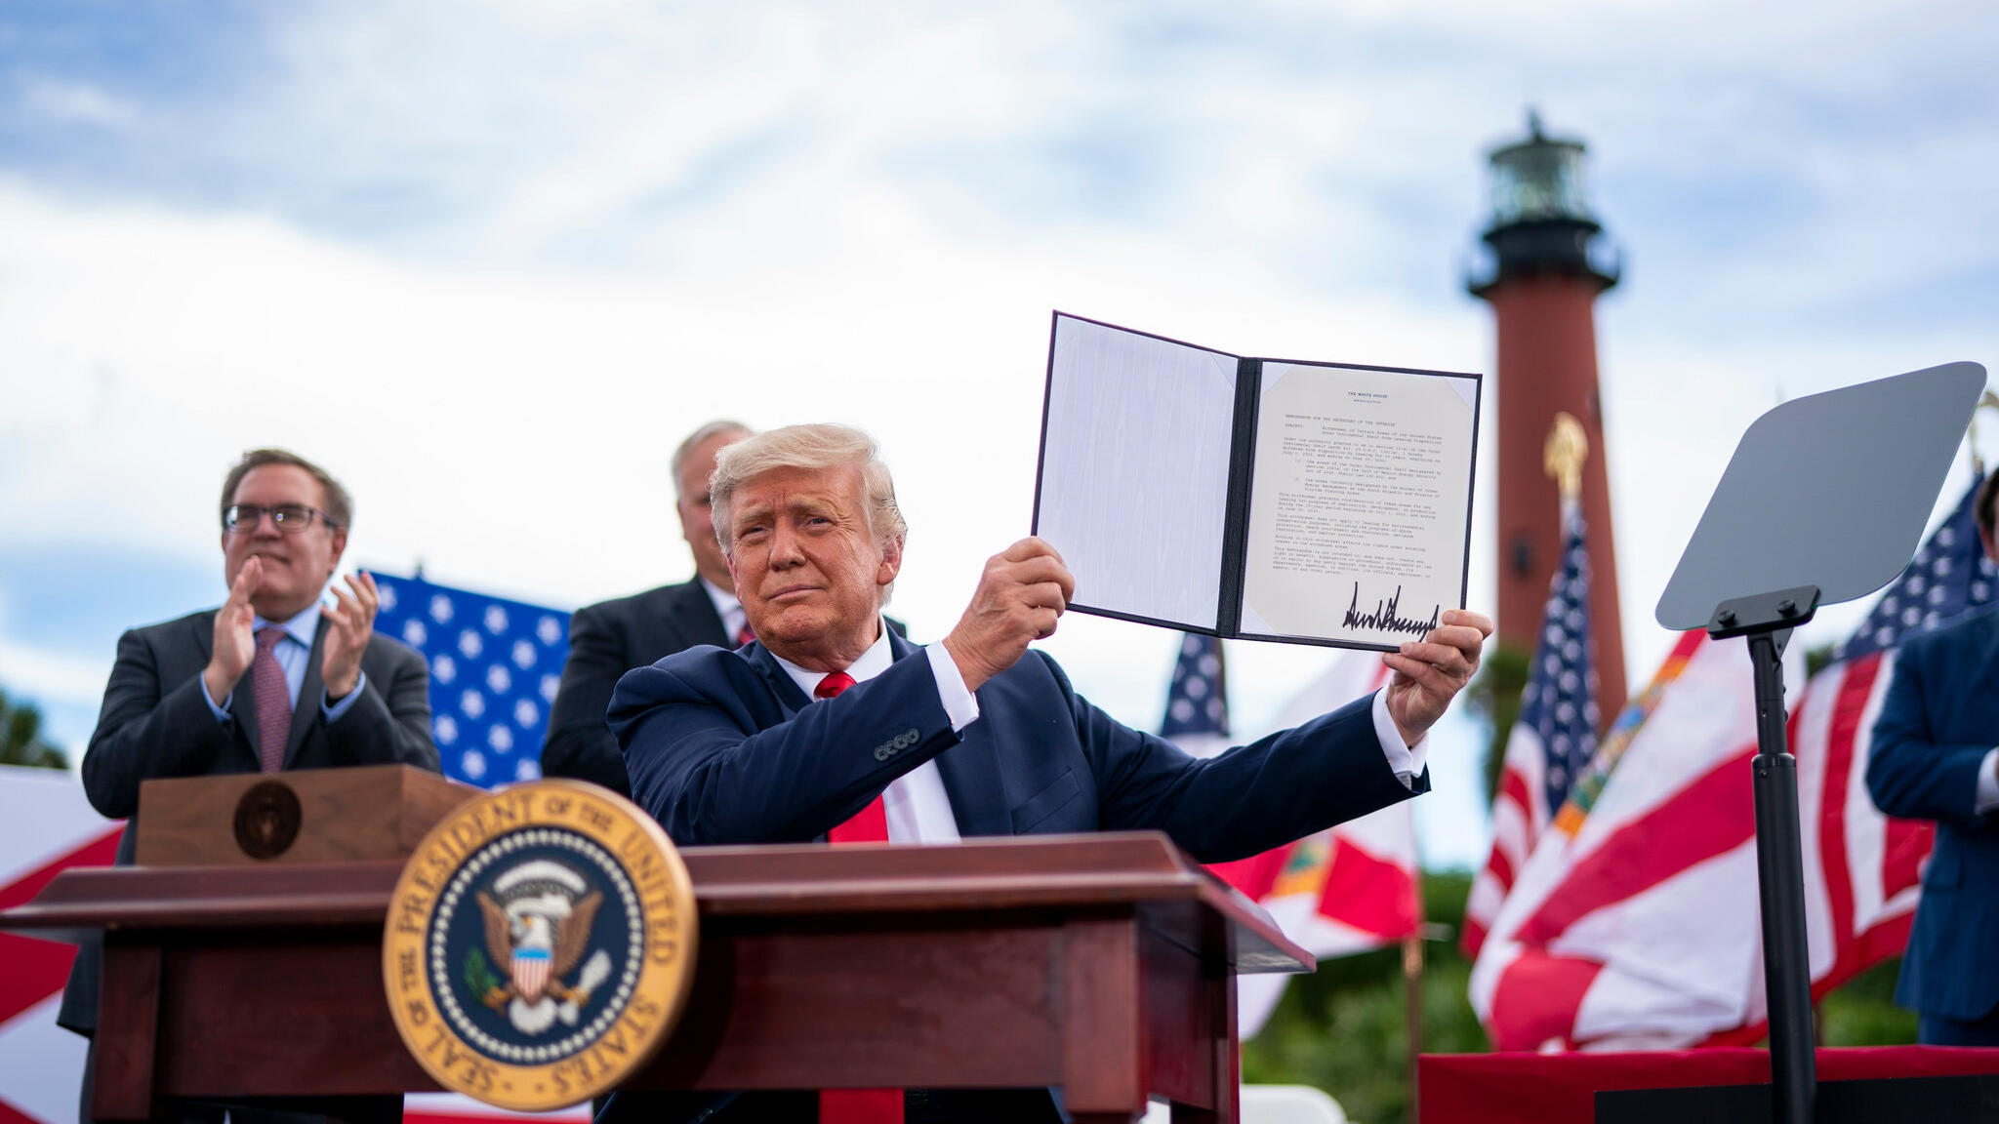
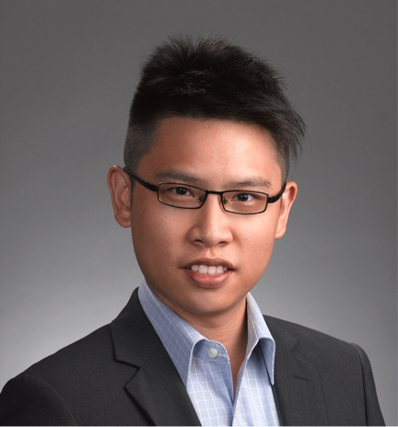
Follow me on:
LinkedIn: @tanpengshi
Medium: @tanpengshi
GitHub: @tanpengshi
Thank You!

