Slide 1
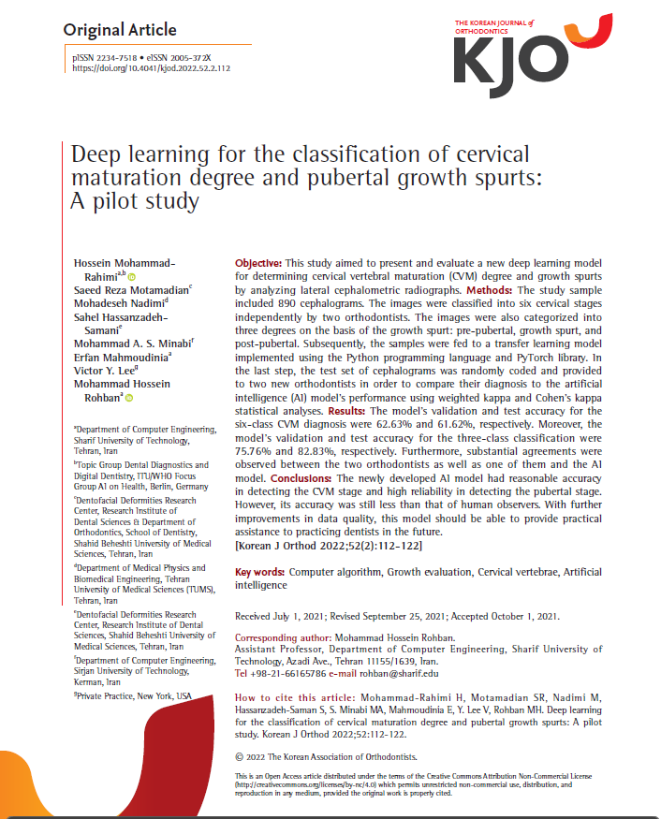
Deep learning for the classification of cervical maturation degree and pubertal growth spurts: A pilot study
Year: 2022
Journal Name: Korean Journal of Orthodontics
Scopus Quartile: Q1 Percentile: 87th
https://doi.org/10.4041/kjod.2022.52.2.112

Slide 2
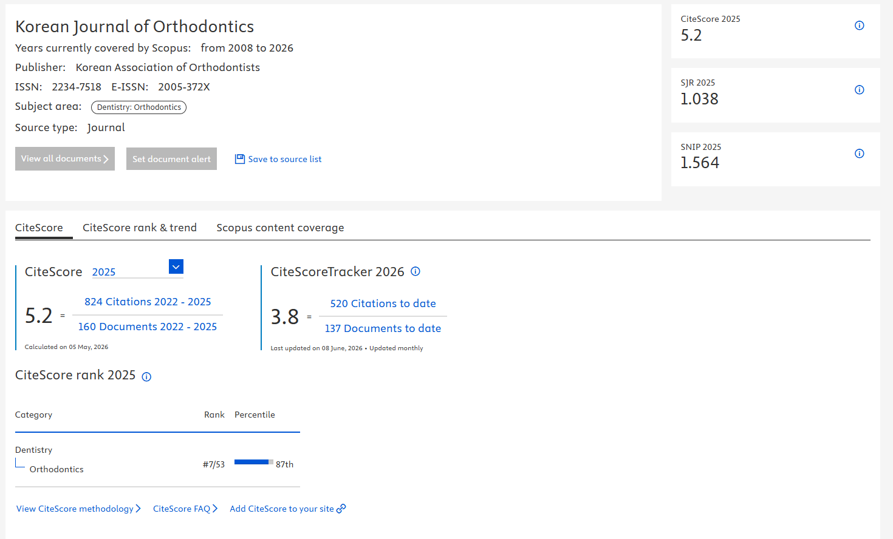
https://www.scopus.com/sourceid/19700168907#tabs=0

Slide 3
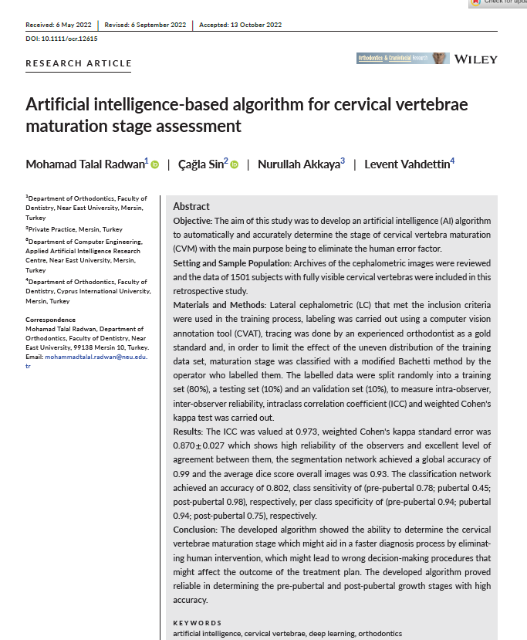
Artificial intelligence-based algorithm for cervical vertebrae maturation stage assessment
Year: 2023
Journal Name: Orthodontics & Craniofacial Research
Scopus Quartile: Q1 Percentile: 83rd, 82nd, 80th, 80th
https://doi.org/10.1111/ocr.12615

Slide 4
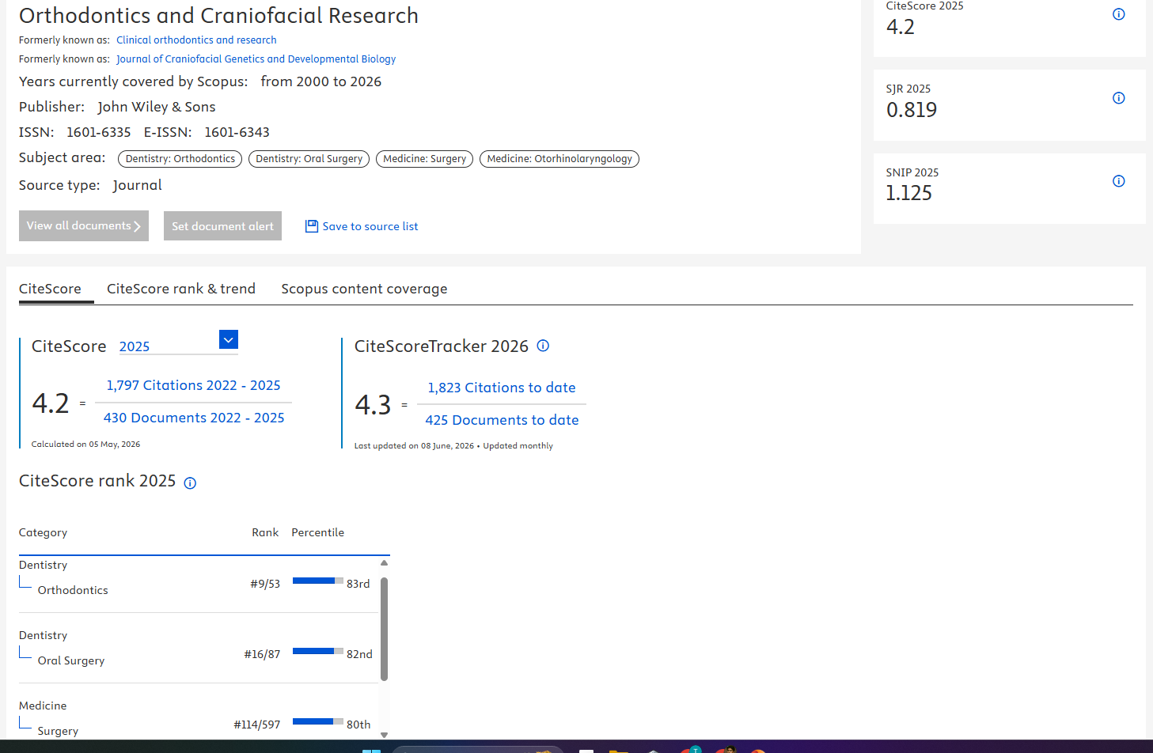
https://www.scopus.com/sourceid/22848

Slide 5
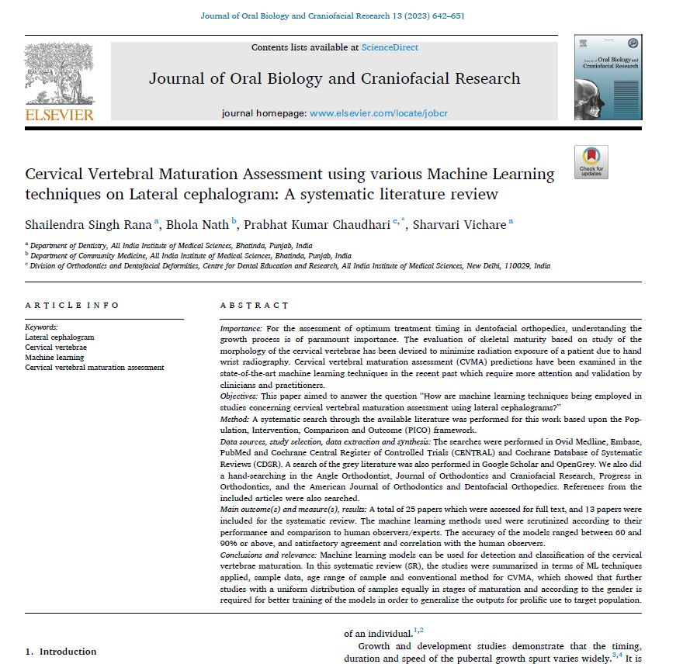
Cervical Vertebral Maturation Assessment using various Machine Learning techniques on Lateral cephalogram: A systematic literature review
Year: 2023
Journal Name: Journal of Oral Biology and Craniofacial Research
Scopus Quartile: Q1, Q2 Percentile: 79th, 72nd
https://doi.org/10.1016/j.jobcr.2023.08.005

Slide 6
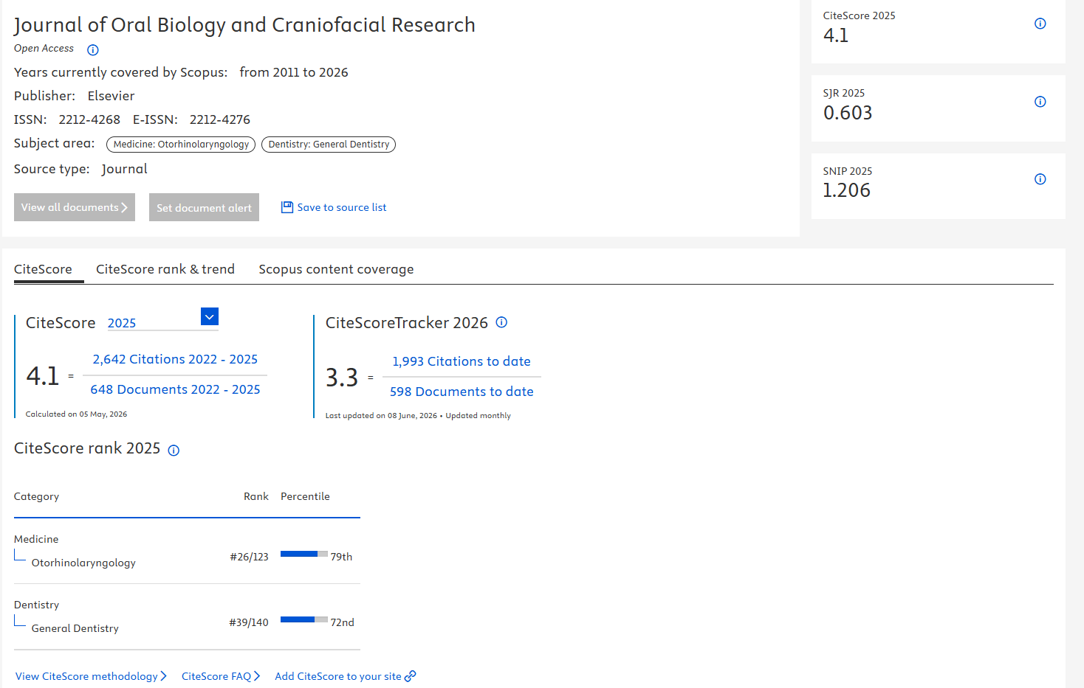
https://www.scopus.com/sourceid/21100461912

Slide 7
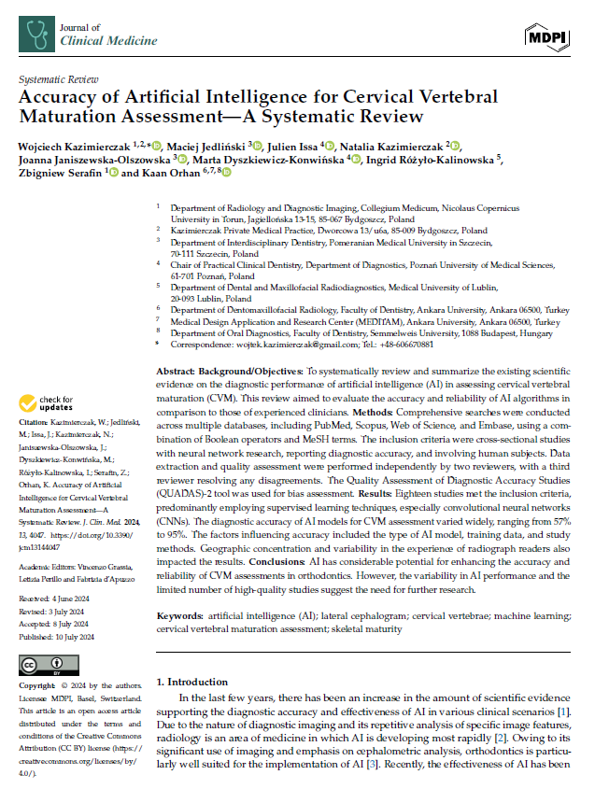
Accuracy of Artificial Intelligence for Cervical Vertebral Maturation: A Systematic Review
Year: 2024
Journal Name: Journal of Clinical Medicine
Scopus Quartile: Q1 Percentile: 86th
https://doi.org/10.3390/jcm13144047

Slide 8
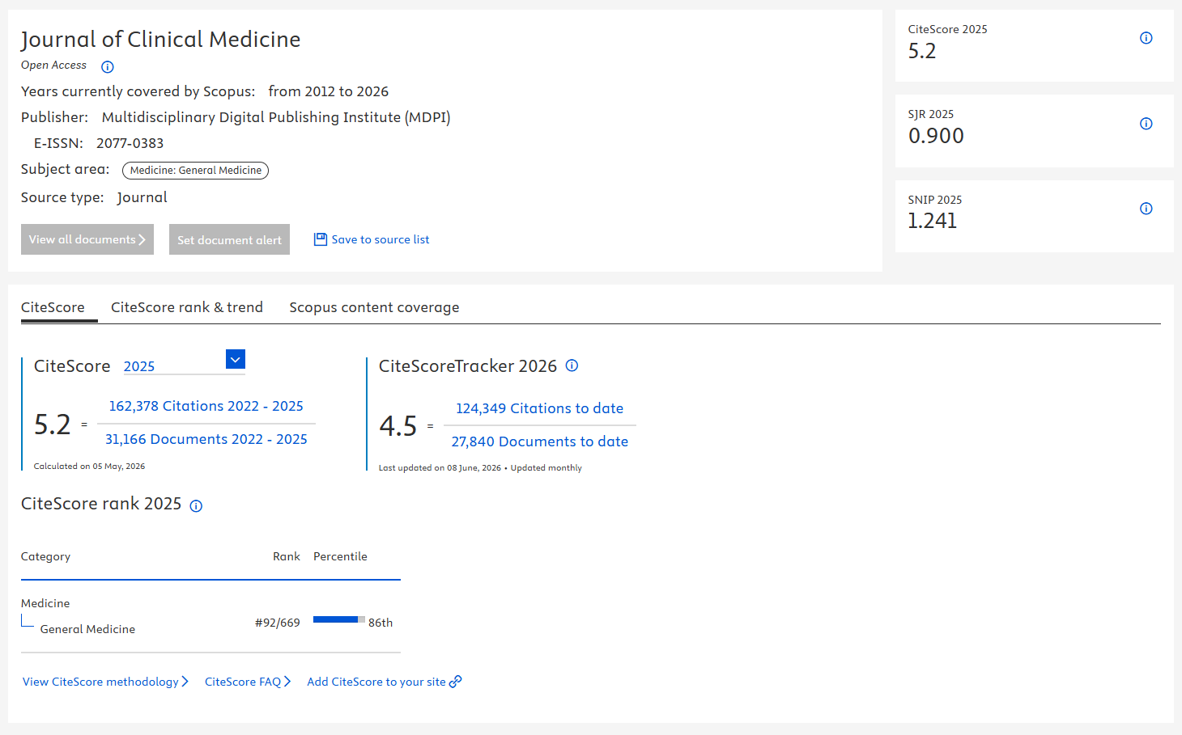
https://www.scopus.com/sourceid/21101054449

