Slide 1
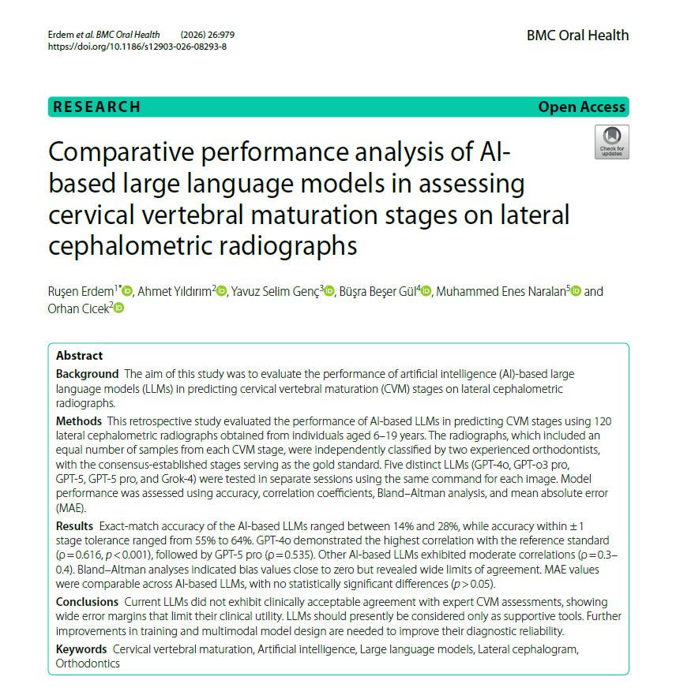
Comparative performance analysis of AI-based large language models in assessing cervical vertebral maturation stages on lateral cephalometric radiographs
Year: 2026
Journal Name: BMC Oral Health
Scopus Quartile: Q1 Percentile: 76th
https://doi.org/10.1186/s12903-026-08293-8

Slide 2
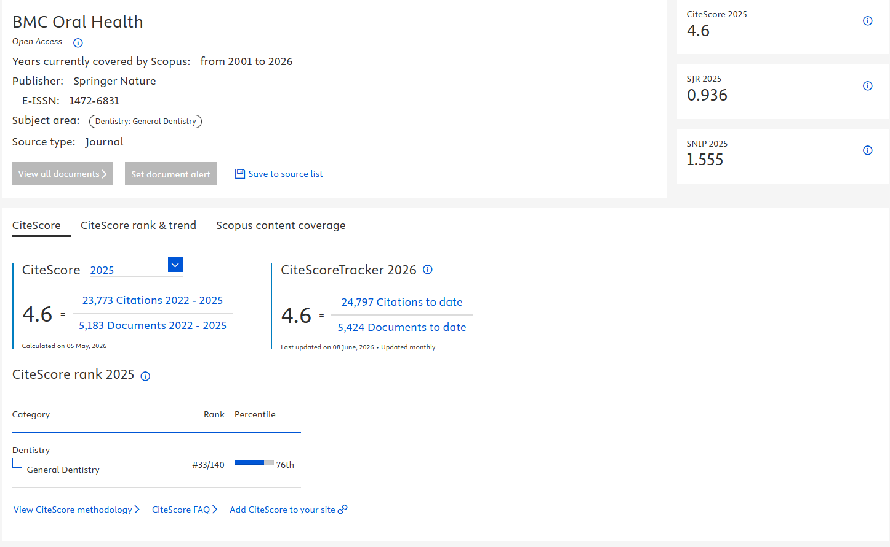
https://www.scopus.com/sourceid/24341

Slide 3
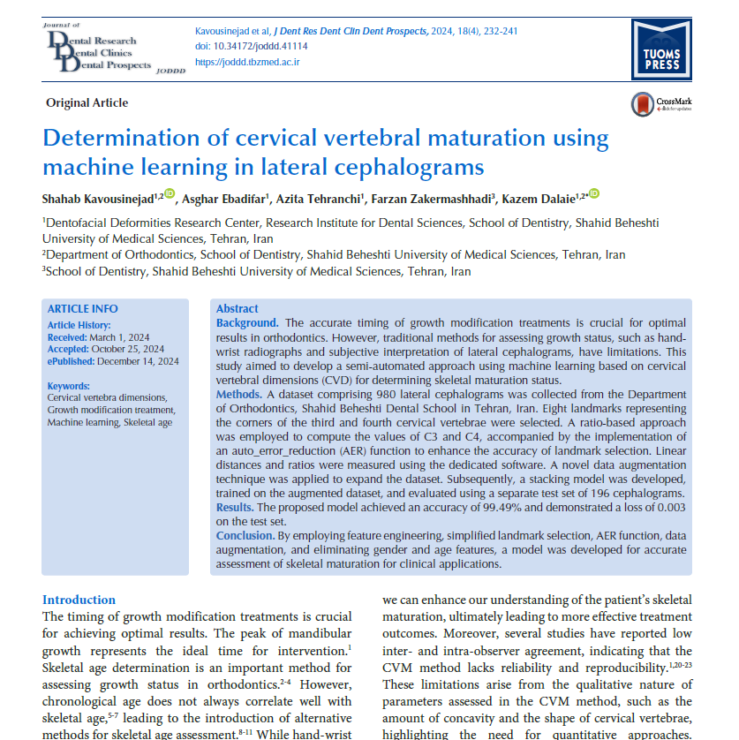
Determination of cervical vertebral maturation using machine learning in lateral cephalograms
Year: 2024
Journal Name: Journal of Dental Research, Dental Clinics, Dental Prospects
Scopus Quartile: Q3 Percentile: 43rd
https://doi.org/10.34172/joddd.41114

Slide 4
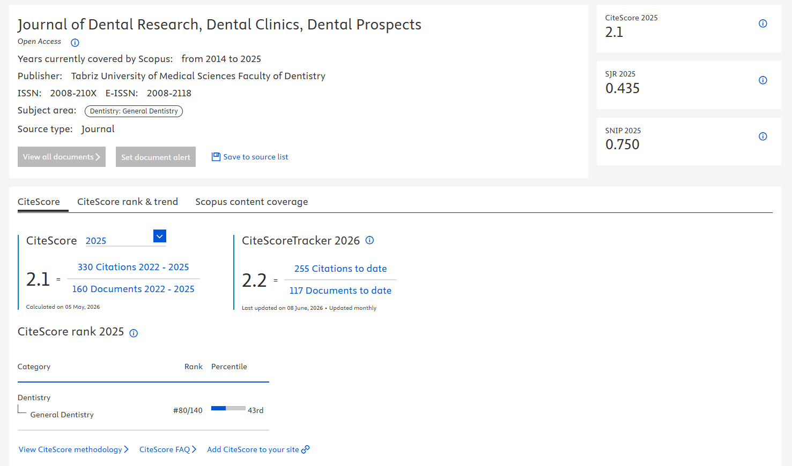
https://www.scopus.com/sourceid/21100854235

Slide 5
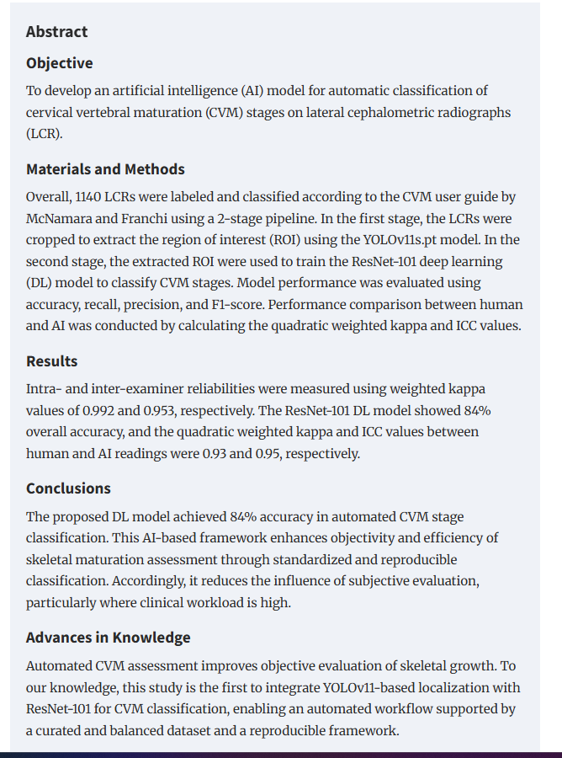
An Artificial Intelligence Model for the Automatic Classification of the Cervical Vertebral Maturation Stages
Year: 2026
Journal Name: Dentomaxillofac Radiol
Scopus Quartile: Q1 Percentile: 97th, 91st, 89th
https://doi.org/10.1093/dmfr/twag032

Slide 6
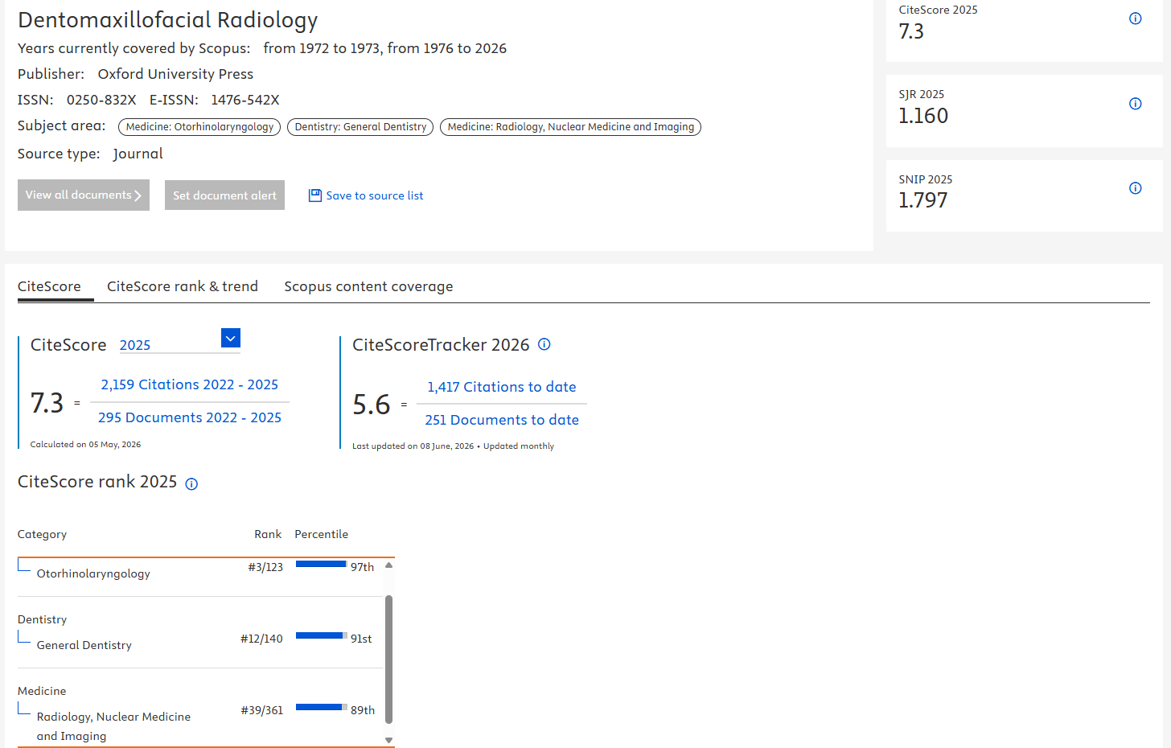
https://www.scopus.com/sourceid/16649

