Slide 1
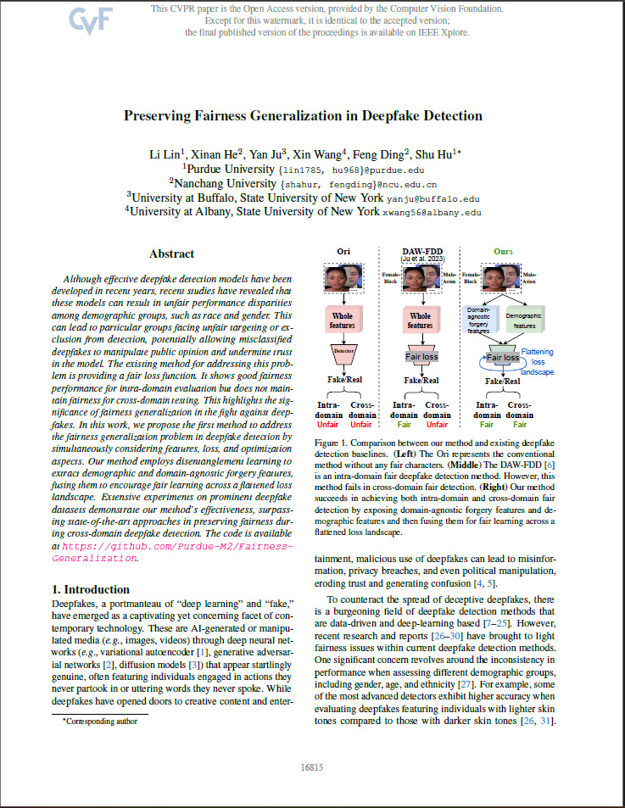
Preserving Fairness Generalization in Deepfake Detection
Year: 2024
Journal Name: Proceedings of the IEEE/CVF Conference on Computer Vision and Pattern Recognition (CVPR)
Scopus Quartile: Q1 Percentile: 99th, 99th
https://doi.org/10.48550/arXiv.2402.17229
https://github.com/Purdue-M2/Fairness-Generalization

Slide 2
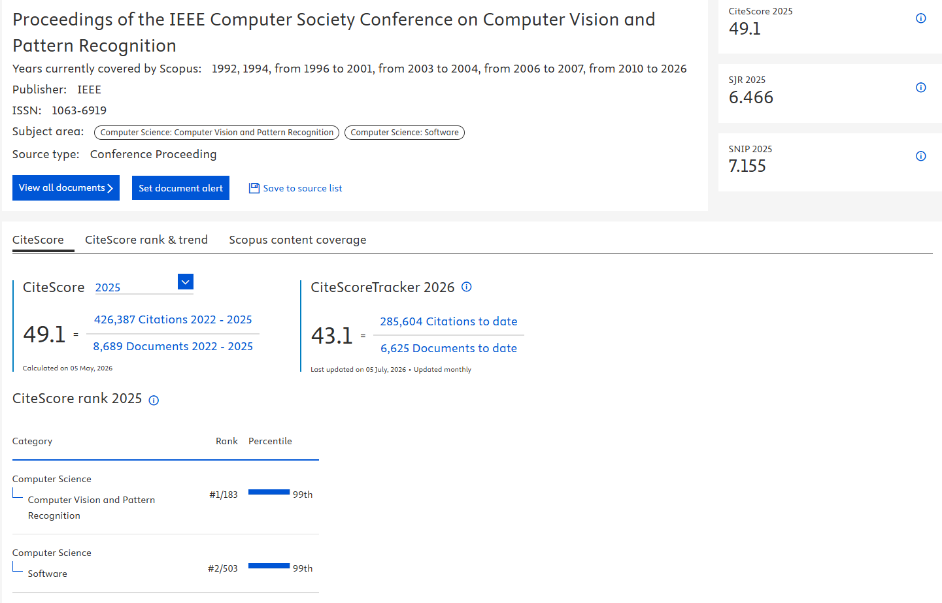
https://www.scopus.com/sourceid/24212

Slide 3
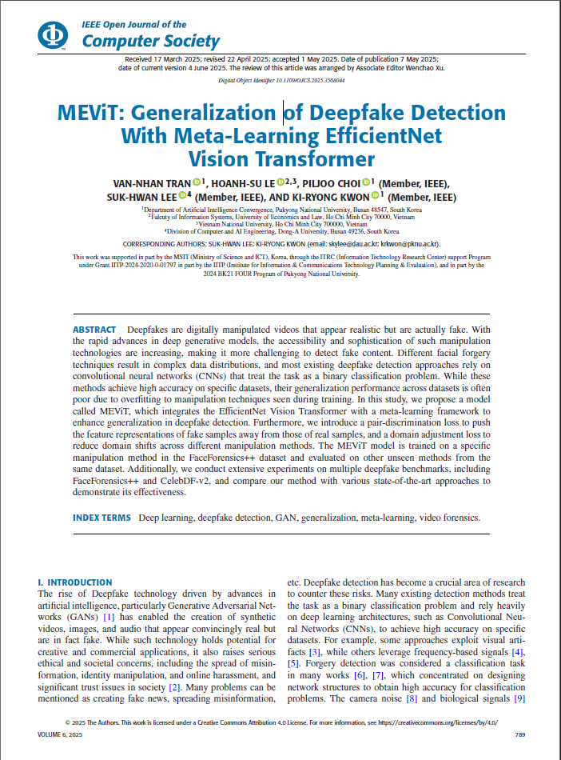
MEViT: Generalized Meta‑Learning EfficientNet Vision Transformer Model for Deepfake Detection
Year: 2024
Journal Name: IEEE Open Journal of the Computer Society
Scopus Quartile: Q1 Percentile: 85th
https://doi.org/10.1109/OJCS.2025.3568044

Slide 4
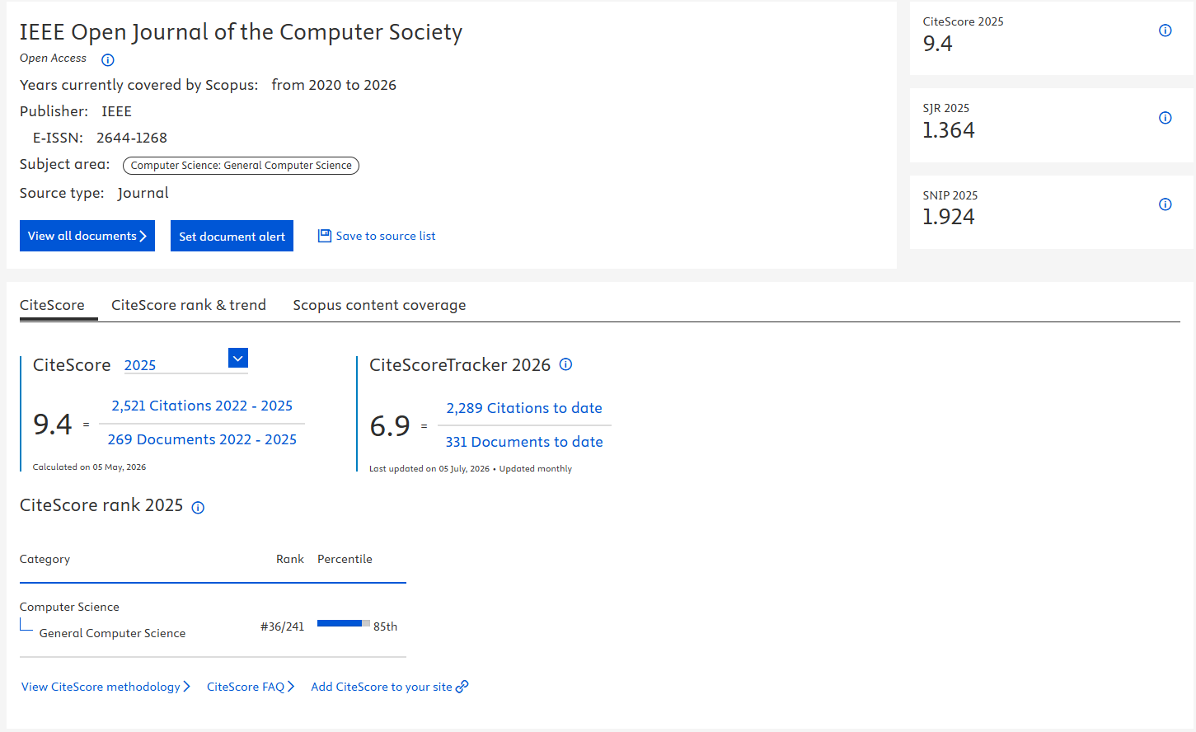
https://www.scopus.com/sourceid/21101132925

Slide 5
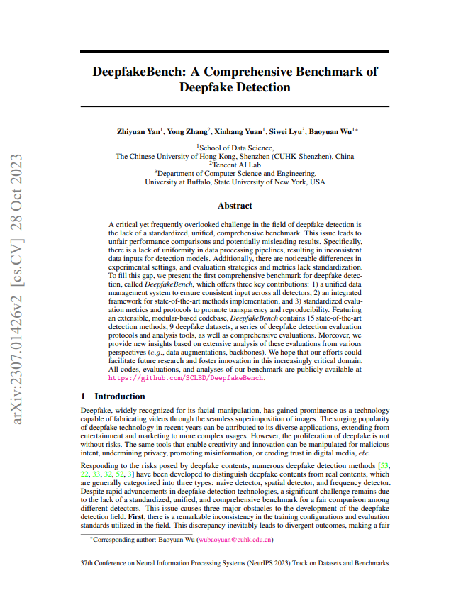
DeepfakeBench: A Comprehensive Benchmark of Deepfake Detection
Year: 2023
Journal Name: Neural Information Processing Systems
Scopus Quartile: Q1 Percentile: 98th, 97th, 97th
https://doi.org/10.48550/arXiv.2307.01426
https://github.com/SCLBD/DeepfakeBench

Slide 6
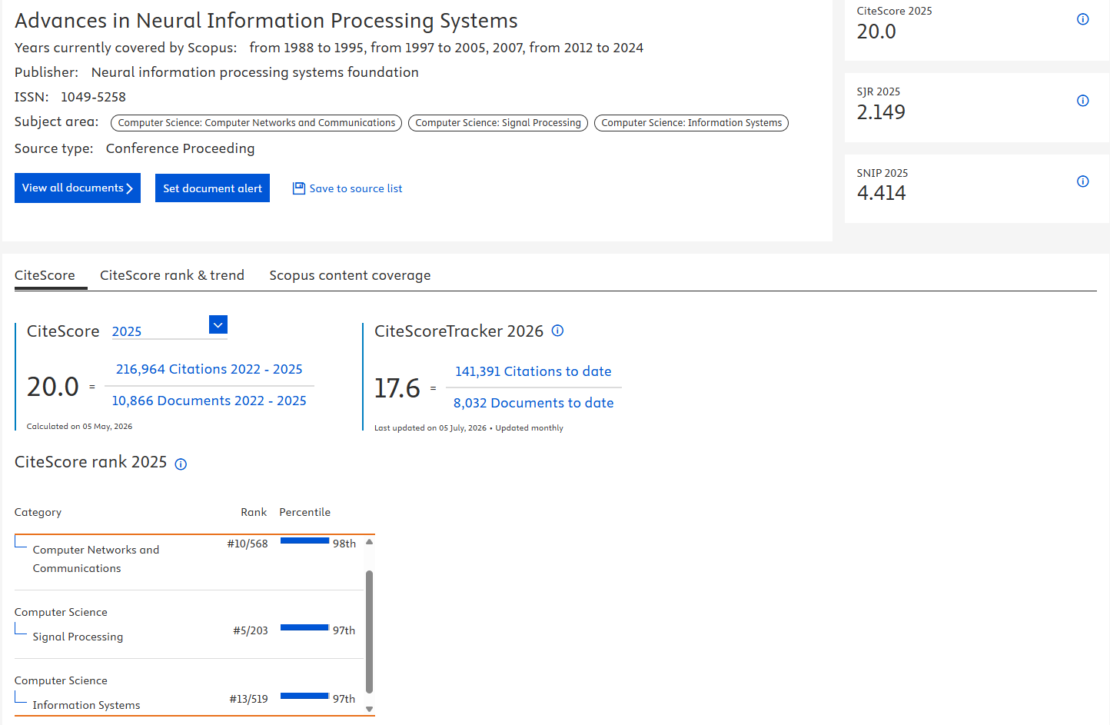
https://www.scopus.com/sourceid/23669

Slide 7
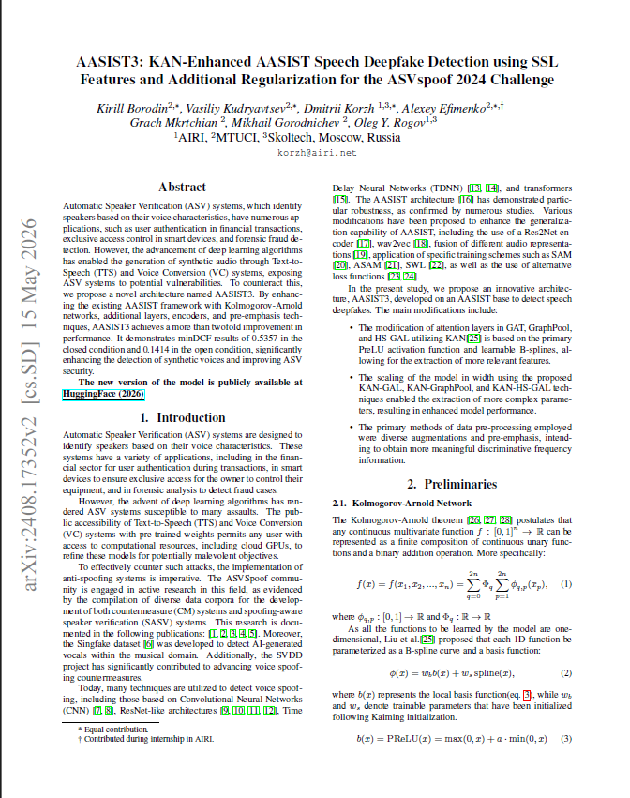
AASIST3: KAN-Enhanced AASIST Speech Deepfake Detection using SSL Features and Additional Regularization for the ASVspoof 2024 Challenge
Year: 2024
Journal Name: the ASVspoof 2024 (the 25th Interspeech Conference)
Scopus Quartile: Q1, Q2, Q3 Percentile: 92nd, 72nd, 65th, 56th, 45th
https://doi.org/10.48550/arXiv.2408.17352
https://huggingface.co/lab260/Spectra-AASIST3

Slide 8
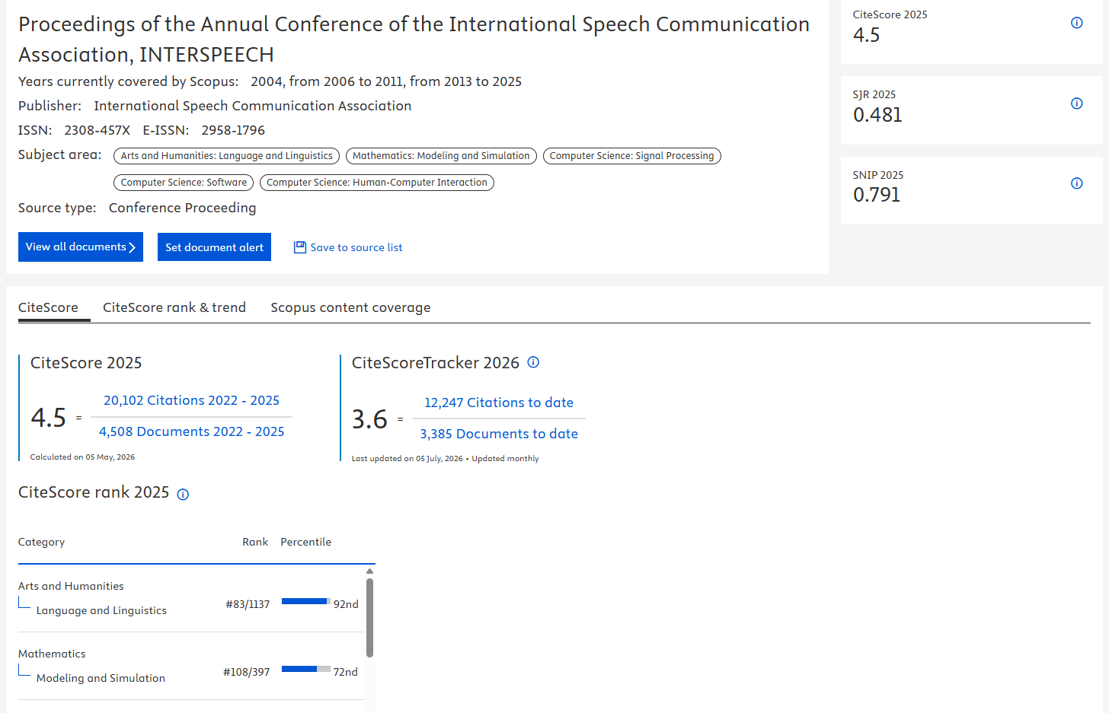
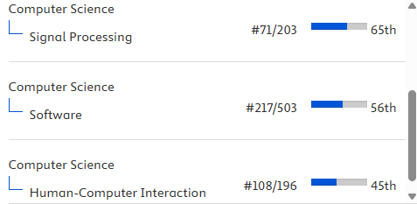
https://www.scopus.com/sourceid/21100212301

Slide 9
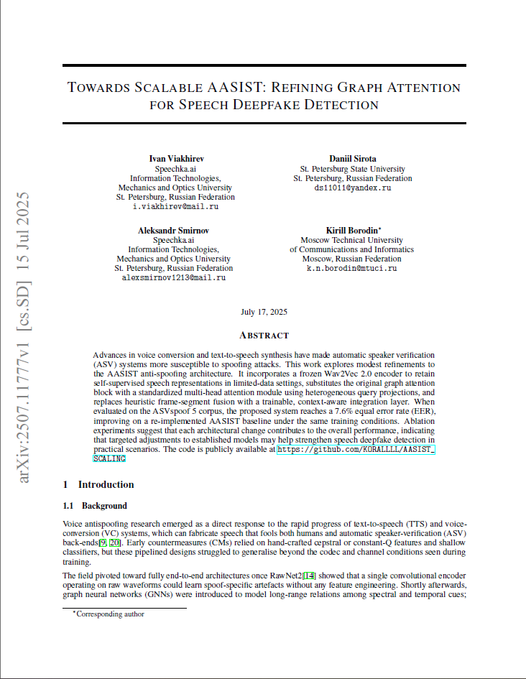
Towards Scalable AASIST: Refining Graph Attention for Speech Deepfake Detection
Year: 2025
Journal Name: arXiv preprint (Peer Review)
Scopus Quartile: None Percentile: None
https://doi.org/10.48550/arXiv.2507.11777
https://github.com/KORALLLL/AASIST_SCALING

Slide 10
Deepfake Detection that Generalizes Across Benchmarks
Year: 2026
Conference: Proceedings of the IEEE/CVF Winter Conference on Applications of Computer Vision
Scopus Quartile: None Percentile: None
https://doi.org/10.1109/WACV61042.2026.00082
https://github.com/yermandy/GenD

