Slide 1



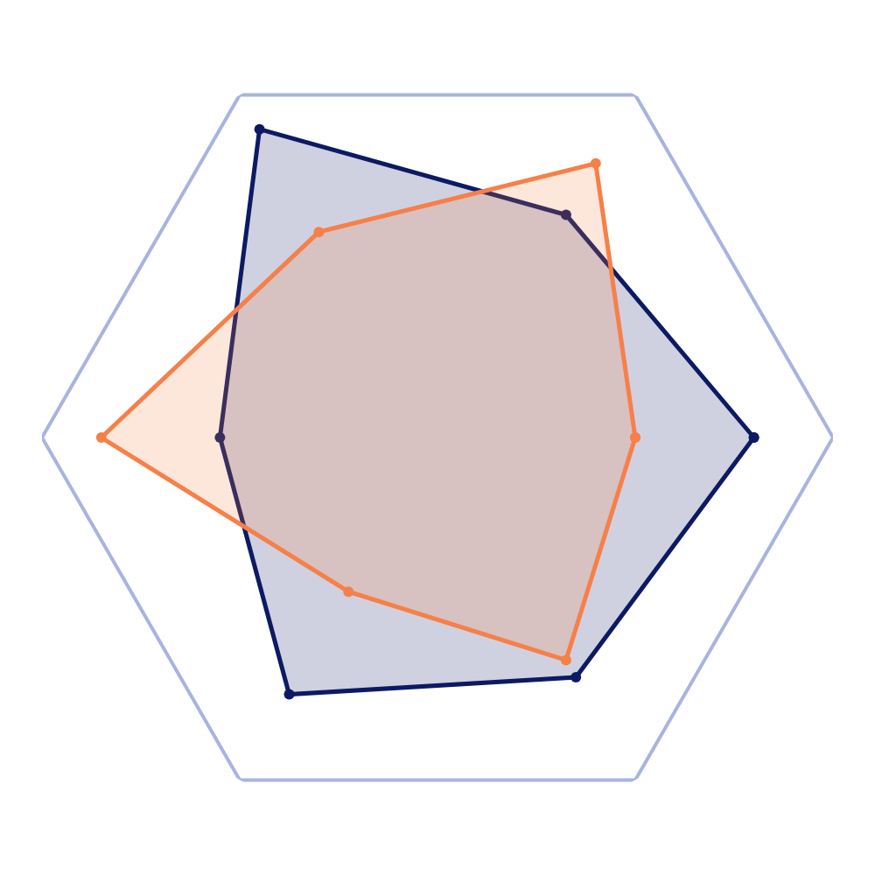
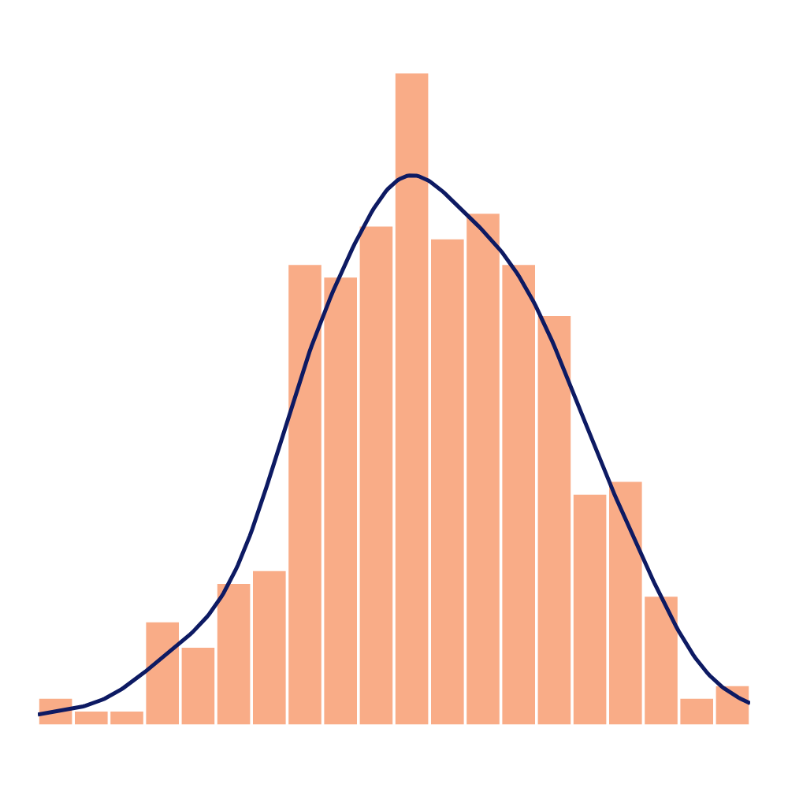
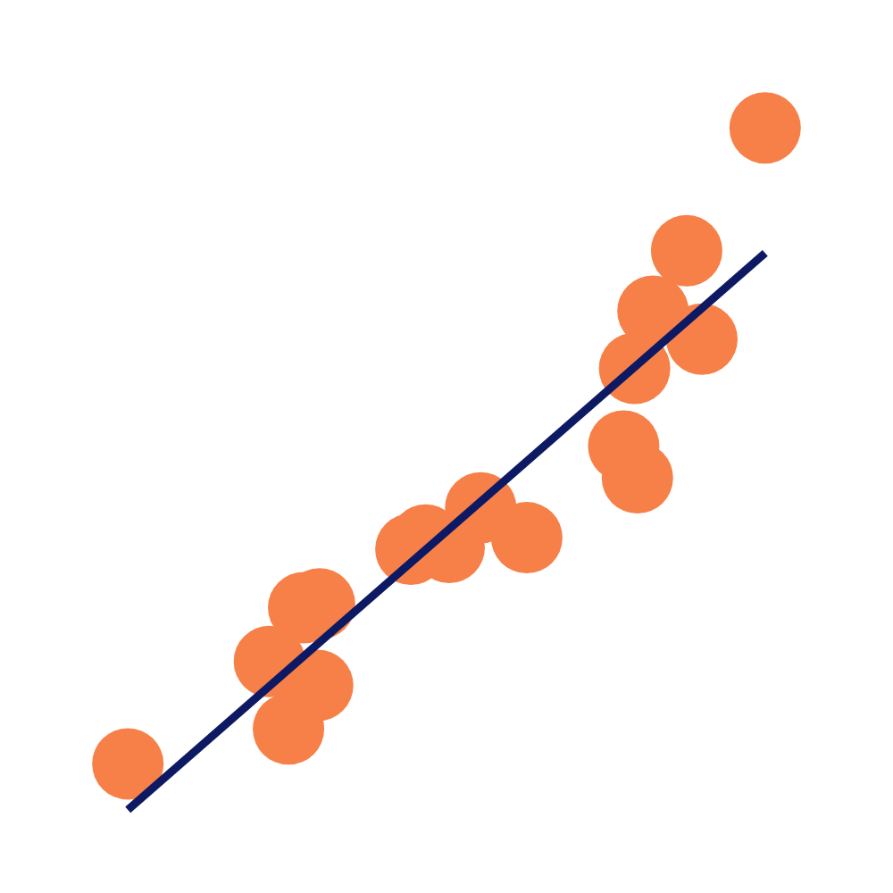
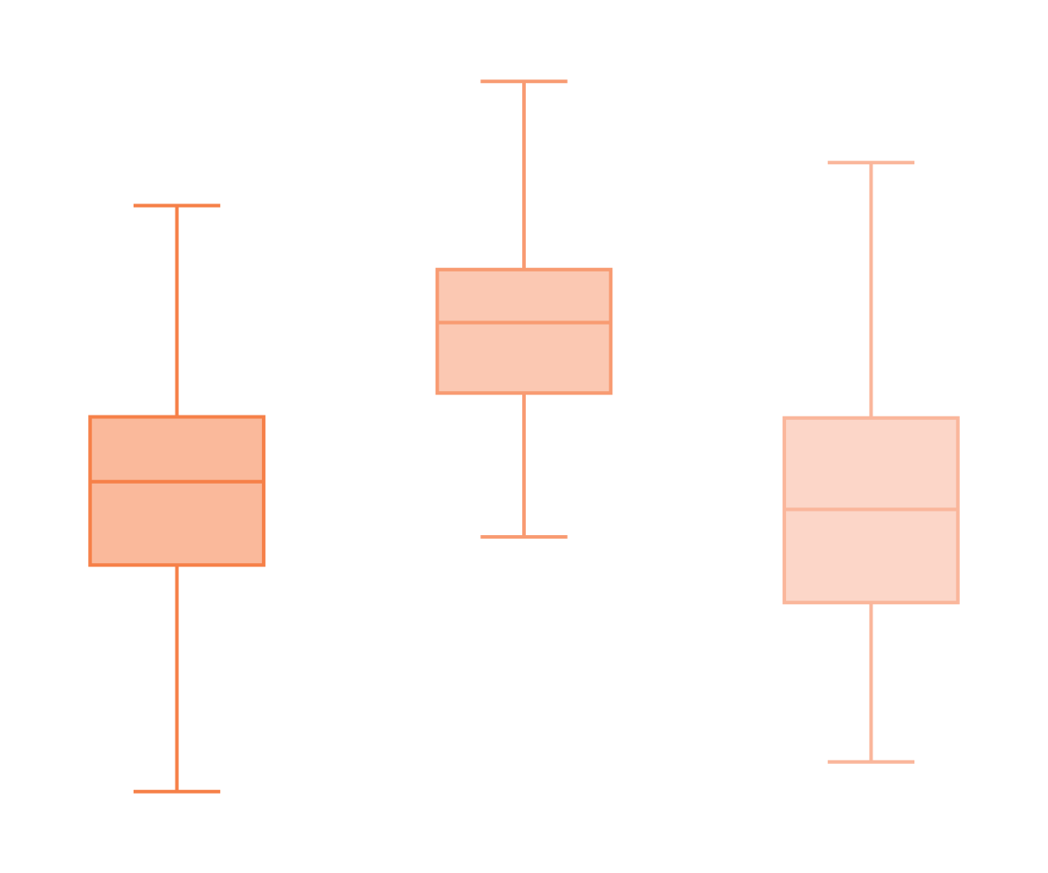







PICTOGRAM
BAR
LINE
RADAR
Discrete
Discrete
Continuous
Discrete
Continuous
OF CATEGORIES
OVER TIME
SCATTER
Continuous
2 VARIABLES
COMPARISON
Continuous
HISTOGRAM
What would you like to show?
RELATIONSHIP
DISTRIBUTION
3 VARIABLES (Continuous)
Discrete
BOX & WHISKERS
BUBBLE
COMPOSITION
STATIC (Discrete or Continuous)
OVER TIME
ABSOLUTE DIFFERENCE
RELATIVE DIFFERENCE
SIMPLE
COMPARE SEVERAL
Discrete
Continuous
Discrete
Continuous
STACKED COLUMN
STACKED AREA
100% ST. COLUMN
100% ST. AREA
DONUT
TREE MAP

Slide 2
THE FOUR TYPES OF VISUAL
DECLARATIVE
Idea Illustration
Everyday
Visualisation
DATA-DRIVEN
CONCEPTUAL
Idea Generation
Visual Discovery
EXPLORATORY

Slide 3
Single Series
Two Series
Multiple Series

Slide 4
Stacked bar chart

Slide 5
Single Series
Two Series
Multiple Series

Slide 6
Survey Results
Strongly Disagree | Disagree | Neutral | Agree | Strongly Agree

Slide 7
86% OF OUR STUDENTS PASS THE DRIVING TEST IN ONE ATTEMPT
Driving test passed by number of attempts
86%
3 attempts or more | 2 attemps | one attemp

Slide 8
86% OF OUR STUDENTS PASS THE DRIVING TEST IN ONE ATTEMPT
Driving test passed by number of attempts
86%
3 attempts or more | 2 attemps | one attemp

Slide 9
86% OF OUR STUDENTS PASS THE DRIVING TEST IN ONE ATTEMPT
Driving test passed by number of attempts

Slide 10
Federal Funds Effective Rate
Basic points

Slide 11
ASIA ACCOUNTS FOR MORE THAN 50% OF THE WORLD POPULATION THROUGH OUT HISTORY
World poluation of continents and major countries by time

Slide 12
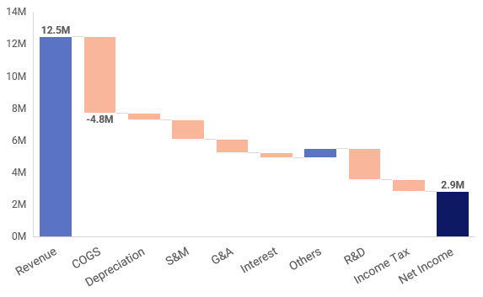
DIRECT COSTS CONSUMED 38% OF REVENUE.
Profit and loss for the FY 2020
Milions USD

