Slide 1
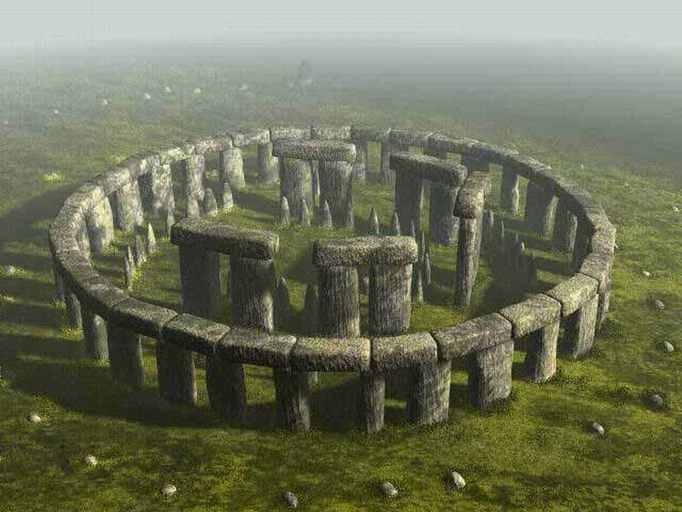
SNAKE
Develop by StoneHenge team

Slide 2
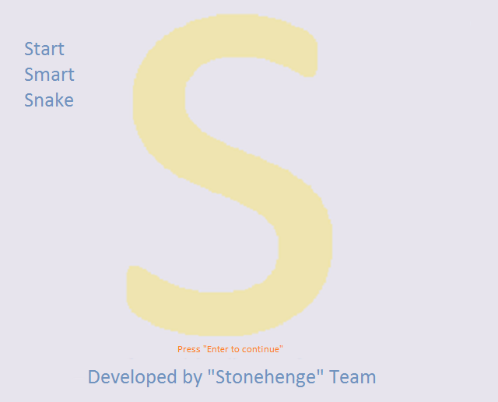
SNAKE
Introduction
It is a well know game that all we played!
In our version of the game, player can rule the direction of the snake with the arrow keys. every time it eat an red apple, snake grows a step and a rotten(black) apple appear on a random position.
Player need to escape the rotten apples and the borders of the canvas.
The speed of the snake rising with the level to hardness.
Player have an option to save his best score.

Slide 3
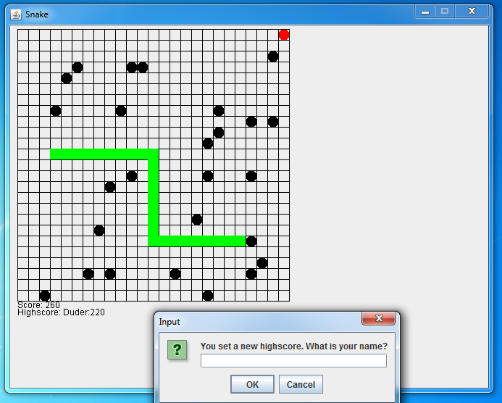

Slide 4
TEAM STONEHeNG
Members
Aneta Marinova
Angel Djambazov
Ivan Krastev
Adelina Yanakieva
Petar Kanev
Tanya Delcheva
Used materials: BrandonioProduction combined with personal improvements.
All the members had improvements to make it interesting !
Enjoy it!

