Slide 1
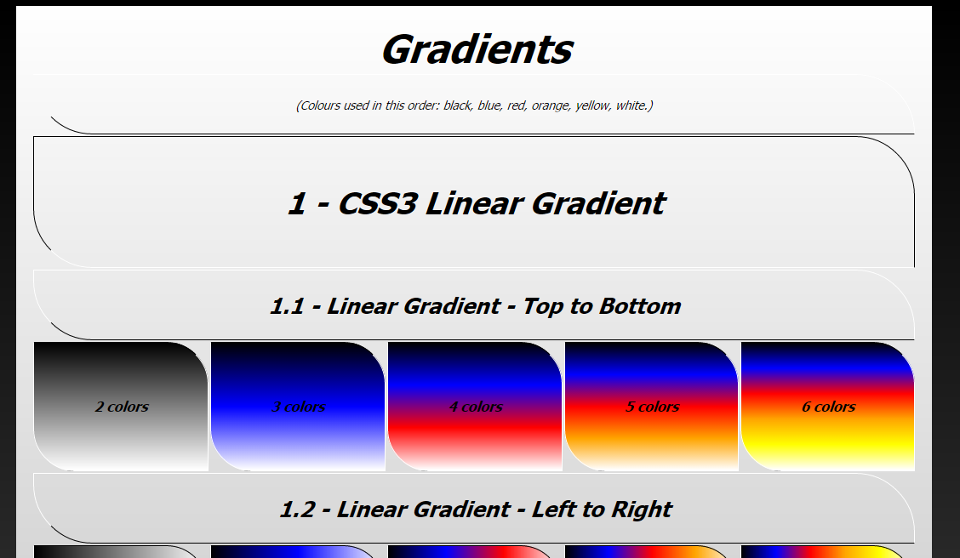
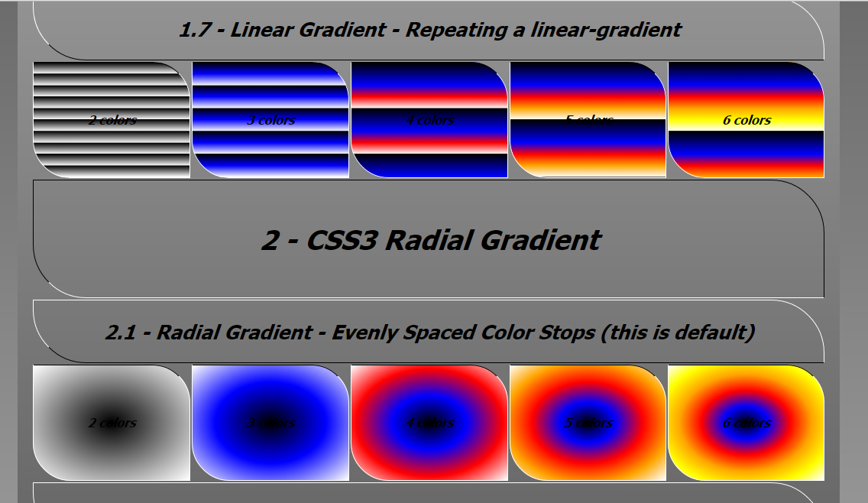
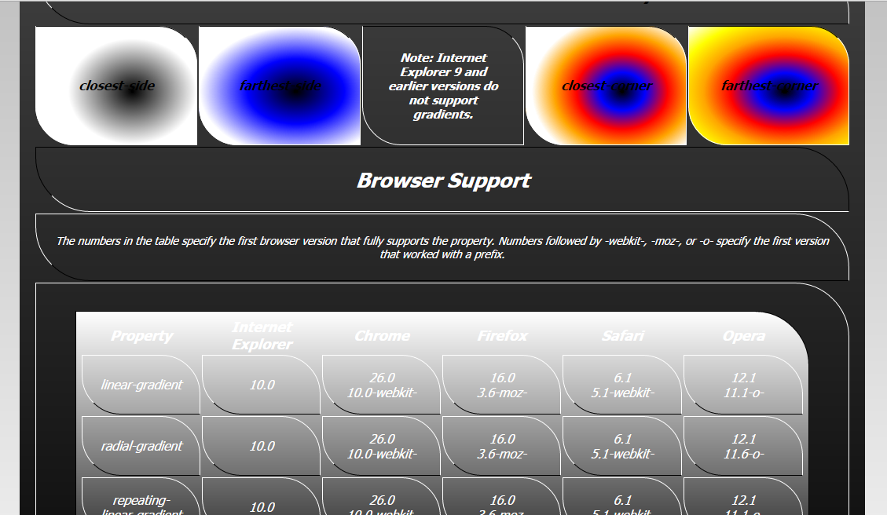
Gradients

Slide 2
Top of page

Slide 3
Various combinations of colors in the various types of gradients

Slide 4
Browser Support

