Slide 1
Introduction to Transformer
Quang Duong

Slide 2
Recurrent Neural Networks (RNN)
Y1
Y2
Y3
YN
State <0>
RNN
RNN
RNN
RNN
X1
X2
X3
XN
Time step 1
Time step 2
Time step 3
Time step N

Slide 3
Problem with RNN (among others)
Slow computation for long sequences
Vanishing or exploding gradients
Difficulty in accessing information from long time ago

Slide 4
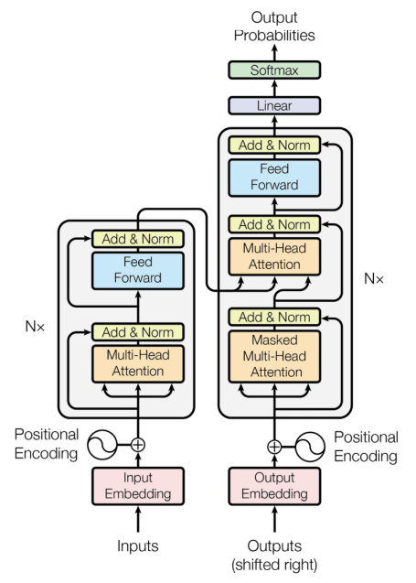
Introducing the Transformer

Slide 5
Notations
Input matrix (sequence, dmodel)

Slide 6
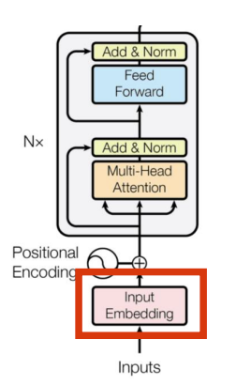
Encoder
Embedding

Slide 7
What is an input embedding?
Original sentence
(token)
This
team
is
the
best
team
Input IDs
(position in the vocabulary)
206
3154
5682
652
826
3154
164.278
523.41
452.716
7745.984
941.625
523.41
Embedding
(vector of size 512)
631.652
1265.142
6234.624
1314.124
6394.531
1265.142
…
…
…
…
…
…
541.461
4189.251
412.414
65.764
3452.945
4189.251
3.421
16.4165
1794.127
1543.345
1643.166
16.4165

Slide 8
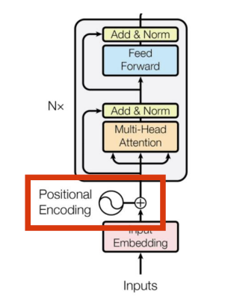
Encoder
Positional Encoding

Slide 9
What is positional encoding?
We want each word to carry some information about its position in the sentence
We want the model to treat words that appear close to each other as ‘close’ and words that are distant as ‘distant’
We want the positional encoding to represent a pattern that can be learned by the model

Slide 10
Original sentence
(token)
This
team
is
the
best
team
Input IDs
(position in the vocabulary)
206
3154
5682
652
826
3154
164.278
523.415
452.716
7745.984
941.625
523.415
Embedding
(vector of size 512)
631.652
1265.142
6234.624
1314.124
6394.531
1265.142
…
…
…
…
…
…
541.461
4189.251
412.414
65.764
3452.945
4189.251
3.421
16.416
1794.127
1543.345
1643.166
16.416
+
+
+
+
+
+
Positional Embedding
(vector of size 512). Only computed once and reused for every sentence during training and inference
…
…
4165.042
…
...
5134.245
…
6234.176
…
…
…
7469.514
…
…
…
…
…
…
…
2177.235
…
…
…
6318.419
…
7412.246
…
…
…
6899.659
=
=
=
=
=
=
Encoder Input
(vector of size 512)
…
4688.457
…
…
...
5657.660
…
7499.318
…
…
…
8734.656
…
…
…
…
…
…
…
6366.486
…
…
…
10507.670
…
7428.662
…
…
…
6916.075

Slide 11
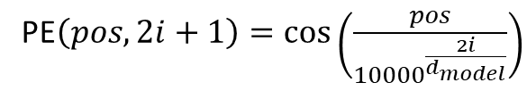
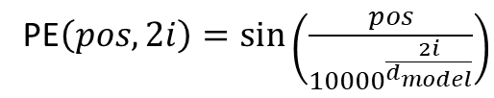
What is positional encoding?
Sentence 1
This
team
is
PE$\left(pos, 2i\right)=\sin\left(\frac{pos}{{10000}^{\frac{2i}{d_{model}}}}\right)$
PE(0,0)
PE(1,0)
PE(2,0)
PE(0,1)
PE(1,1)
PE(2,1)
PE$\left(pos, 2i+1\right)=\cos\left(\frac{pos}{{10000}^{\frac{2i}{d_{model}}}}\right)$
…
…
…
PE(0,510)
PE(1,510)
PE(2,510)
PE(0,511)
PE(1,511)
PE(2, 511)
Sentence 2
Here
we
go
PE(0,0)
PE(1,0)
PE(2,0)
We only need to compute the positional encodings once and reuse them for every sentence during training and inference
PE(0,1)
PE(1,1)
PE(2,1)
…
…
…
PE(0,510)
PE(1,510)
PE(2,510)
PE(0,511)
PE(1,511)
PE(2, 511)

Slide 12
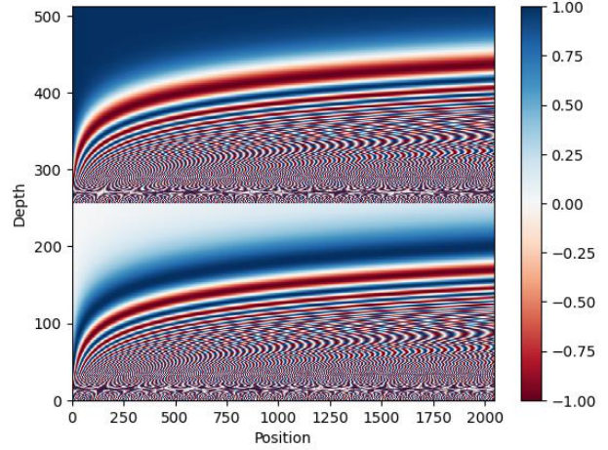
Why trigonometric functions?
Trigonometric functions like cos and sin naturally represent a pattern that the model can recognize as continuous, so relatively positions are easier to see for the model. By watching the plots of these functions, we can also see a regular pattern, so we can hypothesize that the model will see it too

Slide 13
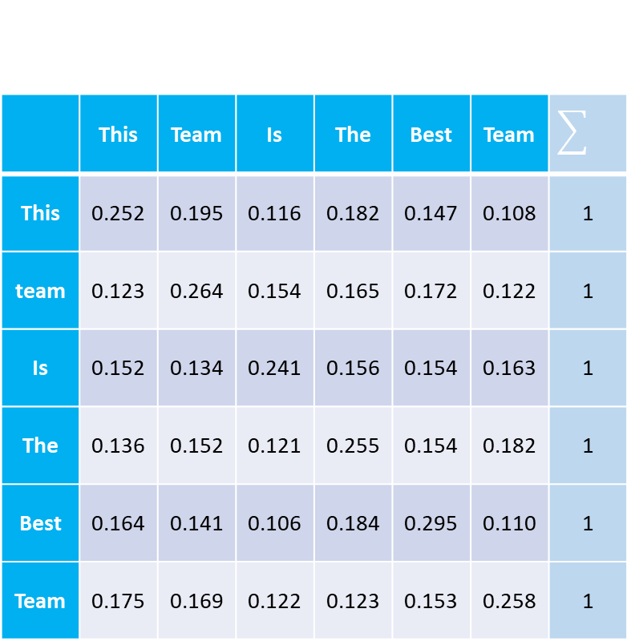

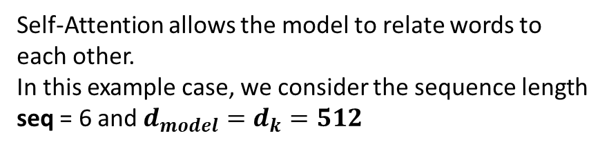



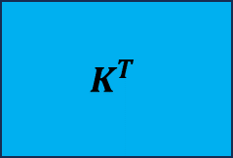
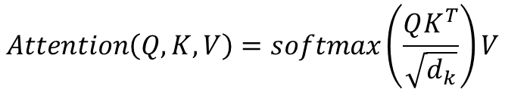
What is Self-Attention?
$$Attention\left(Q, K, V\right)=softmax\left(\frac{QK^{T}}{\sqrt{d_{k}}}\right)V$$
Self-Attention allows the model to relate words to each other.
In this example case, we consider the sequence length seq = 6 and $d_{model}=d_{k}=512$
 | This | Team | Is | The | Best | Team
This | 0.252 | 0.195 | 0.116 | 0.182 | 0.147 | 0.108 | 1
team | 0.123 | 0.264 | 0.154 | 0.165 | 0.172 | 0.122 | 1
Is | 0.152 | 0.134 | 0.241 | 0.156 | 0.154 | 0.163 | 1
The | 0.136 | 0.152 | 0.121 | 0.255 | 0.154 | 0.182 | 1
Best | 0.164 | 0.141 | 0.106 | 0.184 | 0.295 | 0.110 | 1
Team | 0.175 | 0.169 | 0.122 | 0.123 | 0.153 | 0.258 | 1
All values are random.
Q
$$K^{T}$$
$$×$$
(6,512)
(512, 6)
$$softmax$$
$$=$$
$$\sqrt{512}$$
For simplicity, considering only one head, which makes $d_{model}=d_{k}$
(6,6)

Slide 14


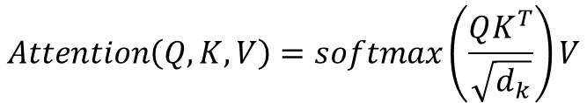

How to compute Self-Attention?
 | This | Team | Is | The | Best | Team
This | 0.252 | 0.195 | 0.116 | 0.182 | 0.147 | 0.108 | 1
team | 0.123 | 0.264 | 0.154 | 0.165 | 0.172 | 0.122 | 1
Is | 0.152 | 0.134 | 0.241 | 0.156 | 0.154 | 0.163 | 1
The | 0.136 | 0.152 | 0.121 | 0.255 | 0.154 | 0.182 | 1
Best | 0.164 | 0.141 | 0.106 | 0.184 | 0.295 | 0.110 | 1
Team | 0.175 | 0.169 | 0.122 | 0.123 | 0.153 | 0.258 | 1
$$Attention\left(Q, K, V\right)=softmax\left(\frac{QK^{T}}{\sqrt{d_{k}}}\right)V$$
V
Attention
$$×$$
$$=$$
(6,512)
(6,512)
Each row in this matrix captures not only the meaning (given by the embedding) or the position in the sentence (represented by the positional encodings) but also each word's interaction with other words
(6,6)

Slide 15
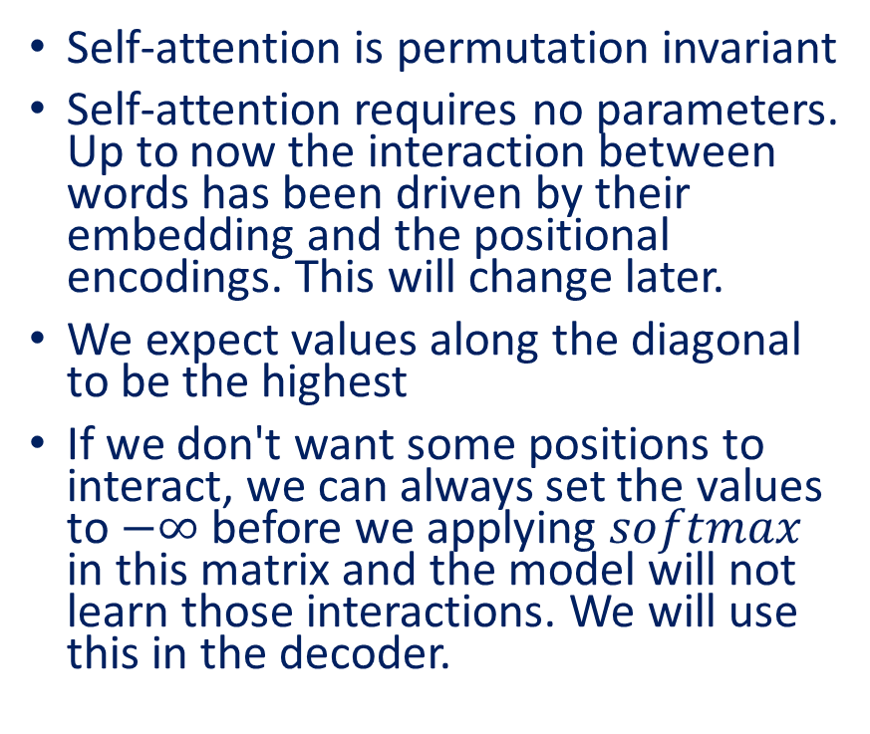
Self-Attention in detail
Self-attention is permutation invariant
Self-attention requires no parameters. Up to now the interaction between words has been driven by their embedding and the positional encodings. This will change later.
We expect values along the diagonal to be the highest
If we don't want some positions to interact, we can always set the values to $−∞$ before we applying $softmax$ in this matrix and the model will not learn those interactions. We will use this in the decoder.
 | This | Team | Is | The | Best | Team
This | 0.252 | 0.195 | 0.116 | 0.182 | 0.147 | 0.108
team | 0.123 | 0.264 | 0.154 | 0.165 | 0.172 | 0.122
Is | 0.152 | 0.134 | 0.241 | 0.156 | 0.154 | 0.163
The | 0.136 | 0.152 | 0.121 | 0.255 | 0.154 | 0.182
Best | 0.164 | 0.141 | 0.106 | 0.184 | 0.295 | 0.110
Team | 0.175 | 0.169 | 0.122 | 0.123 | 0.153 | 0.258

Slide 16
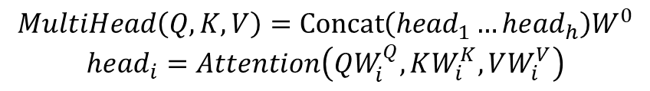
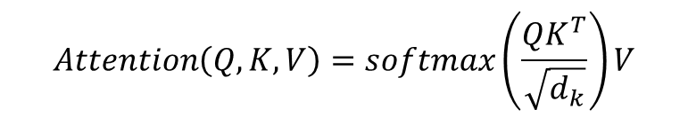
Multi-head Attention
$$Attention\left(Q, K, V\right)=softmax\left(\frac{QK^{T}}{\sqrt{d_{k}}}\right)V$$
$$MultiHead\left(Q, K, V\right)=Concat\left({head}_{1}…{head}_{h}\right)W^{0}$$
$${head}_{i}=Attention\left(QW_{i}^{Q},KW_{i}^{K},VW_{i}^{V}\right)$$

Slide 17
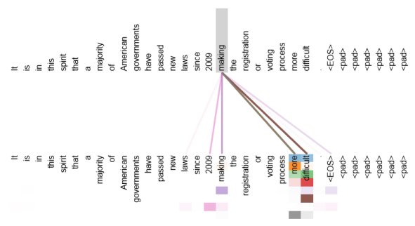
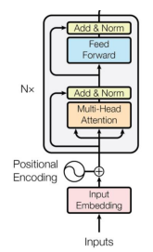









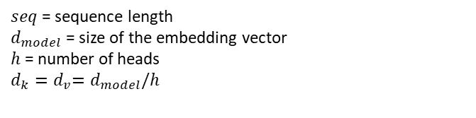

























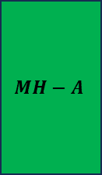















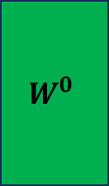
$$d_{k}$$
$$d_{model}$$
Q
$$W^{Q}$$
$$Q^{′}$$
$$Q$$
1
$$Q$$
2
$$Q$$
3
$$Q$$
4
 | This | Team | Is | The | Best | Team
This | 0.252 | 0.195 | 0.116 | 0.182 | 0.147 | 0.108
team | 0.123 | 0.264 | 0.154 | 0.165 | 0.172 | 0.122
Is | 0.152 | 0.134 | 0.241 | 0.156 | 0.154 | 0.163
The | 0.136 | 0.152 | 0.121 | 0.255 | 0.154 | 0.182
Best | 0.164 | 0.141 | 0.106 | 0.184 | 0.295 | 0.110
Team | 0.175 | 0.169 | 0.122 | 0.123 | 0.153 | 0.258
$$×$$
$$=$$
$$\left(seq,d_{model}\right)$$
$$\left(d_{model},d_{model}\right)$$
$$\left(seq,d_{model}\right)$$
$$softmax\left(\frac{QK^{T}}{\sqrt{d_{k}}}\right)$$
Input
K
$$W^{K}$$
$$K^{′}$$
$$K$$
1
$$K$$
2
$$K$$
3
$$K$$
4
$$×$$
$$=$$
$$\left(seq,d_{model}\right)$$
$$\left(d_{model},d_{model}\right)$$
$$\left(seq,d_{model}\right)$$
$$\left(seq,d_{model}\right)$$
Attention visualization
V
$$W^{V}$$
$$=$$
$$V^{′}$$
$$V$$
1
$$V$$
1
$$V$$
1
$$V$$
1
$$×$$
$$\left(seq,d_{model}\right)$$
$$\left(d_{model},d_{model}\right)$$
$$\left(seq,d_{model}\right)$$
$$Attention\left(Q, K, V\right)=softmax\left(\frac{QK^{T}}{\sqrt{d_{k}}}\right)V$$
$$H$$
$$E$$
$$A$$
$$D$$
1
$$H$$
E
A
D
2
$$H$$
E
A
D
3
$$H$$
E
A
D
4
H
$$W^{0}$$
$$MH−A$$
$${head}_{i}=Attention\left(QW_{i}^{Q},KW_{i}^{K},VW_{i}^{V}\right)$$
$$×$$
$$=$$
$$d_{v}$$
$$\left(seq,d_{model}\right)$$
$$\left(d_{model},d_{model}\right)$$
$$\left(seq,d_{model}\right)$$
$seq$ = sequence length
$d_{model}$ = size of the embedding vector
$h$ = number of heads
$d_{k}{=d}_{v}=d_{model}/h$
$$MultiHead\left(Q, K, V\right)=Concat\left({head}_{1}…{head}_{h}\right)W^{0}$$

Slide 18
Why query, keys and values
The terms may come from the database terminology or the Python-like dictionaries
Keys
Values
ROMANTIC | TITANIC
SCIFI | INCEPTION
ACTION | THE DARK KNIGHT
COMEDY | THE INTOUCHABLES
HORROR | THE SHINING
Query = "love"

Slide 19
Why query, keys and values
The terms may come from the database terminology or the Python-like dictionaries
Keys
Values
ROMANTIC | TITANIC
SCIFI | INCEPTION
ACTION | THE DARK KNIGHT
COMEDY | THE INTOUCHABLES
HORROR | THE SHINING
Query = "love"

Slide 20
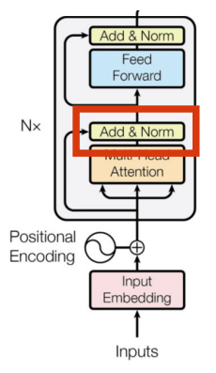
Encoder
Normalization layer

Slide 21
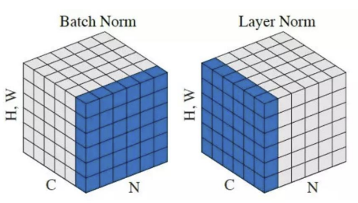


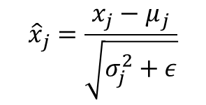

What is layer normalization?
Batch of 3 items
Item 1
Item 2
Item 3
164.278
523.415
452.716
631.652
1265.142
6234.624
…
…
…
541.461
4189.251
412.414
3.421
16.416
1794.127
$${μ }_{1}$$
$$σ_{1}^{2}$$
$${μ }_{2}$$
$$σ_{2}^{2}$$
$${μ }_{3}$$
$$σ_{3}^{2}$$
We also introduce two parameters, usually call gamma (multiplicative) and beta (additive) that introduce some fluctuations in the data, because maybe having all values between 0 and 1 may be restrictive for the network. The network will learn to tune these two parameters to introduce fluctuations when necessary.
$${\hat{x}}_{j}=\frac{x_{j}−μ_{j}}{\sqrt{σ_{j}^{2}+ε}}$$

Slide 22
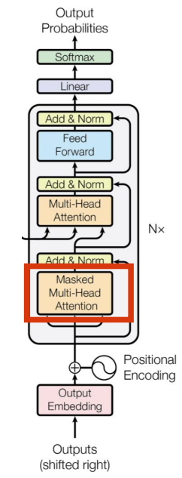
Decoder
Masked Multi-Head Attention

Slide 23
What is Masked Multi-Head Attention?
Our goal is to make the model causal: it means the output at a certain position can only depend on the words on the previous positions. The model must not be able to see future words.
 | This | Team | Is | The | Best | Team
This | 0.252 | 0.195 | 0.116 | 0.182 | 0.147 | 0.108
team | 0.123 | 0.264 | 0.154 | 0.165 | 0.172 | 0.122
Is | 0.152 | 0.134 | 0.241 | 0.156 | 0.154 | 0.163
The | 0.136 | 0.152 | 0.121 | 0.255 | 0.154 | 0.182
Best | 0.164 | 0.141 | 0.106 | 0.184 | 0.295 | 0.110
Team | 0.175 | 0.169 | 0.122 | 0.123 | 0.153 | 0.258

Slide 24
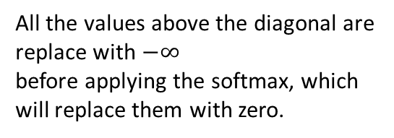
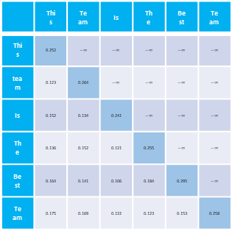
$$d_{k}$$
$$d_{model}$$
Q
$$W^{Q}$$
$$Q^{′}$$
$$Q$$
1
$$Q$$
2
$$Q$$
3
$$Q$$
4
 | This | Team | Is | The | Best | Team
This | 0.252 | $$−∞$$ | $$−∞$$ | $$−∞$$ | $$−∞$$ | $$−∞$$
team | 0.123 | 0.264 | $$−∞$$ | $$−∞$$ | $$−∞$$ | $$−∞$$
Is | 0.152 | 0.134 | 0.241 | $$−∞$$ | $$−∞$$ | $$−∞$$
The | 0.136 | 0.152 | 0.121 | 0.255 | $$−∞$$ | $$−∞$$
Best | 0.164 | 0.141 | 0.106 | 0.184 | 0.295 | $$−∞$$
Team | 0.175 | 0.169 | 0.122 | 0.123 | 0.153 | 0.258
$$×$$
$$=$$
$$\left(seq,d_{model}\right)$$
$$\left(d_{model},d_{model}\right)$$
$$\left(seq,d_{model}\right)$$
$$softmax\left(\frac{QK^{T}}{\sqrt{d_{k}}}\right)$$
Input
K
$$W^{K}$$
$$K^{′}$$
$$K$$
1
$$K$$
2
$$K$$
3
$$K$$
4
$$×$$
$$=$$
$$\left(seq,d_{model}\right)$$
$$\left(d_{model},d_{model}\right)$$
$$\left(seq,d_{model}\right)$$
$$\left(seq,d_{model}\right)$$
V
$$W^{V}$$
$$V^{′}$$
$$V$$
1
$$V$$
1
$$V$$
1
$$V$$
1
All the values above the diagonal are replace with $−∞$
before applying the softmax, which will replace them with zero.
$$=$$
$$×$$
$$\left(seq,d_{model}\right)$$
$$\left(d_{model},d_{model}\right)$$
$$\left(seq,d_{model}\right)$$
$$Attention\left(Q, K, V\right)=softmax\left(\frac{QK^{T}}{\sqrt{d_{k}}}\right)V$$
$$H$$
$$E$$
$$A$$
$$D$$
1
$$H$$
E
A
D
2
$$H$$
E
A
D
3
$$H$$
E
A
D
4
H
$$W^{0}$$
$$MH−A$$
$${head}_{i}=Attention\left(QW_{i}^{Q},KW_{i}^{K},VW_{i}^{V}\right)$$
$$×$$
$$=$$
$$d_{v}$$
$$\left(seq,d_{model}\right)$$
$$\left(d_{model},d_{model}\right)$$
$$\left(seq,d_{model}\right)$$
$seq$ = sequence length
$d_{model}$ = size of the embedding vector
$h$ = number of heads
$d_{k}{=d}_{v}=d_{model}/h$
$$MultiHead\left(Q, K, V\right)=Concat\left({head}_{1}…{head}_{h}\right)W^{0}$$

Slide 25


Training
I love you
Je t’aime beaucoup

Slide 26
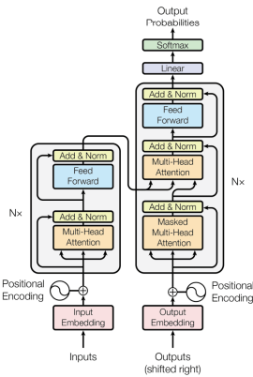






Training
Je t’aime beaucoup <EOS>
Softmax
* This is called the ‘label’ or the ‘target’
$$(seq, vocal_size)$$
Cross Entropy Loss
Time Step = 1
Linear
It all happens in one time step!
$$seq,d_{model}) →(seq, vocal_size)$$
Encoder output
Decoderoutput
$$\left(seq,d_{model}\right)$$
$$\left(seq,d_{model}\right)$$
Encoder
Decoder
The encoder outputs, for each word a vector that not only captures its meaning (the embedding) or the position, but also its interaction with other words by means of the multi-head attention
Encoder input
Decoderinput
$$\left(seq,d_{model}\right)$$
$$\left(seq,d_{model}\right)$$
We prepend the <SOS> token at the beginning. That’s why the paper says that the decoder input is shifted right
<SOS> I love you so much <EOS>
<SOS> Je t’aime beaucoup

Slide 27
Inference
I love you
Je t’aime beaucoup

Slide 28
Inference
Je
Softmax
We select a token from the vocabulary corresponding to the position of the token with the maximum value
$$(seq, vocal_size)$$
Time Step = 1
Linear
The output of the last layer is commonly known as logits
$$seq,d_{model}) →(seq, vocal_size)$$
Encoder output
Decoderoutput
$$\left(seq,d_{model}\right)$$
$$\left(seq,d_{model}\right)$$
Encoder
Decoder
Encoder input
Decoderinput
$$\left(seq,d_{model}\right)$$
$$\left(seq,d_{model}\right)$$
<SOS>
* Both sequences will have same length thanks to padding
<SOS> I love you so much <EOS>

Slide 29
Inference
t’aime
Softmax
Since decoder input now contains two tokens, we select the softmax corresponding to the second token.
$$(seq, vocal_size)$$
Time Step = 2
Linear
$$seq,d_{model}) →(seq, vocal_size)$$
Decoderoutput
$$\left(seq,d_{model}\right)$$
Use the encoder output from the first time step
Decoder
Decoderinput
$$\left(seq,d_{model}\right)$$
<SOS> Je
Append the previously output word to the decoder input
<SOS> I love you so much <EOS>

Slide 30
Inference
beaucoup
Softmax
Since decoder input now contains three tokens, we select the softmax corresponding to the third token.
$$(seq, vocal_size)$$
Time Step = 3
Linear
$$seq,d_{model}) →(seq, vocal_size)$$
Decoderoutput
$$\left(seq,d_{model}\right)$$
Use the encoder output from the first time step
Decoder
Decoderinput
$$\left(seq,d_{model}\right)$$
<SOS> Je t’aime
Append the previously output word to the decoder input
<SOS> I love you so much <EOS>

Slide 31
Inference
<EOS>
Softmax
Since decoder input now contains four tokens, we select the softmax corresponding to the fourth token.
$$(seq, vocal_size)$$
Time Step = 4
Linear
$$seq,d_{model}) →(seq, vocal_size)$$
Decoderoutput
$$\left(seq,d_{model}\right)$$
Use the encoder output from the first time step
Decoder
Decoderinput
$$\left(seq,d_{model}\right)$$
Append the previously output word to the decoder input
<SOS> I love you so much <EOS>
<SOS> Je t’aime beaucoup

Slide 32
Inference strategy
We selected, at every step, the word with the maximum softmax value. This strategy is call greedy and usually does not perform very well
A better strategy is to select at each step the top B words and evaluate all the possible next words for each of them and at each step, keeping the top B most probable sequences. This is the Beam Search strategy and generally perform better.

