Slide 1
Introduction to Transformer
Quang Duong

Slide 2
Recurrent Neural Networks (RNN)
Y1
Y2
Y3
YN
State <0>
RNN
RNN
RNN
RNN
X1
X2
X3
XN
Time step 1
Time step 2
Time step 3
Time step N

Slide 3
Problem with RNN (among others)
Slow computation for long sequences
Vanishing or exploding gradients
Difficulty in accessing information from long time ago

Slide 4
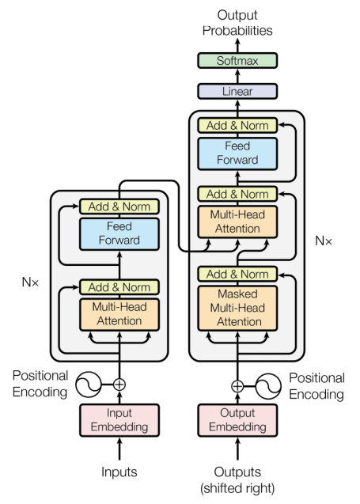
Introducing the Transformer

Slide 5
Notations
Input matrix (sequence, dmodel)

Slide 6
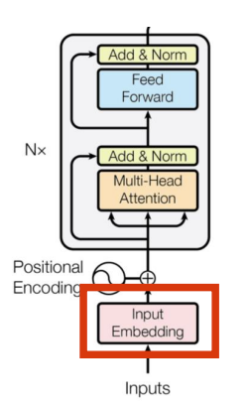
Encoder
Embedding

Slide 7
What is an input embedding?
Original sentence
(token)
This
team
is
the
best
team
Input IDs
(position in the vocabulary)
206
3154
5682
652
826
3154
164.278
523.41
452.716
7745.984
941.625
523.41
Embedding
(vector of size 512)
631.652
1265.142
6234.624
1314.124
6394.531
1265.142
…
…
…
…
…
…
541.461
4189.251
412.414
65.764
3452.945
4189.251
3.421
16.4165
1794.127
1543.345
1643.166
16.4165

Slide 8
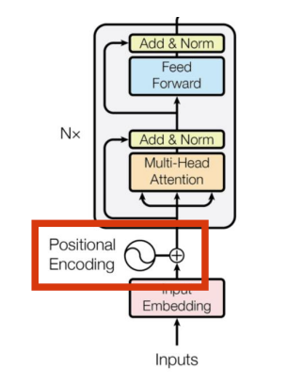
Encoder
Positional Encoding

Slide 9
What is positional encoding?
We want each word to carry some information about its position in the sentence
We want the model to treat words that appear close to each other as ‘close’ and words that are distant as ‘distant’
We want the positional encoding to represent a pattern that can be learned by the model

Slide 10
Original sentence
(token)
This
team
is
the
best
team
Input IDs
(position in the vocabulary)
206
3154
5682
652
826
3154
164.278
523.415
452.716
7745.984
941.625
523.415
Embedding
(vector of size 512)
631.652
1265.142
6234.624
1314.124
6394.531
1265.142
…
…
…
…
…
…
541.461
4189.251
412.414
65.764
3452.945
4189.251
3.421
16.416
1794.127
1543.345
1643.166
16.416
+
+
+
+
+
+
Positional Embedding
(vector of size 512). Only computed once and reused for every sentence during training and inference
…
…
4165.042
…
...
5134.245
…
6234.176
…
…
…
7469.514
…
…
…
…
…
…
…
2177.235
…
…
…
6318.419
…
7412.246
…
…
…
6899.659
=
=
=
=
=
=
Encoder Input
(vector of size 512)
…
4688.457
…
…
...
5657.660
…
7499.318
…
…
…
8734.656
…
…
…
…
…
…
…
6366.486
…
…
…
10507.670
…
7428.662
…
…
…
6916.075

Slide 11
What is positional encoding?
Sentence 1
This
team
is
…
…
…
Sentence 2
Here
we
go
We only need to compute the positional encodings once and reuse them for every sentence during training and inference
…
…
…

