Slide 1
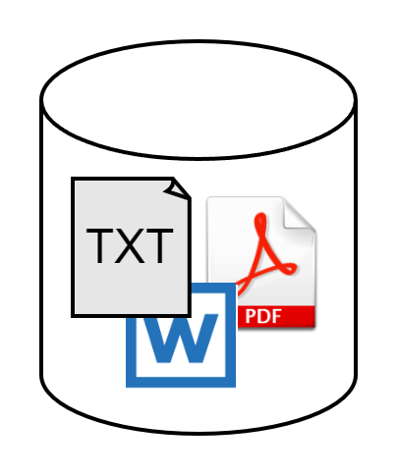
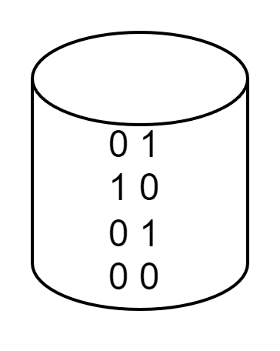
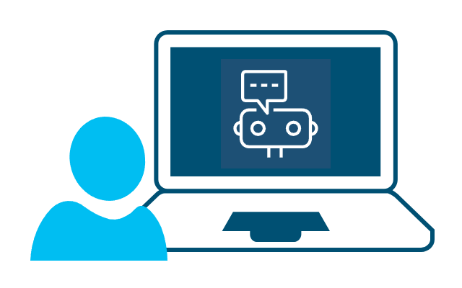


Example for LLM app architecture
Datasource
Un-/structured
databases
Vector Database
FAISS, Chroma,
Qdrant, …
Data loader +
Embedding
REST API
FastAPI,Flask,
LangServe, …
Backend
Open-source LLMs
User's query
Private LLM APIs
Hugging Face
LlamaIndex
Frontend
Streamlit, Gradio,
React, …
LLM's responses
LangChain
…
Search query
Search response
Search tools
Wikipedia,
DuckDuckGoSearch, …

