Slide 1
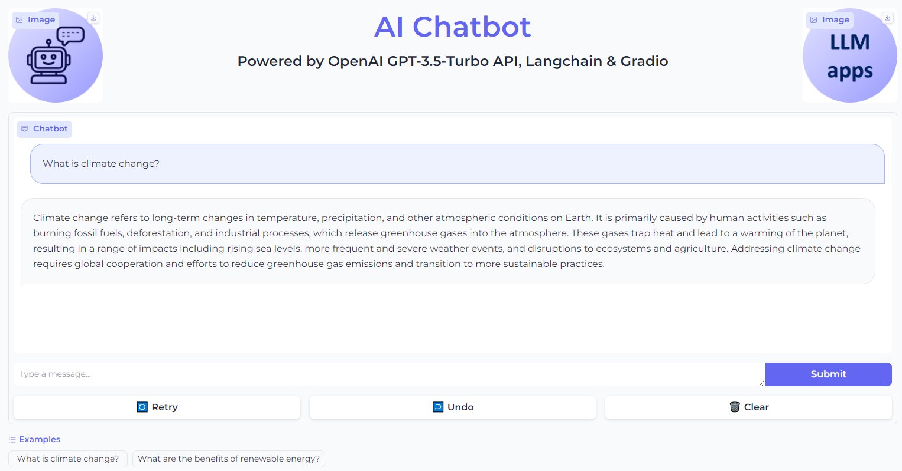
Simple AI Chatbot Interface with Gradio

Slide 2
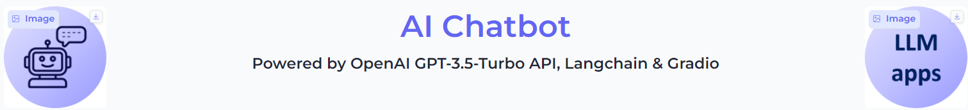
Show Logos and Headers in Gradio
import gradio as gr
# Create a Gradio interface with a soft theme
demo = gr.Blocks(theme="soft")
# Add elements to the interface
with demo:
# Add a row with the product logo, header, and company logo
with gr.Row():
gr.Image(PRODUCT_LOGO_PATH, scale=0) # Product logo
gr.HTML(HEADER) # Header
gr.Image(COMPANY_LOGO_PATH, scale=0) # Company logo

Slide 3
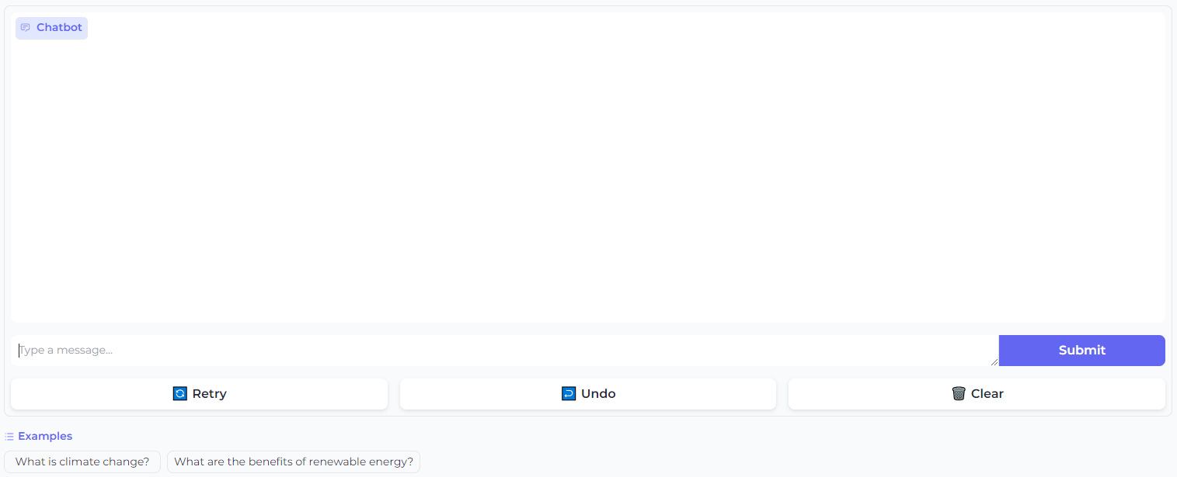
Show Chatbot interface in Gradio
gr.ChatInterface(
predict, # The function to generate responses
examples=[
"What is climate change?",
"What are the benefits of renewable energy?",
],
)

Slide 4
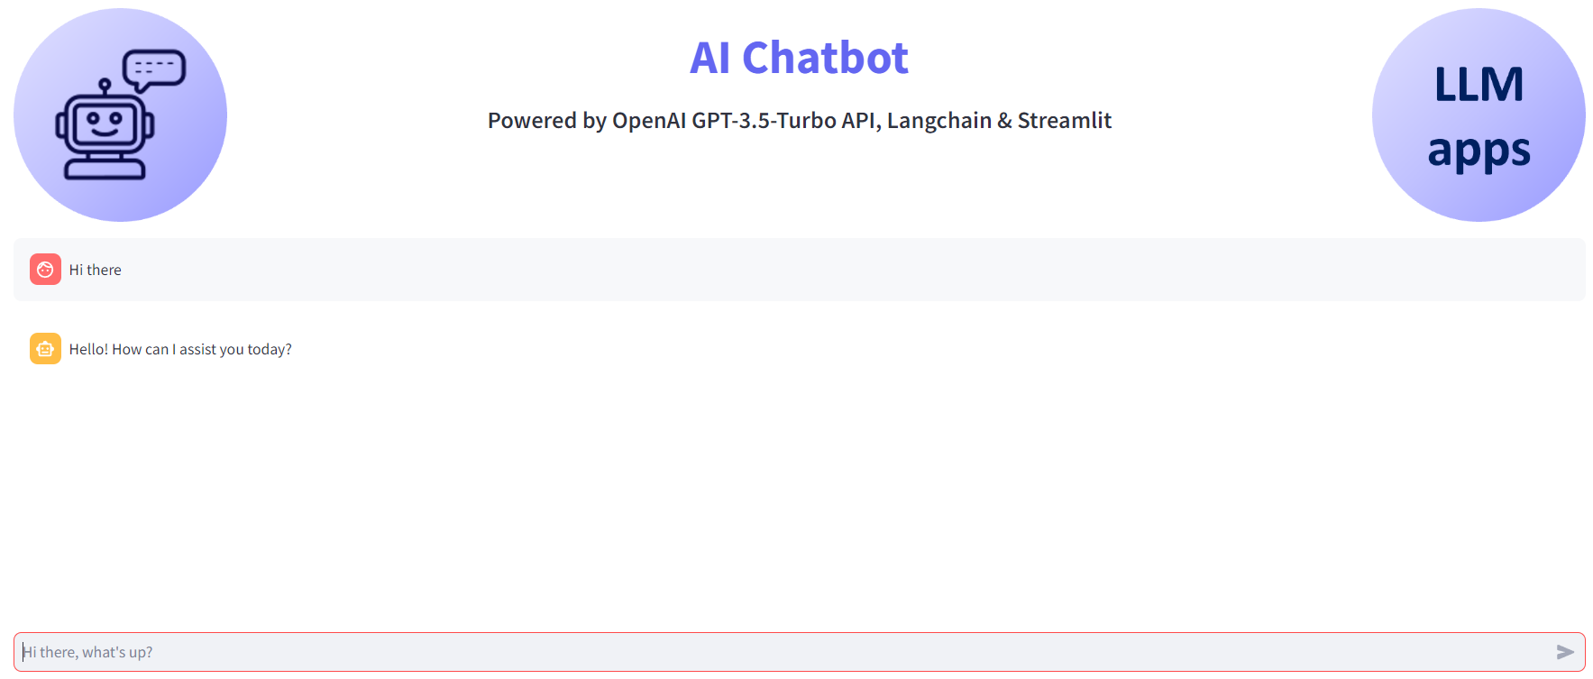
Simple AI Chatbot with Streamlit

Slide 5

Show Logos and Headers in Streamlit
import streamlit as st
def app():
st.set_page_config(page_title="GenAI", page_icon=COMPANY_LOGO_PATH, layout="wide")
c1, c2, c3 = st.columns([1, 5, 1], gap="small")
with c1:
st.image(PRODUCT_LOGO_PATH, use_column_width=True)
with c2:
st.markdown(HEADER, unsafe_allow_html=True)
with c3:
st.image(COMPANY_LOGO_PATH, use_column_width=True)

Slide 6
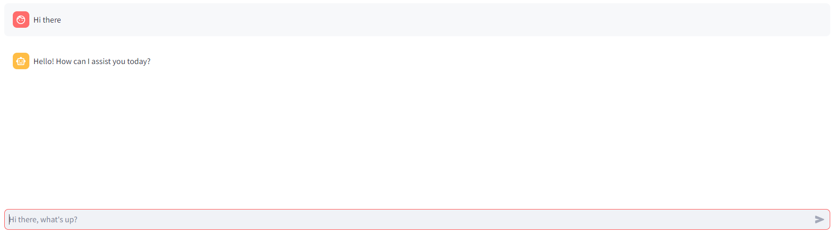
Show Chatbot interface in Streamlit

Slide 7
Show Chatbot interface in Streamlit
def chatbot():
# Initialize chat history if it doesn't exist in the session state if "messages" not in st.session_state:
st.session_state.messages = []
# Display chat messages from history on app rerun for message in st.session_state.messages:
with st.chat_message(message["role"]):
st.markdown(message["content"])
# Accept user input
if user_prompt := st.chat_input("Hi there, what's up?"):
# Add user message to chat history
st.session_state.messages.append({"role": "user", "content": user_prompt })
# Display user message in chat message container
with st.chat_message("user"):
st.markdown(user_prompt )
# Display assistant response in chat message container
with st.chat_message("assistant"):
message_placeholder = st.empty()
full_response = ""
assistant_response = predict(user_prompt)
# Simulate stream of response with milliseconds delay
for chunk in assistant_response.split():
full_response += chunk + " "
time.sleep(0.05)
# Add a blinking cursor to simulate typing
message_placeholder.markdown(full_response + "▌")
message_placeholder.markdown(full_response)
# Add assistant response to chat history
st.session_state.messages.append(
{"role": "assistant", "content": full_response}
)

