Slide 1

Chapter 06- [2]
Throwing in Some Sass
Notes:
https://thachpham.com/web-development/html-css/huong-dan-su-dung-sass-de-viet-css.html
http://sass-lang.com/
http://sass-lang.com/

Slide 2
Objectives
In this chapter, we're going to change gears and learn about Sass, which will allow you to customize the look and feel of your components:
Learning the basics of Sass
Using Sass in the blog project
Importing partials in Sass
Creating a collection of variables
Customizing components
Writing a theme
Notes:
Mô tả nội dung mà học viên phải đạt được khi kết thúc môn học này

Slide 3
Learning the basics of Sass
Notes:
Session: Ghi số thứ tự session trong môn học
Session Name: ghi tên của session sẽ dạy

Slide 4
Sass
Sass stands for Syntactically Awesome Style Sheets.
it's a CSS preprocessor. A preprocessor extends regular CSS by allowing the use of things such as variables, operators, and mixins in CSS.
Sass is written during the development stage of your project and it needs to be compiled into regular CSS before you deploy your project into production.

Slide 5
Using Sass in the blog project
Notes:
Session: Ghi số thứ tự session trong môn học
Session Name: ghi tên của session sẽ dạy

Slide 6
Definitions
Before you can deploy the project, you need to convert or compile the Sass files into regular CSS files.
Normally this would require you to install a Ruby gem and you would have to manually compile your code before you can test it.
Luckily for us, Harp.js actually has an Sass compiler built into it.
When you run the harp compile command to build your templates, it will also build your Sass files into regular CSS.

Slide 7

Updating the blog project
We need to make a few updates to our blog project to set it up for Sass. Head to your project directory and navigate to the CSS directory. In this directory, create a new file called custom.scss.
What we're doing here is creating a custom style sheet that we are going to use to overwrite some of the default Bootstrap look-and-feel CSS.

Slide 8
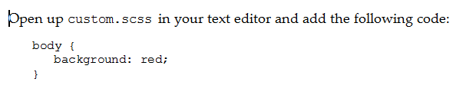
Updating the blog project (cont.)
To do this, we need to load this custom file after the Bootstrap framework CSS file in our layout file.
Open up _layout.ejs in the root of the project directory and insert the following line of code after bootstrap.min.css. Both lines together should look like this:

Slide 9
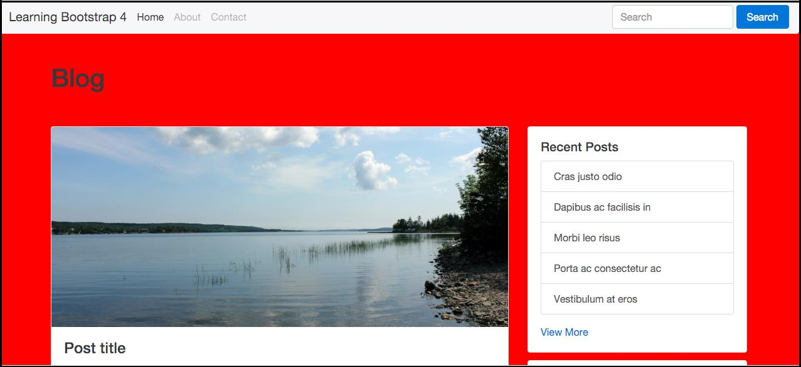
Updating the blog project (cont.)
It is just a simple way to make sure that Sass is compiling to CSS and is being inserted into our layout. Compile your project and launch the server.

Slide 10

Using variables
In Sass, variables are called by using the $ sign character. If you're familiar with Less, the @ symbol is used for variables. So in that case, all you would need to do is use $ instead of @.
Here are a few examples of generic variable names:

Slide 11

Using variables(cont.)
I've shown you how to write the variable name but the other side of the equation is the actual value for the variable. Let's add in some sample values for our first set of variable names:

Slide 12
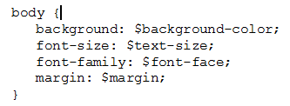
Using the variables in CSS
Let's actually insert them into some CSS. After the variables in custom.scss, enter the following code:

Slide 13
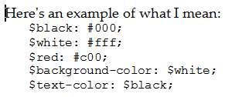
Using other variables as variable values
That might sound like a bit of a mouthful, but you can actually use a variable as the default value for another variable.

Slide 14
Importing partials in Sass
Notes:
Session: Ghi số thứ tự session trong môn học
Session Name: ghi tên của session sẽ dạy

Slide 15
Importing partials in Sass
Just as you can do in Harp.js, you can use partials in Sass. If you've forgotten what a partial is, it's a little snippet of code that is saved into a different file and then imported into the main CSS theme or layout, in the case of Harp.
Let's go over an example of how you could do this for a single component. In your project, go to the /css directory and create a new sub-folder called /components. The the full path should be: /css/components

Slide 16
Importing partials in Sass(cont.)
In the /components directory, create a new Sass file and name it _buttons.scss.
Make sure you always insert an underscore at the start of the filename of a partial.
The compiler will then ignore these files as the underscore means it is being inserted into another file.

Slide 17


Importing partials in Sass(cont.)
Enter the following at the top of the file as a marker:
Save the buttons file and then open up custom.scss and add the following line of code to the file:

Slide 18

Importing partials in Sass(cont.)
Before we can test this out to make sure it works, we need to add some code to our _buttons.scss file.
Let's add some simple CSS to change the primary button as an example:

Slide 19
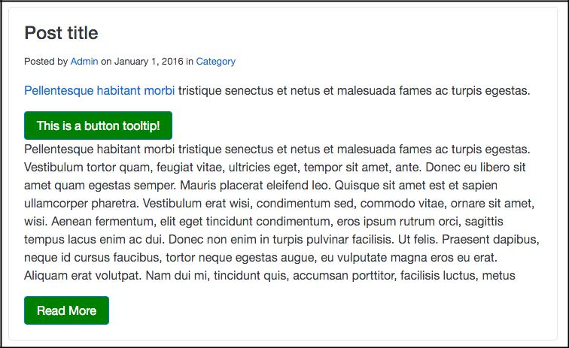
Importing partials in Sass(cont.)
After adding this code, save the file and do a harp compile. Then launch the server and check out the home page; the buttons will be green like this:

Slide 20
Using mixins
Notes:
Session: Ghi số thứ tự session trong môn học
Session Name: ghi tên của session sẽ dạy

Slide 21
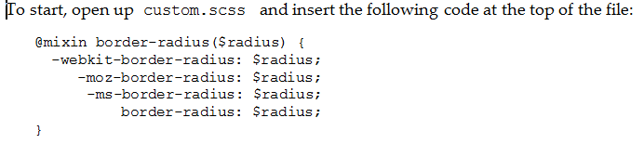
Using mixins
Mixins allow you to group CSS declarations together so that you can reuse them through your project.
This is a great because you can include the code for, say, a border-radius, using one line of code instead of multiple lines for each browser.

Slide 22
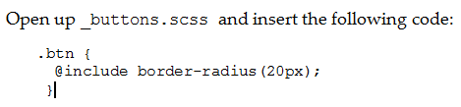
Using mixins (cont.)
We've set up the mixin to handle the border-radius property but we still need to add the corner value to an element. Let's change the border-radius value for the default Bootstrap button.

Slide 23
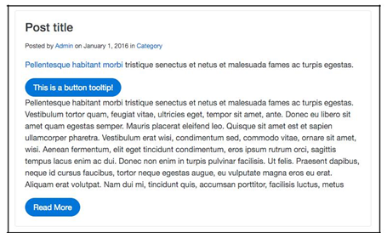
Using mixins (cont.)
Next, save your file, run the harp compile command, and then, when you view the project in the browser, it should look like this:

Slide 24
How to use operators
Notes:
Session: Ghi số thứ tự session trong môn học
Session Name: ghi tên của session sẽ dạy

Slide 25
How to use operators
Sass allows you to perform basic math operations in CSS, which is useful for a number of reasons. First of all, you can use the following operators +, -, *, /, and %.
To give you an understanding of how you can use operators in CSS, let's learn how to convert a pixel-based grid into percentages.

Slide 26
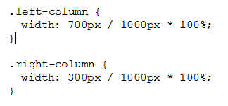
How to use operators (cont.)
We'll create two columns in pixels and then use some Sass to convert them to percentages. Open up custom.scss and insert the following code:

Slide 27
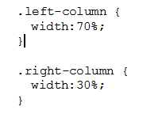
How to use operators (cont.)
Run a harp compile command to build this code and then open up custom.css in the /www/css folder. There you should find the following code:

Slide 28
Creating a collection of variables
One of the main things you'll want to do when using Sass in Bootstrap is to create a library of global variables that can be used throughout your theme. Think of things such as colors, backgrounds, typography, links, borders, margins, and padding. Before we go too far, we need to create a new .scss file. Open up your text editor, create a new file, and call it _variables.scss. Save that file to the /css/components directory.
Notes:
Session: Ghi số thứ tự session trong môn học
Session Name: ghi tên của session sẽ dạy

Slide 29

Importing the variables to your custom style sheet
Now that we've created the variables Sass file, we need to import it into our custom style sheet.
Open up custom.css in your text editor and paste the following line of code at the top of the file.

Slide 30
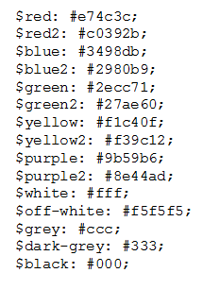
Adding a color palette
Save the custom style sheet and then go back to the variables file. Let's start by inserting a color palette into the variables file like this:

Slide 31
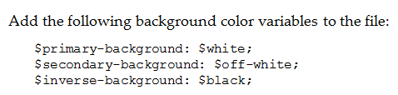
Adding some background colors
You should add to your collection of variables is background colors. As we move through this variables file, we're going to create a variable for all properties that get used over and over again in our style sheet.

Slide 32
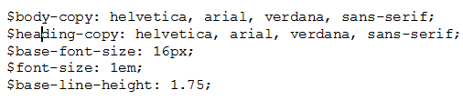
Setting up variables for typography
The next section of variables we are going to set up is for the base typography styles. Insert the following code after the background colors:

Slide 33
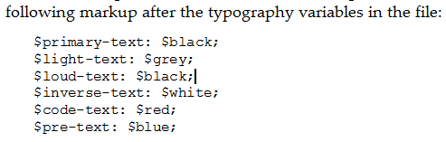
Coding the text color variables
As with the background colors, we need to set up some common color styles for text, as well as defining some colors for base HTML tags such as <pre> and <code>.

Slide 34

Coding variables for links
An extension of basic text colors will be colors for links in our project. Go ahead and add the following code after the text colors in the file:

Slide 35

Setting up border variables
Another CSS property that gets used often is borders. That makes it a great candidate for Sass variables. Insert the following code after the link colors in the file:

Slide 36
Writing a theme
Creating your own Bootstrap theme is a bit of an undertaking. The good news is that once you've done it you can reuse a ton of the code for future themes. That's where the real power in making your code modular comes into play.

Slide 37
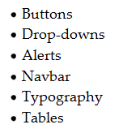
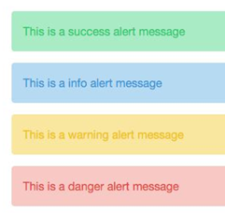
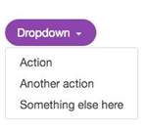

Common components that need to be customized
There are many ways that you can theme Bootstrap.
Here's a list of components that I would recommend customizing:

Slide 38
Summary
Finally. We've covered a ton of new content in this chapter including:
The basics of Sass
How to use Sass in Bootstrap, how to create a library of Sass variables
How to apply those variables to customize Bootstrap components
And, finally, how to start writing your own Bootstrap theme.
Notes:
Tóm tắt lại nội dung đã học

