Slide 1

Chapter 02- [2]
Working with Layout
Notes:
Session: Ghi số thứ tự session trong môn học
Session Name: ghi tên của session sẽ dạy

Slide 2
Objectives
In this chapter, we are going to discuss the following listed topics briefly:
Working with containers
Inserting rows into your layout
Adding columns to your layout
Creating a simple three-column layout
Mixing column classes for different devices
Coding the blog home page
Using responsive utility classes
Notes:
Mô tả nội dung mà học viên phải đạt được khi kết thúc môn học này

Slide 3
Working with containers
Notes:
Session: Ghi số thứ tự session trong môn học
Session Name: ghi tên của session sẽ dạy

Slide 4
Bootstrap layout is a container class
There are two types of containers you can choose to use:
The first is .container-fluid class
The second option is the basic .container class

Slide 5
Fixed Container class
The second option is the basic .container class, which will have a fixed width based on the size of your device's viewport.
There are five different sizes in Bootstrap, with the following width values:
Extra small <544px
Small >544px
Medium >768px
Large >992px
Extra large >1140px

Slide 6
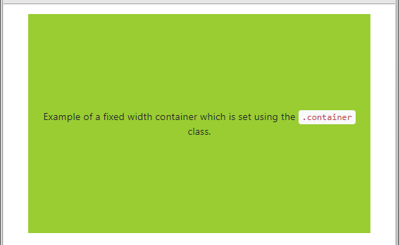
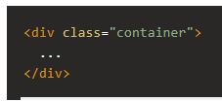
Fixed Container class
Notes:
https://www.quackit.com/html/html_editors/scratchpad/preview.cfm?example=/bootstrap/bootstrap_4/tutorial/bootstrap_4_fixed_layout

Slide 7
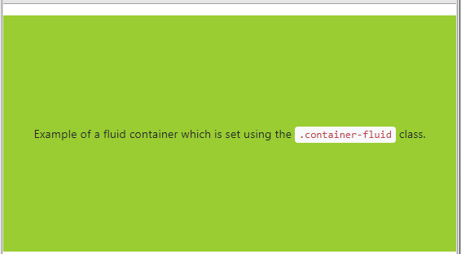

Fluid Container
Which is a full-width box and will stretch the layout to fit the entire width of the browser window.
There is some left and right padding added so the content doesn't bump right up against the browser edge:
Notes:
https://www.quackit.com/html/html_editors/scratchpad/preview.cfm?example=/bootstrap/bootstrap_4/tutorial/bootstrap_4_fluid_layout
Đó là hộp toàn chiều rộng và sẽ kéo giãn bố cục để phù hợp với toàn bộ chiều rộng của cửa sổ trình duyệt.
Có một số đệm lót trái và phải được thêm vào để nội dung không bị va vào cạnh trình duyệt:

Slide 8
Inserting rows into your layout
The next step in creating a layout is to insert at least a single row of columns. Each container class can have one or more rows nested inside of it. A row defines a collection of horizontal columns that can be broken up to twelve times.
Notes:
Session: Ghi số thứ tự session trong môn học
Session Name: ghi tên của session sẽ dạy

Slide 9
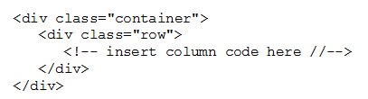
Example of a container with a single row

Slide 10
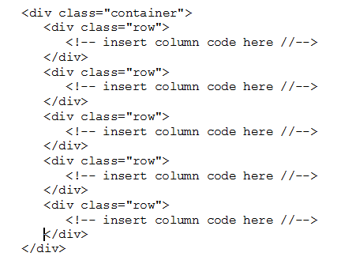
Many rows within a container

Slide 11
Inserting columns into your layout
In Bootstrap 3 there were four different column class widths to choose from: extra small, small, medium, and large. With Bootstrap 4, they have also introduced a new extra large column class.
Notes:
Session: Ghi số thứ tự session trong môn học
Session Name: ghi tên của session sẽ dạy

Slide 12
Column class widths
Extra small: The smallest of the grid classes uses the naming pattern .col-xs-#, where -# is equal to a number from 1 to 12.
Small: The small column class uses the syntax pattern .col-sm-#
Medium: The medium column class uses a similar naming pattern of .col-md-#
Large: The large column class again uses the naming pattern of .col-lg-#
Extra large: The final and new column class is extra large and the syntax for it is .col-xl-#.

Slide 13
Choosing a column class
With all of the class options, it can be hard to decide which ones to use. If you are building a mobile app, then you would likely want to stick to the extra small or small column classes. For a tablet, you might want to use medium. If the primary user for your application will be on a desktop computer, then use the large or extra large classes

Slide 14
Creating a simple three-column layout
Notes:
Session: Ghi số thứ tự session trong môn học
Session Name: ghi tên của session sẽ dạy

Slide 15
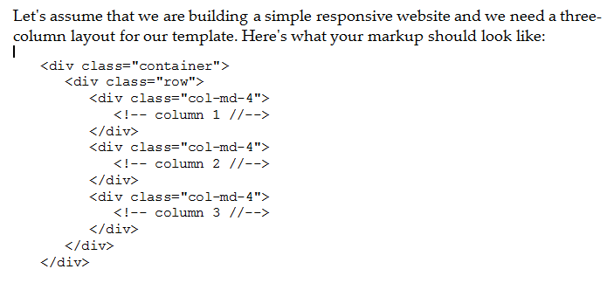
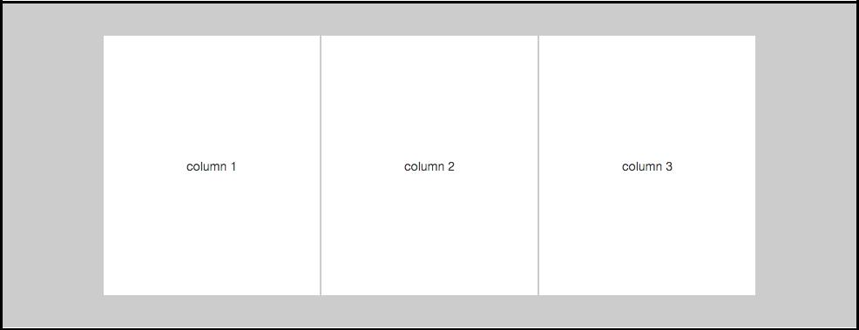
Creating a simple three-column layout
Notes:
<!DOCTYPE html>
<html lang="en">
<head>
<title>Bootstrap Example</title>
<meta charset="utf-8">
<meta name="viewport" content="width=device-width, initial-scale=1">
<link rel="stylesheet" href="https://maxcdn.bootstrapcdn.com/bootstrap/4.0.0-beta.2/css/bootstrap.min.css">
<script src="https://ajax.googleapis.com/ajax/libs/jquery/3.2.1/jquery.min.js"></script>
<script src="https://cdnjs.cloudflare.com/ajax/libs/popper.js/1.12.6/umd/popper.min.js"></script>
<script src="https://maxcdn.bootstrapcdn.com/bootstrap/4.0.0-beta.2/js/bootstrap.min.js"></script>
</head>
<body>
<div class="container">
<h1>Hello World!</h1>
<div class="row">
<div class="col-md-4" style="background-color:lavender;">.col-sm-3</div>
<div class="col-md-4" style="background-color:lavenderblush;">.col-sm-3</div>
<div class="col-md-4" style="background-color:lavender;">.col-sm-3</div>
</div>
</div>
</body>
</html>

Slide 16
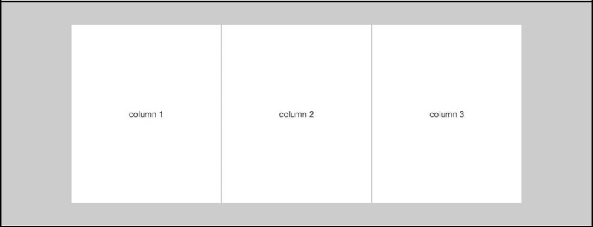
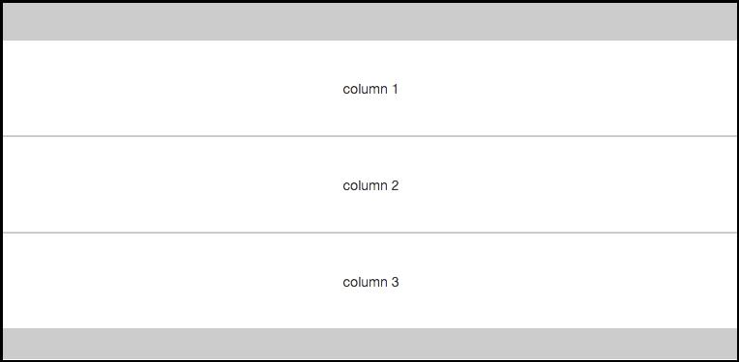
Creating a simple three-column layout
For devices that have a resolution of 768 pixels or greater, you'll see a three-column layout like this:
If you were to view this same layout on a device with resolution smaller than 768 pixels, each column's width would change to 100% and the columns would be stacked on top of each other.
Notes:
<!DOCTYPE html>
<html lang="en">
<head>
<title>Bootstrap Example</title>
<meta charset="utf-8">
<meta name="viewport" content="width=device-width, initial-scale=1">
<link rel="stylesheet" href="https://maxcdn.bootstrapcdn.com/bootstrap/4.0.0-beta.2/css/bootstrap.min.css">
<script src="https://ajax.googleapis.com/ajax/libs/jquery/3.2.1/jquery.min.js"></script>
<script src="https://cdnjs.cloudflare.com/ajax/libs/popper.js/1.12.6/umd/popper.min.js"></script>
<script src="https://maxcdn.bootstrapcdn.com/bootstrap/4.0.0-beta.2/js/bootstrap.min.js"></script>
</head>
<body>
<div class="container">
<h1>Hello World!</h1>
<div class="row">
<div class="col-md-4" style="background-color:lavender;">.col-sm-3</div>
<div class="col-md-4" style="background-color:lavenderblush;">.col-sm-3</div>
<div class="col-md-4" style="background-color:lavender;">.col-sm-3</div>
</div>
</div>
</body>
</html>

Slide 17
Mixing column classes for different devices
Notes:
Session: Ghi số thứ tự session trong môn học
Session Name: ghi tên của session sẽ dạy

Slide 18
Mixing column classes for different devices
Adding additional classes to each of our column <div> will allow us to target the grid layout for different devices.
Let's consider our three-column layout from before, but this time, we want to layout it like this:
The first two columns should be 50% of the layout
The third column should stretch 100% of the layout and be below the first two
Notes:
Tham khảo: https://www.w3schools.com/bootstrap4/tryit.asp?filename=trybs_grid_examples11&stacked=h

Slide 19
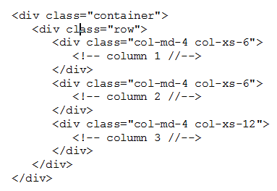
We'll mix some different column classes
Notes:
<!DOCTYPE html>
<html lang="en">
<head>
<title>Bootstrap Example</title>
<meta charset="utf-8">
<meta name="viewport" content="width=device-width, initial-scale=1">
<link rel="stylesheet" href="https://maxcdn.bootstrapcdn.com/bootstrap/4.0.0-beta.2/css/bootstrap.min.css">
<script src="https://ajax.googleapis.com/ajax/libs/jquery/3.2.1/jquery.min.js"></script>
<script src="https://cdnjs.cloudflare.com/ajax/libs/popper.js/1.12.6/umd/popper.min.js"></script>
<script src="https://maxcdn.bootstrapcdn.com/bootstrap/4.0.0-beta.2/js/bootstrap.min.js"></script>
</head>
<body>
<div class="container">
<div class="row">
<div class="col-md-4 col-xs-6" >column 1
<!-- column 1 //-->
</div>
<div class="col-md-4 col-xs-6">column 2
<!-- column 2 //-->
</div>
<div class="col-md-4 col-xs-12"> column 3
<!-- column 3 //-->
</div>
</div>
</body>
</html>

Slide 20
We'll mix some different column classes
I've added the .col-xs-6 class to the first two column <div>s. Now, if our device resolution is less than 768 pixels, the first two columns will be set to a width of 50%.
For the third column, I've used the .col-xs-12 class, which will wrap the third column onto a new line and set it to 100% of the width of the layout.

Slide 21
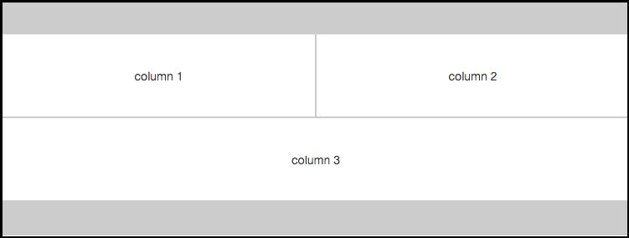
We'll mix some different column classes
The resulting layout will look like this on smaller devices

Slide 22
Using responsive classes
Notes:
Session: Ghi số thứ tự session trong môn học
Session Name: ghi tên của session sẽ dạy

Slide 23
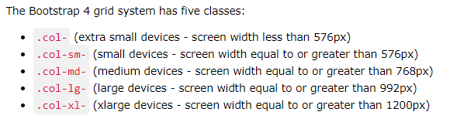
Responsive classes
The classes above can be combined to create more dynamic and flexible layouts.

Slide 24
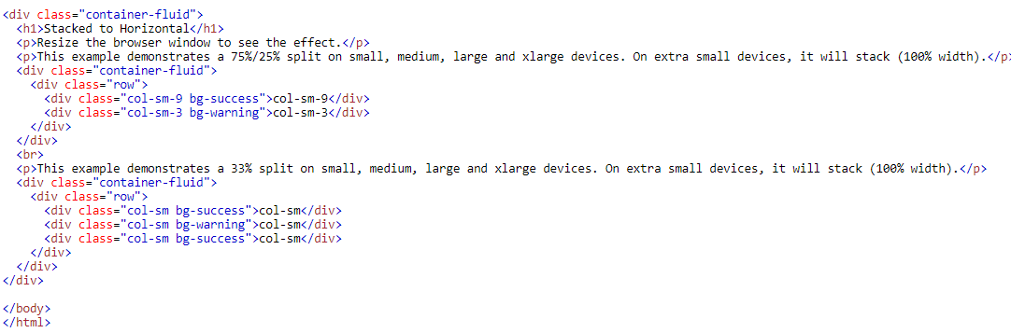
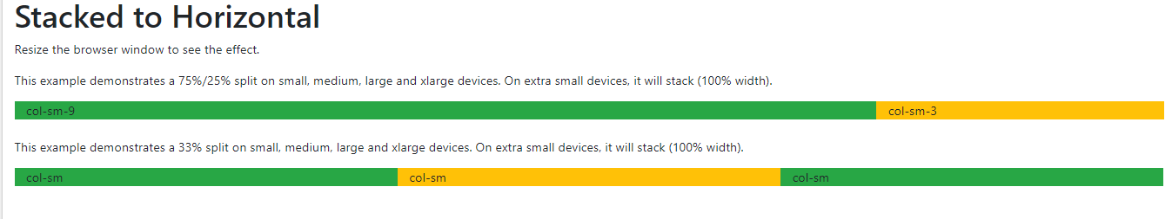
Responsive classes
https://www.w3schools.com/bootstrap4/tryit.asp?filename=trybs_grid_examples10&stacked=h
Notes:
https://www.w3schools.com/bootstrap4/tryit.asp?filename=trybs_grid_examples10&stacked=h

Slide 25
Color and Text Align
Notes:
Session: Ghi số thứ tự session trong môn học
Session Name: ghi tên của session sẽ dạy

Slide 26
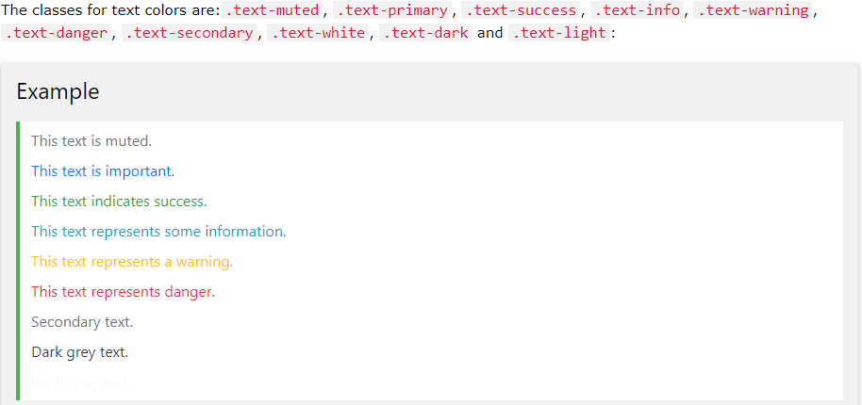
Text color
Bootstrap 4 has some contextual classes that can be used to provide "meaning through colors“

Slide 27
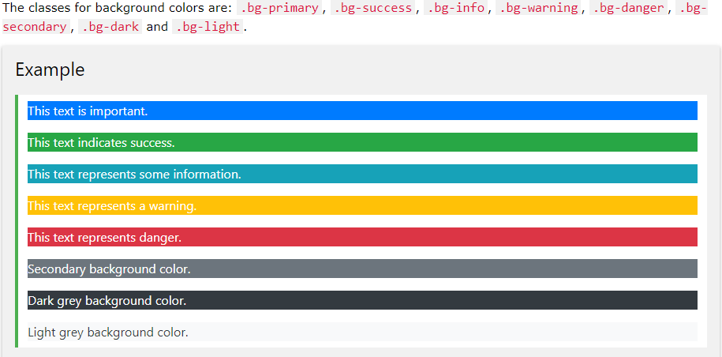
Background Color

Slide 28
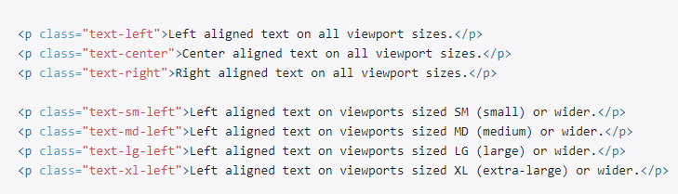
Text Alignment

Slide 29
Coding the blog home page
Now that you have a good grasp of how to use the Bootstrap 4 grid, we're going to code up our blog home page. This page will include a feed of posts, a sidebar, and a newsletter sign-up form section at the bottom of the page.
https://startbootstrap.com/template-overviews/blog-home/
Notes:
Now that you have a good grasp of how to use the Bootstrap 4 grid, we're going to code up our blog home page. This page will include a feed of posts, a sidebar, and a newsletter sign-up form section at the bottom of the page.

Slide 30
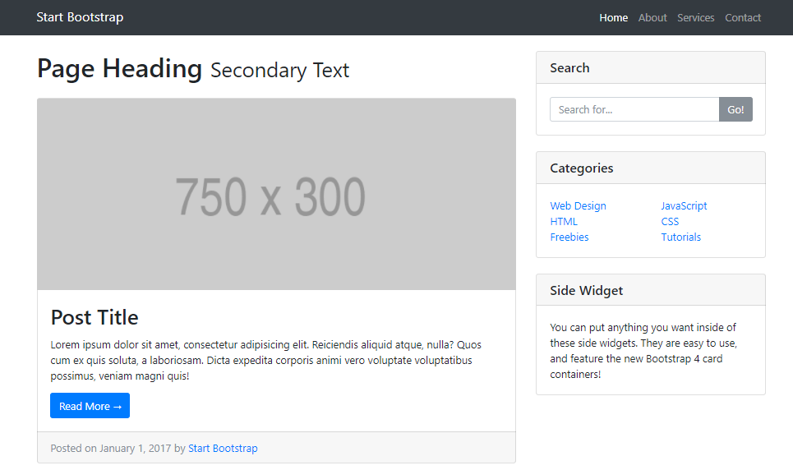
Blog home page

Slide 31
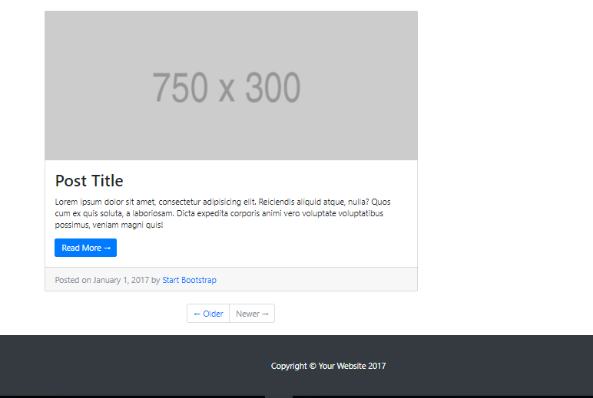
Blog home page

Slide 32
Learn more..
https://getbootstrap.com/docs/4.0/layout/overview/

Slide 33
Summary
At the end of this chapter, we are going to discuss the following listed topics briefly:
Working with containers
Inserting rows into your layout
Adding columns to your layout
Creating a simple three-column layout
Mixing column classes for different devices
Using responsive utility classes
Coding the blog home page
Notes:
Tóm tắt lại nội dung đã học

