Slide 1

Chapter 11
How to working with images and icons
Notes:
Session: Ghi số thứ tự session trong môn học
Session Name: ghi tên của session sẽ dạy

Slide 2
Objectives
Basic skills for working with images
Advanced skills for working images
Related skills for working with images
Notes:
Mô tả nội dung mà học viên phải đạt được khi kết thúc môn học này

Slide 3
Basic skills for working with images

Slide 4
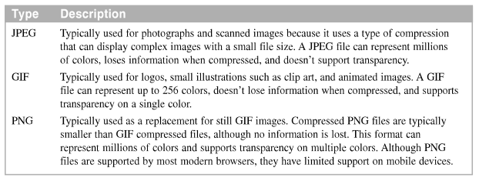
Types of images for the web
Image types
Notes:
Mô tả nội dung chi tiết từng chuyên đề

Slide 5


Types of images for the web (cont.)
Typical JPEG images
Typical GIF images

Slide 6
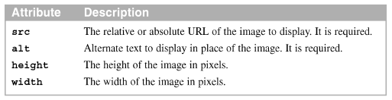
How to resize an image
Use the height and width attributes of the <img> tag only to specify the size of the existing image.
Attribute of the <img> tag

Slide 7
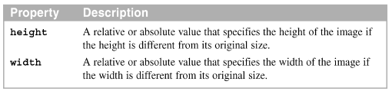

How to resize an image (cont.)
CSS properties for sizing an image
The images in a web browser

Slide 8
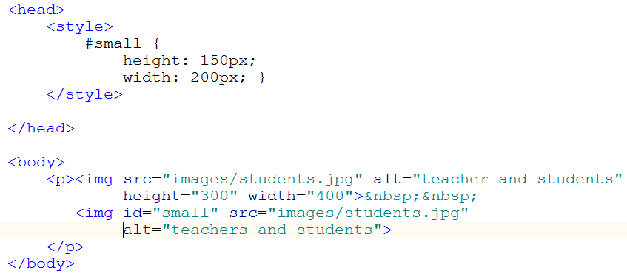
Code Sample

Slide 9

How to align an image vertically
Use pixels, points, or ems to specify the value for the vertical-align property.
The property for aligning images vertically
Common keywords for the vertical-align property

Slide 10
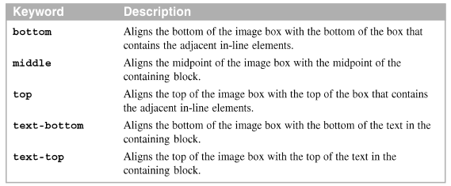
Common keywords for the vertically-align property

Slide 11
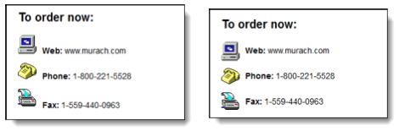
How to align an image vertically (cont.)
The images in a web browser before and after they are apply vertical-align

Slide 12
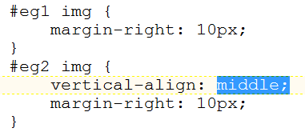
Code Sample

Slide 13
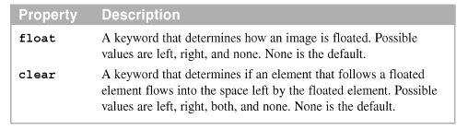
How to float an image
Use the same techniques to float an image
The properties for floating images

Slide 14

How to float an image (cont.)
The HTML in a web browser

Slide 15
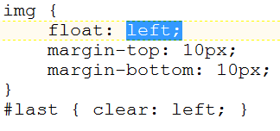
Code Sample

Slide 16
Advanced skills for working with images

Slide 17
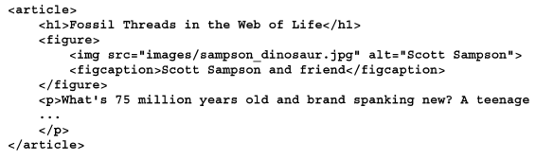
How to use the HTML5 figure and figcaption elements
The HTML for the figure and figcaption elements

Slide 18
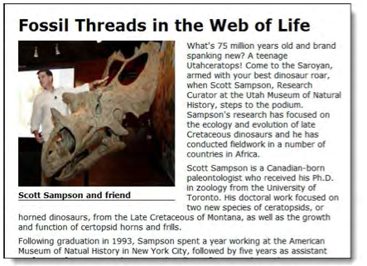
How to use the HTML5 figure and figcaption elements (cont.)
A web page that uses figure and figcaption elements

Slide 19
How to use the picture element
Elements for adding multiple picture resource
Attributes of the source element
Element | Description
picture | The picture element contains one or more source elements and an img element.
source | Each source element refer to an image for a particular window size or in a particular format.
img | The image that’s used if none of the images on the source elements can be used.
Attribute | Description
media | A query that determines when the image should be loaded by the browser.
srcset | The URL of the image to be loaded. Required.
type | The MIME type for the image to be loaded.

Slide 20
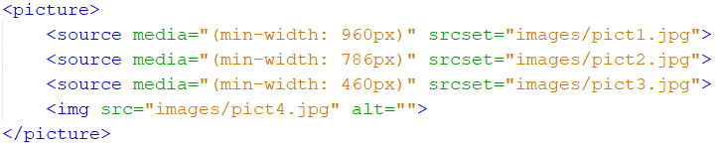

How to use the picture element(cont.)
HTML for displaying an image depending on the screen size
HTML for displaying an image in an alternate format

Slide 21
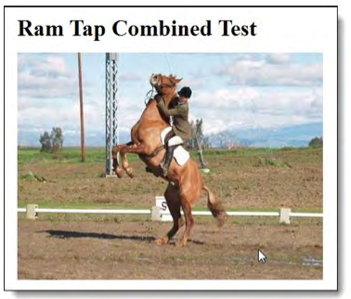
How to do image rollovers
An image rollover is an image the gets changed when the mouse hovers over it
The image has been rolled over because the mouse is hovering over its.

Slide 22
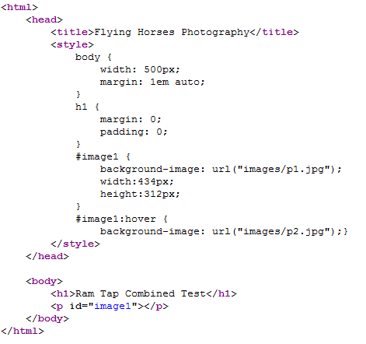
image rollovers code

Slide 23


How to create image maps
Use the map and area elements to define an image map that provides clickable areas for the image called hotspots
The attribute of the img element that identifies the related map element
The attribute of the map element that gives it’s a name

Slide 24
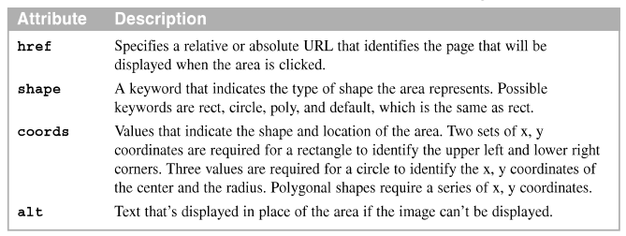
How to create image maps (cont.)
The attribute of the area elements that create the image map

Slide 25
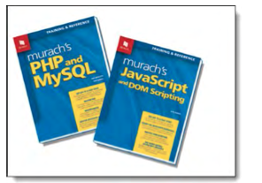
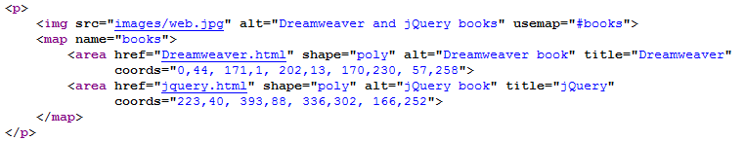
How to create image maps (cont.)
An image in a web browser with hotspots create by an image map

Slide 26
Related skills for working with images

Slide 27
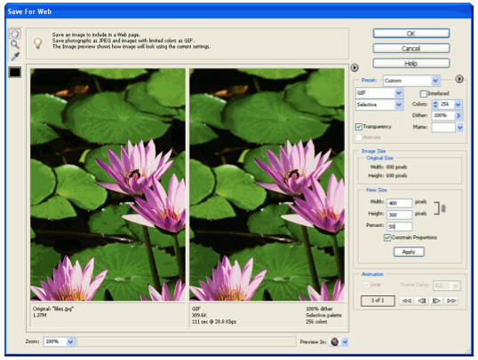
When to use an image editor
An image editor as it is used to change the size of an image

Slide 28
When to use an image editor (cont.)
Typical editing operations
Change the size, image type, or quality of an image
Control the animation of an animated GIF file
Save image with transparency or a matte
Get the coordinates for an image map

Slide 29

When to use an image editor (cont.)
An image without transparency and with transparency and matte

Slide 30
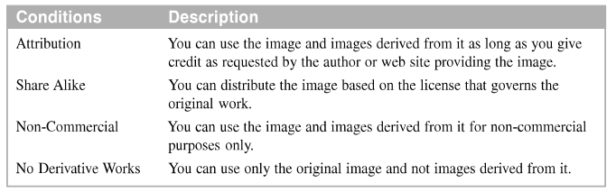
How to get images and icon
Many of the images and icons that are available from the Web are licensed under a Creative Commons license.
Creative Commons license conditions for images and icons

Slide 31
How to create favicons
A favicon is a small image that appears to the left of the URL in the browser’s address bar. It may also appear to the left of the title in a browser tab, and it may be used by the browser for a favorite or bookmark.
The link element in the head section that links to the favicon

Slide 32
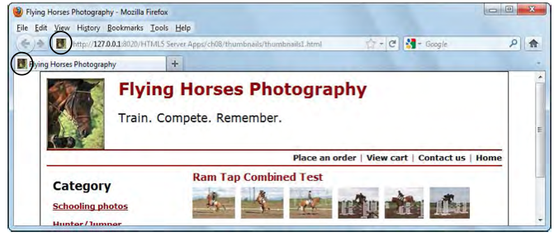
A web page with favicons

Slide 33
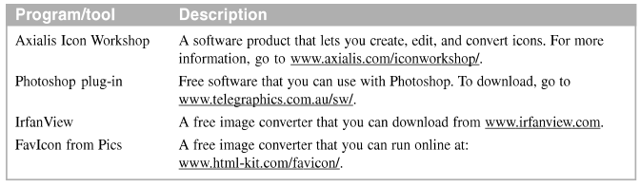
Popular programs and tools for creating favicons

Slide 34
Summary
Use the height and width attributes of an <u=img> tag
The HTML5 figure element can be used to treat an image as a figure that’s referred to outside of the figure.
A thumbnails is a small version of an image that is often used as a link to a page that display a large version of the image
An image rollover –occurs
An image map defines the clickable hotspots for an image
Notes:
Tóm tắt lại nội dung đã học

Slide 35
Discussion
Notes:
Trả lời câu hỏi WHY?

