Slide 1
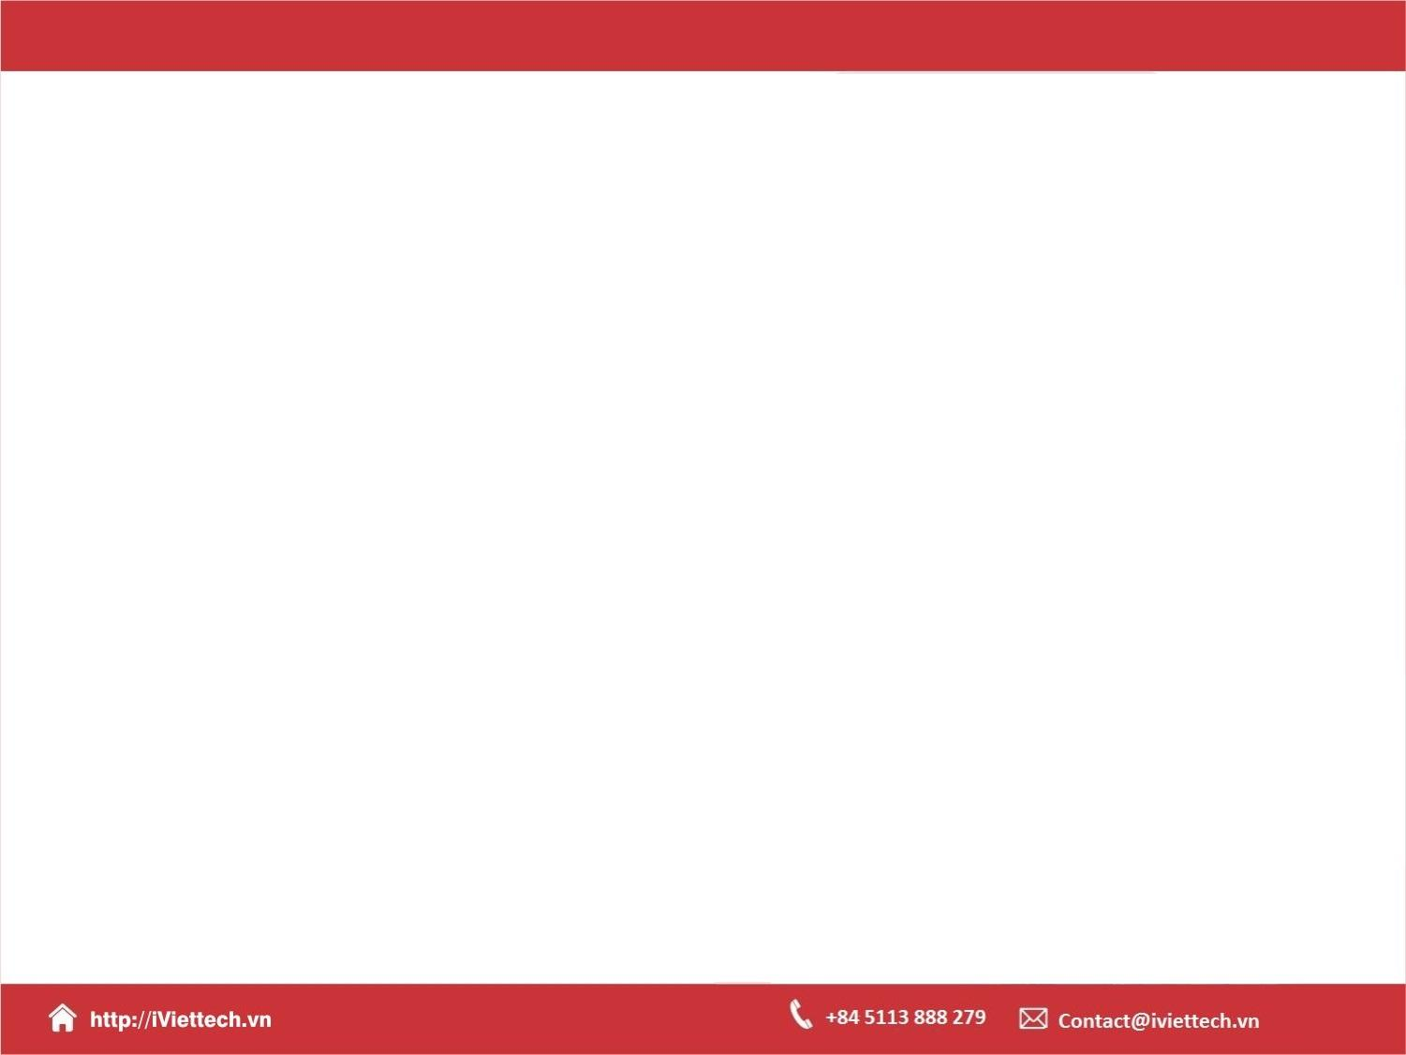
Chapter 12
How to use regular expressions, handle exceptions and validate data
Notes:
Session: Ghi số thứ tự session trong môn học
Session Name: ghi tên của session sẽ dạy

Slide 2
Objectives
How to use regular expressions
How to handle exceptions
The register application
Notes:
Mô tả nội dung mà học viên phải đạt được khi kết thúc môn học này

Slide 3
How to use regular expressions
Notes:
Session: Ghi số thứ tự session trong môn học
Session Name: ghi tên của session sẽ dạy

Slide 4
How to create and use regular expression
A regular expression defines a pattern that can be searched for in a string. This pattern is stored in a regular expression object.
To create a regular expression object, you can use the RegExp constructor function or use regular expression literal.

Slide 5
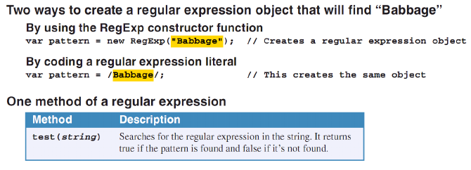
How to create and use regular expression (cont.)

Slide 6
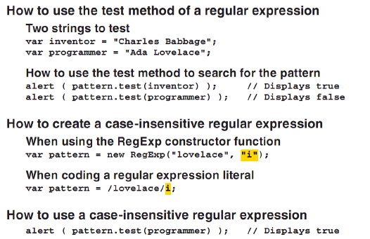
How to create and use regular expression (cont.)

Slide 7
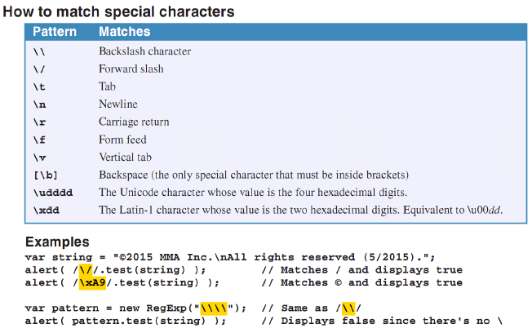
How to create regular expression patterns

Slide 8
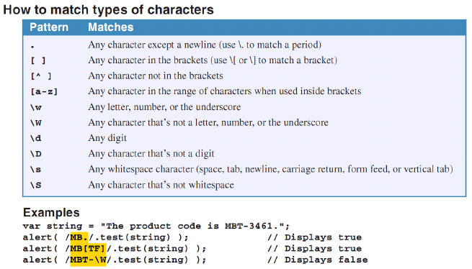
How to create regular expression patterns (cont.)

Slide 9
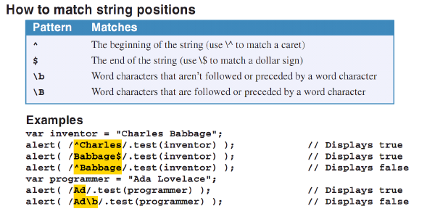
How to create regular expression patterns (cont.)

Slide 10
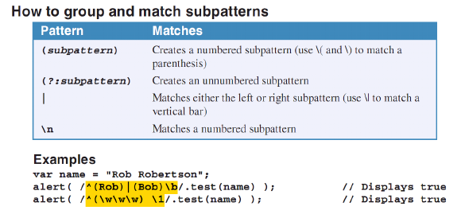
How to create regular expression patterns (cont.)

Slide 11
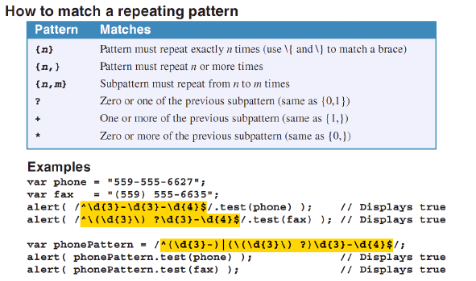
How to create regular expression patterns (cont.)

Slide 12
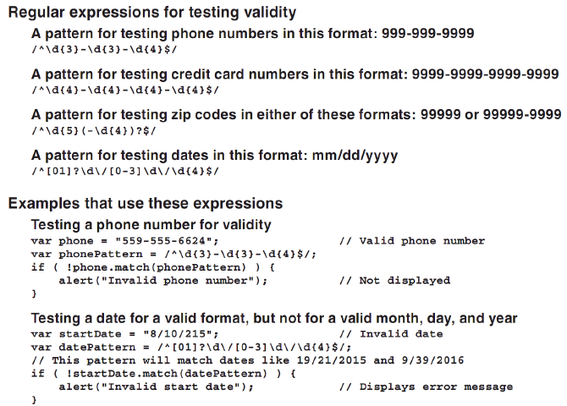
Regular expressions for data validation

Slide 13
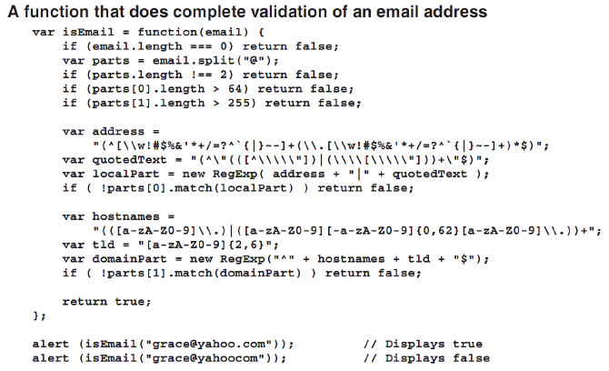
Regular expressions for data validation (cont.)

Slide 14
How to handle exceptions
Notes:
Session: Ghi số thứ tự session trong môn học
Session Name: ghi tên của session sẽ dạy

Slide 15
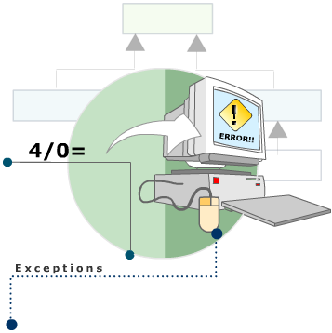
Concept of Exception
An exception is an abnormal condition that arise out of an extraordinary situation disrupting the flow of program instruction.
In programs, exceptions can
occur due to any of the following
reasons:
Programming errors
Client code errors
Errors beyond the control of a
program

Slide 16
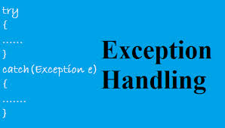
Handle checked exception
Two ways handle checked exception:
Throw the exception to the calling method
Catch the exception and handle it

Slide 17
Why you need to handle an exception?
If you don’t handle an exception:
Program maybe crash
User may be lost their data
Some resource can’t reuse

Slide 18
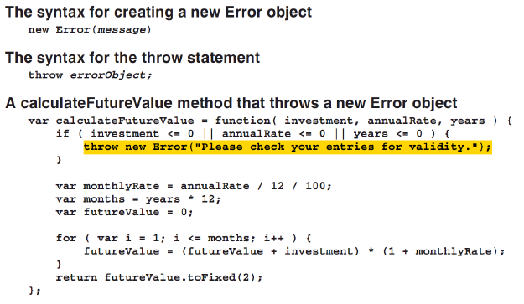
How to create and throw Error objects

Slide 19
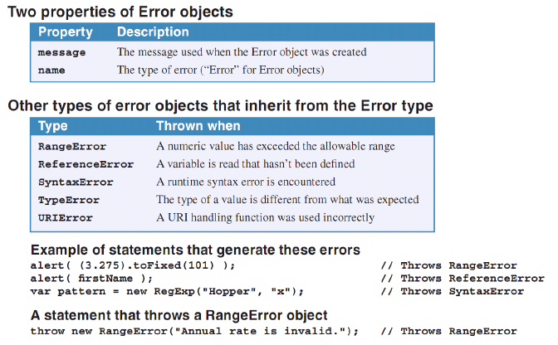
How to create and throw Error objects (cont.)

Slide 20
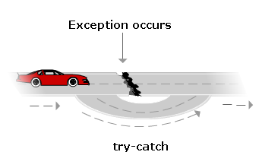
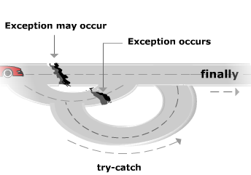
How to use try catch statement to handle exceptions
The syntax of the try statement
try {statements}
catch(errorName) {statements}
[finally {statements}]

Slide 21
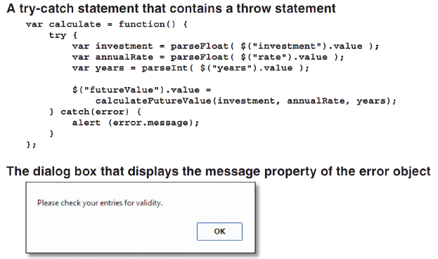
How to use try catch statement to handle exceptions (cont.)

Slide 22
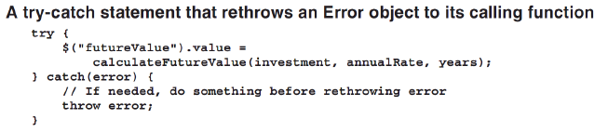
How to use try catch statement to handle exceptions (cont.)

Slide 23
The Register application
Notes:
Session: Ghi số thứ tự session trong môn học
Session Name: ghi tên của session sẽ dạy

Slide 24
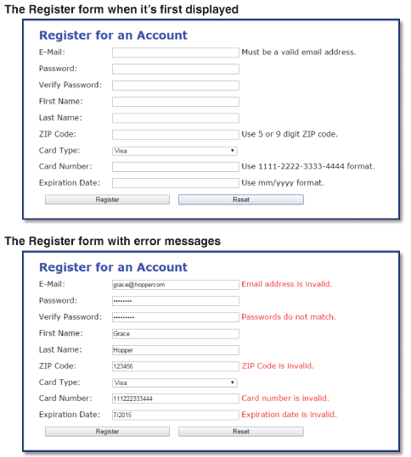
The Register application

Slide 25
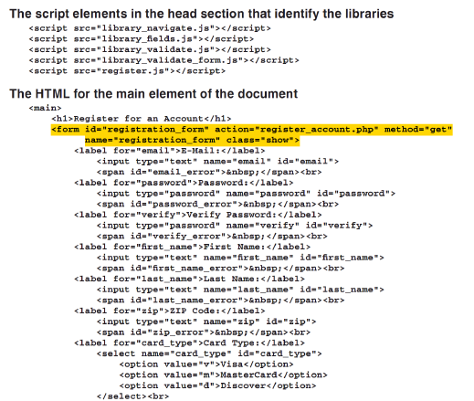
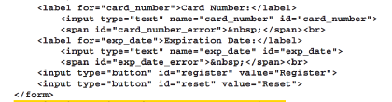
The Register application
The HTML Code

Slide 26
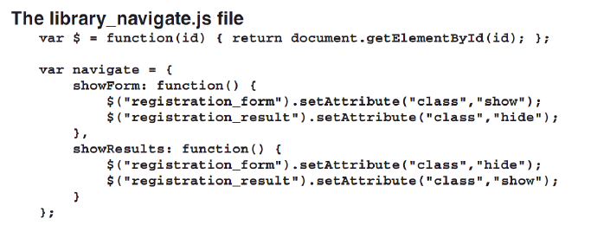
The Register application

Slide 27
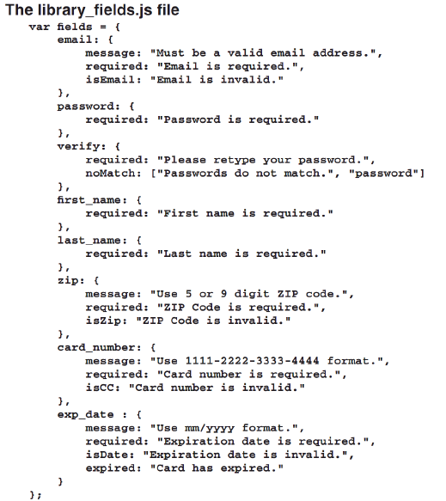

Slide 28
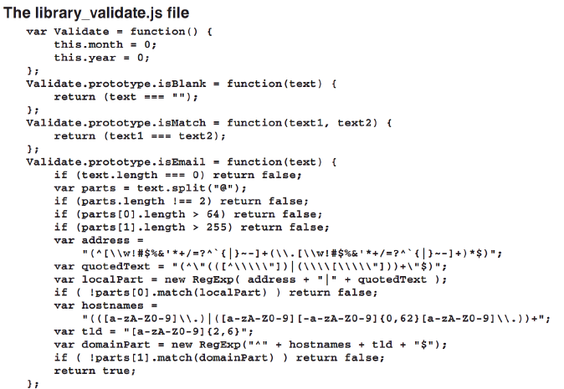
The Register application

Slide 29
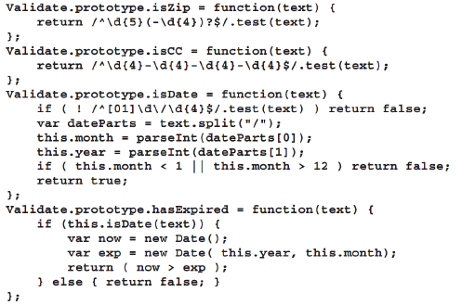
The Register application

Slide 30
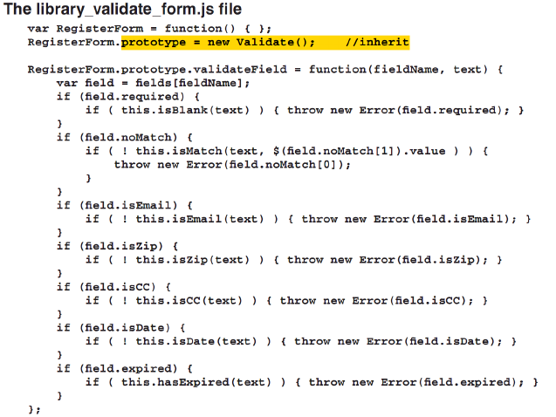
The Register application

Slide 31
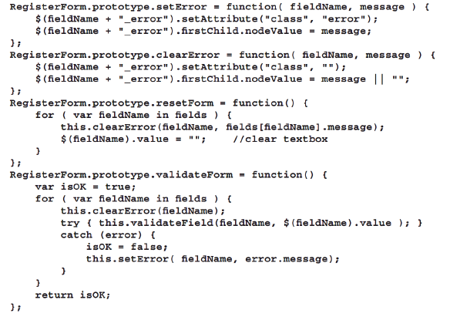
The Register application

Slide 32
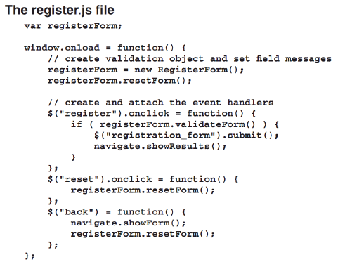
The Register application

Slide 33
Summary
A regular expression defines a pattern that can be searched for in a string. This pattern is stored in a regular expression object.
To create a regular expression object, you can use the RegExp constructor function or use regular expression literal.
An exception is an abnormal condition that arise out of an extraordinary situation disrupting the flow of program instruction.
Notes:
Tóm tắt lại nội dung đã học

Slide 34
The End.

