Slide 1

Chapter 13
How to work with events, images, and timers
Notes:
Session: Ghi số thứ tự session trong môn học
Session Name: ghi tên của session sẽ dạy

Slide 2
Objectives
How to work with events
The FAQs application
How to work with images
The Rollover application
How to use timers
The Slide Show application
Notes:
Mô tả nội dung mà học viên phải đạt được khi kết thúc môn học này

Slide 3
How to work with events
Notes:
Session: Ghi số thứ tự session trong môn học
Session Name: ghi tên của session sẽ dạy

Slide 4
Introduction to events
Events are triggered when the user does something with the mouse or keyboard or when the HTML action occurs on the page.
Event handlers can be attached to these events so the handlers run when the events are triggered.

Slide 5
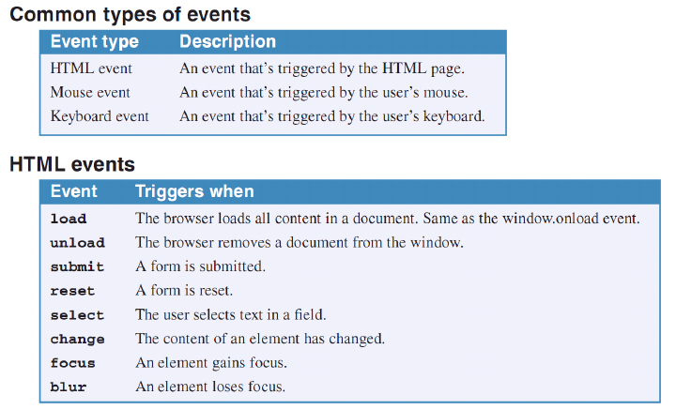
Introduction to events (cont.)

Slide 6
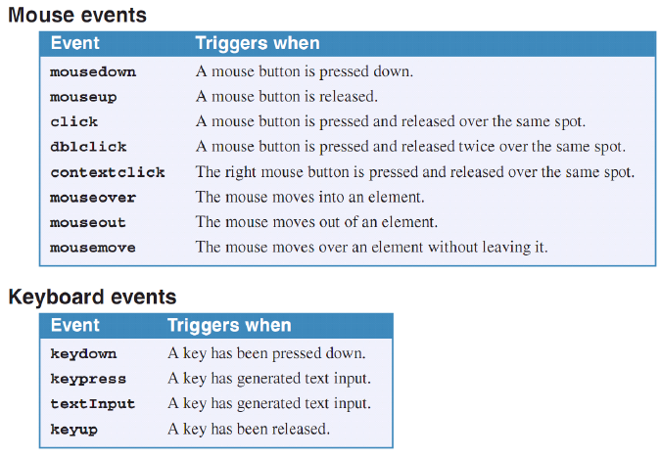
Introduction to events (cont.)

Slide 7
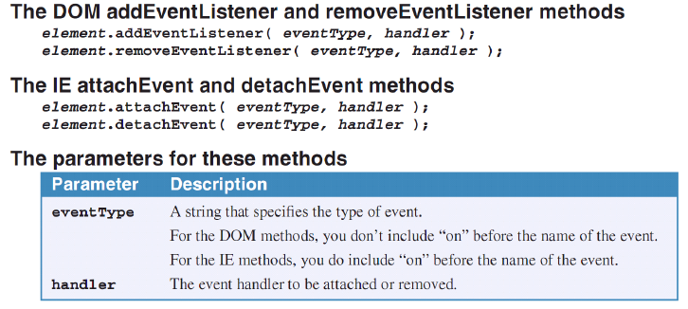
How to attach and detach event handlers
You still use JavaScript to attach an event handler:
$(“button”).onclick = eventHandlerName;
Also you can use other methods to attach and detach an event handler:

Slide 8
How to attach and detach event handlers
You still use JavaScript to attach an event handler:
$(“button”).onclick = eventHandlerName;
Also you can use addEventListener() and removeEventListener() methods to attach and detach an event handler.

Slide 9
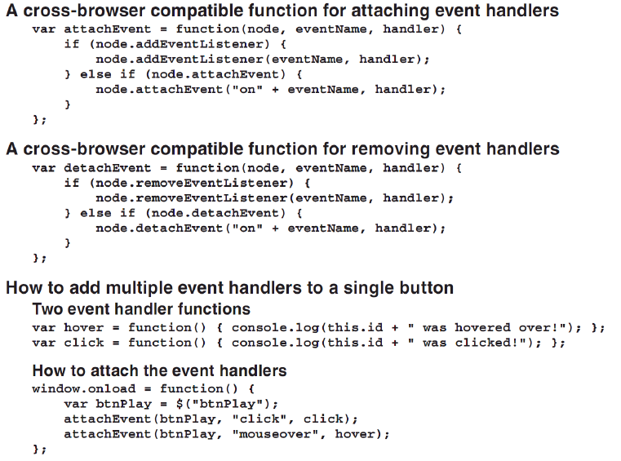

Slide 10
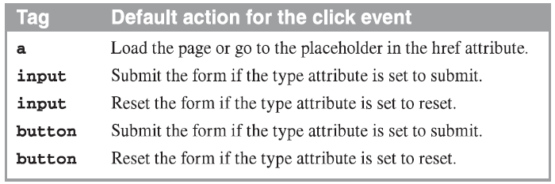
How to cancel the default action of an event
Sometime, when user click on web elements a default action is performed. To prevent default action you can cancel them.
Common HTML elements that have default actions for click event

Slide 11
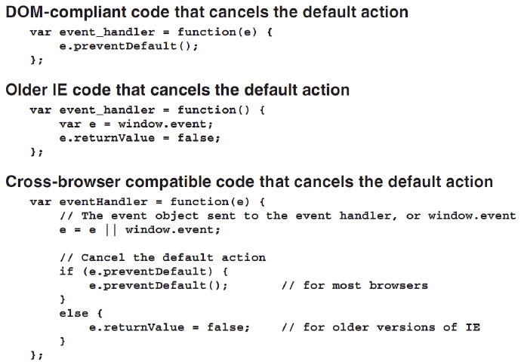
How to cancel the default action of an event (cont.)

Slide 12
The FAQs application
Notes:
Session: Ghi số thứ tự session trong môn học
Session Name: ghi tên của session sẽ dạy

Slide 13
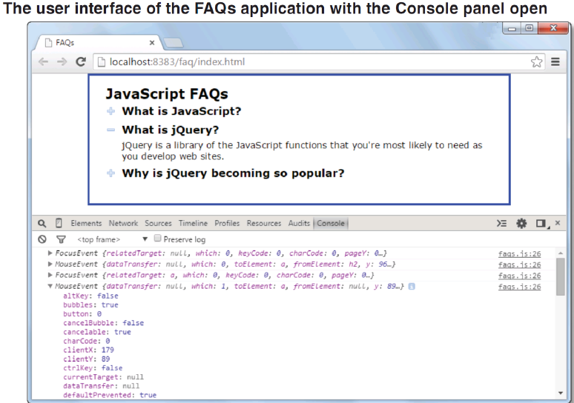
The FAQs application

Slide 14
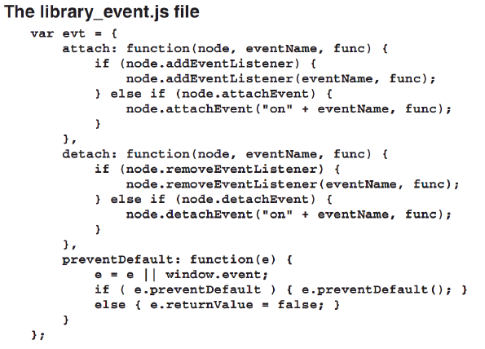
The FAQs application

Slide 15
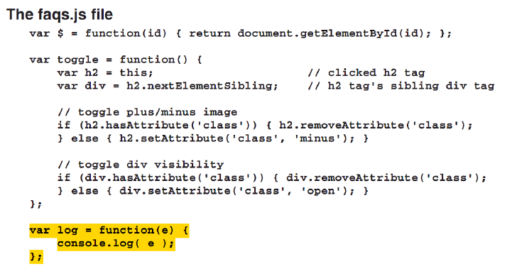
The FAQs application

Slide 16
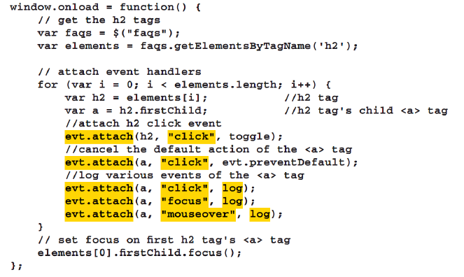
The FAQs application

Slide 17
How to work with images
Notes:
Session: Ghi số thứ tự session trong môn học
Session Name: ghi tên của session sẽ dạy

Slide 18
How to preload images
When an application preloads images, it loads all of the images that it’s going to need when the page loads, and it stores these images in the web browser’s cache for future use.
When the images are preloaded, the browser can display them whenever they’re needed without any noticeable delay.

Slide 19
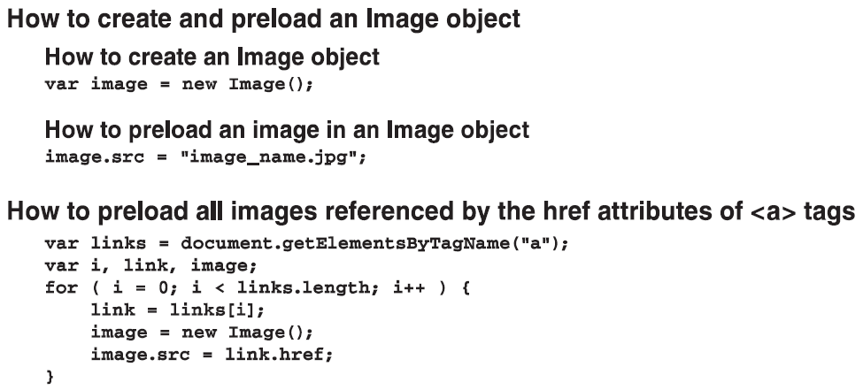
How to preload images(count.)

Slide 20
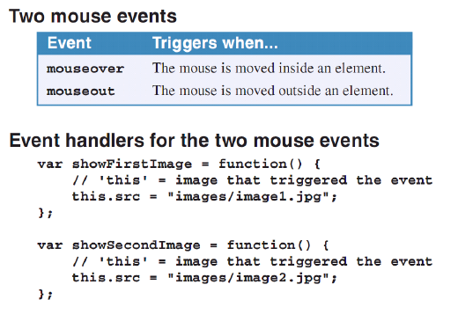
How to create image rollovers
An image rollover occurs when the user positions the mouse over an image and the image is changed.

Slide 21
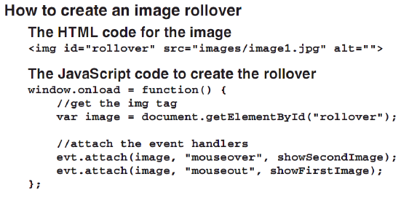
How to create image rollovers(cont.)

Slide 22
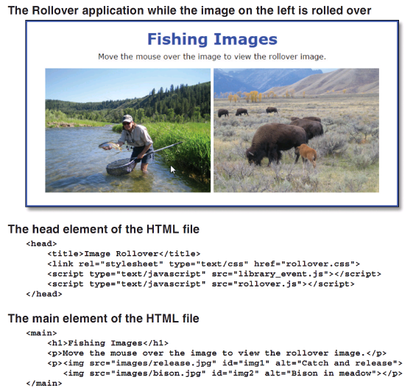

Slide 23
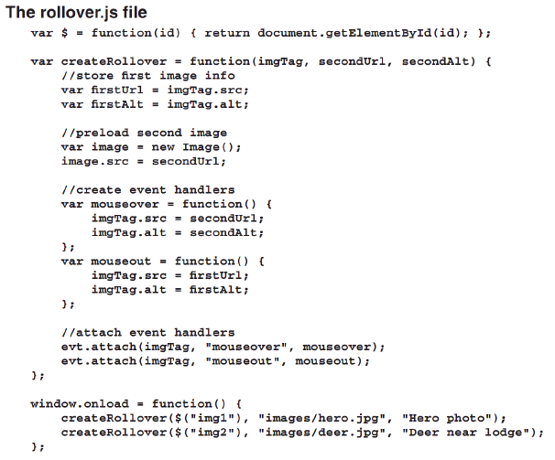

Slide 24
How to use timers
Notes:
Session: Ghi số thứ tự session trong môn học
Session Name: ghi tên của session sẽ dạy

Slide 25
How to use a one-time timer
Timer lets you execute a function after a specified period of time.
Two methods for working with a timer that calls a function one

Slide 26
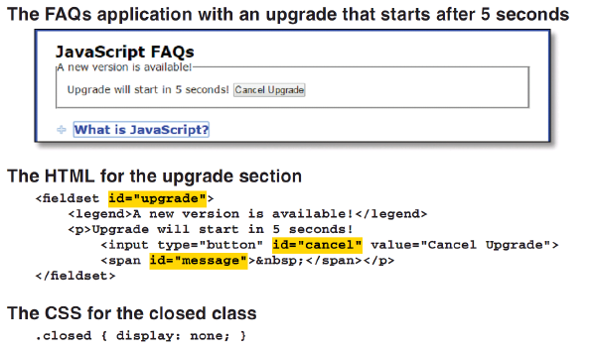
How to use a one-time timer(cont.)

Slide 27
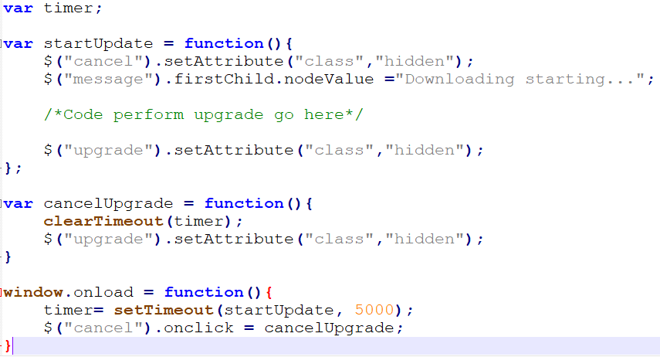
How to use a one-time timer(cont.)
The code JavaScript

Slide 28
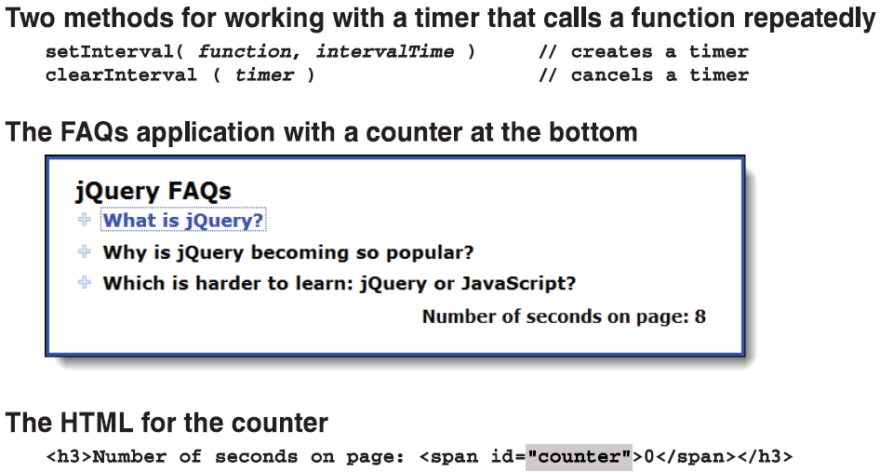
How to use an interval timer

Slide 29
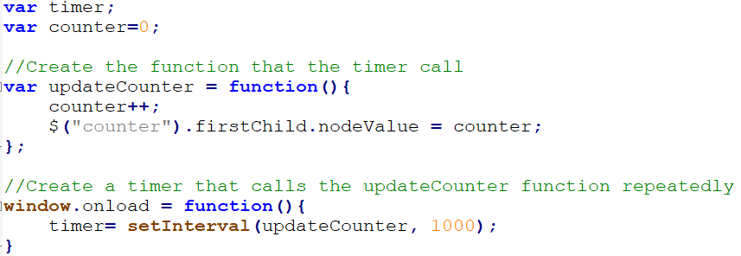
How to use an interval timer (Cont.)
How to use the setInterval() method to add a counter to a page
How to cancel the timer
clearInterval(timer);

Slide 30
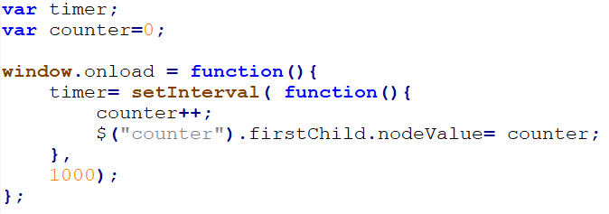
How to use an interval timer (Cont.)
How to use an anonymous function with the setInterval() method

Slide 31
The Slide Show application
Notes:
Session: Ghi số thứ tự session trong môn học
Session Name: ghi tên của session sẽ dạy

Slide 32
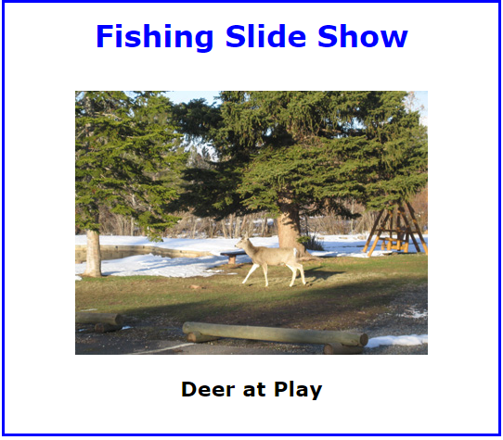
The Slide Show application
The User Interface

Slide 33
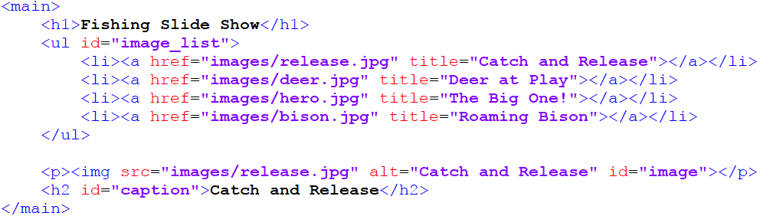
The Slide Show application
The HTML code

Slide 34
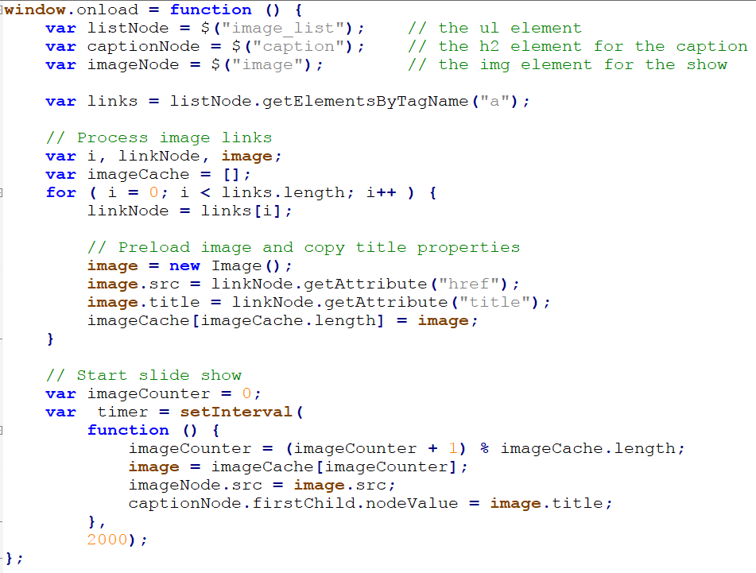
The Slide Show application
The JavaScript code

Slide 35
Summary
Events are triggered when the user does something with the mouse or keyboard or when the HTML action occurs on the page.
Event handlers can be attached to these events so the handlers run when the events are triggered.
When an application preloads images, it loads all of the images that it’s going to need when the page loads, and it stores these images in the web browser’s cache for future use.
Timer lets you execute a function after a specified period of time. You cam use timer to call function one or repeatedly by an interval.
Notes:
Tóm tắt lại nội dung đã học

Slide 36
The End.

