Slide 1

Chapter 15
How to work with namespaces,
modules, and custom properties
Notes:
Session: Ghi số thứ tự session trong môn học
Session Name: ghi tên của session sẽ dạy

Slide 2
Objectives
How to work with namespaces
The Task Manager application
How to work with the module pattern
The Slide Show application
How to customize properties
The enhanced Slide Show application
Notes:
Mô tả nội dung mà học viên phải đạt được khi kết thúc môn học này

Slide 3
How to work with namespaces
Notes:
Session: Ghi số thứ tự session trong môn học
Session Name: ghi tên của session sẽ dạy

Slide 4
Introduction to namespaces
A namespaces is a container or grouping of certain objects, usually related object.
In JavaScript, variables, functions and objects that are created outside of any other object have global scope so they are in global namespace.
When multiple libraries add many variable, functions, objects to global namespace, it can lead global namespace pollution.
To reduce this pollution you can create and use your owner namespace.

Slide 5
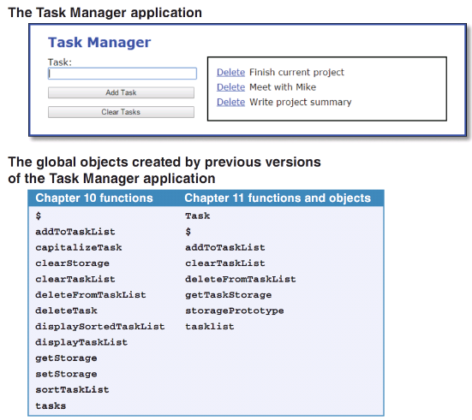
Global namespace pollution
So many name in namespace global

Slide 6
Global namespace pollution(cont.)
Problem with adding functions and object to the global namespace:
There’s a possibility of name collision with other libraries.
It’s harder to implement security check that detect malware.

Slide 7
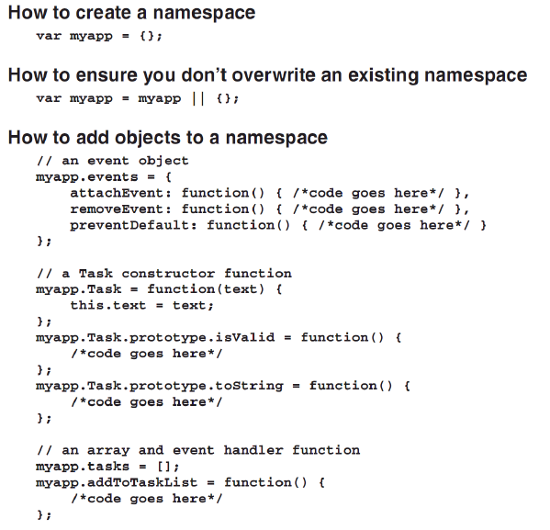

How to create and use namespaces

Slide 8
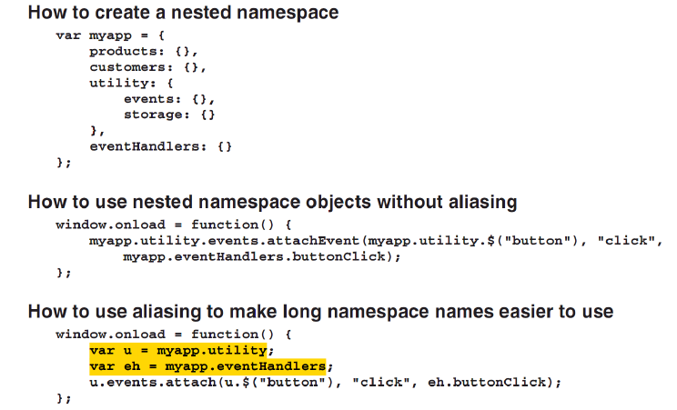
How to create nested namespace and use aliases

Slide 9
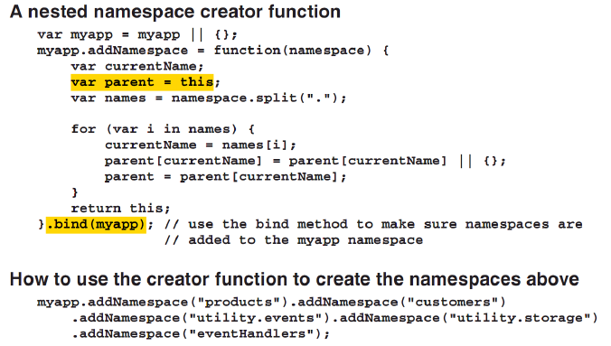
How to create nested namespace and use aliases (cont.)

Slide 10
The Task Manager application
This version of application use namespace
Page 482-487
Notes:
Session: Ghi số thứ tự session trong môn học
Session Name: ghi tên của session sẽ dạy

Slide 11
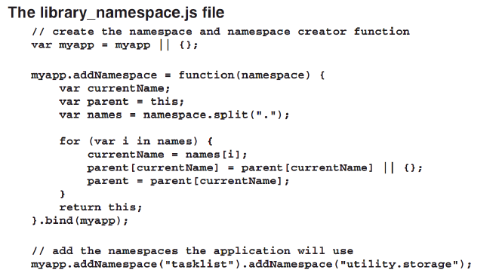
Create a namespace for application

Slide 12
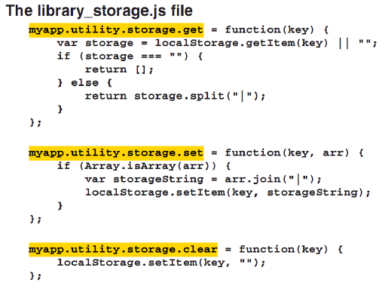
Create a namespace for application (cont.)

Slide 13
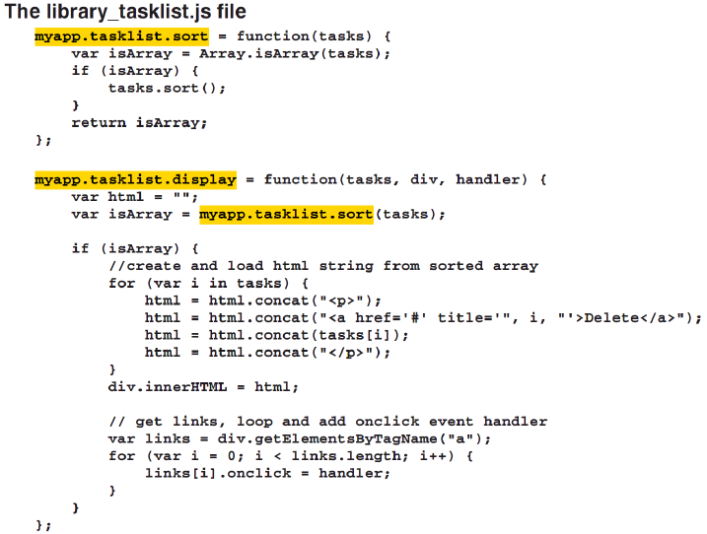
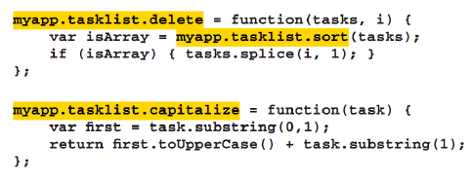
The Task library use namespace

Slide 14
How to work with module pattern
Notes:
Session: Ghi số thứ tự session trong môn học
Session Name: ghi tên của session sẽ dạy

Slide 15
Introduction to module pattern
The module pattern uses immediately invoked function expression(IIFE) to create a single instance of the closure return by the function.
That way, you get the benefits of an object literal while still having the private state of a closure.
Since a module is easy to argument, you can split an object among multiple files. This is helpful when you work with a large of code.

Slide 16
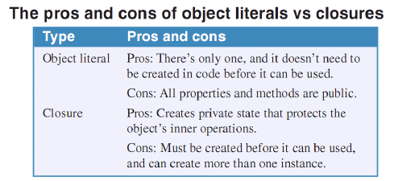
Introduction to module pattern(cont.)

Slide 17
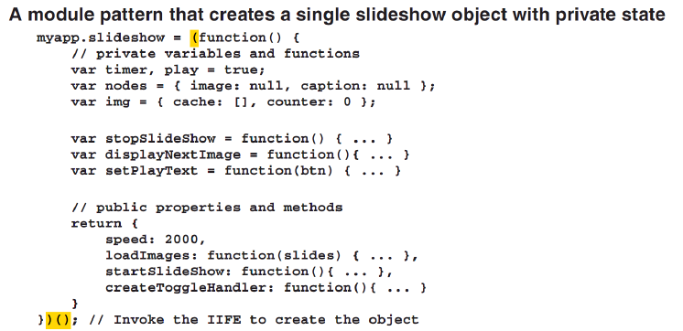
Module pattern example

Slide 18
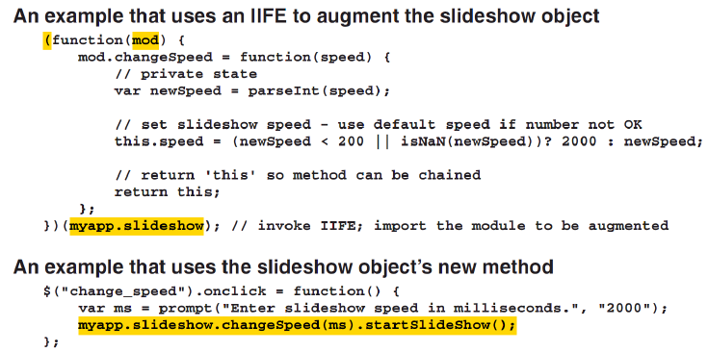
How to argument a module
To argument a module object, you can use an IIFE, and you import the module to be augmented by passing it as an argument when you invoke the IIFE.

Slide 19
How to customize properties
Notes:
Session: Ghi số thứ tự session trong môn học
Session Name: ghi tên của session sẽ dạy

Slide 20
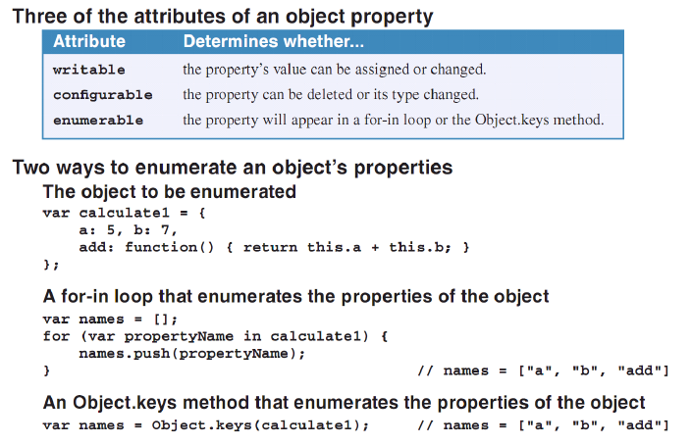
How to enumerate an object’s properties

Slide 21
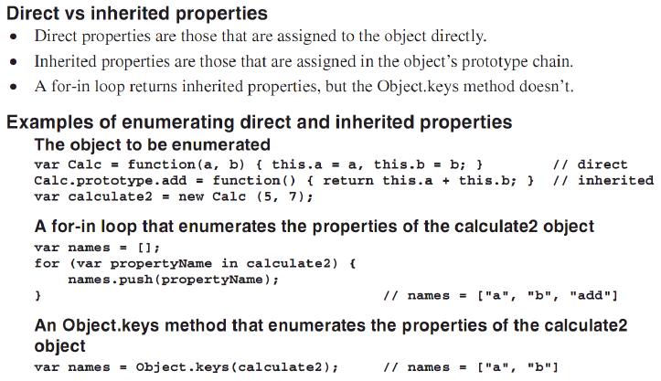
How to enumerate an object’s properties (cont.)

Slide 22
How to enumerate an object’s properties (cont.)
When you assign a property or method to an object, it is writable, configurable, and enumerable is default.
You can enumerate the properties of an object using a for-in loop or the Object.keys method.

Slide 23
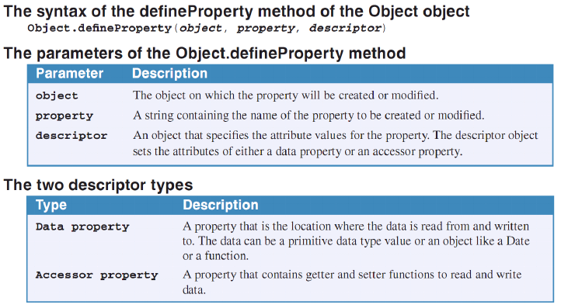
The defineProperty method of the Object object

Slide 24
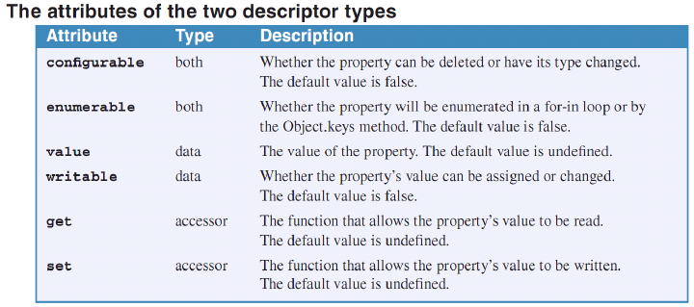
The defineProperty method of the Object object (cont.)

Slide 25
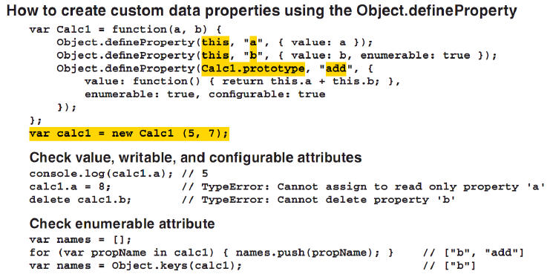
How to use defineProperty method

Slide 26
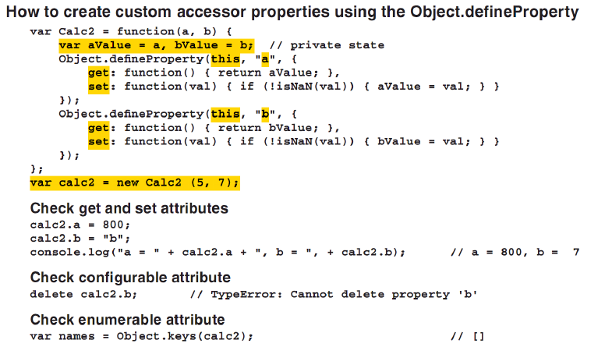
How to use defineProperty method (cont.)

Slide 27
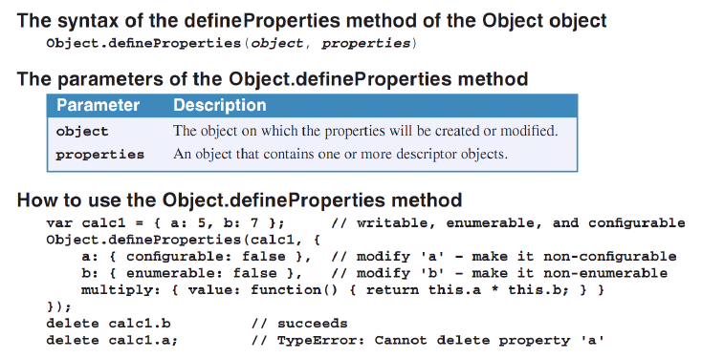
How to use defineProperty method and create method of the Object object

Slide 28
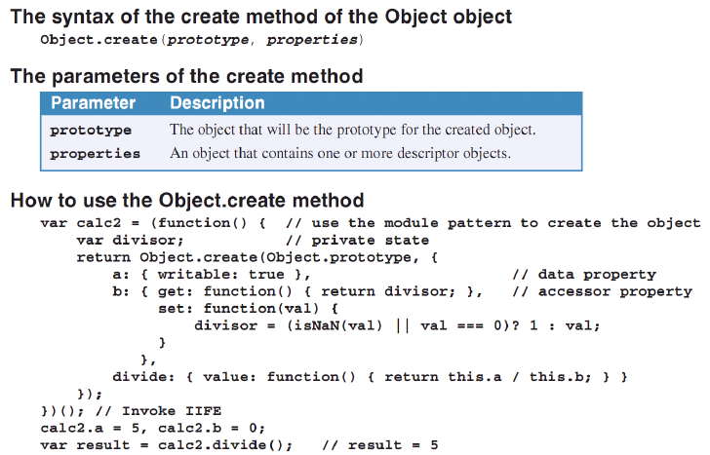
How to use defineProperty method and create method of the Object object (cont.)

Slide 29
The enhanced Slide Show application
This application use custom properties
Notes:
Session: Ghi số thứ tự session trong môn học
Session Name: ghi tên của session sẽ dạy

Slide 30
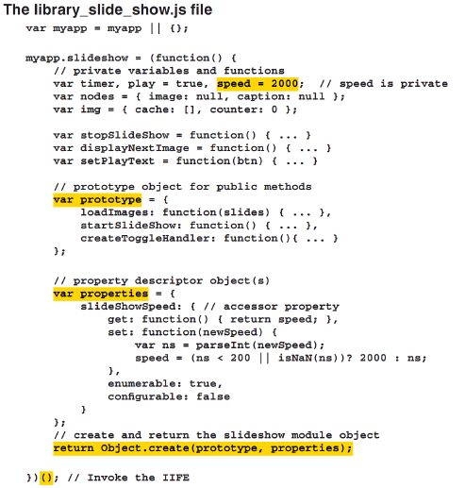
The library use customize properties

Slide 31
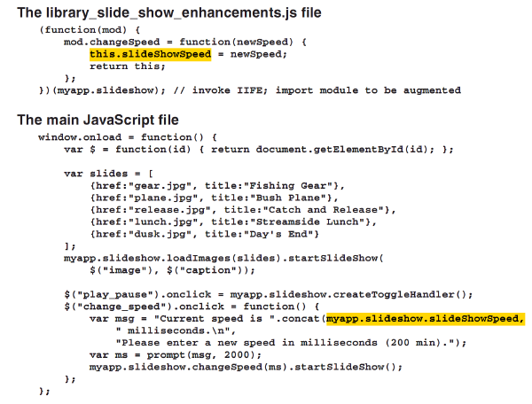
The library use customize properties (cont.)

Slide 32
Summary
A namespaces is a container or grouping of certain objects, usually related object.
Variables, functions and objects that are created outside of any other object have global scope called global namespace.
To reduce global namespace pollution you can create and use your owner namespace.
The module pattern uses immediately invoked function expression(IIFE) to create a single instance of the closure return by the function.
When you assign a property or method to an object, it is writable, configurable, and enumerable is default.
You can enumerate the properties of an object using a for-in loop or the Object.keys method.
Notes:
Tóm tắt lại nội dung đã học

Slide 33
The End.

