Slide 1
MedSight
AI-Powered Prescription Intelligence
Clinical Natural Language Technology for Health Care:
Past, Present, & Future Approaches
Tanaya Joshi | University of Maryland, College Park
Cotiviti Intern Assessment | 2026
Notes:
Introduce yourself, the topic, and the assessment. Mention MedSight is the proof of concept you built.

Slide 2





What is Clinical NLP?
Clinical NLP extracts structured information from unstructured healthcare data: notes, claims, prescriptions, faxed documents
Scope extends beyond text: OCR, Computer Vision, LLMs, and Multimodal Models form an evolving technology pipeline
The field is shifting from multi-stage specialized pipelines to unified foundation models that read, extract, and reason in one step
80%
of healthcare data
is unstructured
OCR
NLP
Computer
Vision
LLMs
Multimodal
Models
Notes:
Explain that 80% of healthcare data is unstructured. Introduce the technology scope: OCR, NLP, CV, LLMs, Multimodal.

Slide 3
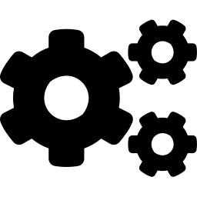
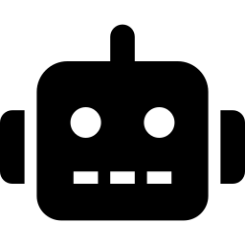

Evolution of Clinical NLP
Past
Present
Future
Rule-Based Systems
Domain-Specific Transformers
Foundation & Multimodal AI
Handcrafted rules, regex, UMLS dictionaries
MedLEE (1994), cTAKES (2010)
Tesseract OCR — fails on handwriting
Brittle: manual engineering per document type
BioBERT, PubMedBERT — pre-trained on biomedical text
TrOCR — 90%+ handwriting accuracy
Mistral OCR — 88.9% on handwriting
One model per task, one pipeline per workflow
GPT-4, Mistral Large — zero-shot extraction
GPT-4o: 0.95 F1 on medical NER (no fine-tuning)
Pixtral, GPT-4V — image to structured data
Entire OCR + NLP pipeline requires one model
Notes:
Walk through past (rule-based), present (transformers), future (foundation models). Emphasize the trend toward unification.

Slide 4

MedSight — System Architecture
Prescription Image
OCR Pipeline (Past/Present)
Multimodal LLM (Future)
OpenCV preprocessing
Tesseract OCR extraction
Mistral Large text cleanup
Pixtral Large
Image to structured JSON
Single inference call
openFDA API — Drug Labels & Interactions
Output:
Patient Information | Medications to take
Output:
Patient Information | Medications to take | Drug Interactions by severity | Medication Schedule
Notes:
Explain the dual-pipeline architecture. OCR path on the left is past/present, multimodal on the right is the future. Both feed into FDA grounding.

Slide 5
Tech Stack
Frontend
Streamlit — interactive web UI with custom CSS theming
OCR Pipeline
OpenCV (preprocessing) + Tesseract OCR (text extraction)
AI Models
Pixtral Large (multimodal) + Mistral Large (text reasoning)
Data Grounding
openFDA Drug Label API — interactions, dosage, warnings
Language: Python
Notes:
Walk through each layer of the tech stack. Mention why each technology was chosen.

Slide 6




Why Grounding Matters in Healthcare AI
The Risk of Raw LLMs
The MedSight Approach (RAG)
LLMs can hallucinate — generate plausible but incorrect medical facts
In healthcare, wrong drug interactions or missed warnings can directly harm patients
"Sounds right" is not acceptable when patient safety is at stake
LLM extracts medications from the prescription
openFDA API retrieves official drug label data
LLM generates output using ONLY FDA data as context
Every warning traces back to an authoritative source
The LLM is the reasoning engine, not the knowledge source. Authoritative databases are the knowledge source.
Applicable Beyond MedSight
Payment Policy Management → ground in CMS billing policies
Coding Validation → ground in ICD-10/CPT references
Risk Adjustment → ground in validated clinical guidelines
Notes:
This is the key argument. Stress: LLM reasons, authoritative data provides the facts. The pattern is reusable across Cotiviti's product lines.

Slide 7
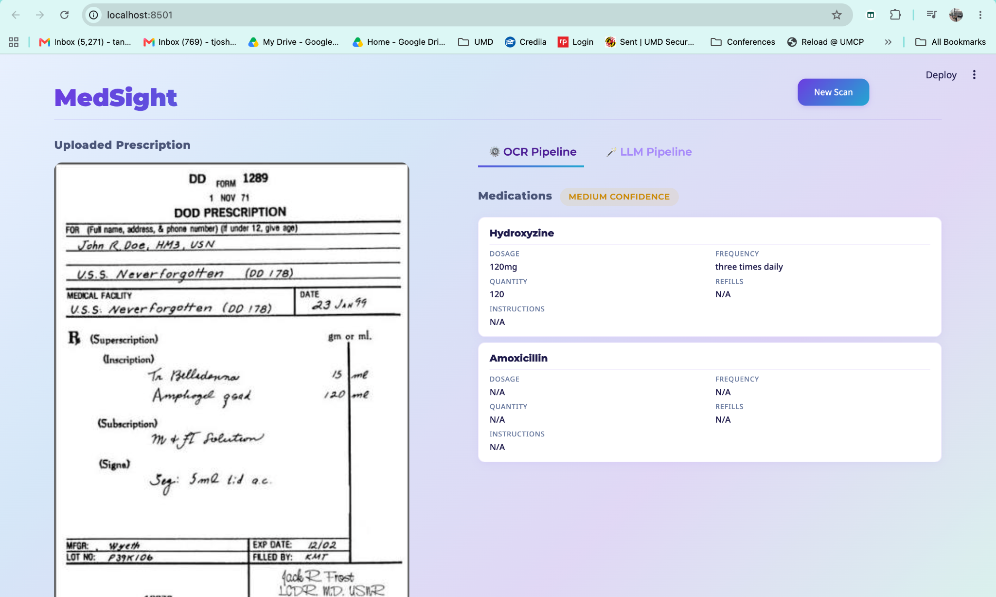
Live Demo
[ MedSight Application Demo ]
Screenshare of the working application
Upload prescription image
Compare OCR Pipeline vs Multimodal LLM extraction
View medication cards, interaction warnings, and daily schedule
Notes:
Switch to screenshare. Show the landing page, upload a prescription, toggle between OCR and LLM pipelines, show medication cards and interaction warnings.

Slide 8
Strategic Recommendation for Cotiviti
Pilot retrieval-augmented generation across existing product lines, grounding LLM outputs in authoritative sources
The MedSight pattern — multimodal extraction + FDA data grounding — maps directly to Cotiviti workflows: Payment Policy, Coding Validation, Risk Adjustment
Cotiviti's connected data platform (3.5B+ claims/year) is already the grounding layer
Lead the industry on auditable healthcare AI: every AI output traceable to a verified source
3.5B+ claims annually — the grounding data already exists
Notes:
Summarize: pilot RAG pipelines, replicate the MedSight pattern, leverage Cotiviti's existing data as the grounding layer.

Slide 9
Thank You
Tanaya Joshi | University of Maryland, College Park

