Slide 1
Face Analytics
Detecting Face, Emotion, Gender, Age from Images,
using Convolutional Neural Networks
Tan Shu Jun, GA DSI 11

Slide 2



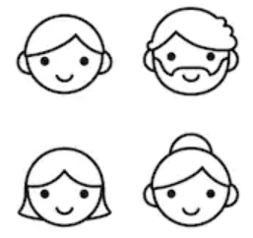
Product Features
Face Detection
Emotion Detection
Gender Detection
Age Detection

Slide 3
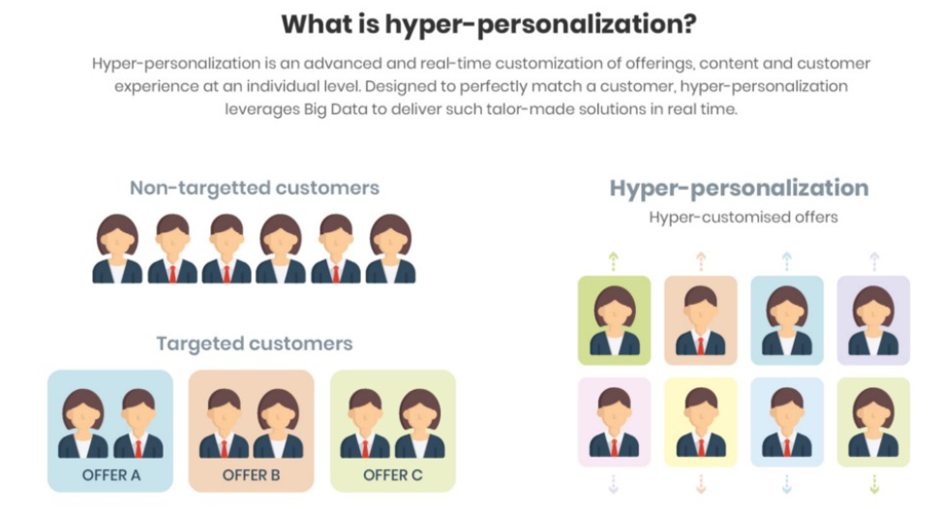
Problem Statement
This project aims to detect and classify human faces by emotions, gender and age, to allow companies to better customise user experience, improve customer loyalty and generate additional sales
Improve understanding of emotions induced by products that customers interact with, and how these impact customer satisfaction and their decisions to purchase

Slide 4
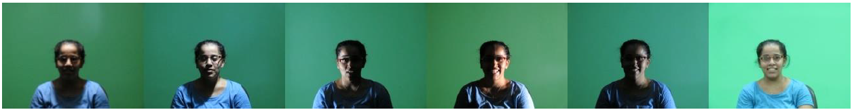
Data Collection, Pre-Processing & Exploratory Data Analysis
The Specs on Face (SoF) dataset (https://sites.google.com/view/sof-dataset)
Collection of images for 112 persons who wear glasses under different illumination conditions
Devoted to two main problems: face occlusions and harsh illumination environments

Slide 5
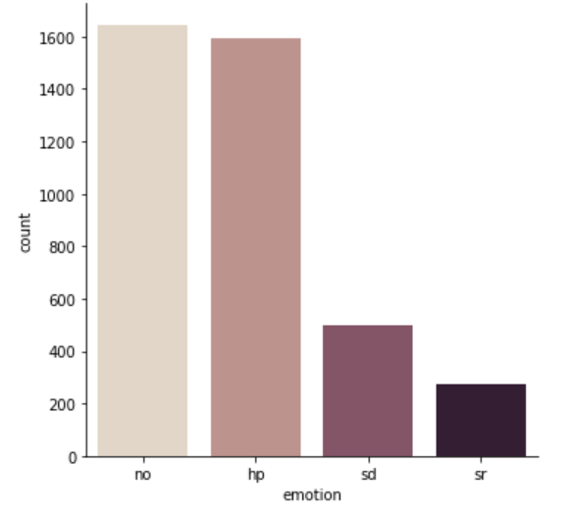
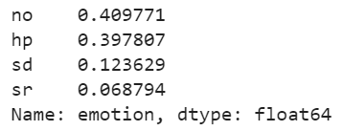
Data Collection, Pre-Processing & Exploratory Data Analysis
Four emotion labels provided in dataset
No: Neutral
Hp: Happy
Sd: Sad/Angry/Disgusted
Sr: Surprised/Fearful
Added CK+48 dataset (https://www.kaggle.com/shawon10/ckplus) to increase size of train data for hp/sd/sr emotion classes

Slide 6
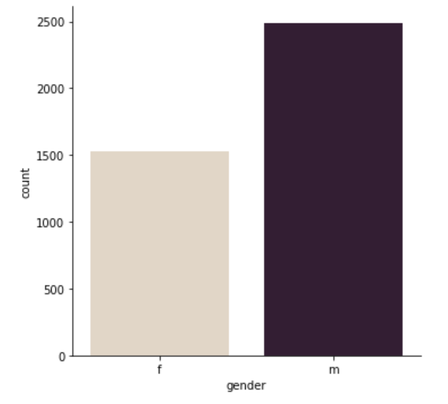
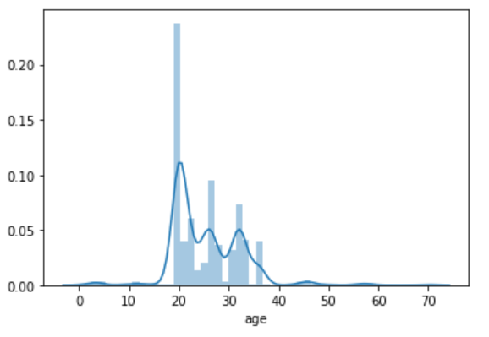
Data Collection, Pre-Processing & Exploratory Data Analysis
Gender and Age labels also provided in SoF dataset

Slide 7
Data Collection, Pre-Processing & Exploratory Data Analysis
Resize to standardise all images (150x150 px)
Convert to greyscale and normalise images to reduce effect of poor lighting
Tried Adaptive Thresholding, but did not improve results
Image augmentation to increase size of train dataset (horizontal flipping)

Slide 8
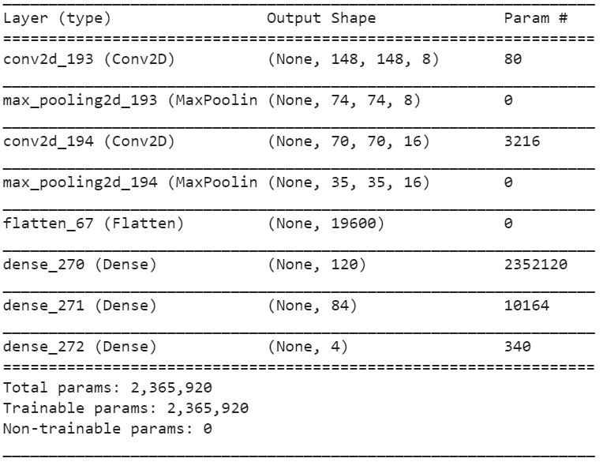
CNN Models Implemented
Face Detection – Transfer Learning using pre-trained MTCNN model
Emotion, Gender, Age Detection – Reference from simple LeNet-5 architecture
Emotion classification accuracy = 60.0%
Gender classification accuracy = 93.6%
Age regression MAE = 3.2

Slide 9
Emotion Detection Model: Initial Problems and Subsequent Improvements
Imbalanced classes
Class weights to penalise the model more for wrong predictions on images from smaller classes
Overfitting
Dropouts, Batch Normalization, Early Stopping methods
Difficult to tune hyperparameters manually given time and resource constraints
Hyperas/Hyperopt (Bayesian Sequential Model-based Optimisation)
Uses information from past trials to inform next set of hyperparameters to explore

Slide 10
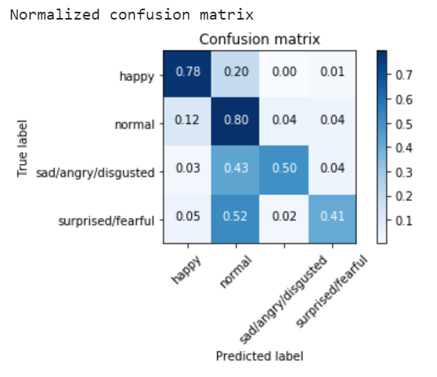
Emotion Detection Model: Further Optimisations
With the above improvements, model accuracy improved to 72.8%
However, model still performs poorly when detecting sd/sr emotion classes
Tried implementing ensemble with Machine Learning models (e.g. Random Forest, Naive Bayes) but did not improve results

Slide 11
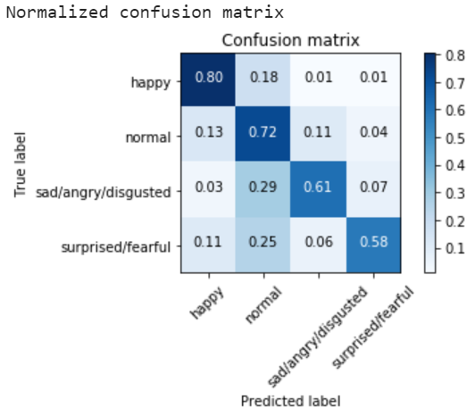
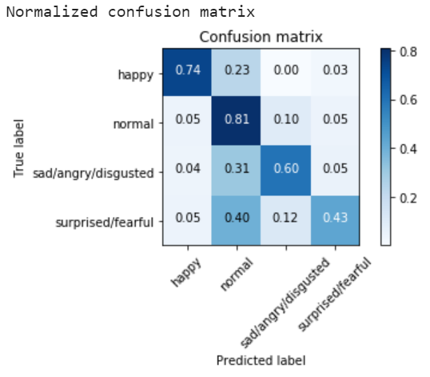
Emotion Detection Model: Further Optimisations
Ensemble three CNN models
Slightly different architectures and hyperparameters (combining Hyperas top performing models)
Grid search model weights

Slide 12
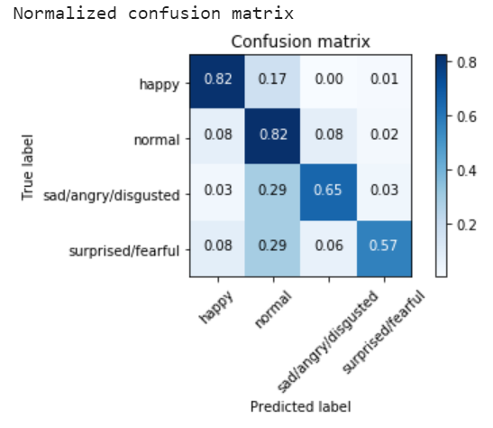
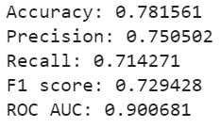
Emotion Detection Model: Ensemble Results
Significant improvement in model accuracy for sd/sr emotions
‘macro’ – calculate metrics for each class and find unweighted mean

Slide 13
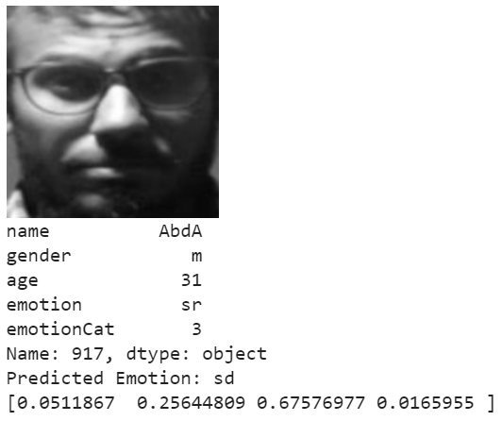
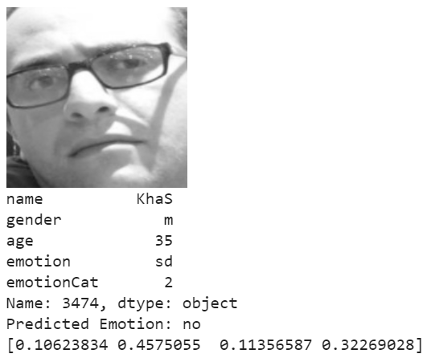
Emotion Detector Model: Examples of Wrongly Classified Emotions

Slide 14
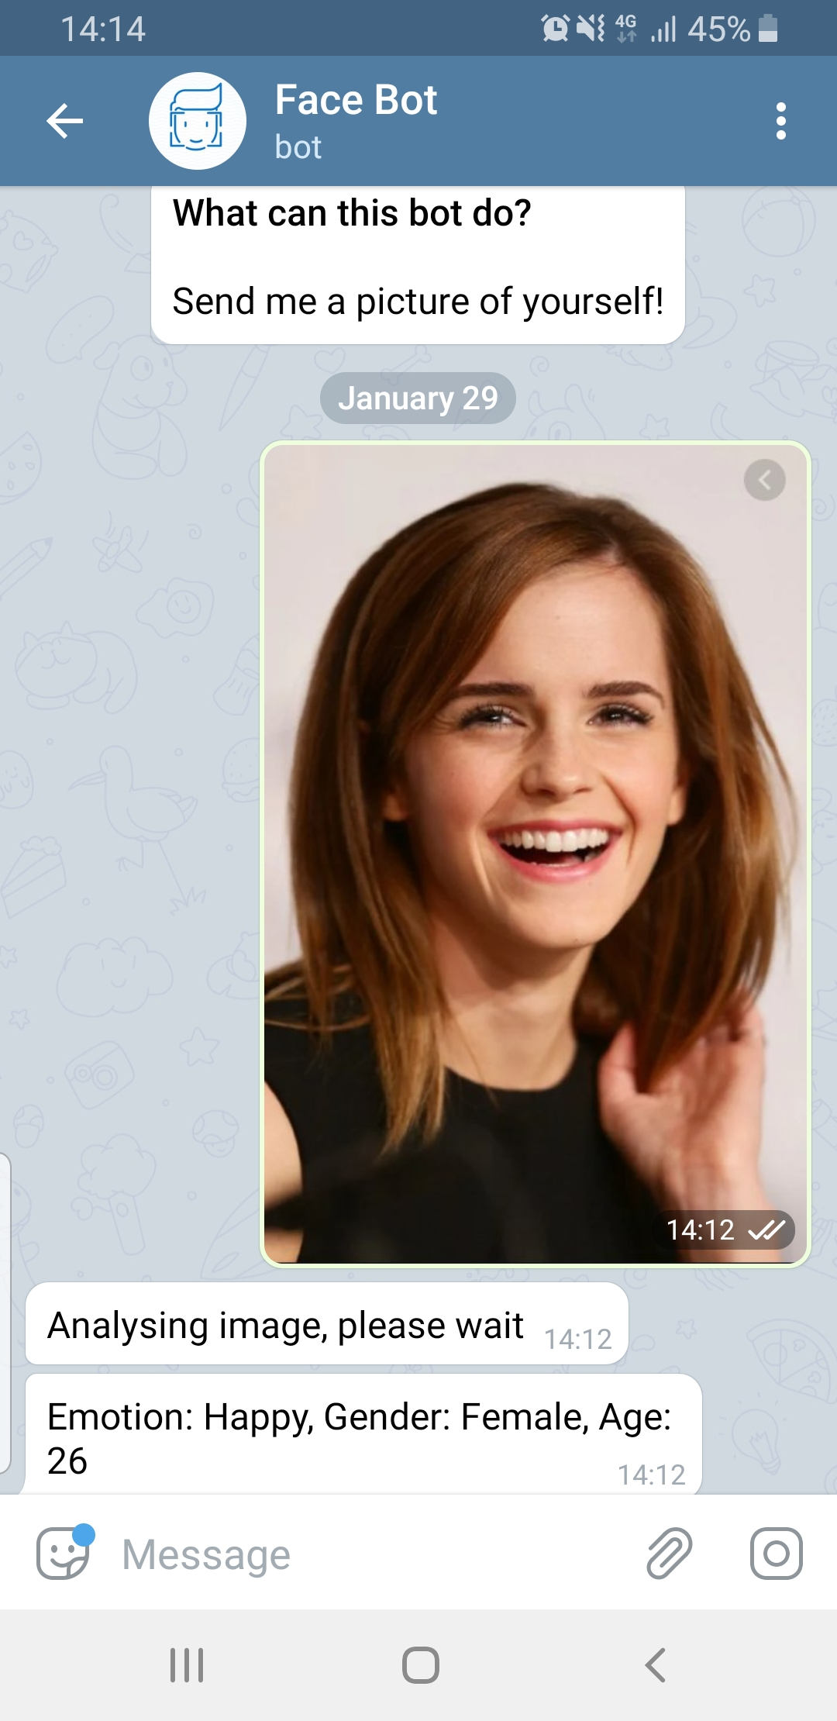
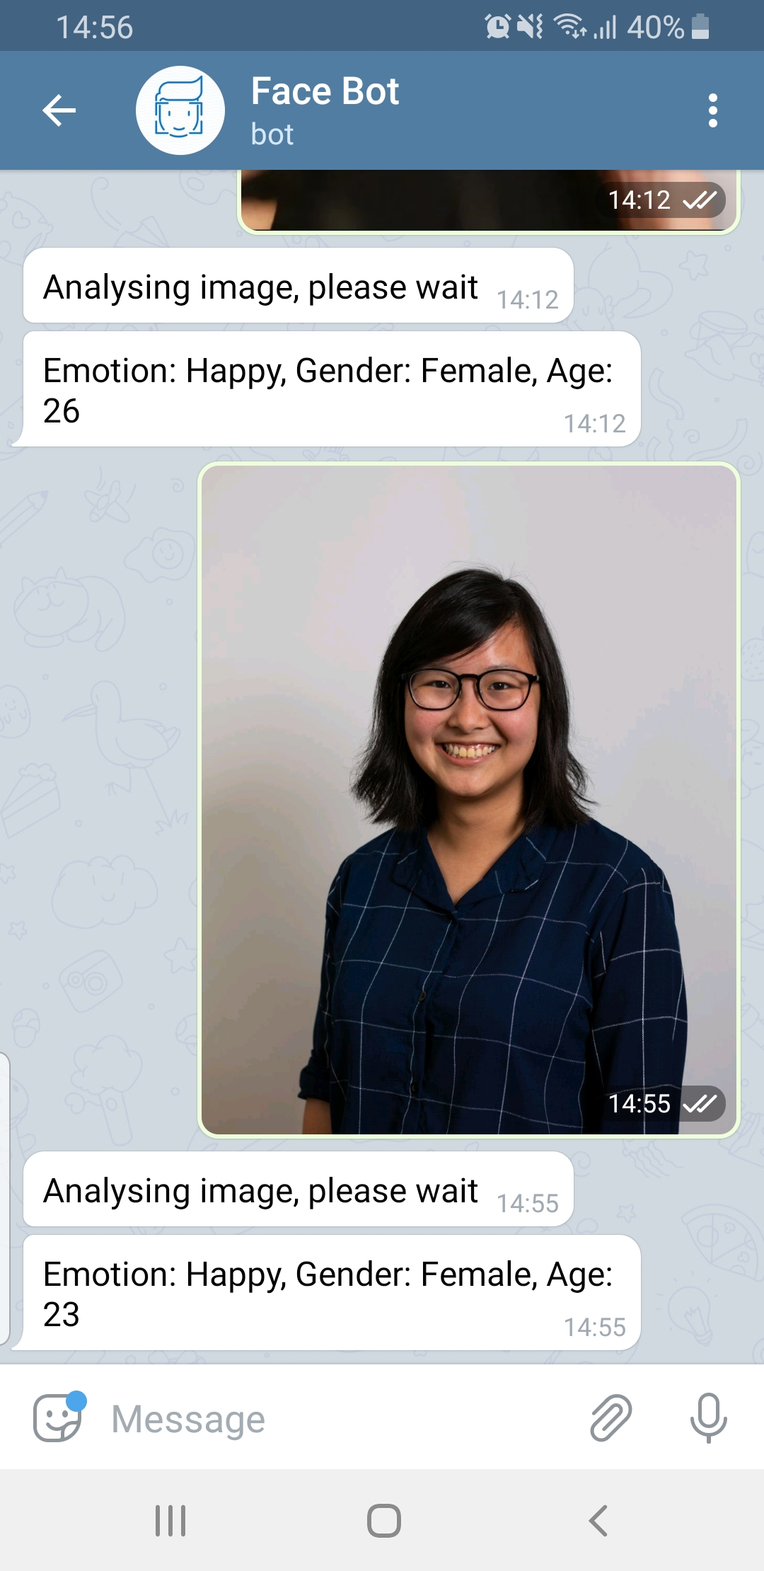
Deployment to Telegram App using Heroku
Telegram bot @FaceClassificationBot
Real time prediction of a person’s emotions, gender and age based on the image provided by the user

Slide 15
Project Limitations
Models trained on SoF dataset, which is not representative of population
Most volunteers were from Egypt, very few Asians
Age range mostly between 20-35 years old – model performs poorly on very young (e.g. babies) or very old people
Emotions are complex, even humans get it wrong sometimes
Challenging to judge someone’s emotions just by their facial expressions
Consider body language, choice of words, tone of voice

