Slide 1
UI Revamp to Corporate Page
Corporate Information Page
5th Aug 2016

Slide 2
Objectives & Scope
Objectives
Update UI
Re-organize and remove unwanted information
Scope
GSOL Corporate Information Page

Slide 3
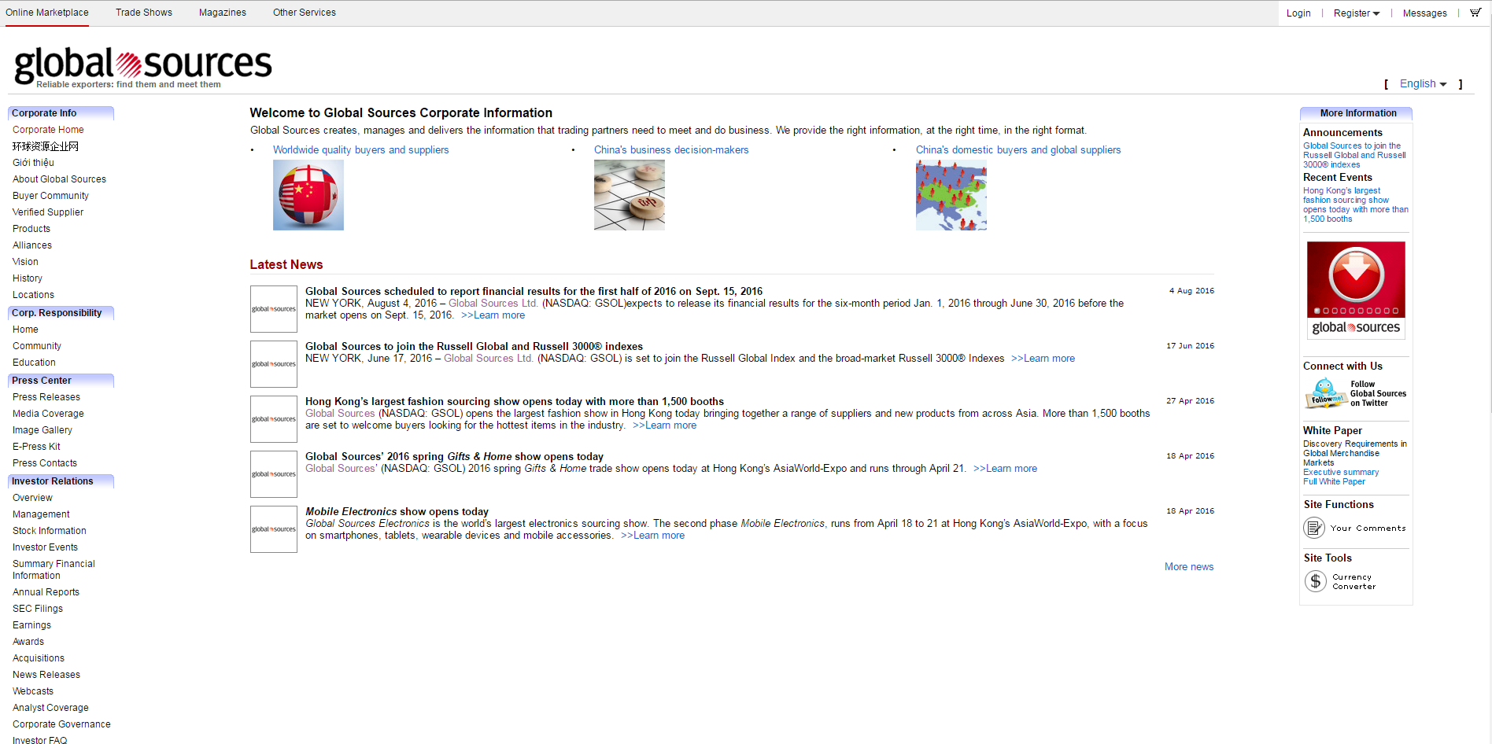
Current Screenshot

Slide 4
Proposed Changes
Centralize contents to the center of the screen
Update color scheme from purple shade to light grey scheme to be consistent with other pages on GSOL
Re-organize information
Remove unwanted information
Update page to be responsive

Slide 5
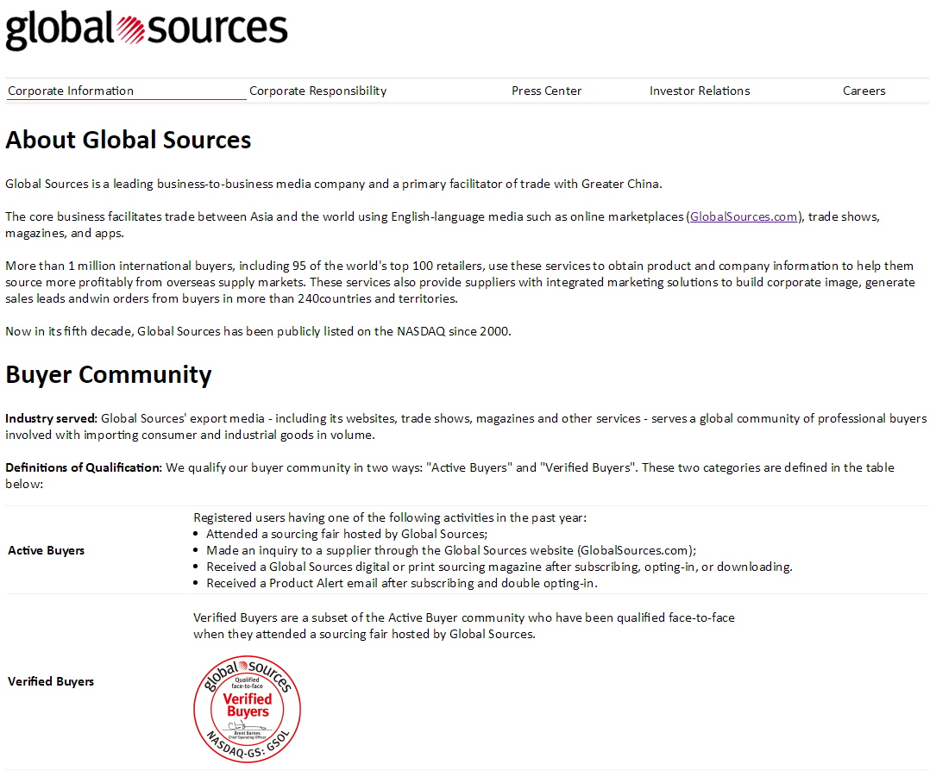

Draft UI
Desktop View:
Mobile View:

