Slide 1
Preprocessing – data generation
Create a new dataset based on hyper-KVASIR DATASET

Slide 2
Outline
Past works (finished)
Current works (on-going)
Future work (plan)

Slide 3
The objective of project
Step 1
Pre-processing
Step 2
Segmentation
Select the ROI region of the relevant features
Step 3
Classification
Based on the selected ROI, we can make a better classification
Remove the distortions

Slide 4
Pre-processing
Distortion Removal
We have to know the kind of distortions
Distortion classification
Dataset Generation
We have two choices (1- used existed dataset, 2-create our own dataset)
We need a dataset with many kinds of common distortions

Slide 5
The idea (to create our own dataset with distortions)
Step 1
Analysis Hyper-Kvasir
Step 2
Refresh data
Make it clear with distortion
Step 3
Add artificial distortion
Create ourselves and add it into the free-distortion images
Step 4
Distortion classification
We will apply it on the created dataset

Slide 6
Past works (finished)
Analyse the Hyper-Kvasir dataset
Create some common distortions

Slide 7
Analyse the hyper-kvasir dataset
ID | Label | ID | Label
0 | barretts | 12 | oesophagitis-b-d
1 | bbps-0-1 | 13 | polyp
2 | bbps-2-3 | 14 | retroflex-rectum
3 | dyed-lifted-polyps | 15 | retroflex-stomach
4 | dyed-resection-margins | 16 | short-segment-barretts
5 | hemorrhoids | 17 | ulcerative-colitis-0-1
6 | ileum | 18 | ulcerative-colitis-1-2
7 | impacted-stool | 19 | ulcerative-colitis-2-3
8 | normal-cecum | 20 | ulcerative-colitis-grade-1
9 | normal-pylorus | 21 | ulcerative-colitis-grade-2
10 | normal-z-line | 22 | ulcerative-colitis-grade-3
11 | oesophagitis-a
Labeled images In total, the dataset contains 10,662 labeled images stored using the JPEG format
Unlabeled Images In total, the dataset contains 99,417 unlabeled images
Segmented Images We provide the original image, a segmentation mask and a bounding box for 1,000 images from the polyp class
Annotated Videos The dataset contains a total of 373 videos containing different findings and landmarks
The dataset contains some existed distortion (specular reflection, etc…)

Slide 8
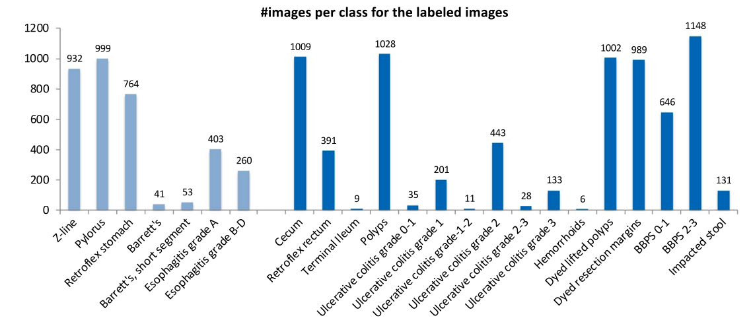
Class size

Slide 9
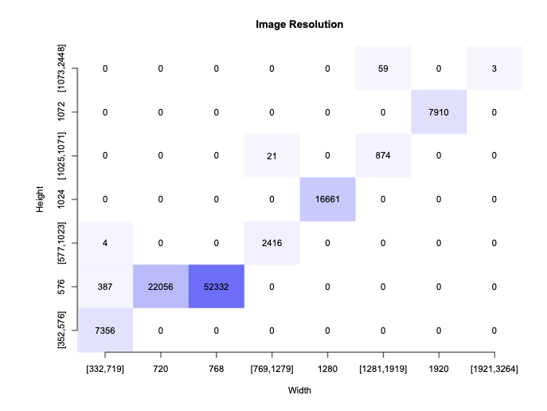
Resolution

Slide 10
Create some simple distortions
Noise (Additive White Gaussian Noise)
Blur
Motion Blur
Defocus Blur
Uneven Illumination
Specular Reflection

Slide 11
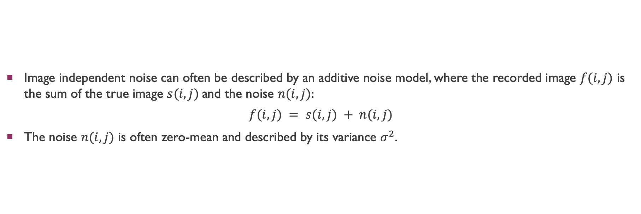
AWGN
Image independent noise can often be described by an additive noise model, where the recorded image $f(i,j)$ is the sum of the true image $s(i,j)$and the noise $n(i,j):$
$$f(i,j) = s(i,j) + n(i,j)$$
The noise $n(i,j)$ is often zero-mean and described by its variance $σ^{2}$.

Slide 12
Blur
Motion Blur
Defocus Blur (Gaussian)

Slide 13
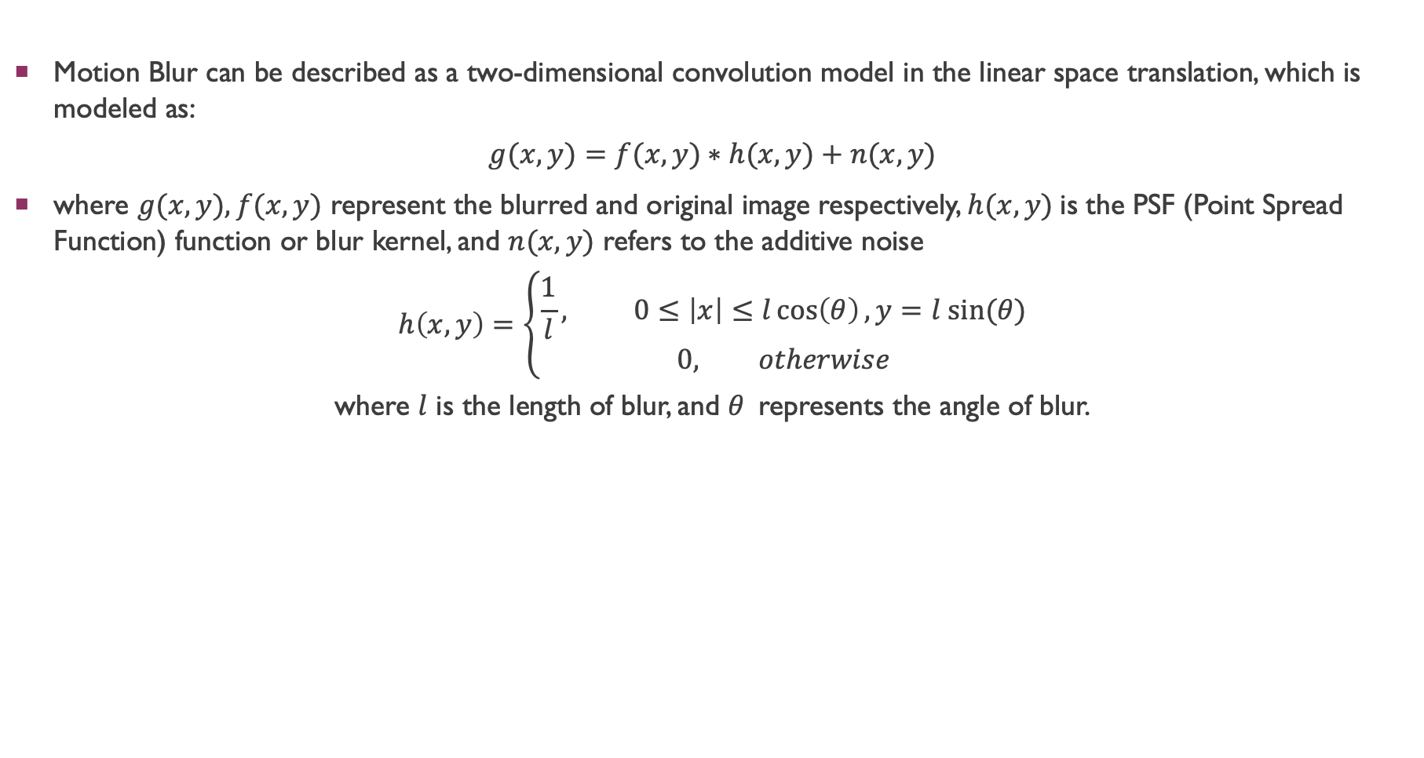
Motion blur
Motion Blur can be described as a two-dimensional convolution model in the linear space translation, which is modeled as:
$$g(x,y)=f(x,y)∗h(x,y)+n(x,y)$$
where $g(x,y),f(x,y)$ represent the blurred and original image respectively, $h(x,y)$is the PSF (Point Spread Function) function or blur kernel, and $n(x,y)$ refers to the additive noise
$$h\left(x,y\right)=\left\{\begin{aligned}\frac{1}{l}, 0≤\left|x\right|≤l\cos\left(θ\right),y=l sin⁡(θ) \\ &0, otherwise\end{aligned}\right.$$ where $l$ is the length of blur, and $θ$represents the angle of blur.

Slide 14
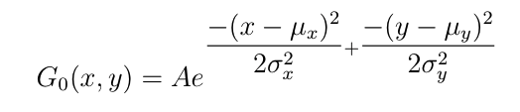
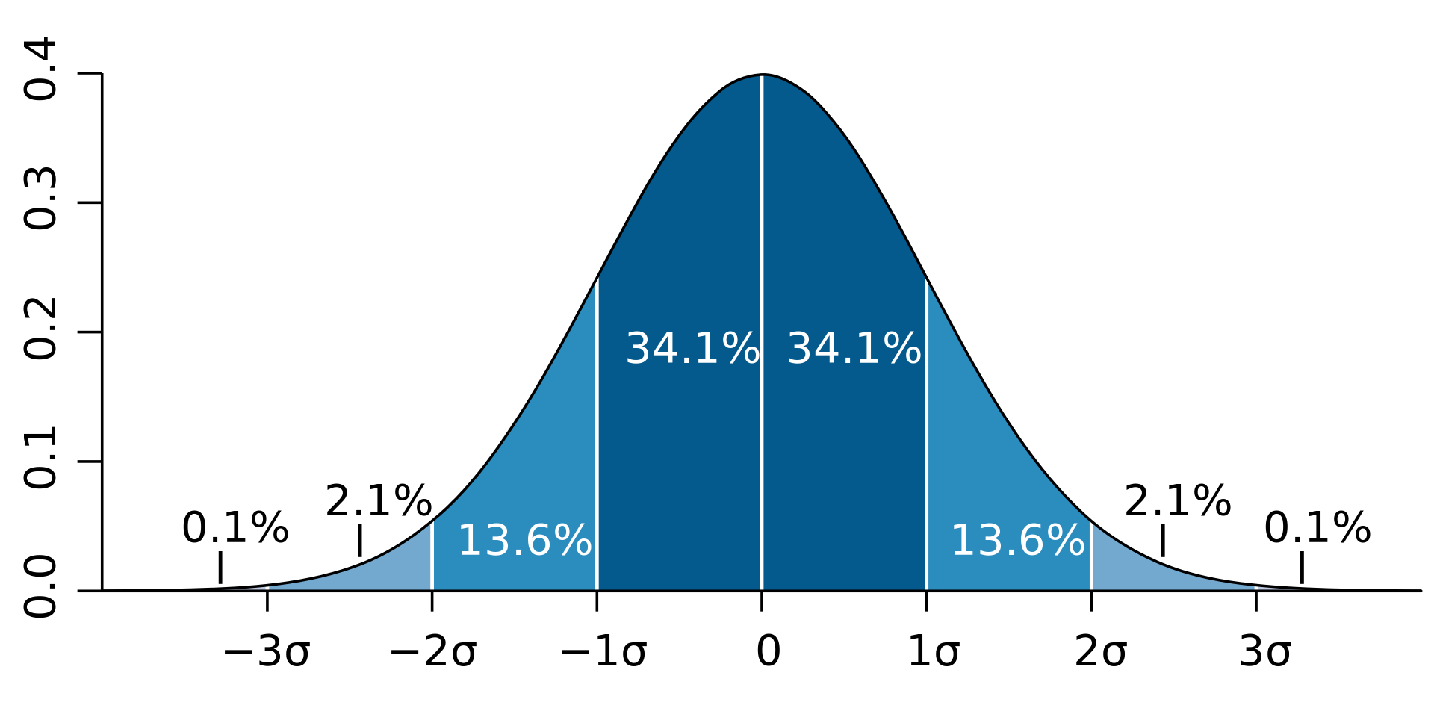


Defocus blur
where $μ$is the mean (the peak) and $σ^{2}$represents the variance (per each of the variables x and y)
$$k= \left\lceil 6σ\right\rceil$$
Where $k$ is the size of kernel

Slide 15
UNEVEN ILLUMINATION
Convert the original image from RGB colorspace to HSV colorspace.
A circular-gradient mask will be generated which represent the uneven illumination distortion.
In HSV color space, channel V will be extracted and applied above mask.
Convert the distorted image back to RGB channel.

Slide 16

UNEVEN ILLUMINATION
The level of distortion is calculated as the difference between the highest illumination (in the middle of the light source) and the lowest illumination (in the border of light sigh).
$$∆_{I}=I_{center}−I_{border}$$

Slide 17
Current works (on-going)
Specular Reflection Detection and Inpainting
Recall: The objective of our work is creating a new dataset by adding some artificial distortion into Hyper-Kvasir dataset, so the first step is refreshing (erase the existed distortions) the dataset.

Slide 18
Specular reflection
SR occurs in the image with a variance of shape, position, size, etc.
The patient information (text) has the similar intensity to SR
- Objective: Detect and remove all of these interferers, impaint the SR and text naturally.

Slide 19
SR detection
We have 2 existed methods to be considered. Note that I focus on the fast method because our objective is not create a new SR detection method and we want to get out the mask of SR in the image as fast as possible.
Using wavelet energy (method 1)
Using TOP-HAT morphological operation and Otsu thresholding (method 2)

Slide 20
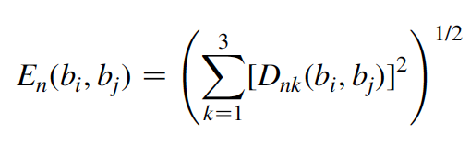
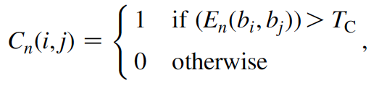
Method 1
Property: The wavelet coefficients around the SR (or text) pixels should have large values
Calculate the wavelet energy feature
Thresholding the features map to select the SR candidate pixels
Apply a region growing method to connect all candidate pixels and generate the SR map

Slide 21
Method 2
Apply the TOP-HAT transformation
Calculate the Otsu threshold
Thresholding the image using given threshold to separate the object and the background

Slide 22
Inpainting
We have two options for image inpainting (a trade-off)
Using isotopic method to get the fast advantage (the image will be processed fast but lower quality)
Using deep learning model to get the natural advantage (higher quality but it will take more time)

Slide 23
Future work (plan)
Finish creating a new dataset
Focus on distortion classification
Apply pre-processing step as the first stage of the system

