Slide 1
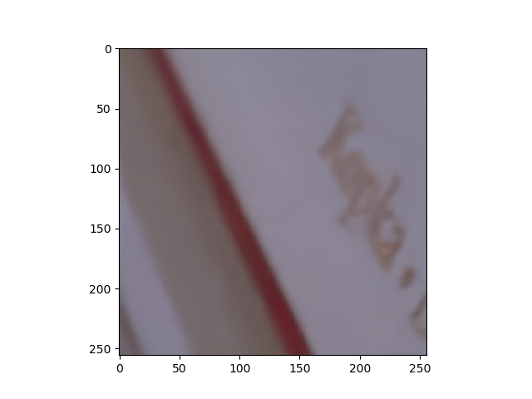

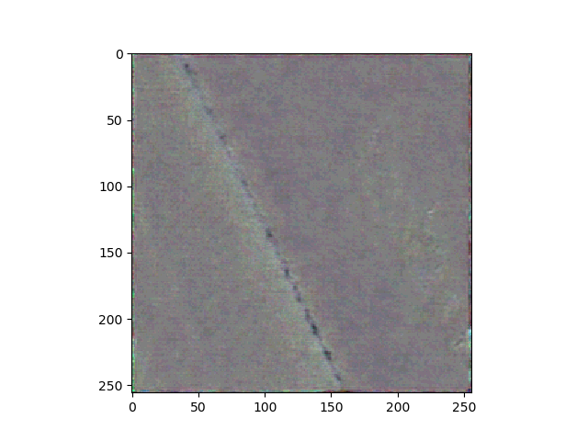
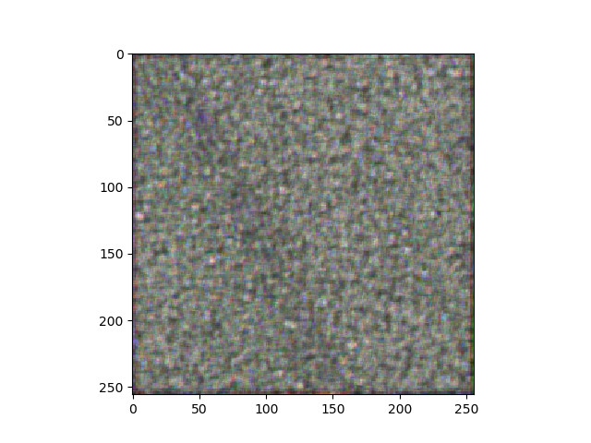
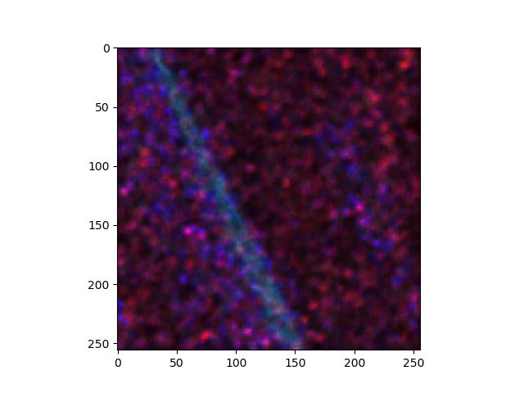







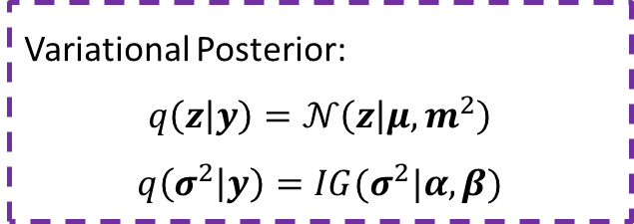



$$μ$$
$$m^{2}$$
$$D_{kl}(q(z|y)||p\left(z\right))$$
$$y$$
$$E_{q(z,σ^{2})}[\log{p\left(y | z, σ^{2}\right)}]$$
$$ℒ(z, σ^{2};y)$$
D-Net: Denoising Network
$$α$$
$$β$$
$$D_{kl}(q(σ^{2}|y)||p\left(σ^{2}\right))$$
$$y$$
Variational Posterior:
$$q\left(z | y\right)=𝒩\left(z | μ,m^{2}\right)$$
$$q\left(σ^{2} | y\right)=IG(σ^{2}|α, β)$$
S-Net: Sigma Network

