Slide 1




FPGA Platform applied for Facial Expression Recognition System using CNNs
The 2nd International Conference on Emerging Data and Industry 4.0 (EDI40)
April 29th - May 2nd , 2019, Leuven, Belgium
Conducted by: Hanh Phan-Xuan, * Thuong Le-Tien, Sy Nguyen-Tan
Ho Chi Minh City University of Technology.
Date: April 29th, 2019

Slide 2
Content
Problem definition
Model Implementation
Hardware Design
Experimental results
Conclusion

Slide 3
Problem Definition

Slide 4
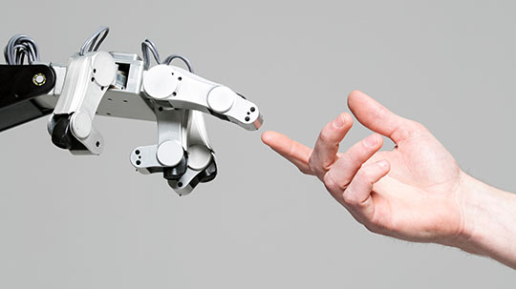
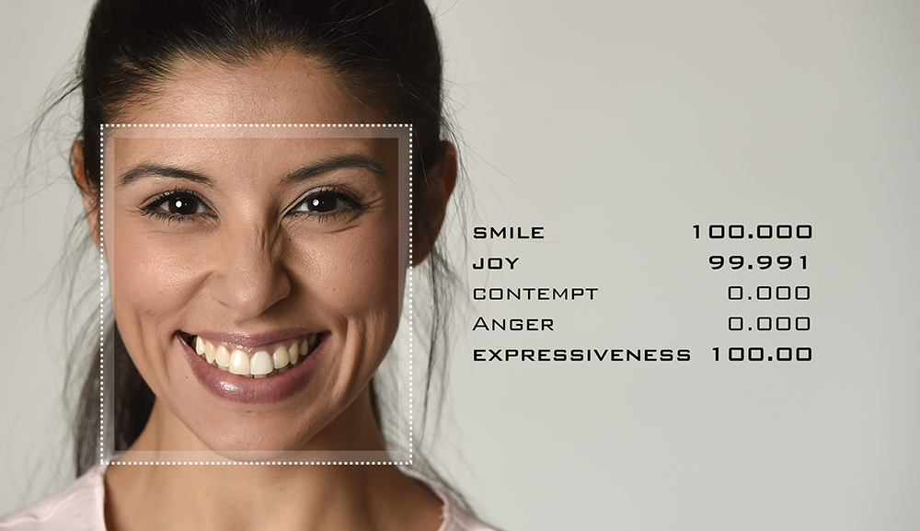
About this template
Problem Definition
Figure [1]: Human- Robot Interaction
Figure [2]: Emotion Recognition
Human- Robot interaction is increasing its attention.
=> Understanding the facial gestures and visual cues of an individual is a need
FER system allows a robot to understand the expression of humans in turn enhancing its effectiveness in performing various tasks
Source: [1][2] Internet

Slide 5

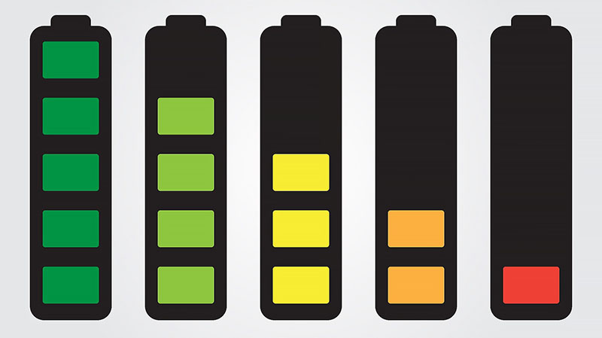
About this template
Problem Definition
Figure [3]: Artificial Intelligence Development
Figure [4]: Energy consumption Problem
In recent years, the development of artificial intelligence opens up the opportunity to create more complex systems to bring people and robots closer together.
“The energy industry is facing decades of transformation”[5]. Yet the implications of the changes underway go far deeper. There are political, economic and social issues at stake, but it may also require each of us to make some fundamental shifts in our behavior too.
Source: [3][4] Internet
[5] 2016 World Energy Scenarios, World Energy Council, https://www.worldenergy.org/wp-content/uploads/2016/10/World-Energy-Scenarios-2016_Full-Report.pdf

Slide 6
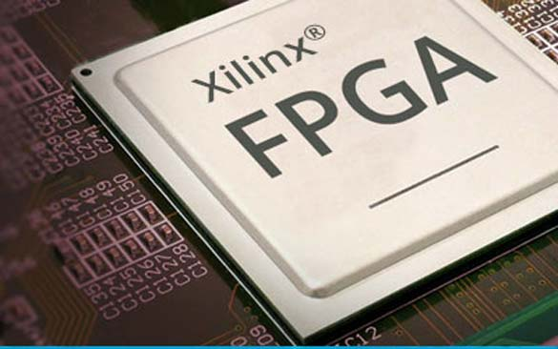
About this template
Problem Definition
Table [7] | GPU | FPGA
Execution Time (s) | 18.7 | 21.4
Power Consumption (W) | 30 | 15
Figure [6] FPGA acceleration
Furthermore, reduced data precision allows FPGA to reach performance in range of Tera-Operations per second
Source: [6]: Xilinx FPGA Power, https://www.renesas.com/us/en/solutions/key-technology/fpga-power-solutions/fpga-power-xilinx.html
[7]: Wonlai Zhao, Haohuan Fu, Wayne Luk, “F-CNN: An FPGA-based framework for training Convolutional Neural Network” 2016, IEEE 27th International Conference on Application-specific System, Architecture and Processors (ASAP)

Slide 7
Model Implementation

Slide 8
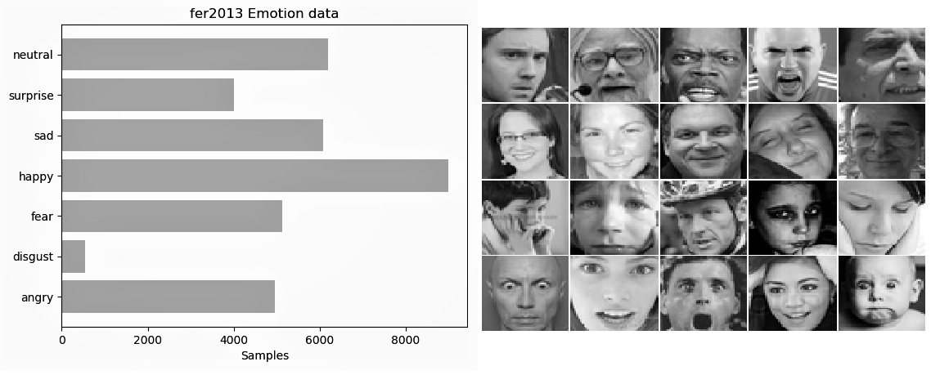
About this template
Dataset
[8] | Training set | Public testing set | Private testing set
Image Quantity (sample) | 28709 | 3589 | 3589
Figure [9] Structure of FER-2013 dataset
Figure [10] FER-2013 details
FERC-2013 has seven categories (0=Angry, 1=Disgust, 2=Fear, 3=Happy, 4=Sad, 5=Surprise, 6=Neutral) [9]
Source: [8] Internet
[9][10] Kaggle, FER2013, https://www.kaggle.com/deadskull7/fer2013.

Slide 9
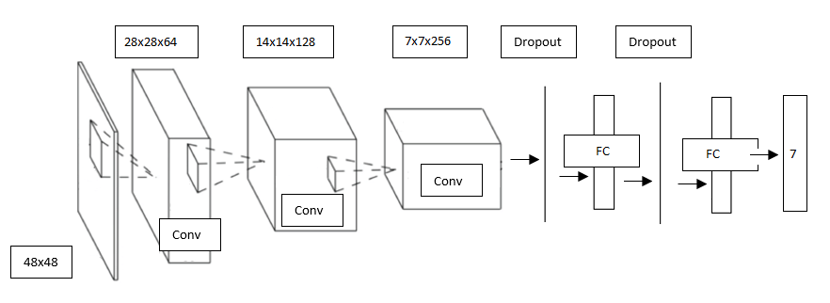
About this template
CNN Architecture
3 convolution layers
2 Dropout layers
2 Fully connected Layers
The input size : 48x48
Output: 7-dimention one-hot vector

Slide 10
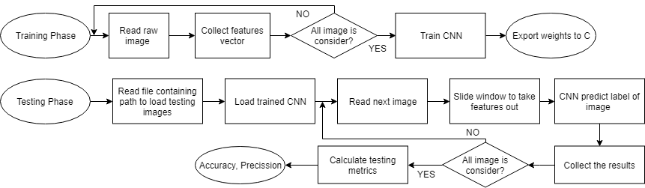
About this template
Proposed System
The GPU based processing is divided into 2 stages including training and testing process. After finishing the deployment of the system on the computer, the weights of the model is exported and downloaded to the FPGA system.
Metrics are carefully calculated and compared between training and testing processes to detect phenomena such as overfitting. Just then, the model will be modified to achieve the desired quality.

Slide 11
Hardware Design

Slide 12
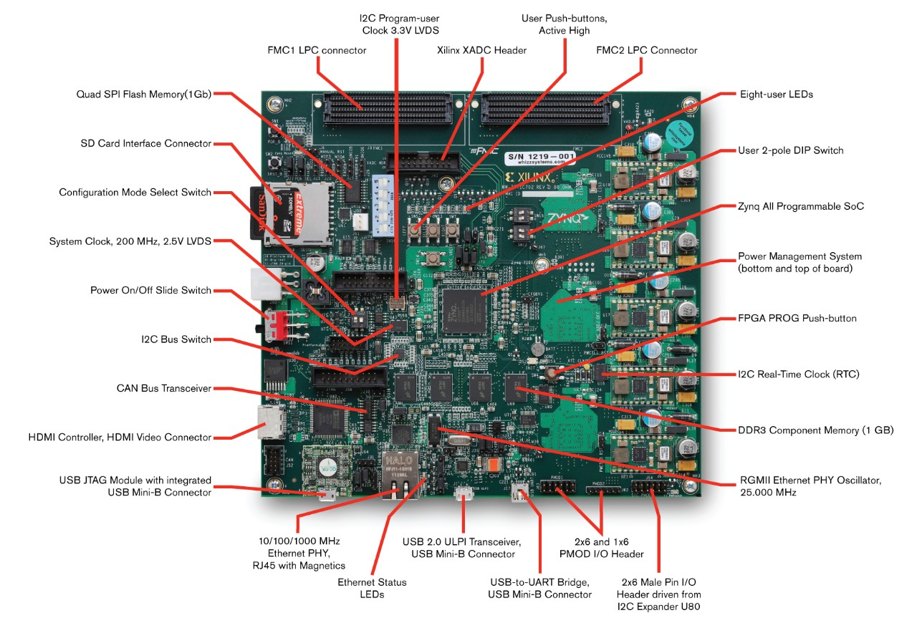
About this template
Xilinx Zynq-7000 SoC ZC702
[11] | XC7Z020-CLG484-1
Logic Cells (K) | 85
Logic Cells (K) | 4.9
DSP Slices | 220
Maximum I/O Pins | 200
[11]
[12]
Source: [11][12] Xilinx, https://www.xilinx.com/products/boards-and-kits/ek-z7-zc702-g.html

Slide 13
About this template
Used Formula
The 2D convolution between k × k filter F and H × W input image I yields output image O with
(k is an odd integer)
An input image is a three-dimensional stack of chin input images called input feature maps I(ci) (y,x)
The output feature maps O(co) (y,x) by applying a bank of filters F(ci,co)
Despite requiring a high computational effort, the mathematical operations behind convolutional layers are not complex at all, and offer a lot of opportunities for data reuse and parallelization.

Slide 14
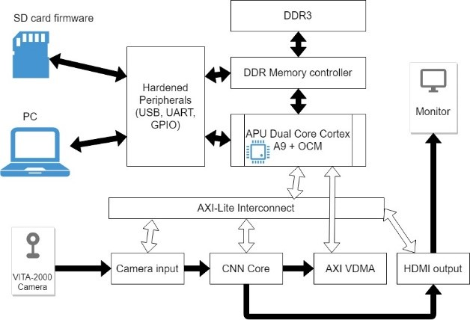
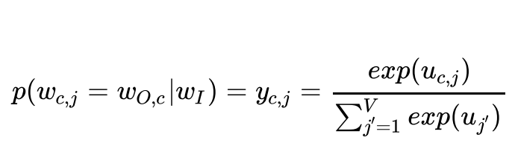
About this template
FPGA implementation
The ARM Processor communicates with the host computer via Gigabit Ethernet and controls the data-flow on the AXI-Lite and AXI buses
Memory Controller and the DDR3 store the human faces extracted from the video stream, trained weights and also the sub and final results of the classification process.
The data transfer between the CNN Core and the Board Memory is handled by the AXI VDMA Controller
Once the classification process was finished, the softmax function is computed and label will appear

Slide 15
Implement Result

Slide 16
About this template
Experimental Result
Evaluation Metrics
Cases of classification:
True Positive (TP) False Positive (FP)
True Negative (TN) False Negative (FN)
Metrics Problems
The number of happy samples are typically greatly bigger than the all other ones
If the model is simply set in a way that all of inputs are classified as happy, it can reach a spectacular accuracy
Precision and Recall are exploited to overcome the shortcoming of Accuracy

Slide 17
About this template
Experimental Result
Evaluation Metrics
Cases of classification:
True Positive (TP) False Positive (FP)
True Negative (TN) False Negative (FN)
Accuracy: basic metric
Precision: how exactly sample predicted positive
Recall: How much positive samples are missed
F-score: joint feature of Precision and Recall

Slide 18
About this template
Experimental Result
Training Process
Adam Optimizer with learning rate 1e-3, decay factor 0.95
Implemented by Tensorflow on Core-i7 @2.8Ghz + 8GiB RAM+ GTX1050
Train 30 epoch, time : less than 1 hour
Metric | Training | Testing
Accuracy | 60.5% | 60.4%
Precision | 61.2% | 60.71%
Recall | 60.43% | 59.86%
F-score | 59.6% | 59.85%

Slide 19
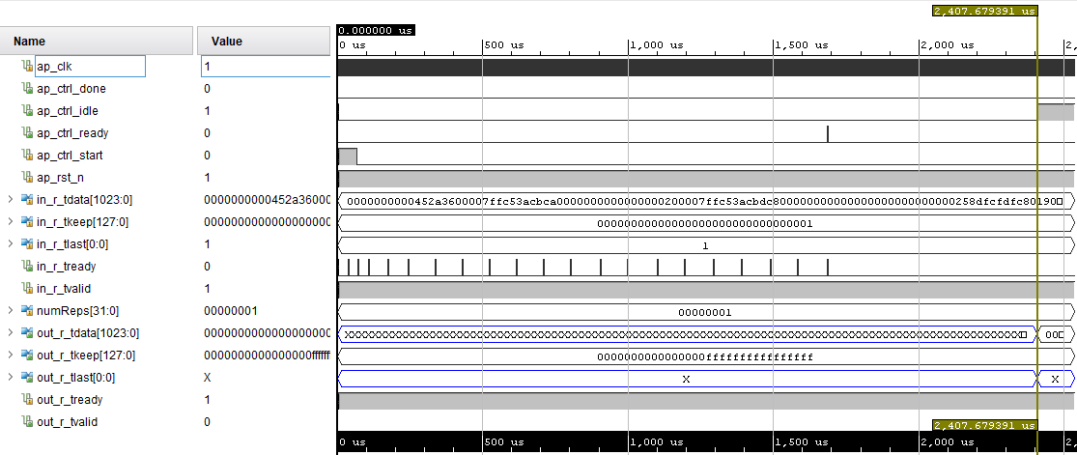
About this template
Simulation Result
After 2.404s since the start signal is set to 1, the signal appears at the output. This shows that the system performs a snapshot of the image to meet the demand in real time

Slide 20
About this template
Experimental Result
FPGA resource
There are four kinds of hardware resources on FPGA:
Look-up Tables Unit (LUT)
Flip-Flop Unit (FF)
Block-RAM Unit (BRAM)
Digital Signal Processing Unit (DSP)
The system works with a very heavy and deep model to detect emotion, but a system like the XC7Z020 can still be found to show that the system has the cost advantage in computing

Slide 21
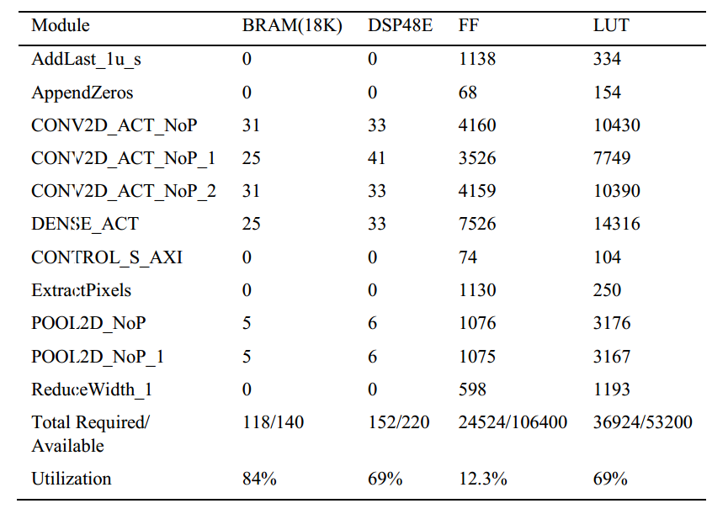
About this template
Experimental Result
The system works with a very heavy and deep model to detect emotion, but a system like the XC7Z020 can still be found to show that the system has the cost advantage in computing

Slide 22
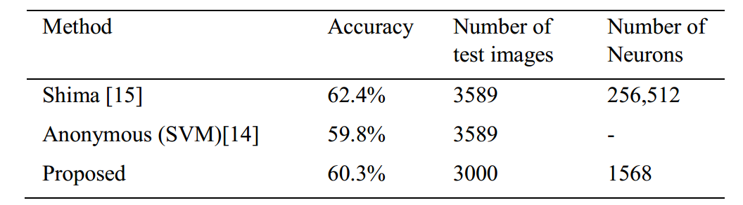
About this template
Other method
[14] Amine Horseman. (2007) “SVM for Facial Expression Recognition.” A demonstrate project using SVM.: https://github.com/amineHorseman/facial-expression-recognition-svm/commit/aecd525367f6d77e5d274de7c6f0166d5bfa4bb9.
[15] Shima A., Azar F. (2016) “ Convolutional Neural Network for Facial Expression Recognition” Proceedings of Stanford University
Report: http://cs231n.stanford.edu/reports/2016/pdfs/005_Report.pdf.

Slide 23
Conclusion

Slide 24
About this template
Conclusion
Propose a model to solve the problem of Facial Recognition.
FPGA platform implementation, Low computational cost
Suffer tough conditions, while keeping a high accuracy
Future work:
Boost the speed: dimensionality reduction methods
Enhance classification: Deep Learning architectures
Improve the discrimination : Model quality

Slide 25
About this template
References
D. Ververidis, and C. Kotropoulos. (2004) "Automatic speech classification to five emotional states based on gender information " Proceedings of the EUSIPCO2004 Conference, Austria: 341-344.
Cowie, R., Douglas-Cowie, E., Tsapatsoulis, N., Votsis, G., Kollias, S., Fellenz, W., and Taylor. (2001) "Emotion recognition in human computer interaction " IEEE Signal Processing magazine, Vol. 18, No. 1: 32-80.
Yann LeCun, Yoshua Bengio, and Georey Hinton. (2015) “Deep learning.” Nature. Vol.521: doi 10.1038/nature14539.
Amine Horseman. (2007) "SVM for Facial Expression Recognition." A demonstrate project using SVM.: https://github.com/amineHorseman/facial-expression-recognition-svm/commit/aecd525367f6d77e5d274de7c6f0166d5bfa4bb9.
Shima A., Azar F. (2016) “Convolutional Neural Networks for Facial Expression Recognition.” Proceedings of the Stanford University report.: 3-4. http://cs231n.stanford.edu/reports/2016/pdfs/005_Report.pdf.

Slide 26
Thank you for your attention!
Department of EEE, Ho Chi Minh City University of Technology, Vietnam.
You can find me at:
thuongle@yahoo.com
Tel.: +84-903-787-989

