Slide 1
Mobile Computing Course
Introduction
1st session

Slide 2
What’s Mobile Computing?
Mobile computing can be defined as a human-computer interaction that enables transmission of voice, video and data via a computer or any other wireless enabled device without having to be connected to a fixed physical link.

Slide 3
Mobile Computing Applications
The emerging leading application domains:
Transportation.
Social networking.
Environmental monitoring.
Health and well being.

Slide 4
Mobile Computing Concepts
The main concept involves :
Mobile communication
Mobile hardware
Mobile software

Slide 5

Mobile Communication
Mobile communication represents the infrastructure insured in the wireless device that corroborates seamless and reliable communication.
This is inclusive of services, protocols, bandwidth and portals required for rendering services.
It also defines the data format and prevents collision among other systems that deliver similar services.

Slide 6
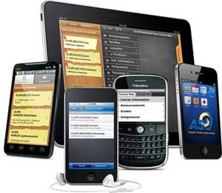
Mobile Hardware
Mobile Hardware refers to device components or mobile devices that employ and deploys the service of mobility.
It includes smartphones, tablet Pc’s, portable laptops and Personal Digital Assistants.
A receptor medium designed to sense and receive signals are installed in these devices.
Configured to operate in full duplex, signals can be sent and received simultaneously.
Mobile Hardware operates on the wireless network.

Slide 7

Mobile Software
Mobile software is the actual program that runs on the mobile hardware.
It deals with the characteristics and requirements of mobile applications.
This is the engine of the mobile device.
In other terms, it is the operating system of the appliance.
It's the essential component that operates the mobile device.
Since portability is the main factor, this type of computing ensures that users are not tied or pinned to a single physical location, but are able to operate from anywhere. It incorporates all aspects of wireless communications.

Slide 8
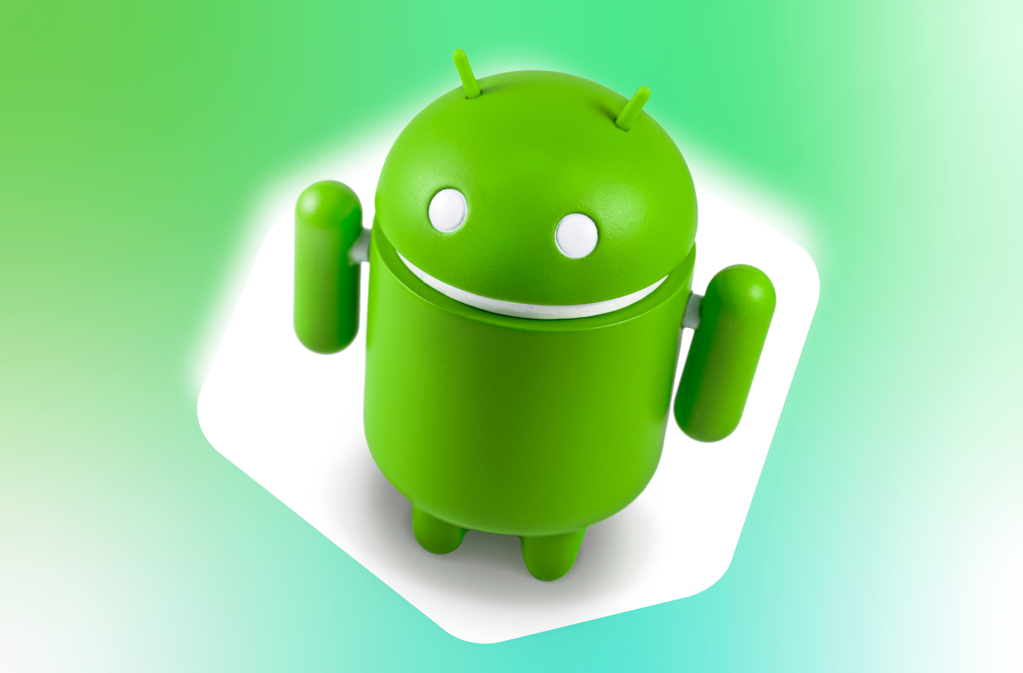

Slide 9

What Is Android?
Android is a Linux based mobile phone operating system developed by Google.
It launched in 2003 and is the world’s most popular mobile operating system (OS).
Powering phones, tablets, watches, TVs and cars.
First open source mobile operating system. Android is open to everyone: developers, designers and device makers.
Anyone can customize the Android Platform.

Slide 10
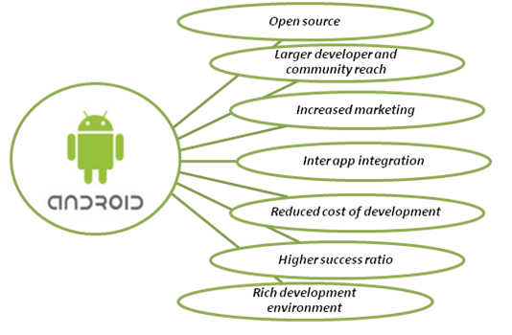
Why Android?

Slide 11
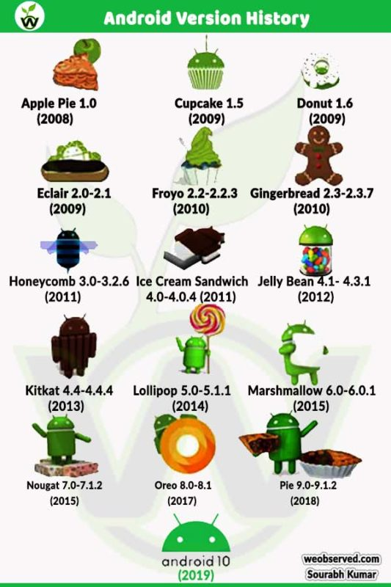
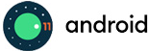
Android Versions History

Slide 12
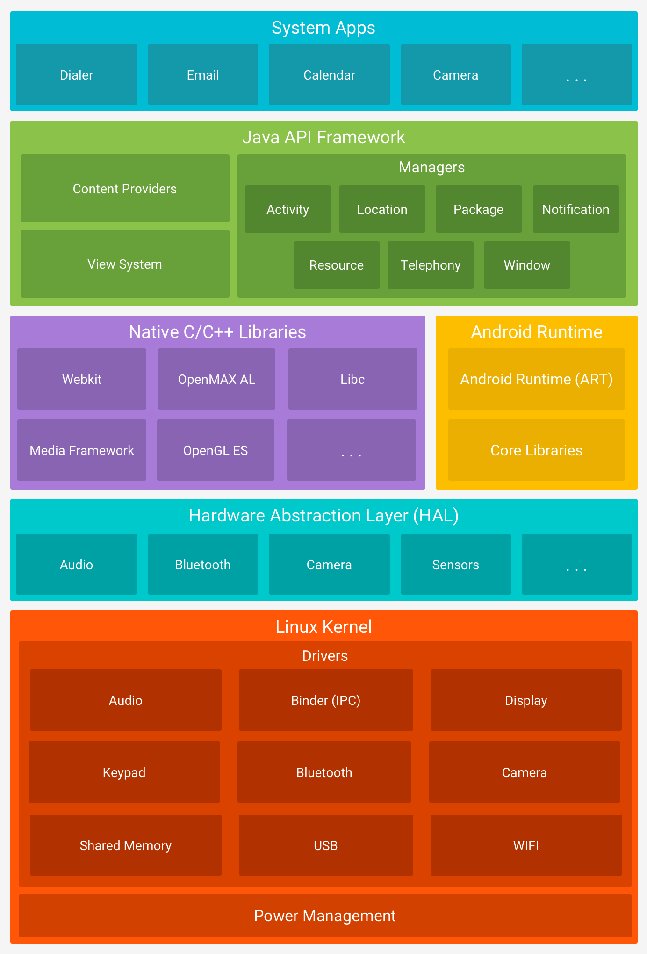
Android Framework Architecture

Slide 13
The Major Components Of The Android Platform
The Linux Kernel
The android uses the powerful Linux kernel and it supports wide range of hardware drivers.
The kernel is the heart of the operating system that manages input and output requests from software.
This provides basic system functionalities like process management, memory management, device management like camera, keypad, display,…etc.
The Linux is really good at networking and it is not necessary to interface it to the peripheral hardware. The kernel itself does not interact directly with the user but rather interacts with the shell and other programs as well as with the hard ware devices on the system.

Slide 14
The Major Components Of The Android Platform
Hardware Abstraction Layer (HAL)
The hardware abstraction layer (HAL) provides standard interfaces that expose device hardware capabilities to the higher-level Java API framework.
The HAL consists of multiple library modules, each of which implements an interface for a specific type of hardware component, such as the camera or bluetooth module. When a framework API makes a call to access device hardware, the Android system loads the library module for that hardware component.

Slide 15
The Major Components Of The Android Platform
Android Runtime
The android runtime provides a key component called Dalvik Virtual Machine which is a kind of java virtual machine. It is specially designed and optimized for android. The Dalvik VM is the process virtual machine in the android operating system. It is a software that runs apps on android devices.
The Dalvik VM makes use of Linux core features like memory management and multithreading which is in a java language. The Dalvik VM enables every android application to run it own process. The Dalvik VM executes the files in the .dex format.

Slide 16
The Major Components Of The Android Platform
Native C/C++ Libraries
Many core Android system components and services, such as ART and HAL, are built from native code that require native libraries written in C and C++. The Android platform provides Java framework APIs to expose the functionality of some of these native libraries to apps. For example, you can access OpenGL ES through the Android framework’s Java OpenGL API to add support for drawing and manipulating 2D and 3D graphics in your app.
If you are developing an app that requires C or C++ code, you can use the Android NDK to access some of these native platform libraries directly from your native code.

Slide 17
The Major Components Of The Android Platform
Java API Framework
The entire feature-set of the Android OS is available to you through APIs written in the Java language. These APIs form the building blocks you need to create Android apps by simplifying the reuse of core, modular system components and services, which include the following:
A rich and extensible View System you can use to build an app’s UI, including lists, grids, text boxes, buttons, and even an embeddable web browser
A Resource Manager, providing access to non-code resources such as localized strings, graphics, and layout files
A Notification Manager that enables all apps to display custom alerts in the status bar
An Activity Manager that manages the lifecycle of apps and provides a common navigation back stack
Content Providers that enable apps to access data from other apps, such as the Contacts app, or to share their own data
Developers have full access to the same framework APIs that Android system apps use.

Slide 18
The Major Components Of The Android Platform
System Apps
Android comes with a set of core apps for email, SMS messaging, calendars, internet browsing, contacts, and more.
Apps included with the platform have no special status among the apps the user chooses to install.
The system apps function both as apps for users and to provide key capabilities that developers can access from their own app. For example, if your app would like to deliver an SMS message, you don't need to build that functionality yourself—you can instead invoke whichever SMS app is already installed to deliver a message to the recipient you specify.

Slide 19

Android Studio provides the fastest tools for building apps on every type of Android device. Android Studio is the official Integrated Development Environment (IDE) for Android app development.

Slide 20
Install Android Studio
Android studio & SDK download link: https://developer.android.com/studio/
To install Android Studio on Windows, proceed as follows:
If you downloaded an .exe file (recommended), double-click to launch it.
If you downloaded a .zip file, unpack the ZIP, copy the android-studio folder into your Program Files folder, and then open the android-studio > bin folder and launch studio64.exe (for 64-bit machines) or studio.exe (for 32-bit machines).
Follow the setup wizard in Android Studio and install any SDK packages that it recommends.

Slide 21
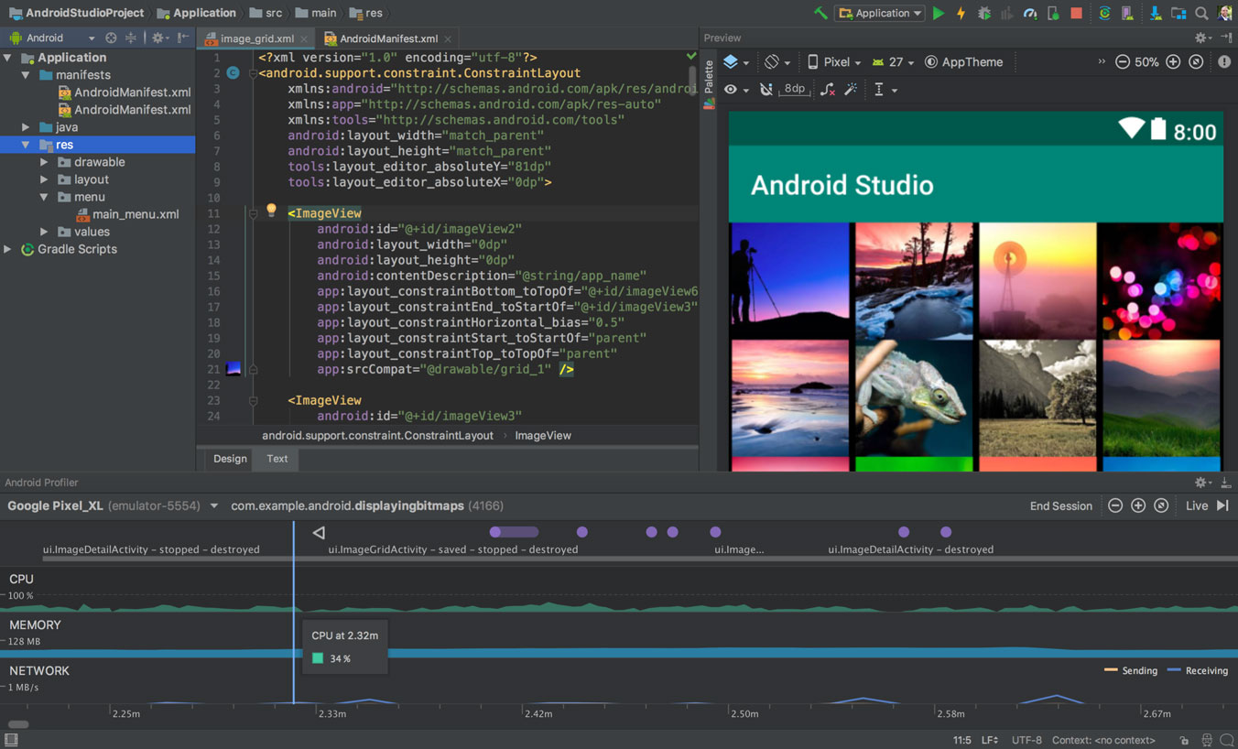

Slide 22
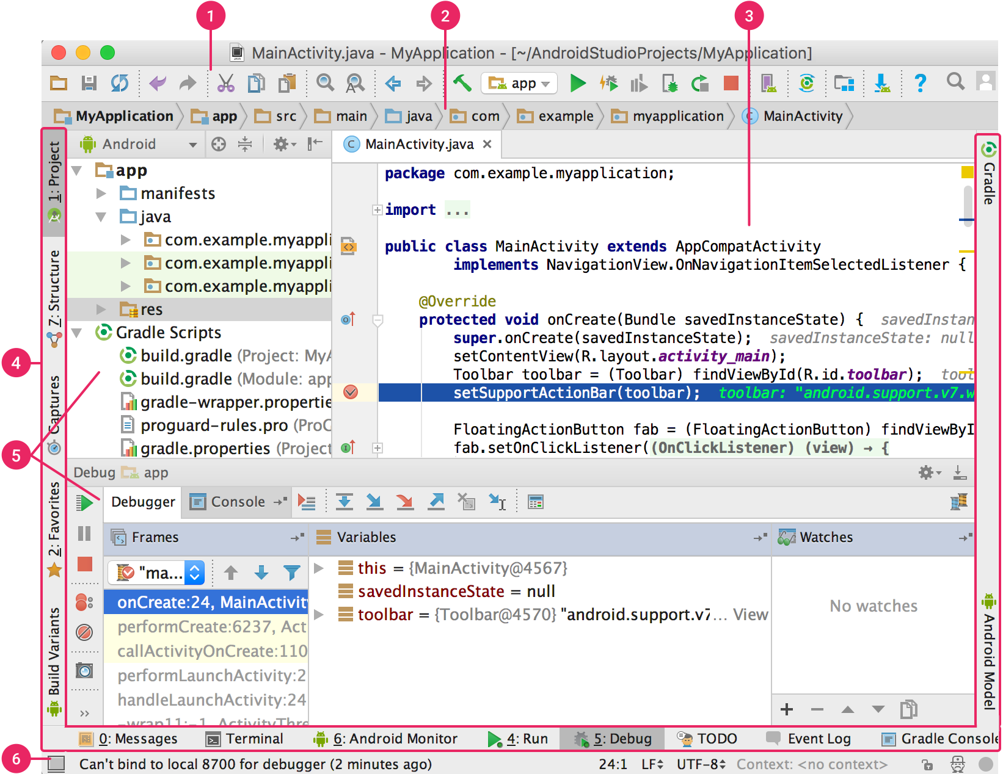
Android Studio User Interface
The toolbar
The navigation bar
The editor window
The tool window bar
The tool window
The status bar

Slide 23
Create a project

Slide 24
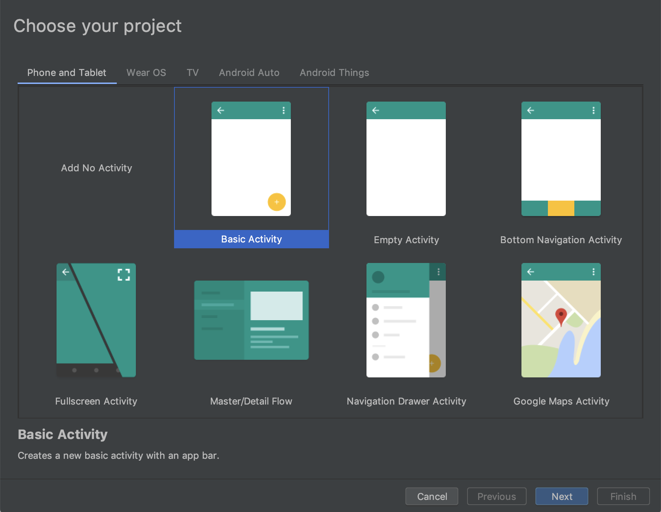

Slide 25
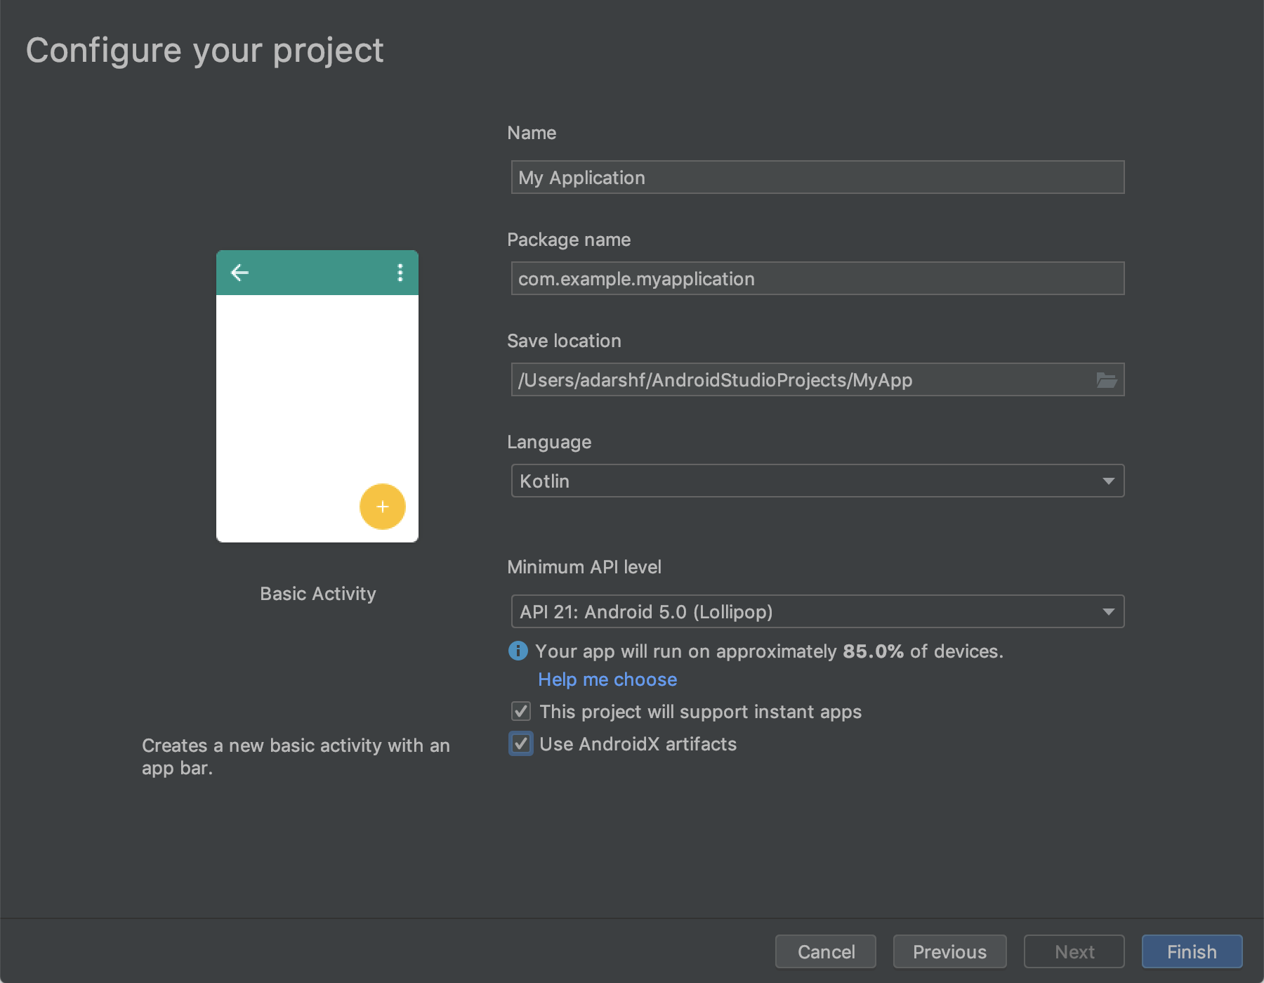

Slide 26
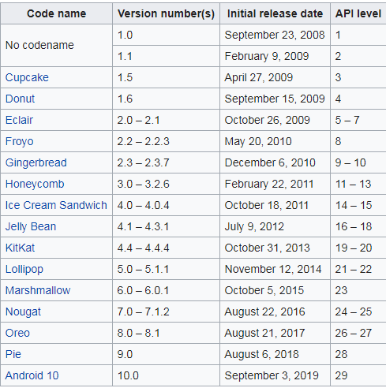
Android Versions with API Level

Slide 27

See you in next session

