Slide 1
FINAL PROJECT PRESENTATION
Nighttime Lane Detection
Enhancement, Fine-Tuning, and Comparison with Published Work
23 September 2026
Notes:
Opening slide. State the project's scope: an independent, rigorous evaluation of a lightweight enhancement pipeline for nighttime lane detection, and a comparison against two published papers.

Slide 2
INTRODUCTION
Why This Matters
1
Low contrast, high glare. Headlight glare and wet-road reflections degrade the visual cues lane detectors rely on at night.
2
A tempting fix. Enhance the image itself, rather than retrain or redesign the detector.
3
The question. Does a lightweight enhancement pipeline actually help CLRNet-ResNet18 on CULane — tested with real rigor?
Verified test-set integrity · Official evaluation protocol · Statistical significance testing
2
Notes:
Set up the motivation: night driving degrades the visual cues detectors rely on. Enhancement is a tempting, low-cost fix. This project tests it rigorously.

Slide 3
METHOD
Detector, Dataset, and Evaluation Protocol
Detector
Dataset
Evaluation
CLRNet with a ResNet-18 backbone [1]
CULane lane-detection benchmark [3], night-category subset
Proxy F1@20px for fast iteration. Official IoU@0.5 metric + paired bootstrap significance testing (10,000 resamples) for every final result.
3
Notes:
Introduce the detector (CLRNet-ResNet18), dataset (CULane), and the two-metric evaluation protocol used throughout: a fast proxy metric and the official metric with significance testing for final numbers.

Slide 4
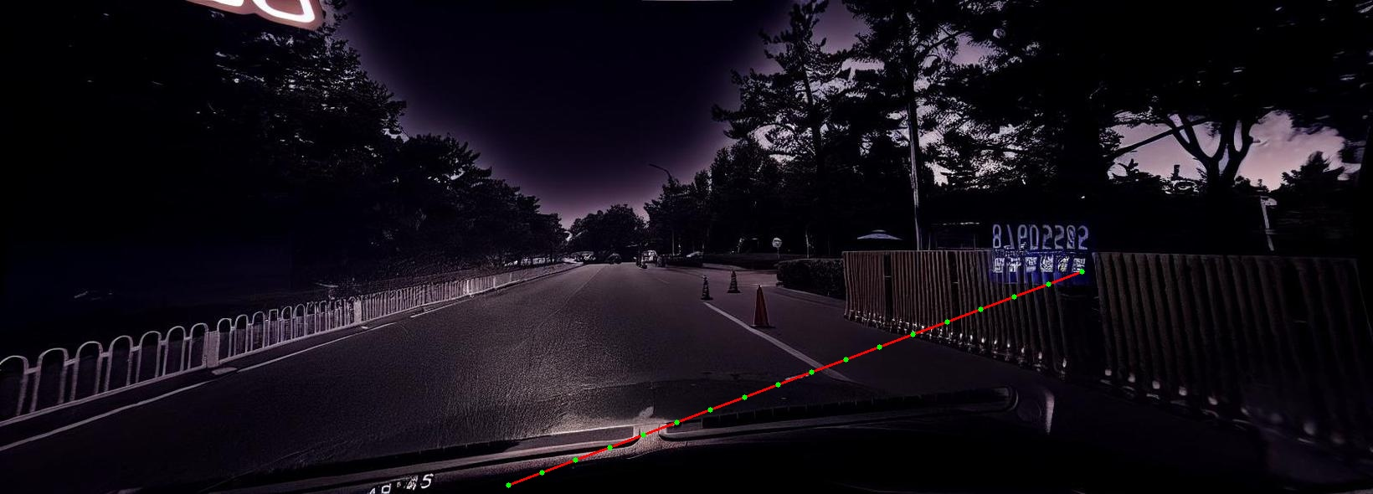
METHOD
The Enhancement Pipeline (4 Steps)
1
2
3
4
Rough pre-brighten
Candidate detection
Targeted re-enhance
Debug overlay
Gamma-brighten a coarse road-shaped ROI, feathered edges.
Canny edges + HSV color threshold + Hough transform.
Stronger brighten (CLAHE + gamma) in a narrow band around detected lanes.
Visual inspection only — not used downstream.
Actual debug-overlay output (Steps 2–4): the fitted lane-candidate path — green points, red line — used to place the enhancement band.
4
Notes:
Walk through the 4-step enhancement pipeline: rough pre-brighten, classical lane candidate detection, targeted re-enhancement, and a debug overlay used only for inspection. The photo shows a real debug-overlay frame — the fitted lane-candidate path used to place the enhancement band.

Slide 5
METHOD
Three Iterations, Diagnosed by Debug Inspection
v1
v2
v3
Full-frame pre-brighten
ROI-limited pre-brighten
Stricter matching, gamma bug fixed
Detected lines lock onto guardrails instead of lane paint.
Guardrail issue persists, plus a new failure: shadow / glare edges.
Canny AND color required. Luminance 42.7 → 112.4.
5
Notes:
Three iterations, each fixing a failure mode found by manually inspecting the debug overlays: guardrail mistracking, then shadow/glare mistracking, then a sign-flipped gamma bug.

Slide 6
RESULTS
Enhancement Alone Never Beats Baseline
Image set | Precision | Recall | proxy F1@20px
baseline (no enhancement) | 0.9291 | 0.9085 | 0.9187
enhancement v1 | 0.9265 | 0.9038 | 0.9150
enhancement v2 | 0.9272 | 0.9056 | 0.9162
enhancement v3 (most correct) | 0.9227 | 0.8996 | 0.9110
The more accurately enhancement is applied, the further the image drifts from CLRNet's training distribution — and the worse it scores.
6
Notes:
All three enhancement versions score below the unenhanced baseline — and the most bug-free version (v3) scores worst of all. This points to a structural, not implementation, explanation.

Slide 7
CRITICAL FINDING
The Original Test Set Was 100% Leaked
The fix: Rebuilt a verified-clean, 1,000-image held-out set from CULane's official test list — zero filename overlap with training.
500 / 500
0.9187
baseline F1@20px, leaked set
0.9004
baseline F1@20px, clean set
night test images were already in the training set
7
Notes:
A critical audit: the original 500-image night test set was found to be 100% contained in the training set. A new, verified-clean 1,000-image held-out set was built to fix this.

Slide 8
METHOD
Fine-Tuning on Enhanced Images
Run 1 — short
Run 2 — extended
• 3 epochs
• 8 epochs
• lr 6e-5 (1/10th of original)
• lr 1e-4 (~1/6th of original)
• conservative, brief setting
• checks whether the effect grows
Training labels unchanged — pixel-level enhancement doesn't move lane positions.
8
Notes:
Instead of enhancing only at test time, fine-tune the detector itself on enhanced training images, in two regimes: a short conservative run and an extended run.

Slide 9
RESULTS
A Reversal That Wasn't Real
Checkpoint | raw | enhanced | proxy F1@20px
Original | 0.9004 | 0.8988 | raw wins
Fine-tuned (3 ep) | 0.9019 | 0.9026 | enhanced wins
Fine-tuned_ext (8 ep) | 0.9036 | 0.9027 | raw wins
Paired bootstrap testing: none of these differences are statistically significant. The apparent “reversal” is noise, not a real effect.
9
Notes:
The internal proxy metric seemed to show a reversal after 3 epochs of fine-tuning, then flipped back at 8 epochs. Paired bootstrap testing shows none of this is statistically significant.

Slide 10
RESULTS
The Official Metric Tells a Different Story
Checkpoint | raw F1 | enhanced F1 | Enhanced − Raw | Significant?
Original | 0.9304 | 0.9267 | −0.0036 | Yes, p ≈ 0.002
Fine-tuned (3 ep) | 0.9284 | 0.9276 | −0.0007 | No, p ≈ 0.489
Fine-tuned_ext (8 ep) | 0.9303 | 0.9292 | −0.0011 | No, p ≈ 0.334
Fine-tuning NEUTRALIZES the harm from enhancement — it does not REVERSE it into a proven benefit.
10
Notes:
Under the official metric with significance testing: the original checkpoint shows real, significant harm (p≈0.002). Fine-tuning neutralizes this to insignificance — but enhancement never wins.

Slide 11
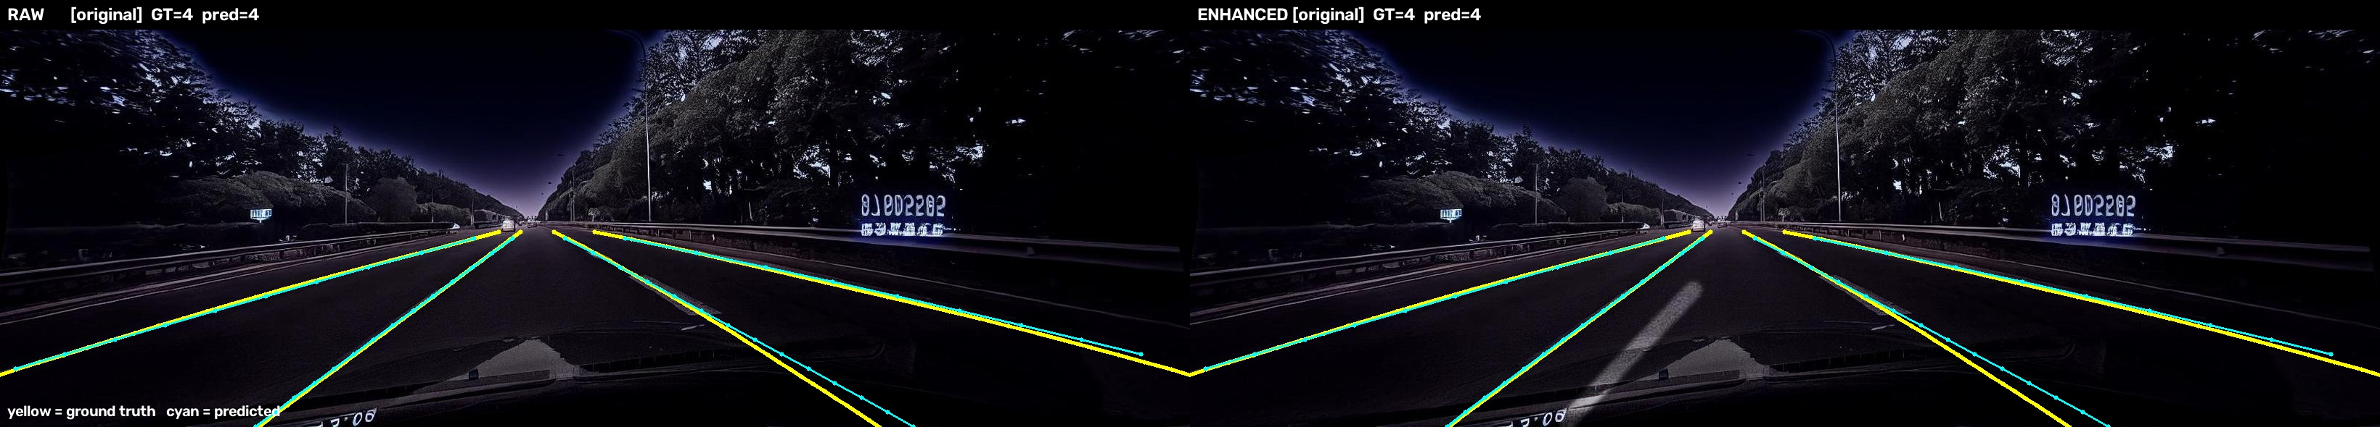
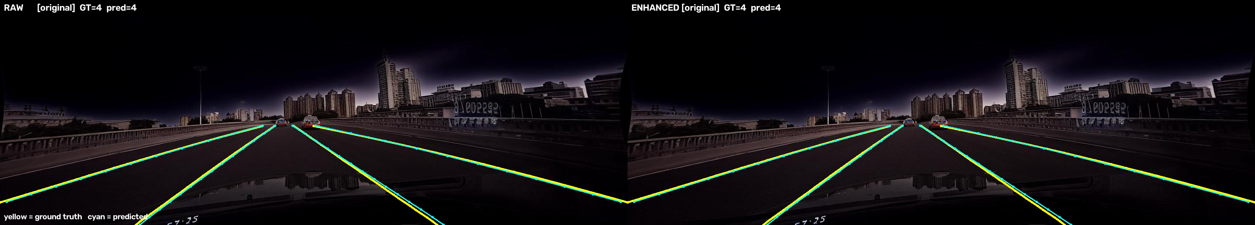
RESULTS
Where Does the Effect Actually Show Up?
night_4067.jpg — original checkpoint. Enhancement loses a matched lane (TP=4 → TP=3, one spurious lane appears).
night_4000.jpg — looks visually difficult, but both raw and enhanced detect all 4 lanes perfectly.
Only 19 of 1,000 held-out images (1.9%) differ at all — a 16:3 asymmetry drives the significant net effect.
11
Notes:
Two representative cases: one where enhancement measurably degrades a perfect detection, and one that looks hard to a human but is detected perfectly either way — human and model difficulty don't always agree.

Slide 12
DISCUSSION
Versus CLRNet [1] — an 18-Point Gap to Explain
Source | Test set | Night F1@50
CLRNet — published Table 1 | Official CULane Night, full test split | 75.11
This project — original checkpoint | Custom held-out subset (1,000 imgs) | 93.04
Different test sets — this is NOT an apples-to-apples win. It needs direct verification against CULane's official Night split, which has not yet been done.
12
Notes:
This project's F1 (93.04) looks much higher than CLRNet's own published Night result (75.11) — but they're measured on different test sets. This is a gap to verify, not a win to claim.

Slide 13
DISCUSSION
Versus HG-Lane [2] — Real-World Night Is Much Harder
CLRNet trained on CULane alone scores just 22.47 on real night photos — far below CULane's official Night category (75.11) or this project's held-out score (93.04).
Lightweight enhancement is not a substitute for learned, distribution-aware augmentation.
13
Notes:
HG-Lane's own baseline shows real-world night photos are far harder than CULane's official Night category — context for why this project's held-out score looks high.

Slide 14
DISCUSSION
Limitations & Lessons Learned
1
Proxy metrics can hide or invert small real effects — always check against the official metric with significance testing.
2
Test-set leakage is easy to introduce and easy to miss — caught only by an explicit filename-overlap check.
3
A verified-clean held-out set is not automatically representative — this project's F1 sits far above published Night baselines.
4
Every measured enhancement effect is under 0.004 F1 — small effects need rigor, not raw numbers.
14
Notes:
Four honest limitations: proxy-metric fragility, leakage risk, held-out set representativeness, and small absolute effect sizes throughout.

Slide 15
CONCLUSION
Key Takeaways
p ≈ 0.002
Neutralized,
not reversed
93.04 vs 75.11
Enhancement significantly hurts the original (non-fine-tuned) checkpoint
Fine-tuning removes the harm but never proves a net benefit
A test-set gap to verify directly — not a performance claim
Lightweight pixel-level enhancement, evaluated rigorously, is not a substitute for learned, distribution-aware augmentation.
15
Notes:
Close with the three headline takeaways, then the closing line: lightweight pixel-level enhancement is not a reliable substitute for learned, distribution-aware augmentation.

