Slide 1


Dehazing Laparoscopic Images with Advanced Generative Models
Vikramadithya Pabba
Rohan Reddy Pathi
Chaitanya Prudvi Balusu
Param Madan
D2R2group.com
|

Slide 2
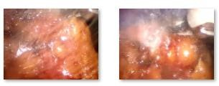
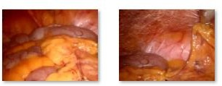
Problem Setting: Input and Output data
Desmoke – LAP - Dataset
Data Preprocessing – consolidating hazy, clear and test images
Resize images to 256x256
Convert images to tensor
Corrupt Image Check
Normalization
Training – Hazy and Clear Evaluation – Test Clips
Unpaired Image to Image Translation
D2R2group.com
|

Slide 3
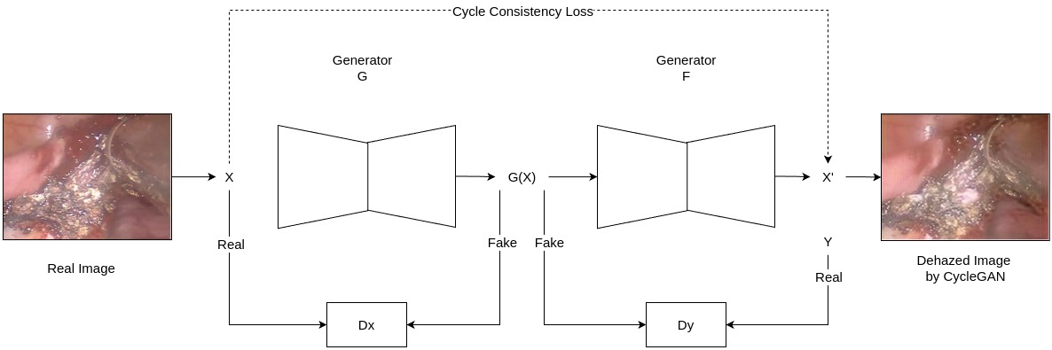
Baseline Model
cycleGAN
D2R2group.com
|

Slide 4
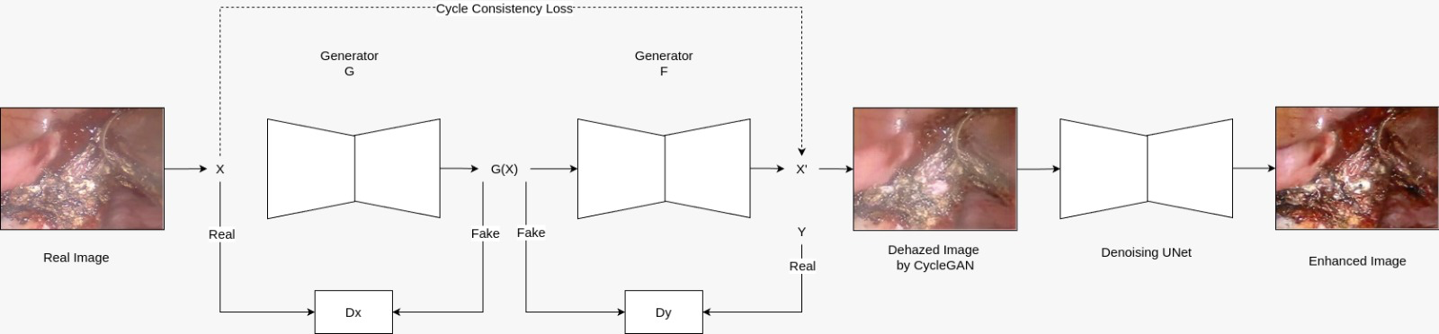
Enhanced Model
Diffusion + cycle GAN
Added Diffusion model for noise reduction.
Implemented ResidualBlocks with skip connections.
Introduced noise addition during training.
Added diffusion loss for denoising.
D2R2group.com
|

Slide 5
Enhanced Model
Cycle Diffusion
Cycle Diffusion integrates CycleGAN’s unpaired image translation with Diffusion Models’ high-fidelity generation.
Replaces CNN generators in Cycle GAN with UNet-based diffusion models:
G_A2B: Domain A → B
G_B2A: Domain B → A
Preserves cycle-consistency: A → B → A ≈ original A, and vice versa.
Produces sharper, more detailed images with strong reversibility, ideal for tasks like dehazing, medical translation, and unpaired image adaptation.

Slide 6
Evaluation Metrics
FADE (Fog Aware Density Evaluator): Measures the perceived fog density in an image without requiring a reference (i.e., no-reference metric).
JNBM (Just Noticeable Blur Metric):
Quantifies image blurriness, especially useful when evaluating smoke-induced blur.
REA (Restoration Evaluation Algorithm):
REA is a full-reference metric to compare a hazy/smoky image restoration against a ground truth.

Slide 7
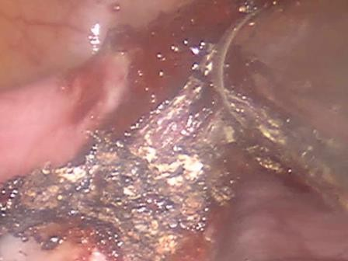
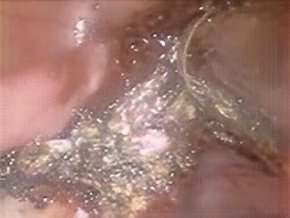
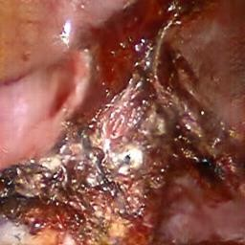

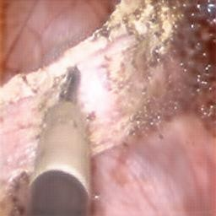
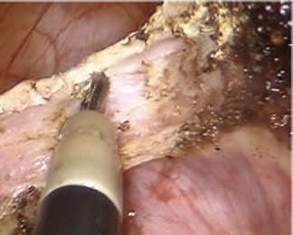
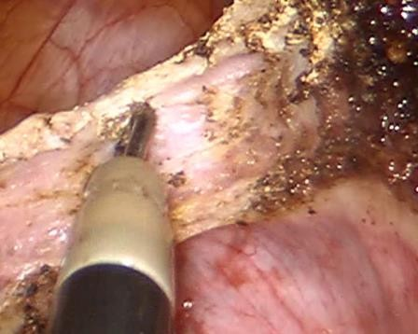
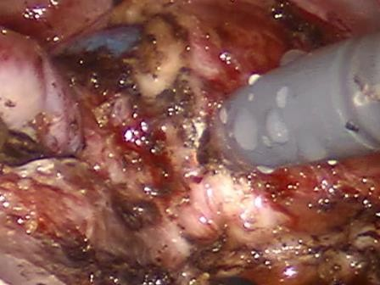
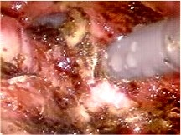
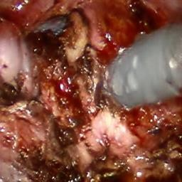
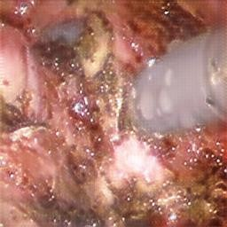
Results
Test Input | Cycle GAN | Cycle GAN + Diffusion | Cycle Diffusion
Baseline : cycle GAN
Average FADE: 2.5761
Average JNBM: 36.1544
Average REA: 7.5609
Cycle GAN + Diffusion
Average FADE: 2.1674
Average JNBM: 24.984
Average REA: 9.8
Cycle Diffusion
Average FADE: 5.4152
Average JNBM: 54.984
Average REA: 4.654
D2R2group.com
|

Slide 8
THANK YOU
D2R2group.com
|

