Slide 1
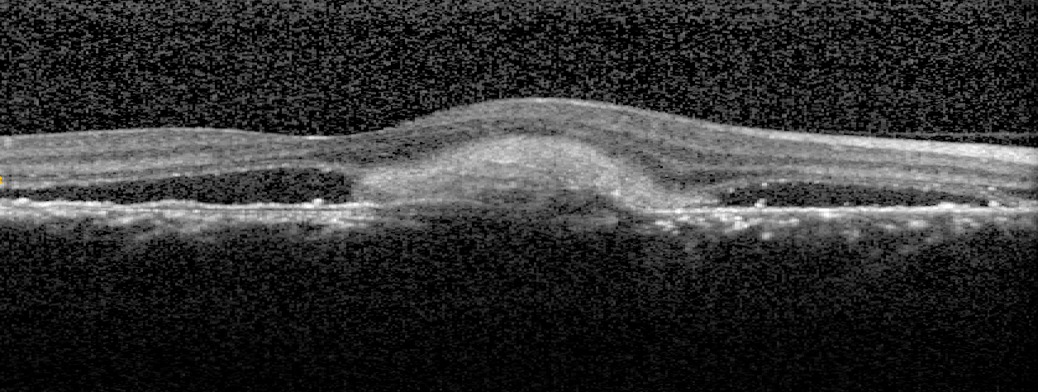
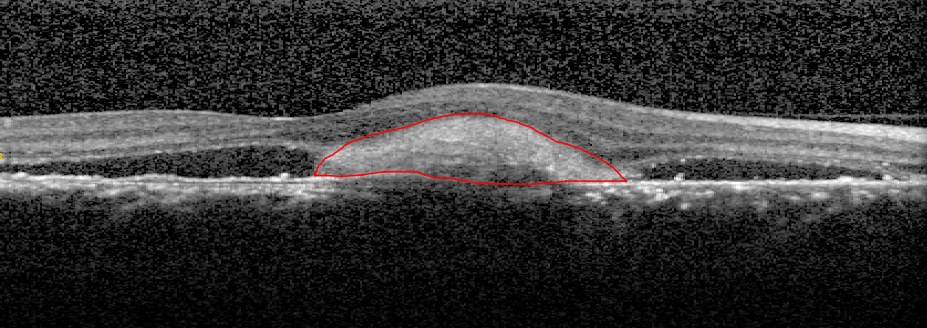
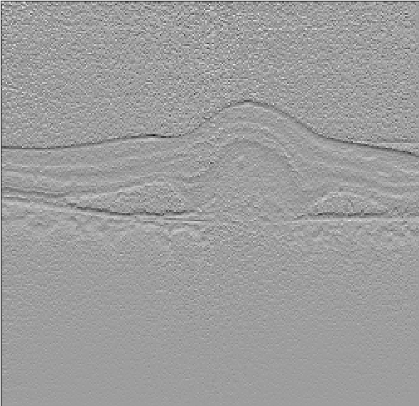
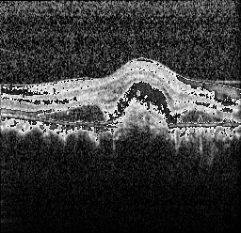

Slide 2
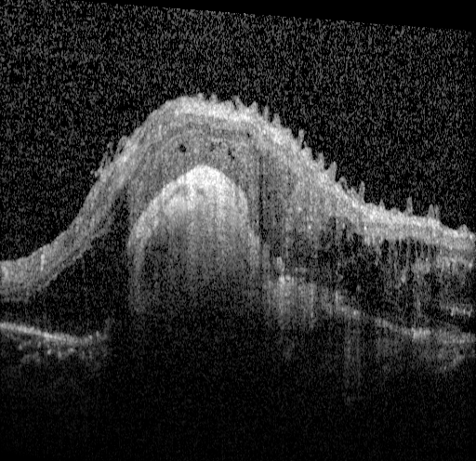
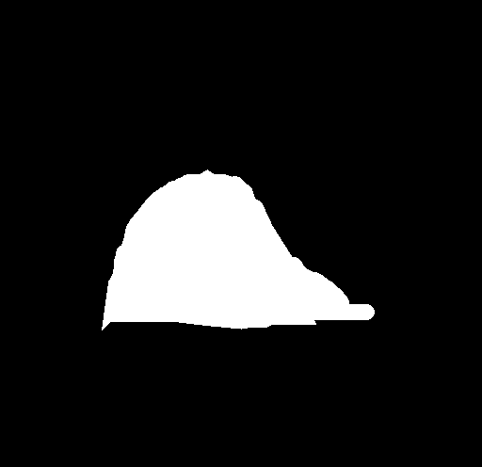
512x512x1
64x64x256
64x64x512
64x64x1024
PMP
512x512x3
128x128x64
128x128x128
128x128x512
256x256x64
256x256x256
512x512x64
BCELoss+DiceLoss
Focal Loss
Classification Result
Linear
Element-wise add
conv1x1 + maxpool
PMP
Dilated ResNetBlock
Pyramid mixed pooling
module
Upsampling

Slide 3
maxpool(1x1)
＋
Input feature map
avgpool(1x1)
conv1x1+upsample
maxpool(2x2)
＋
avgpool(2x2)
conv1x1+upsample
conv1x1
Output feature map
maxpool(3x3)
＋
avgpool(3x3)
conv1x1+upsample
maxpool(6x6)
＋
avgpool(6x6)
conv1x1+upsample

Slide 4

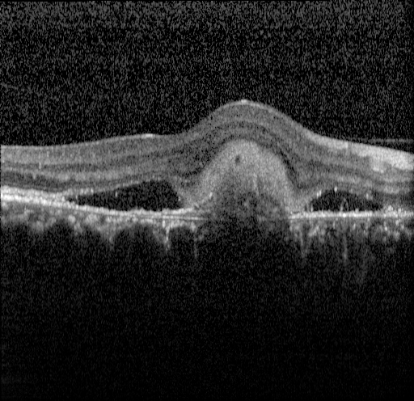
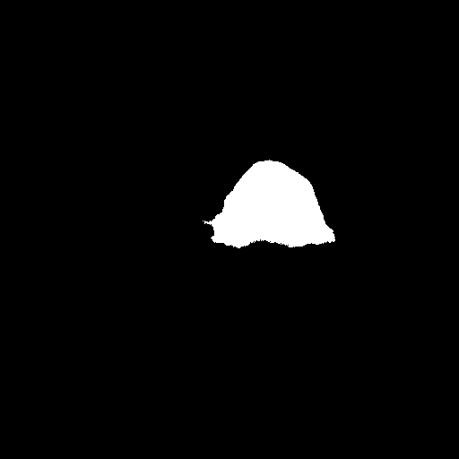



实验结果
origin img
UNet
CENet
DCG-Net
Ground truth

