Slide 1
> CMU 11-868 • LLM Systems • Spring 2026
RAGCache++
Cache-Aware Document Ordering
for Low-Latency RAG Serving
Prompt-layer scheduling that reduces TTFT by 20–33% with zero engine modifications
Kaizhen Tan • Rong Gu • Mingyuan Li
Heinz College, Carnegie Mellon University
20–33% TTFT ↓ • 97.5% Oracle • ~150 LOC
1/16
Notes:
Good morning/afternoon, everyone. I'm Kaizhen Tan, and together with Rong Gu and Mingyuan Li, we'll present RAGCache++, a prompt-layer scheduling system that reduces LLM serving latency in RAG applications through intelligent document ordering.
Our system achieves 20 to 33 percent TTFT reduction, reaches 97.5% of oracle performance, and requires only about 150 lines of Python — with absolutely zero modifications to the serving engine.

Slide 2
01 MOTIVATION
The RAG Latency Problem
RAG improves accuracy but inflates latency
• Retrieved documents make prompts 2–10× longer
• Prefill cost scales as O(n·d) — dominates serving
• TTFT (Time-To-First-Token) = what users feel
• Steps 1–3 (embed, retrieve, build): ~10–50 ms
• Step 4 (LLM inference / prefill): 50–200+ ms
Goal: reduce prefill cost without modifying the engine.
RAG Pipeline
┌─────────────────────┐
│ 1. Query Embedding │ ~5 ms
├─────────────────────┤
│ 2. Vector Retrieval │ ~20 ms
├─────────────────────┤
│ 3. Prompt Build │ ~1 ms
├═════════════════════┤
│ 4. LLM PREFILL │ 50–200 ms
│ ← bottleneck │
└─────────────────────┘
2/16
Notes:
RAG improves LLM accuracy by injecting retrieved passages into the prompt, but this comes at a significant cost. Prompts become 2 to 10 times longer, and since prefill computation scales linearly with input length, this directly inflates Time-To-First-Token — the metric users feel most.
In a typical RAG pipeline, query embedding and vector retrieval take about 10 to 50 milliseconds. But the LLM prefill — step 4 — can take 50 to 200 or more milliseconds, dominating total latency. Our goal is to reduce this prefill cost without modifying the serving engine itself.

Slide 3
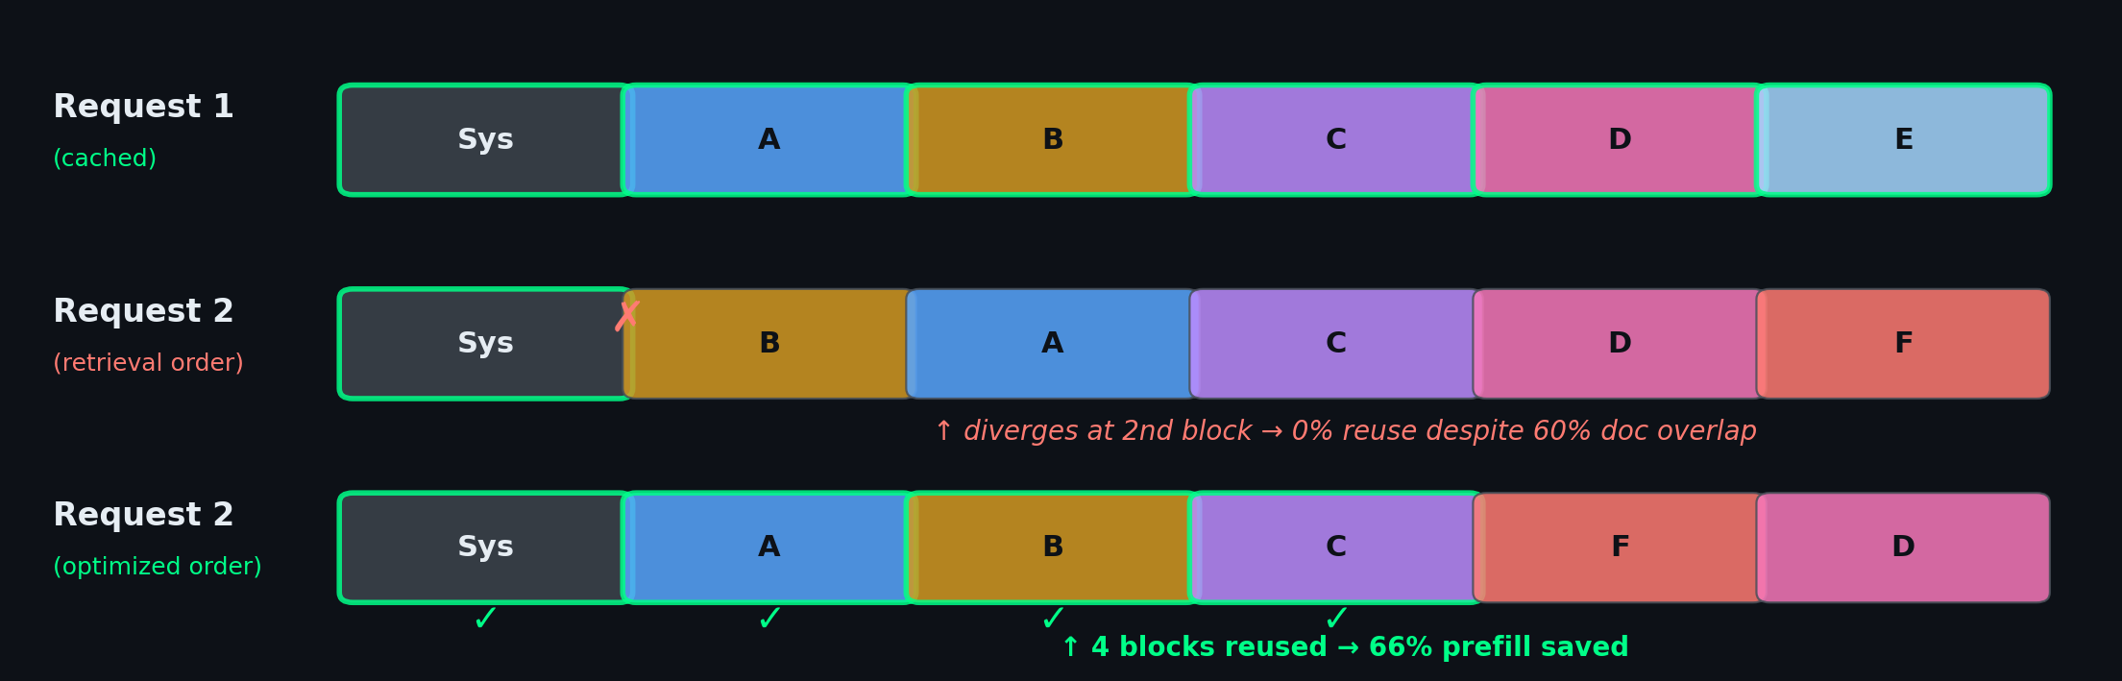
02 BACKGROUND
vLLM's Automatic Prefix Caching (APC)
How APC works
• KV cache in fixed-size blocks (PagedAttention)
• Reuses blocks when requests share identical prefix
• Chained hashes: mismatch at pos j → all ≥ j invalid
The gap we target:
RAG retrieval → document level Prefix caching → token level Different ordering = no reuse
3/16
Notes:
Modern serving engines like vLLM provide Automatic Prefix Caching. It manages KV cache in fixed-size blocks and reuses them when requests share identical token-level prefix. The critical detail: chained hashes mean a single-token mismatch at position j invalidates ALL subsequent blocks. The diagram shows: retrieval order causes 0% reuse despite 60% overlap, while optimized ordering reuses 4 blocks and saves 66%.

Slide 4
03 APPROACH
RAGCache++: Prompt-Layer Cache Scheduling
Key Insight
Reorder documents to align with cached prefixes → converts document overlap into APC-aligned token prefixes
01
Knowledge Tree
Trie indexed by doc-ID sequences tracks cached orderings
02
Greedy Algorithm
O(k) trie walk finds longest cached prefix per request
03
Zero Modifications
~150 lines of Python prompt-layer only, any engine
Analogy: like a disk I/O scheduler reordering requests for spatial locality — without modifying the disk firmware.
4/16
Notes:
Our approach is straightforward. Since APC requires exact token-level prefix matches, we can maximize cache reuse simply by reordering documents to align with cached prefixes.
RAGCache++ has three core components. First, a knowledge tree — a trie indexed by document-ID sequences — that tracks which orderings are currently in the KV cache. Second, a greedy O(k) algorithm that walks the trie to find the longest cached prefix for each new request. Third, the entire system requires zero modifications to vLLM — it's about 150 lines of Python operating purely at the prompt-construction layer.
The analogy is a disk I/O scheduler: it reorders requests to exploit spatial locality without modifying the disk firmware. We do the same for KV cache locality.

Slide 5
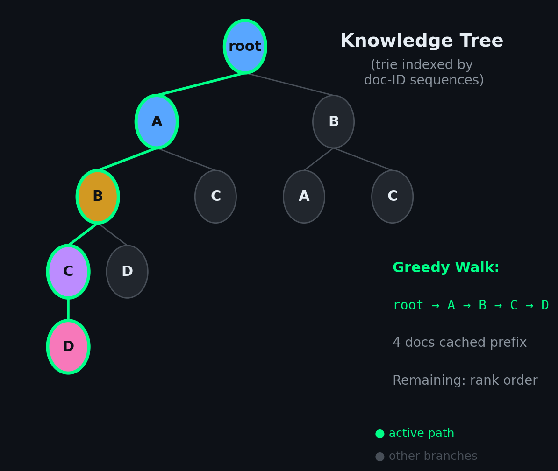
03 ALGORITHM
Greedy Ordering Algorithm
Cache-Aware Document Ordering
Input: docs D = {d₁,...,dₖ}, trie T
Output: ordered sequence O
O ← [], R ← D, node ← T.root
while R ≠ ∅:
for each d in R:
if node.child(d) is cached:
append d to O, remove from R
node ← child; break
if no match found:
append R in rank order; break
return O
O(k) Complexity
97.5% Of Oracle
0.997 Mean Ratio
98.5% Optimal
5/16
Notes:
The algorithm walks the trie greedily. At each level, it selects a child whose doc ID is in the candidate set. When no cached continuation exists, it falls back to retrieval-rank order. O(k) complexity, 97.5% of oracle, mean optimality ratio 0.997.

Slide 6
04 FEEDBACK LOOP
Cache-State Feedback Loop
Challenge
Trie tracks served sequences, not resident blocks. Under memory pressure, vLLM may evict blocks that the trie still considers cached.
Integrated Pipeline Results
Prediction accuracy
99.5%
Mismatches detected
1 / 200 queries
Per-request overhead
0.049 ms
Overhead fraction
< 0.1% of TTFT
Trie-reality correlation
Pearson r = 0.972
Under memory pressure
r = 0.965 (stable)
Solution: TTFT-based feedback
1. Maintain EMA estimate of cold-start TTFT
2. After each request, compare:
predicted reuse r̂ = prefix_len / k
actual reuse r = 1 − T_actual / T_cold
3. If r̂ > 0.3 but r < 0.15 → mismatch!
4. Mark predicted path as stale → prune trie
6/16
Notes:
A key challenge is that the trie tracks what we've served, not what's actually resident in vLLM's cache. Under memory pressure, vLLM may evict blocks that the trie thinks are cached, leading to stale predictions.
We close this gap with a TTFT-based feedback loop. The system maintains a running estimate of cold-start TTFT using an exponential moving average. After each request, it compares the trie's predicted reuse fraction with the TTFT-inferred actual reuse. When the trie predicts a significant cache hit but the observed TTFT is near-cold, we detect a mismatch and prune the stale path.
This achieves 99.5% prediction accuracy with only 0.049 milliseconds of overhead — less than 0.1% of TTFT. The trie-reality correlation is 0.972, and it remains stable even under memory pressure at 0.965.

Slide 7
05 ARCHITECTURE
System Architecture
Knowledge Tree
Trie walk, O(k) greedy ordering
Prompt Builder
Reorder docs + construct prompt
vLLM (APC)
Prefill + decode block-level reuse
→
→
↻ Cache-State Feedback Loop
CacheStateFeedback (TTFT-based) → detects trie-vs-reality mismatch → prunes stale paths → keeps trie synced
99.5% accuracy • 0.049 ms overhead • Pearson r = 0.972
VLLMCacheProxy
Integrates all components into a serving proxy
RAGCacheMiddleware
FastAPI wrapper with /v1/rag/generate endpoint
Zero Engine Mods
Works with any APC-enabled serving engine
7/16
Notes:
Three core stages: Knowledge Tree for ordering, Prompt Builder for construction, vLLM with APC for inference. The feedback loop detects trie-reality mismatches via TTFT and prunes stale paths. Wrapped in VLLMCacheProxy with FastAPI middleware. Zero engine modifications.

Slide 8
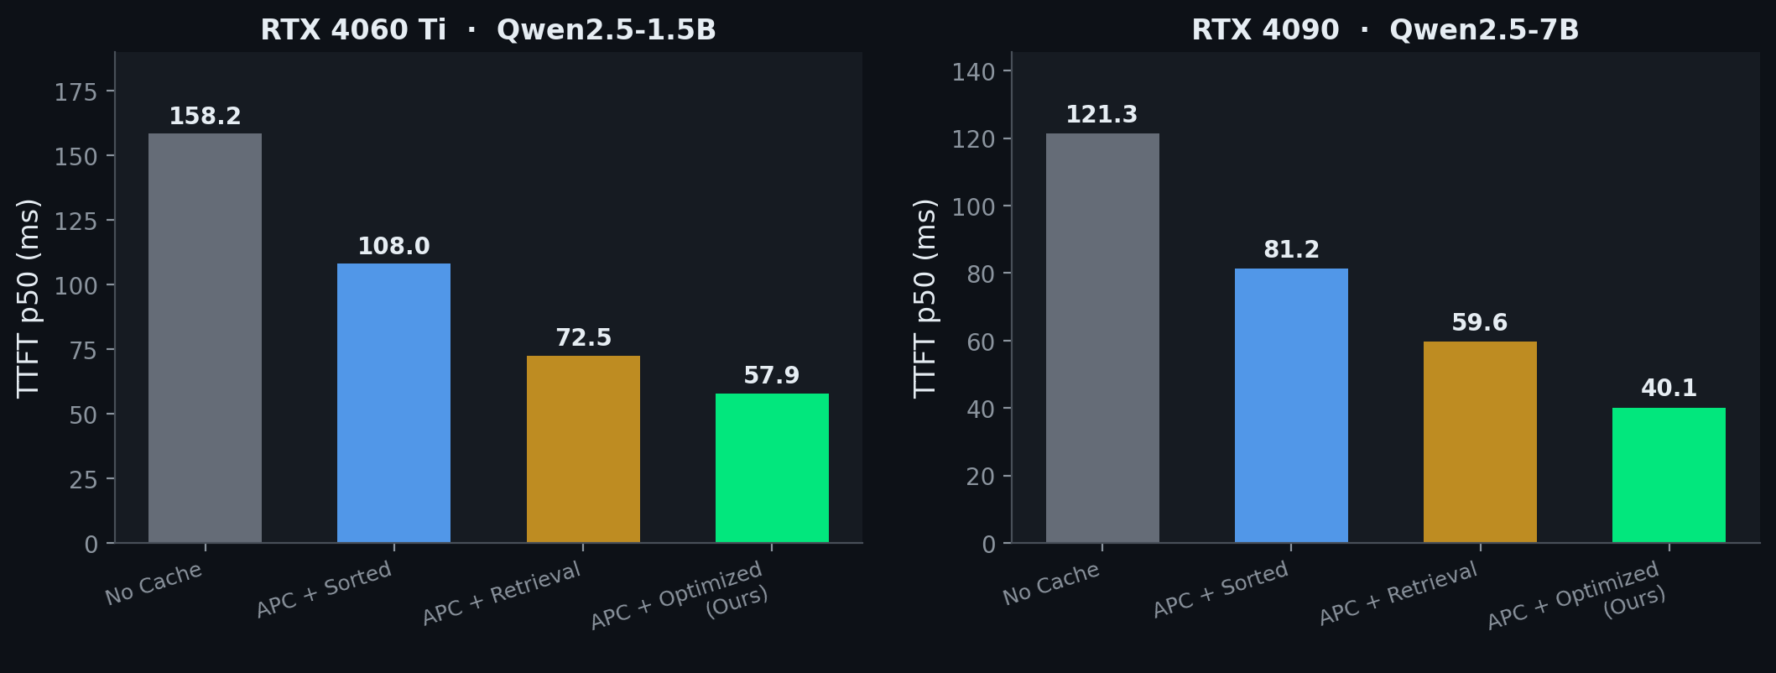
06 RESULTS
Main Results: TTFT Reduction
20–33%
TTFT REDUCTION
66%
PREFILL SAVED
97.5%
OF ORACLE
<0.13%
OVERHEAD
Statistically significant: 16.8 ± 1.6 ms improvement (95% CI excludes zero, 3 independent seeds)
8/16
Notes:
20-33% TTFT reduction. On 4060 Ti: 72.5 to 57.9ms (20%). On 4090: 59.6 to 40.1ms (33%). Statistically significant across 3 seeds: 16.8 +/- 1.6ms, 95% CI excludes zero. 66% prefill saved, 97.5% of oracle, <0.13% overhead.

Slide 9
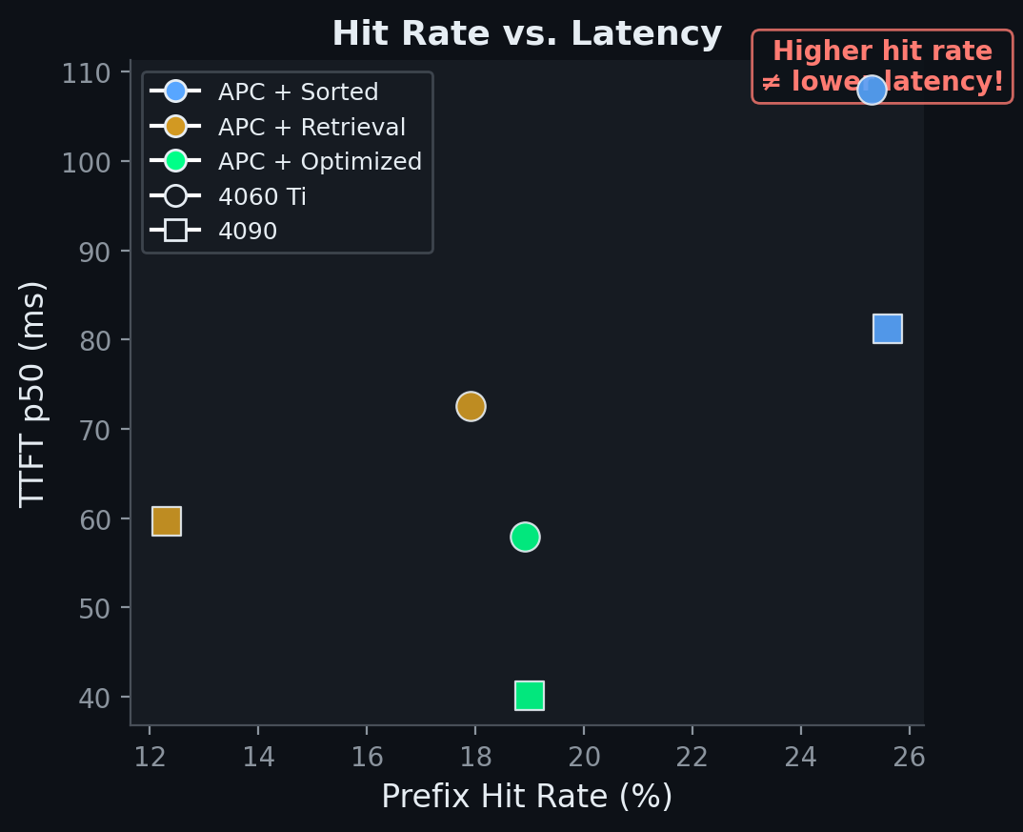
07 KEY FINDING
Key Finding: Prefix Depth > Hit Count
Counterintuitive result:
Higher hit rate ≠ lower latency
APC+Sorted:
• Highest hit rate (25.6%)
• But highest TTFT among APC!
• Many short, fragmented matches
APC+Optimized (ours):
• Fewer but LONGER matches
• Lowest TTFT (40.1 ms)
• Longer prefixes save more
Takeaway: prefix depth drives latency reduction, not hit count.
9/16
Notes:
Counterintuitive: APC+Sorted has highest hit rate (25.6%) but highest TTFT. Our optimized ordering has lower hit rate (19%) but lowest TTFT. Why? Sorted creates many short fragmented matches; our approach creates fewer but longer contiguous matches. Prefix DEPTH, not hit COUNT, drives latency.

Slide 10
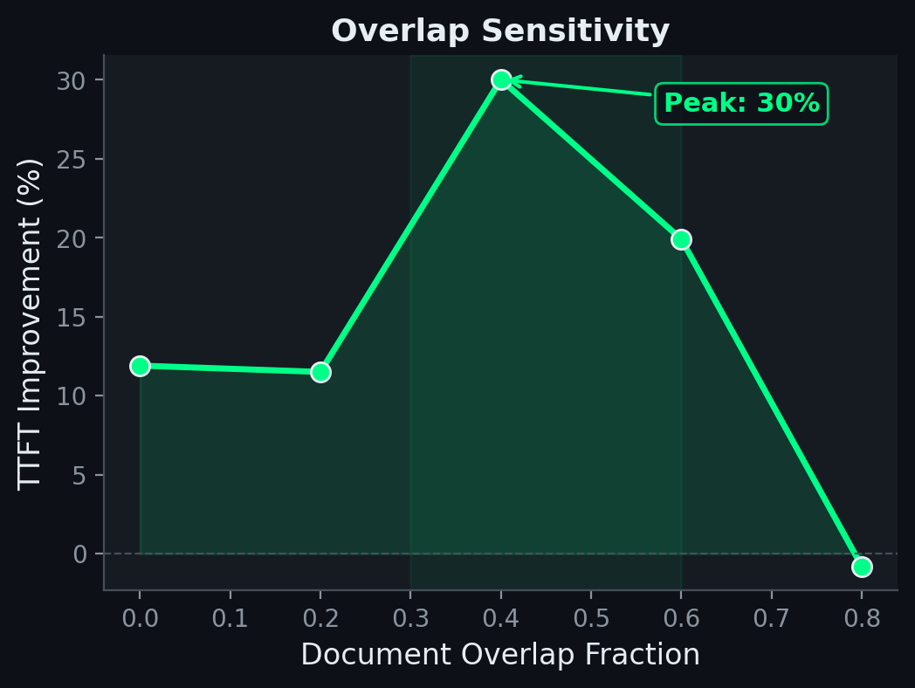
08 ROBUSTNESS
Robustness & Generality
Concurrent Load
7–10% improvement at batch 1–8 Benefit persists under GPU sharing
GPU Memory Levels
29–31% stable across gpu_mem 0.78 → 0.90 Also stable at max_model_len = 2048
Cross-Architecture
Qwen2.5: 19% (0.5B) / 20% (1.5B) / 33% (7B) Phi-3-mini: 18% — 4 sizes, 2 architectures
Top-k sweep: 7.8% (k=3) → 61.2% (k=10)
10/16
Notes:
Concurrent load: 7-10% across batch 1-8. GPU memory: 29-31% stable across 0.78-0.90. Cross-arch: Qwen2.5 (19/20/33%) + Phi-3 (18%). Overlap sensitivity: peak 30% at moderate overlap. Top-k sweep: 7.8% to 61.2%.

Slide 11
09 QUALITY
Answer Quality Preservation
Extractive QA (Qwen2.5-7B)
100 questions, strict extractive prompt
Retrieval order: EM = 1.000
Optimized order: EM = 1.000
ΔEM = 0 — Zero degradation
Multi-hop Reasoning (2-hop QA)
40 two-hop examples, 4 conditions tested
Evidence Doc Order EM F1
Natural Retrieval 0.675 0.862
Natural Optimized 0.675 0.862
Reversed Retrieval 0.625 0.826
Reversed Optimized 0.625 0.826
Why quality is preserved
• Reordering changes only the order of passages, not their content
• For extractive QA, passages are interchangeable evidence — order is immaterial
• For multi-hop: evidence order matters, but our reordering produces identical quality
• Within each evidence config: ΔEM = 0, ΔF1 = 0 (bit-identical outputs)
11/16
Notes:
A natural concern is whether reordering degrades answer quality. Our evaluation confirms it does not.
On extractive QA with 100 questions using Qwen2.5-7B, both orderings achieve perfect exact match of 1.000. Delta EM equals zero — absolutely no degradation.
For multi-hop reasoning, which is a harder test — we used 40 two-hop examples where passage A contains "X is related to Y" and passage B contains "Y leads to Z." We tested four conditions: natural and reversed evidence order, crossed with retrieval and optimized document ordering.
Two findings: first, evidence order matters — natural ordering yields higher EM than reversed. Second, and crucially, within each evidence configuration, our document reordering produces identical quality. Delta EM equals zero, Delta F1 equals zero. This is because we change only the order of passages in the prompt, not their content.

Slide 12
10 WORKLOADS
Diverse Workload Evaluation
Geospatial
Spatial-RAG inspired 20 cities, natural locality
Jaccard = 0.17
+4.5%
NQ-Open
Real questions from Natural Questions
Jaccard = 0.88
+2.3%
Mixed-Topic
30% topic-switching heterogeneous queries
Jaccard = 0.31
+16.3%
Real Corpus
1000 Wikipedia passages TF-IDF retrieval, 20 topics
No controlled overlap
+10.2%
Ordering benefits scale with moderate overlap (Jaccard ≈ 0.3–0.5) — the regime of real multi-topic RAG deployments
12/16
Notes:
Beyond synthetic benchmarks, we evaluate on four diverse workloads.
On a geospatial workload with natural spatial locality — Jaccard 0.17 — we see 4.5% improvement. The lower gain is expected: with low overlap, there's less room for prefix optimization.
On NQ-Open with very high overlap — Jaccard 0.88 — we see only 2.3%, because retrieval order already produces near-maximal prefix alignment at such high overlap.
On a mixed-topic workload with 30% topic switching — Jaccard 0.31 — we get 16.3% improvement. And on a real corpus of 1000 Wikipedia passages with TF-IDF retrieval and NO controlled overlap parameter, we still achieve 10.2%.
The pattern is clear: ordering benefits scale with the moderate-overlap regime, Jaccard around 0.3 to 0.5, which characterizes real multi-topic RAG deployments where users shift between related subjects.

Slide 13
11 SYSTEMS
Systems Analysis
Latency Overhead
• Ordering: 22.2 μs
• Prompt build: 44.4 μs
• Total overhead: 66 μs (<0.13%)
• Inference p50: -29% (41.4 vs 58.6 ms)
Throughput
• Sequential: 1.19 req/s (identical)
• Batched: 94K tok/s (< 0.4% diff)
• Zero throughput regression
• Decode path unchanged by ordering
GPU Memory
• Peak memory: 21,751 MB (identical)
• vLLM pre-allocates fixed pool
• Ordering changes block reuse,
• not pool size. Trie: < 1 MB host mem
Pipelining
• System prompt warmup || retrieval
• T_ret=50ms: 106.8→78.8 ms (26%↓)
• Benefits cold starts & eviction recovery
• Only concurrent.futures — no mods
13/16
Notes:
From a systems perspective, our overhead is minimal. The ordering step takes 22.2 microseconds, prompt construction 44.4 microseconds — together 66 microseconds or less than 0.13% of total latency. Meanwhile, inference p50 drops by 29%.
Throughput is completely unaffected. Both sequential and batched processing show identical throughput because ordering affects only the prefill path, not decode.
GPU memory is identical — vLLM pre-allocates a fixed KV cache pool. Our ordering changes which blocks within this pool are reused, not the pool size itself. The knowledge tree resides in host memory and uses less than 1 megabyte.
For pipelining, we overlap system prompt prefill with retrieval using a simple ThreadPoolExecutor. At a realistic 50 millisecond retrieval latency, this reduces cold-start TTFT from 106.8 to 78.8 milliseconds — a 26% reduction. No engine modifications needed.

Slide 14
12 RELATED WORK
Related Work & Positioning
RAGCache
Engine-level KV management, modified serving engine
Our scheduling matches its benefits without engine mods
ContextPilot
Concurrent, similar prompt-layer approach
Validates cache-aware ordering as a systems abstraction
CacheBlend
Position-independent KV reuse via selective recomputation
Complementary: handles the non-prefix portion
TurboRAG
Pre-computed chunk KV caches, reordered-RoPE stitching
Complementary: relaxes prefix constraint at attention level
Our Contribution: Deployment-ready realization
Engine-agnostic • Formally near-optimal (97.5%) • Closed-loop feedback • Cross-workload/architecture evaluation
14/16
Notes:
RAGCache modifies engine; we match benefits at prompt layer. ContextPilot validates the abstraction. CacheBlend/TurboRAG are complementary. Our contribution: deployment-ready, engine-agnostic, near-optimal, closed-loop feedback.

Slide 15
Conclusion
RAGCache++: prompt-layer scheduling for APC-based RAG serving
20–33% TTFT reduction with < 0.13% overhead
66% prefill computation saved at p50
97.5% of oracle performance with O(k) greedy algorithm
Zero engine modifications — ~150 lines of Python
Closed-loop feedback with 99.5% prediction accuracy
Robust across 4 model sizes, 2 architectures, 5 workloads
20–33%
TTFT REDUCTION
66%
PREFILL SAVED
~150
LINES OF PYTHON
Key systems insight: prefix depth > hit count for latency reduction
15/16
Notes:
In conclusion, RAGCache++ demonstrates that a thin prompt-layer scheduling policy can recover substantial cache locality in RAG serving.
Our headline results: 20 to 33% TTFT reduction with less than 0.13% overhead. 66% of prefill computation saved at the median. 97.5% of oracle performance with an O(k) greedy algorithm. All with about 150 lines of Python and zero engine modifications.
The closed-loop feedback mechanism achieves 99.5% prediction accuracy, keeping the trie synchronized with vLLM's actual cache state. And the approach generalizes across 4 model sizes, 2 architectures, and 5 diverse workloads.
Our key systems insight is that prefix depth — not hit count — is the relevant metric for latency reduction in prefix-caching systems. Thank you.

Slide 16
Thank You
Questions?
Kaizhen Tan • kaizhent@cmu.edu
Rong Gu • ronggu@andrew.cmu.edu
Mingyuan Li • mingyua4@andrew.cmu.edu
github.com/tantansir/RAGCachePlusPlus
16/16
Notes:
Thank you for your attention. We're happy to take any questions about RAGCache++, our experimental methodology, or the systems insights we've discussed.
The code is available at github.com/tantansir/RAGCachePlusPlus.

