Slide 1

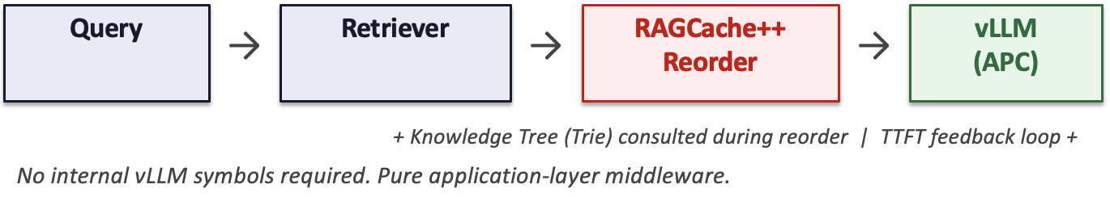
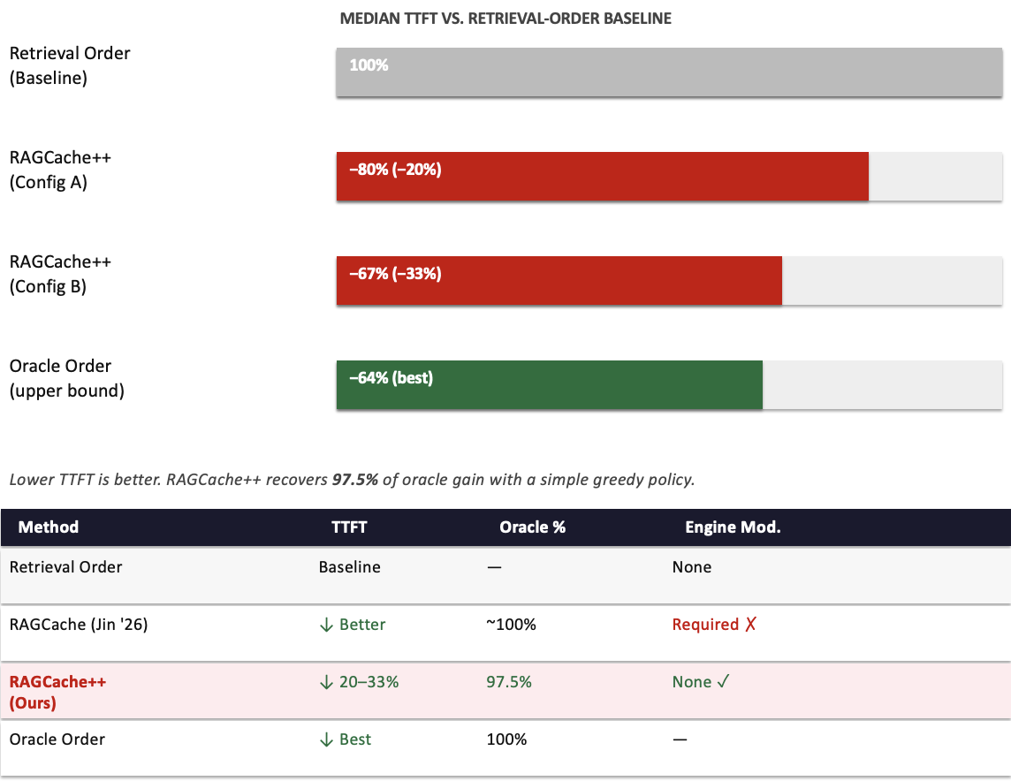
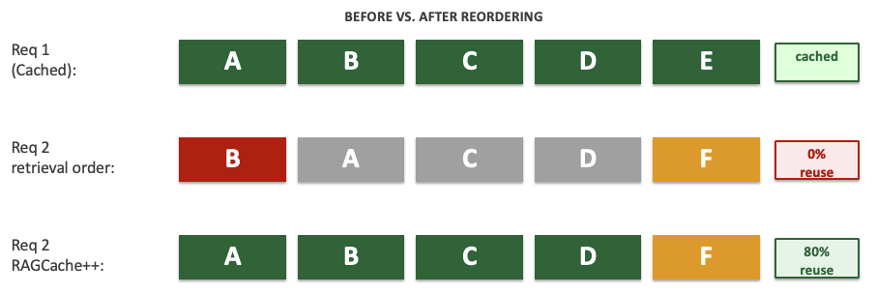
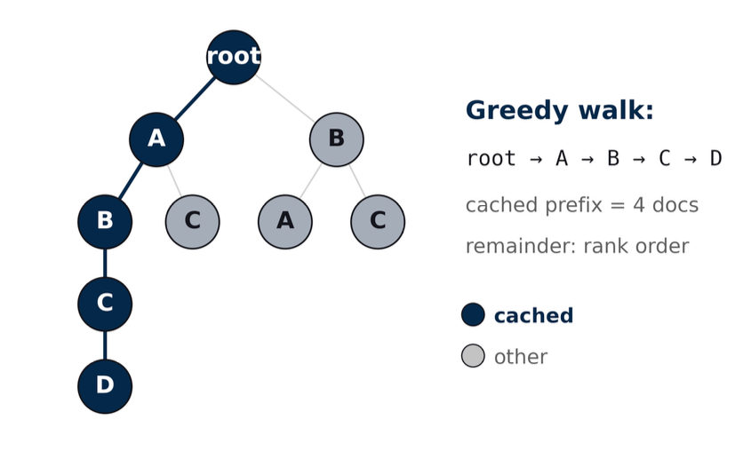
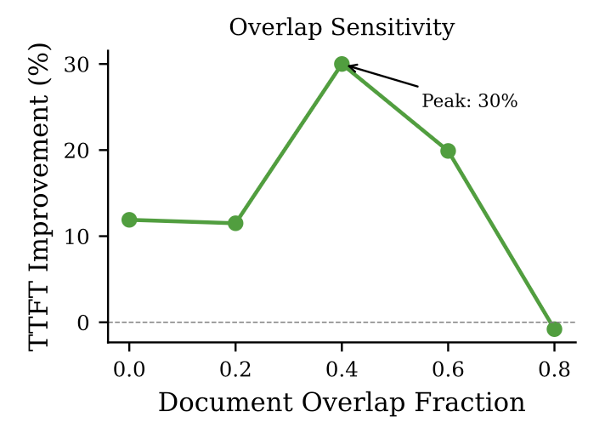
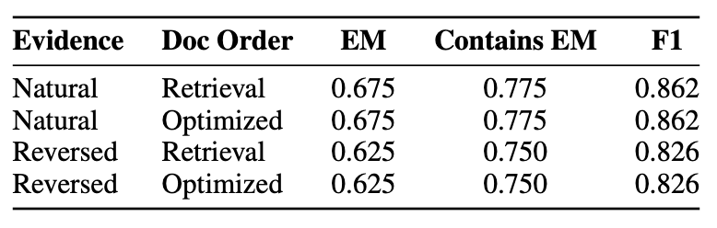
RAGCache++: Cache-Aware Document Ordering for Low-Latency RAG Serving
Kaizhen Tan · Rong Gu · Mingyuan Li
Heinz College, Carnegie Mellon University | 11868 Large Language Model Systems, Spring 2026
THE PROBLEM
METHOD
Results & ANALYSIS
RAG improves factual grounding by injecting retrieved documents into prompts — but this makes prompts long and makes prefill the main bottleneck for interactive use.
How vLLM APC works:
Automatic Prefix Caching reuses previously computed KV blocks when a new request shares the same token prefix as a cached one.
1
Knowledge Tree (Trie)
The Mismatch
Tracks recently served document orderings. Each root-to-leaf path = one cached sequence. Updated after every request — compact memory of recent prompt structure.
Retrieval returns documents as a set. APC requires ordered prefix agreement. Two requests retrieving the same documents in different orders get zero cache reuse.
2
Greedy Ordering Algorithm
"Document overlap is common in RAG, but prefix overlap is much rarer."
Walk trie root -> pick the remaining document extending a cached path -> repeat. When no cached match exists: fall back to retrieval rank order. Only ~22 us overhead per request.
KEY INSIGHT
3
TTFT Feedback Loop
Reorder retrieved documents so the prompt matches an existing cached prefix.
Trie is only an approximation. If predicted reuse was high but TTFT stayed cold -> mark path stale, prune it. Adapts online without instrumentation of vLLM internals.
RAGCache++ is not a universal speedup for all workloads. It is most effective when requests are related enough to share evidence.
E
Answer quality remains unchanged in our QA tests, suggesting that reordering improves latency without disrupting evidence use.
MEDIAN TTFT REDUCTION
20–33%
✓ NO ANSWER QUALITY LOSS
The method adds negligible CPU overhead, preserves baseline APC throughput, and remains beneficial under concurrent and end-to-end settings.
0 ENGINE MODIFICATIONS

