Slide 1








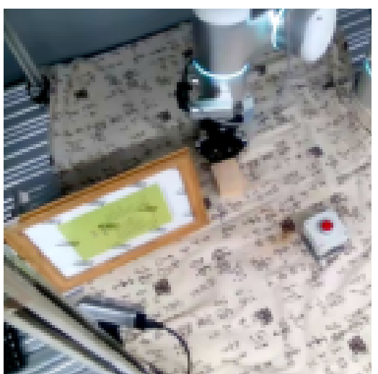
The certificate-gated protocol
linear / MLP probes
raw
observations
certificate
gate
interventions
inputs · targets · horizons
frozen
latent
functional prediction
closed-loop control
recoverable?
decodable?
two testbeds instantiate the protocol
functionally used?
PokeWorld
simulated arena · ground-truth m, γ, k
RH20T
real robot streams · held-out tasks

