Slide 1








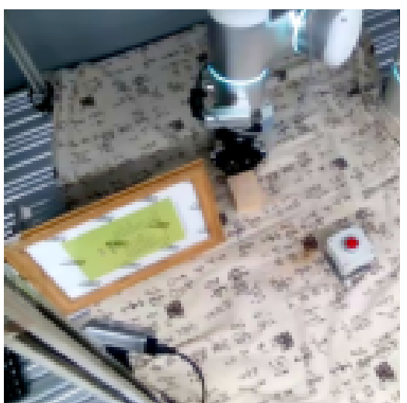
recoverable?
decodable?
raw
observations
certificate
gate
interventions
inputs, targets, horizons
frozen
latent
linear / MLP probes
functional prediction
closed-loop control
functionally used?
two testbeds instantiate the protocol
PokeWorld
simulation · known m, γ, k
RH20T
real streams · held-out tasks

