Slide 1


SMART INDIA HACKATHON 2025
TITLE PAGE
Problem Statement ID – SIH25072
Problem Statement Title- Design and Implementation of Solar Powered Dewatering in Mining Operations.
Theme- Renewable Energy
PS Category- Hardware
Team ID-
Team Name (Registered on portal)- BrainDraft

Slide 2

IDEA TITLE
Proposed Solution:
Detailed explanation:
Deploy solar PV powered submersible/surface pumps for continuous mine dewatering.
Operate under OPEX/PPA model – eliminating upfront CAPEX burden.
Hybrid configuration (Solar + Grid/Diesel) ensures 24/7 pumping.
Vendor-managed operation and maintenance.
How it addresses the problem:
Reduces electricity and diesel costs.
Ensures reliability during power outages.
Minimizes carbon emissions.
Reduces maintenance complexity for HCL.
Innovation and uniqueness:
First-of-its-kind OPEX + Renewable model in mining dewatering.
Modular, scalable, and replicable across multiple mines.
Combines financial efficiency with sustainability.

Slide 3
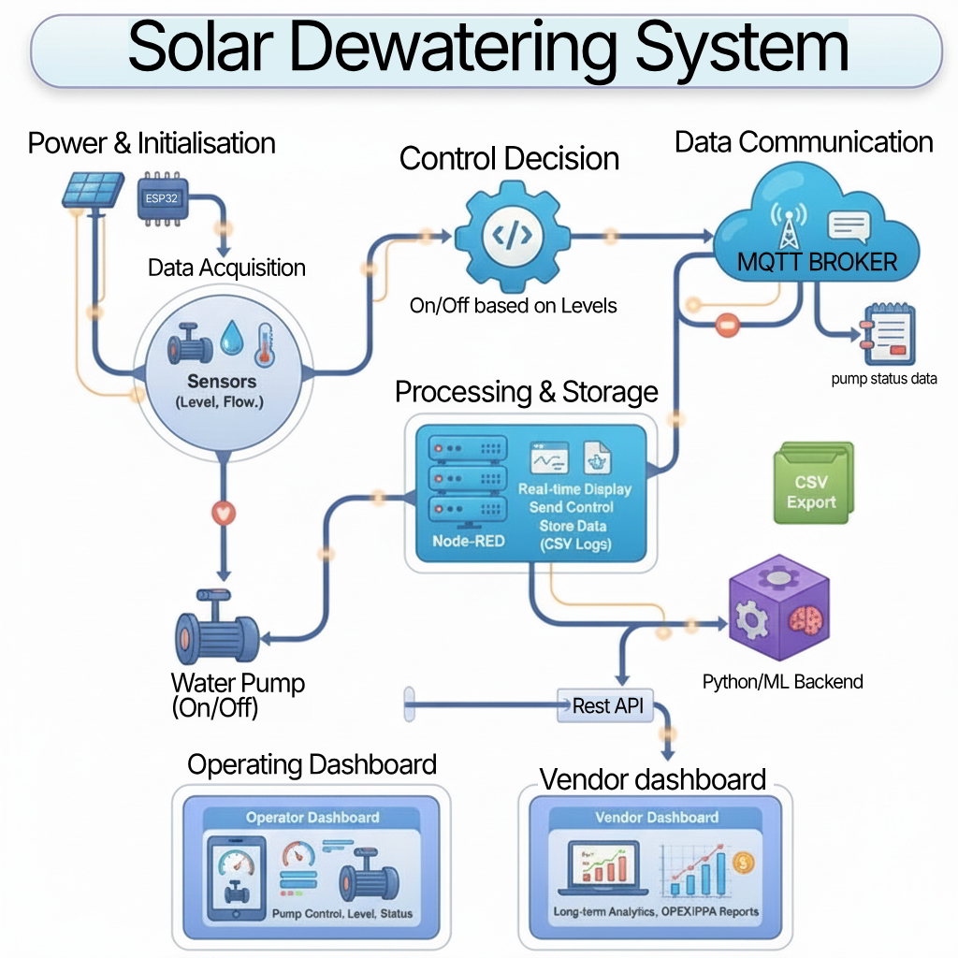







TECHNICAL APPROACH
Next.js
React
Node-Red

Slide 4
FEASIBILITY AND VIABILITY
Feasibility:
Solar pumping technology is already proven in agriculture and industry.
OPEX/PPA model removes upfront cost barrier.
Modular design allows scale-up as mine expands.
Potential Challenges:
Weather dependency (low solar generation during monsoons).
Space requirement for solar panels.
Vendor reliability and long-term service.
Risk Mitigation:
Hybrid backup system ensures uninterrupted pumping.
Use high-efficiency PV panels to reduce land footprint.
Vendor selection with strict SLA and performance guarantees.

Slide 5
IMPACT AND BENEFITS
Potential Impact:
Reliable and uninterrupted mine dewatering.
Predictable and reduced operational costs.
Strengthens sustainability and ESG commitments.
Benefits:
Economic: 30–50% reduction in OPEX compared to diesel-based systems.
Environmental: CO₂ emissions reduced by 60–70%.
Social: Supports green mining and local community image.
Operational: Vendor-managed operation reduces maintenance load.

Slide 6
RESEARCH AND REFERENCES
Machine Learning Approach to Identify Important Parameters Influencing Pumping Load Shift in a Complex Dewatering System of a Deep-Level Mine – by Fortunate Olifant, Shaun Hancock, Johan du Plesis, Jean van Laar & Corne Schutte – 2024.
Link : https://www.mdpi.com/2673-6489/4/2/12
Feasibility study of solar photovoltaic/grid-connected hybrid renewable energy system with pumped storage hydropower system using abandoned open cast coal mine: A case study in India – by Ambati Bhimaraju, Aeidapu Mahesh, Joshi Sukhdev Nirbheram – 2023.
Link: https://www.sciencedirect.com/science/article/abs/pii/S2352152X23016031

