Slide 1
数据库专题训练
数据库新型检索技术
空间数据的检索
计算机系软件所数据库组 李国良
DB Training - Spatial

Slide 2
Outline
Motivation
knn Search
Location-aware Instant Search
knn Search on Road Networks
DB Training - Spatial

Slide 3

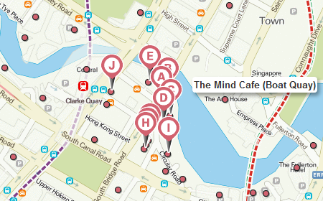
Motivation
Geographical Information System (GIS)
Location-Base Services (LBS)
Smart Phones
DB Training - Spatial

Slide 4
KNN Search
Point of interests (POIs)
  Location (Longitude, Latitude)
  Tag – a set of keywords
Given a set of POIs and a query POI, find k POIs nearest to the query POI.
DB Training - Spatial

Slide 5
Minimum Bounding Rectangle (MBR)
DB Training - Spatial

Slide 6
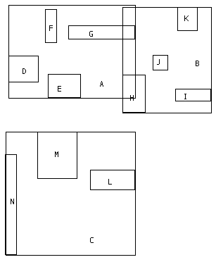
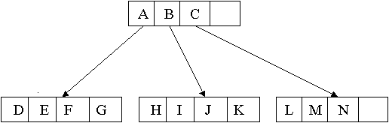
R-tree
A balanced tree similar to a B⁺-tree;
Each tuple has a unique identifier which can be used to retrieve it
(I, child-pointer)
(I, tuple-identifier)
DB Training - Spatial

Slide 7
R-Trees: The Structure.
Internal nodes : ( MBR, child pointer)
  MBR is minimum bounding rectangle
  Pointer to all rectangles contained by the MBR.
Leaf Nodes : (MBR , tuple-identifier)
  MBR is minimum bounding rectangle
  Tuple-identifier is a pointer to the data object.
DB Training - Spatial

Slide 8
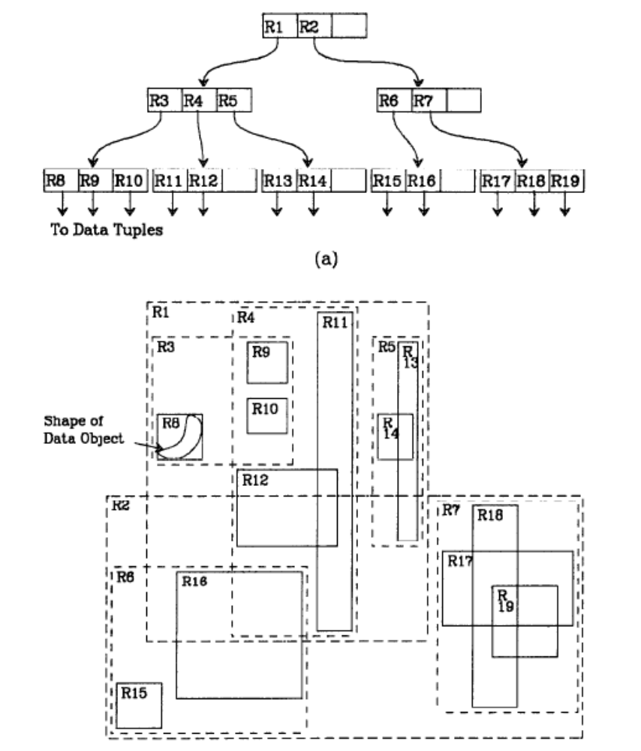
Example
3 levels
m=2, M=4
DB Training - Spatial

Slide 9
Properties of R-trees
An R-tree satisfies the following properties
The root has at least two children unless it is a leaf
Every non-leaf node has between m and M children unless it is the root
Every leaf node contains between m and M entries unless it is the root
All leaves appear on the same level
M: the maximum number of entries in a node
m: the minimum number of entries in a node
DB Training - Spatial

Slide 10
R-Trees: Operations
Inserts
Deletes
Updates ( delete and re-insert)
Queries/Searches
  Give me all rectangles that are contained in the input rectangle.
  Give me all rectangles intersecting this rectangle.
  Give me k nearest neighbors to a given location
DB Training - Spatial

Slide 11
Insert
Similar to insertion into B+-tree but may insert into any leaf; leaf splits in case capacity exceeded.
  Which leaf to insert into? (Choose Leaf)
    Find the mbr whose rectangle needs least enlargement to include the record
  How to split a node? (Node Split)
    Similar to B-trees, new index records are added to the leaves
    Nodes that overflow are split
    Splits propagate up the tree
DB Training - Spatial

Slide 12
Insert: Choose Leaf
n
m
o
p
DB Training - Spatial
Notes:
Rationale: MBR with larger area has higher probability of intersecting random query. Want to minimize this probability so as to minimize number of intersected MBRs (and hence subtrees that need to be searched).

Slide 13
Insert : Choose Leaf
m
DB Training - Spatial

Slide 14
Insert: Choose Leaf
n
DB Training - Spatial

Slide 15
Insert: Choose Leaf
o
DB Training - Spatial

Slide 16
Insert: Choose leaf
p
DB Training - Spatial

Slide 17
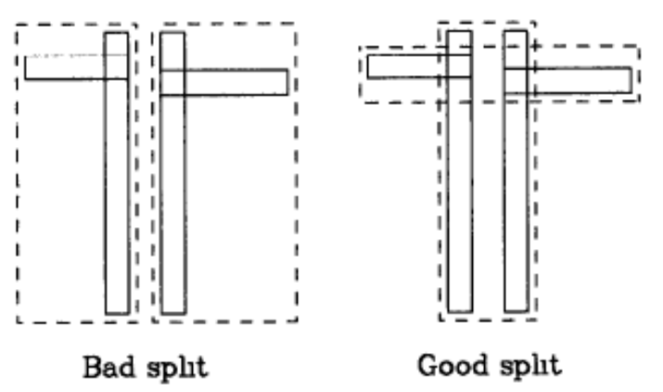
Node Splitting
A full node contains M entries.
Divide the collection of M+1 entries to 2 nodes.
Objective: Make it as unlikely as possible for the resulting two new nodes to be examined on subsequent searches.
Heuristic: The total area of two covering rectangles after a split should be minimized.
Total area is larger!
DB Training - Spatial

Slide 18
Node Splitting
Divide M+1 objects to 2 groups
Exhaustive algorithm
  Generate all possible cases and choose the best case with minimum total area.
Quadratic method
  A heuristic to find a small-area split.
  Cost is quadratic in M and linear in the number of dimensions.
Linear method
  A heuristic to find a small-area split.
  Cost is linear in M and linear in the number of dimensions.
DB Training - Spatial

Slide 19
Quadratic method
Initialize: Pick two of the M+1 entries to be the first elements of the two new groups, such that
  O_{i} in Group 1
  O_{j} in Group 2
  O_{i,j} – O_{i} – O_{j} is maximized
Pick Next
  d₁ = O_{l,1} – O_{l} –G₁
  d₂ = O_{l,2} – O_{l} –G₂
  Find O_{l} to maximize |d₁-d₂|
  Add O_{l} to Group 1 if d₁<d₂; otherwise Group 2
DB Training - Spatial

Slide 20
Linear method
Initialize: Choose two objects that are furthest apart.
Pick Next
  simply chooses any of the remaining entries and insert it into the group to minimize the total area
DB Training - Spatial

Slide 21
Delete
Straightforward.
The only complication is under-flows:
An under-full node can be merged with whichever sibling will have its area increased least.
DB Training - Spatial

Slide 22
Search
Dist(q, o): distance between query q and object o
MinDist(q, R) function: minimal distance from q to R
  q: location
  R: MBR
NN Search
  If Dist(q, o_{best})≤ MinDist(q, R) , prune R
KNN Search
  k best objects
DB Training - Spatial

Slide 23
MINDIST Function
MINDIST (q, R) is the minimum distance between a point q and a rectangle R.
  If the point is inside the rectangle, MINDIST = 0;
  If the point is outside the rectangle, MINDIST is the minimal possible distance from the point to any object in or on the perimeter of the rectangle.
q
q
t
q
R
q
DB Training - Spatial

Slide 24
NN Search Algorithm
Maintain a priority queue Q
Insert the root into Q
While Q is not empty
  Dequeue the element e with minimal MinDist(q, e)
  If e is an object
    return e
  Else
    For each child C of e, Add C into Q
DB Training - Spatial

Slide 25
KNN Search Algorithm
Maintain a priority queue Q and a result set A
Insert <root, 0> into Q
While Q is not empty and |A|<k
  Dequeue the element e with minimal MinDist(q, e)
  If e is an object
    add e into A
  Else if e is a non-leaf MBR,
    For each child C of the MBR, Add <C, MinDist(q, C)> into Q
  Else if e is a leaf MBR
    For each object O in the MBR, Add <O, Dist(q, O)> into Q
DB Training - Spatial

Slide 26
Quadtree
Space-based hierarchical structures
A recursive subdivision of the space into 4 quadrants
The subdivision can be into either equal sized or unequal sized quadtrants
Each leaf node has at most m objects
A
B
C
D
F
E
[D,E,J]
[G,H,I,L]
[H,J,K]
J
G
H
I
[A,B,F]
[B,C,F]
[F,G]
[F]
K
L
DB Training - Spatial

Slide 27
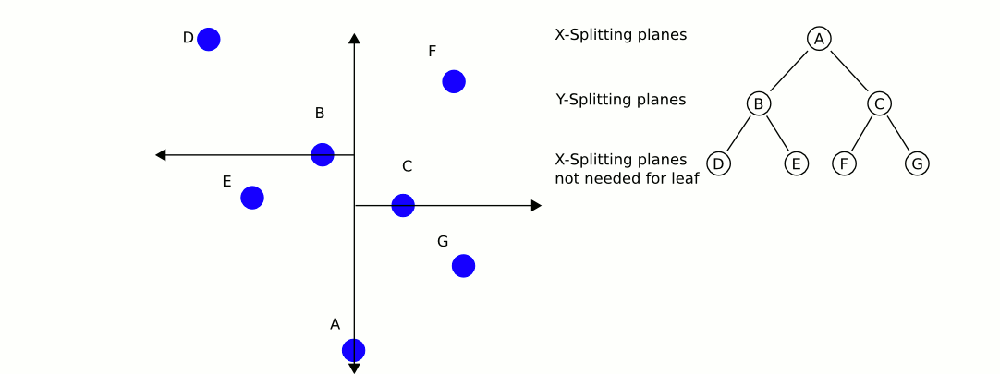
KD-tree
A recursive space partitioning tree.
  Partition along x and y axis in an alternating fashion.
  Each internal node stores the splitting node along x (or y).
DB Training - Spatial

Slide 28
Location-aware Instant Search
DB Training - Spatial

Slide 29
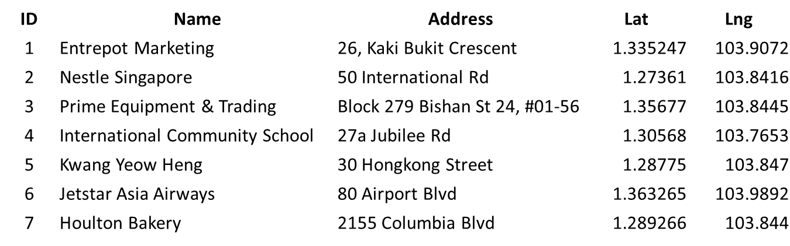
Data Model
O={o₁, o₂, . . . , o_{|O|}}. Each o_{i}=(l, W), where l is the location and W is a set of keywords.
  o₇.W={Houlton, Bakery, Columbia, Blvd}
  o₇.l.=(1.289266, 103.844)
DB Training - Spatial

Slide 30
Query Model
A query q = (l, W, k)
  l: the query location
  W: the query keyword set. Each keyword may be a prefix
  k: topk answers
Answer set R={o}
  For each p∈W, object o has at least one word with p as its prefix
Topk answer set is a subset of R
  For each o∈Topk, o’∈R-Topk, Dist(q,o)≤ Dist(q,o’)
DB Training - Spatial

Slide 31
Example
For example, for a query q, where
  q.l = (1.28, 103.8 )
  q.W = { Columbia, “Bak”}
  q.k = 1
The answer of this query is o₇.
DB Training - Spatial

Slide 32
Naïve Methods
Text First Strategy:
  First find those objects satisfying the query prefix.
    Trie
  Then sort the candidates by Euclidean distance.
Space First Strategy:
  First retrieve the nearest neighbor objects from the query point.
    R-tree, Quadtree
  Then check whether they satisfy textual constraint.
However, both methods are inefficient for large datasets.
DB Training - Spatial

Slide 33
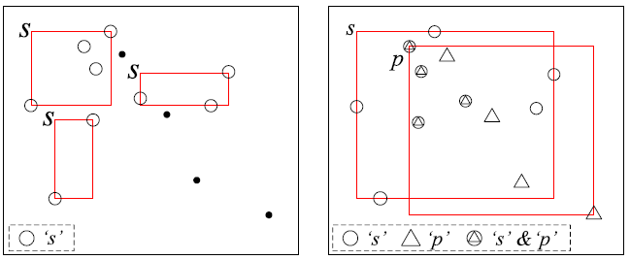
Prefix Region Tree (PR-Tree)
Two observations:
  (1) Trie: Given a specific prefix p, the objects with p may be located in different areas.
  (2) Spatial Structure: Given a specific region r, the objects in r may contain different prefixes but it is hard to distinguish them by spatial information only.
DB Training - Spatial

Slide 34
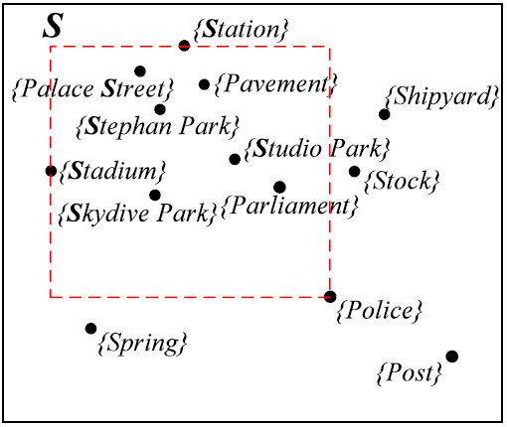
Basic Ideas of PR-Tree
Combine textual and spatial information
Prefix-Region
  <p, r>
  p: a prefix
  r: a region
Prefix-Region is used to describe both textual and spatial information for a set of objects.
DB Training - Spatial

Slide 35
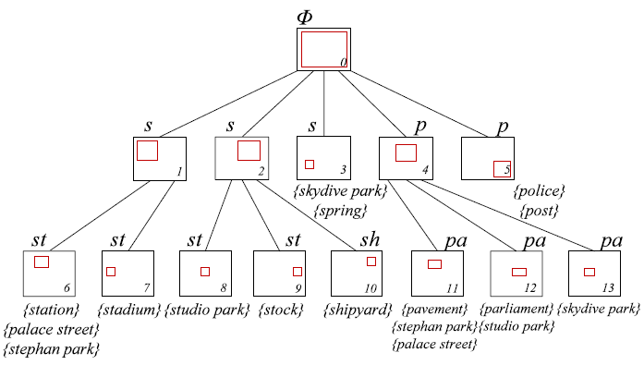
PR-Tree
A Sample of PR-Tree:
DB Training - Spatial

Slide 36
PR-Tree
PR-Tree organizes all objects in a hierarchical manner
  each node is a prefix region which indicates that all the objects in this sub-tree satisfying the prefix-region constraints.
The root node of PR-Tree is f_{root} = <∅, r_{all}>, where r_{all} represents the MBR of all objects in O.
Each leaf node is associated with an object list.
The number of objects in each leaf node is less than M, where M is a pre-defined parameter.
DB Training - Spatial

Slide 37
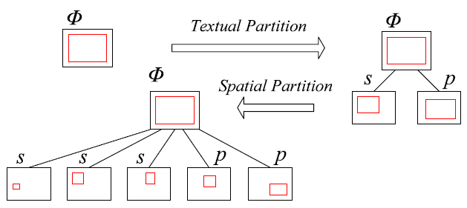
PR-Tree Construction
Combine textual and spatial partition to generate child nodes:
We recursively apply the above procedure until leaf node contains less than M objects.
DB Training - Spatial

Slide 38
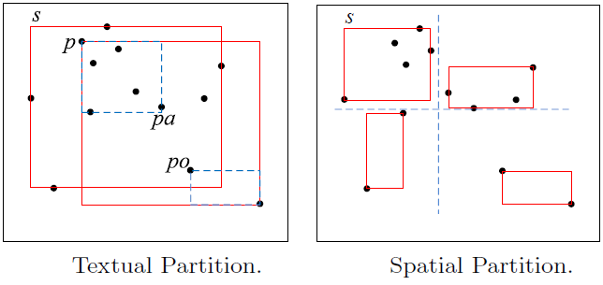
PR-Tree Construction
To build a PR-Tree, two partition methods are employed:
  Textual Partition
  Spatial Partition
DB Training - Spatial

Slide 39
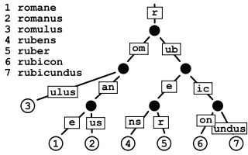
Textual Partition
Textual partitioning groups the objects based on the textual information.
Let Next(p) be a function that returns the prefixes of child nodes of node ‘p’ on a trie.
For example, W ={romane, romanus, romulus, rubens, ruber, rubicon, rubicundus}
Next(‘rub’)={rube, rubic}
DB Training - Spatial

Slide 40
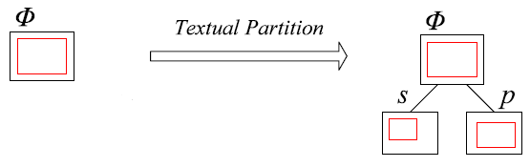
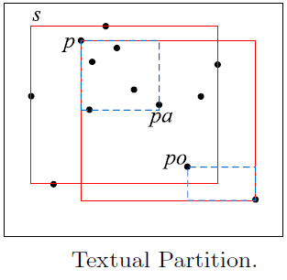
Textual Partition
Given the objects O_{f} of a tree node f, in the textual partition, O_{f} is partitioned into several subsets to generate child nodes based on the Next(O_{f}.p).
DB Training - Spatial

Slide 41
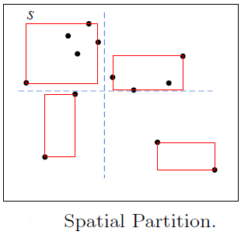
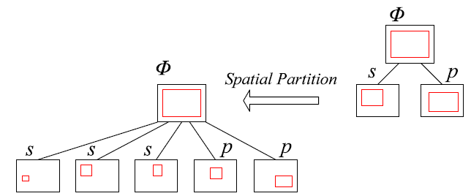
Spatial Partition
Spatial partitioning groups objects O_{f} of node f based on the spatial information.
Specifically, we consider one of the most fundamental strategies, i.e., to partition a region into four non-overlapped subregions by splitting at a central point horizontally and vertically.
DB Training - Spatial

Slide 42
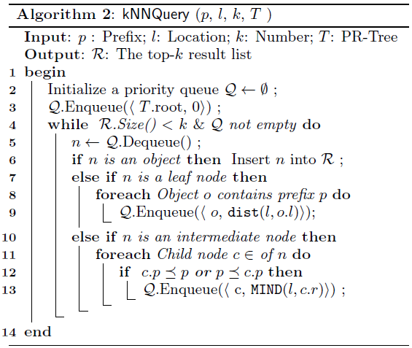
Single-Prefix Queries
We employ the effective Best-First Traversal algorithm (BFT).
The BFT algorithm uses a priority queue for maintaining the nodes and objects in the PR-Tree that need to be visited by the minimum distance from query location.
DB Training - Spatial

Slide 43
Multi-Keyword Queries
  To support multi-keyword queries by PR-Tree, a straightforward method is to simply extend the algorithm for single-prefix queries.
  Each time when a dequeued element is a leaf node, we can only enqueue the objects which contain all keywords in q.W.
  How to check whether an object contains all keywords?
    Intersection: Inverted lists
    Probing: Forward index
DB Training - Spatial

Slide 44
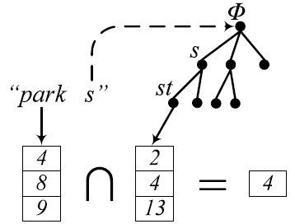
Intersection-based Method
Consider a query that W={park, st}
For ‘park’, we get inverted list I(‘park’)={o₄,o₈,o₉}.
By the traversal of prefix ‘st’ on the PR-Tree, we can get that candidate objects are {o₂,o₄,o₁₃}.
Then, we know that by checking
the leaf node ‘st’, we only
need to enqueue o₄ into
the priority queue.
DB Training - Spatial

Slide 45
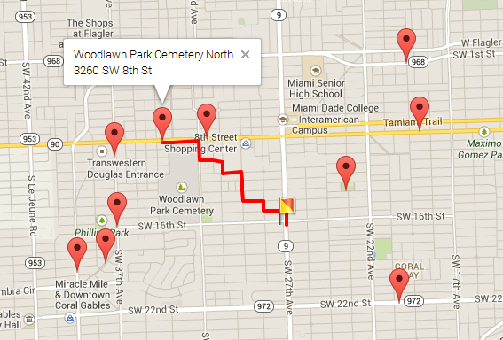
KNN Search on Road Network
Given [a query location], [a set of candidate objects], KNN query returns the [K]-nearest objects ranked by shortest path distance.
DB Training - Spatial

Slide 46
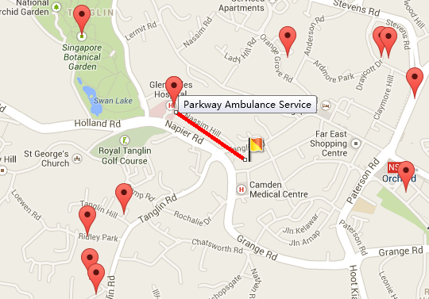
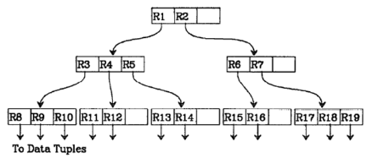
KNN Search on Metric Space
As known, on metric space, R-tree is elegant and efficient in finding top-k answers.
DB Training - Spatial

Slide 47
Challenge
However, it is not easy to extend KNN search on metric space to road networks.
Bottleneck 1: Calculating distance between two nodes
  On metric space: O(1) time, O(1) space
  On road network(graph):
 | Time | Space
Pre-compute all pairs | O(1) | O(n²)
Improved Dijkstra | O(nlogn) | O(1)
DB Training - Spatial

Slide 48
Challenge
Bottleneck 2: Pruning algorithm
  On metric space:
    By exploiting minimal bounding rectangle(MBR), R-tree can efficiently support top-k pruning with the help of best-first-search algorithm.
  On road network:
    However, NO SUCH index exists.
    Best-first-search algorithm cannot be used.
DB Training - Spatial

Slide 49
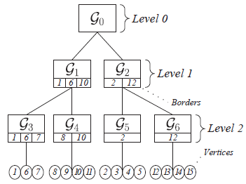
G-tree
What we want?
  An elegant index similar to R-tree on road network.
    1. Balance tree structure;
    2. Exploit best-first-search to find top-k answers;
    3. Good extensibility (keyword search, etc.).
R-tree
G-tree
DB Training - Spatial

Slide 50
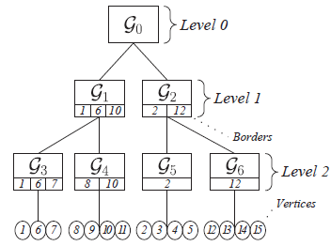
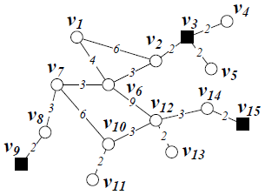
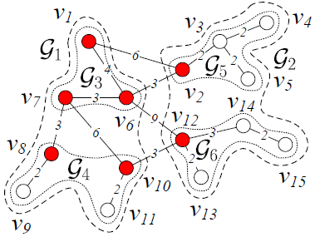
G-tree
The G-tree is constructed by recursively partitioning the road network into sub-networks and each G-tree node corresponds to a sub-network.
Each leaf node contains no more than τ nodes.
We employ METIS to produce balancing partition and minimize the cross-edge between sub-graphs.
DB Training - Spatial

Slide 51
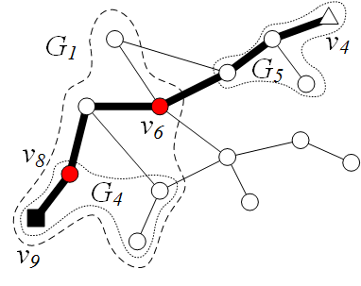
Border
One type of nodes is important: BORDER.
Border is the entry or exit of one sub-network, i.e. any path enters or exits one sub-network MUST bypass at least one border of such sub-network.
DB Training - Spatial

Slide 52
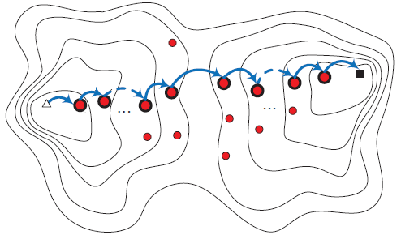
Border
On a hierarchy graph, one path will bypass a series of borders which respectively belongs to one tree node on the G-tree.
DB Training - Spatial

Slide 53
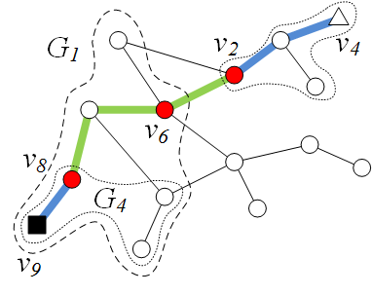
Distance Matrix
Note that, a path on graph can be assembled segment by segment with only TWO types of distances:
  1. Distances between two borders(within the same level or adjacent level of G-tree)
  v₂↔v₆, v₆ ↔ v₈
  2. Distances between leaves’ nodes and borders(within leaf nodes)
  v₄↔v₂, v₈ ↔ v₉
DB Training - Spatial

Slide 54
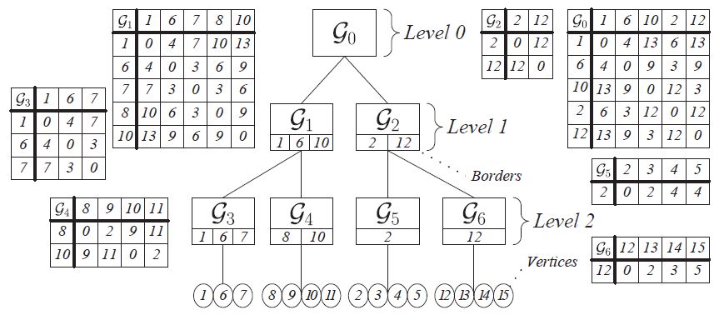
Distance Matrix
Thus, we store a distance matrix on each node of G-tree.
  1. For non-leaf node:
    The rows/columns are all borders in its children
    The value of each entry is the shortest-path distance between the two borders.
  2. For leaf node:
    The rows/columns are all borders/vertices in the node
    The value of each entry is the shortest-path distance between the border and the vertex.
DB Training - Spatial

Slide 55
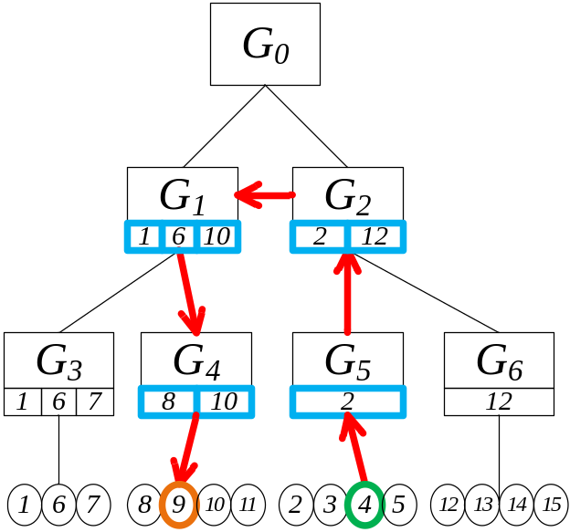
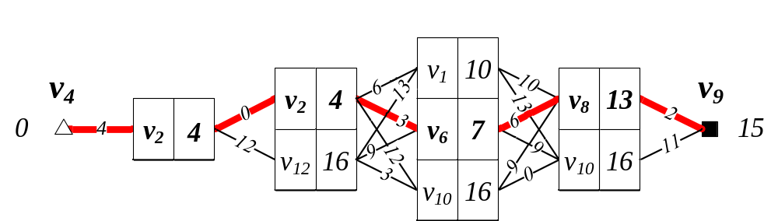
Single Pair Shortest Path
Given two nodes s & t, the graph distance, denoted by Mind(s,t), is calculated as follows:
  1. Find the path from s’ to t’ leaf node on G-tree.
  2. Use dynamic programming algorithm to find the shortest path distance.
DB Training - Spatial

Slide 56
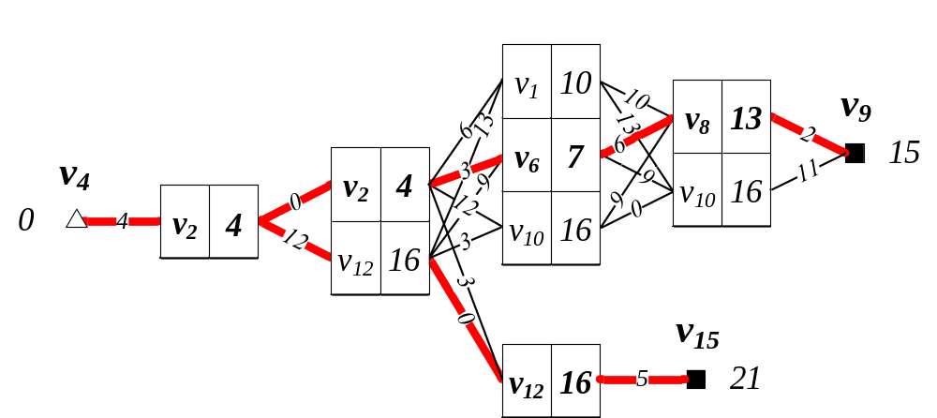
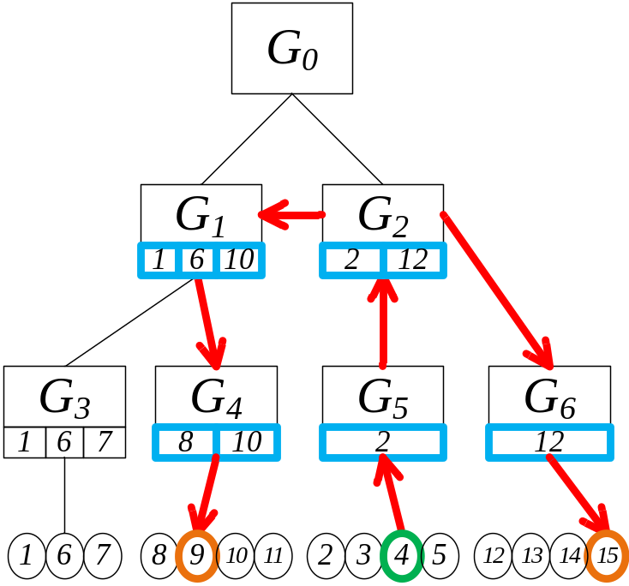
Single Source Shortest Path
Given two paths started from one node, e.g. v₄ to v₉/v₁₅, they might share a section of intermediate paths. Dynamic programming is applied as well.
DB Training - Spatial

Slide 57
KNN Search
We enable best-first-search algorithm on G-tree to retrieve top-k answers.
[Best-First-Search]
  Organize the promising nodes/objects in a priority-queue Q ranked by the minimal distance from query location to such node/object.
  Iteratively dequeue the head element e of the priority-queue:
    If e is a tree node, add e’s children into Q;
    If e is an object, thus, e is the nearest object so far, then we add e to the result list.
It’s Proven Good
DB Training - Spatial

Slide 58
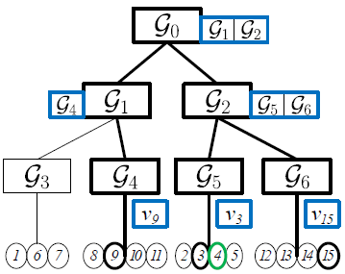
KNN Search: Occurrence List
Occurrence list (on each node) is an indicator for quickly locating promising nodes/objects:
  For non-leaf node: composed of child nodes’ ID of which descendants contain candidate objects;
  For leaf node: composed of objects’ ID.
O={v₃,v₉,v₁₅}
DB Training - Spatial

Slide 59
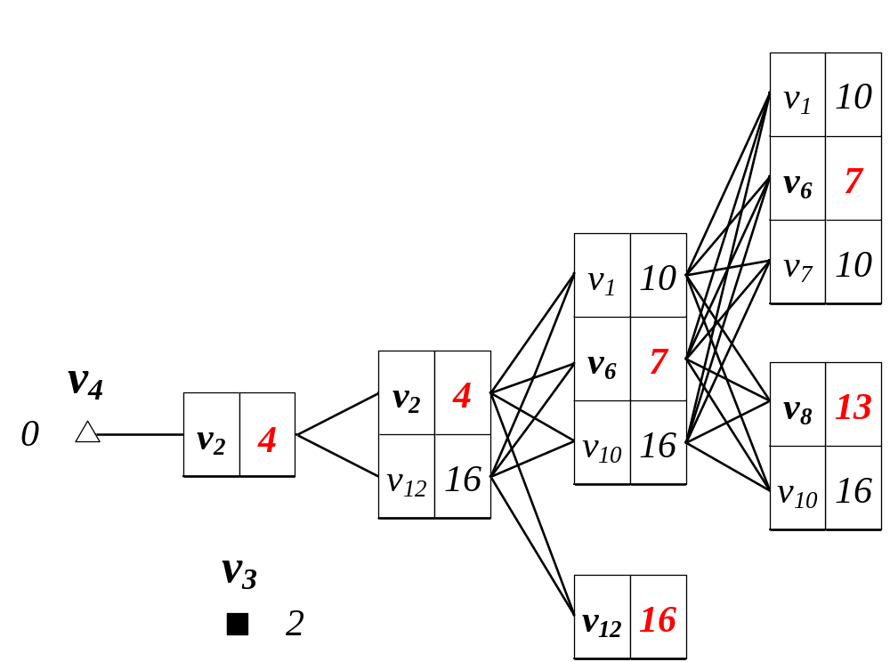
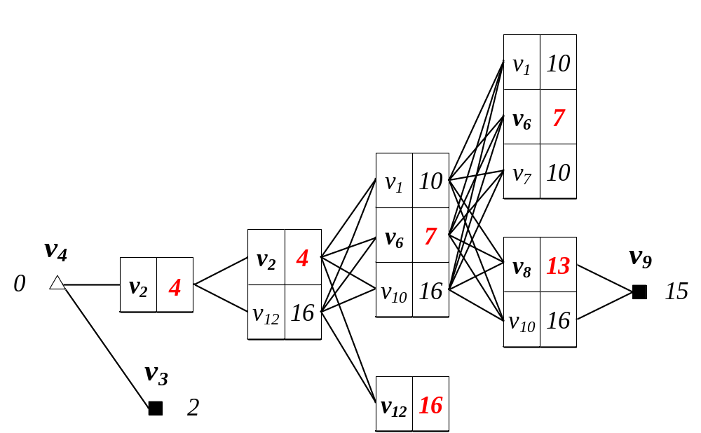








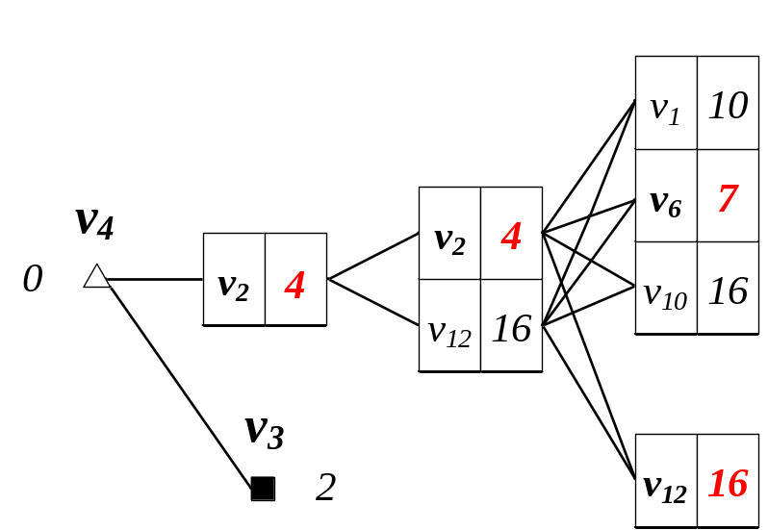
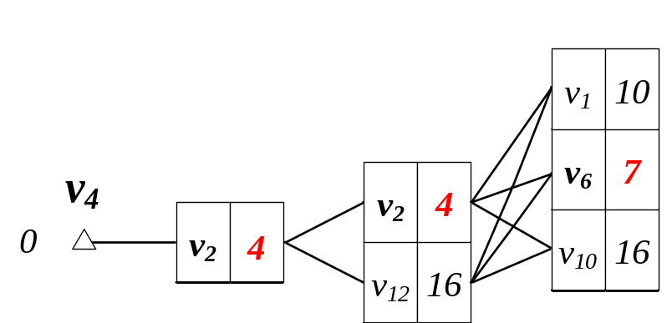
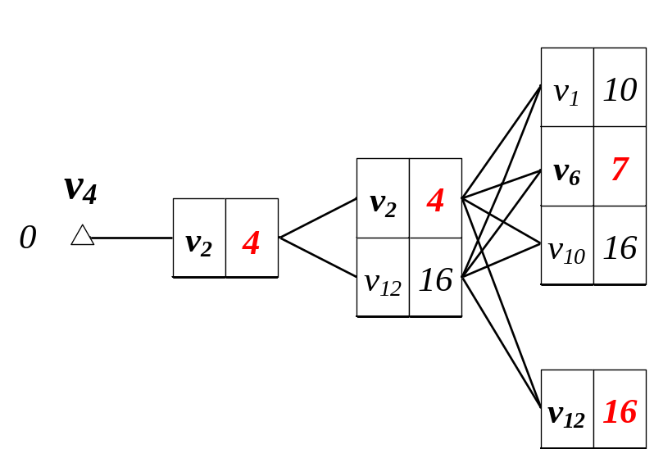
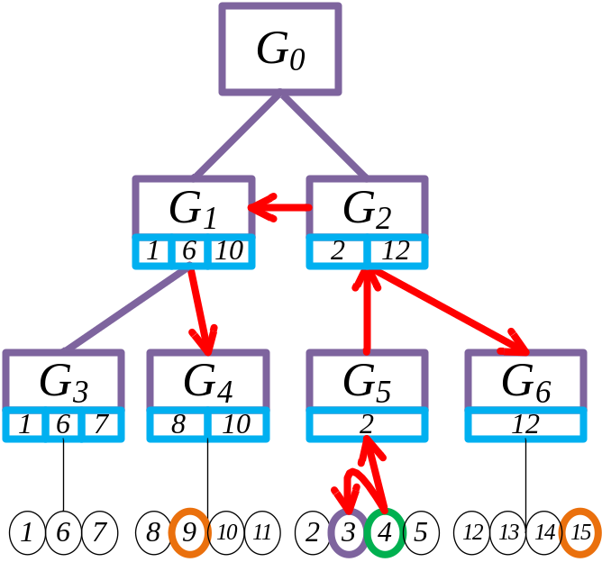
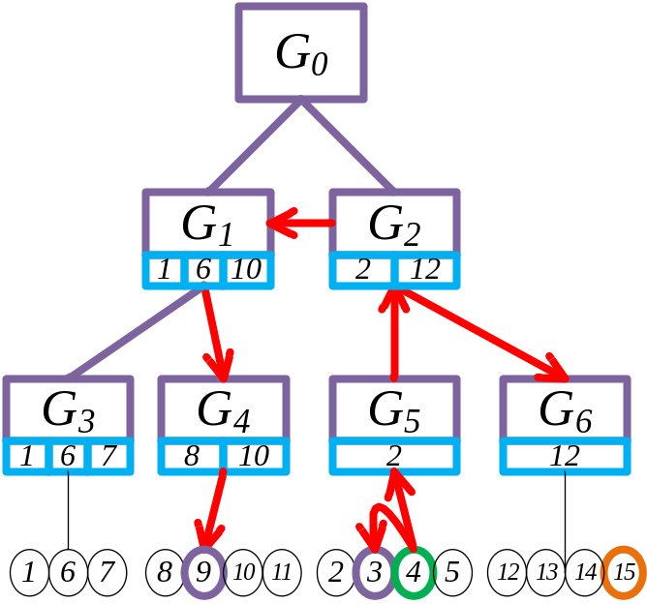
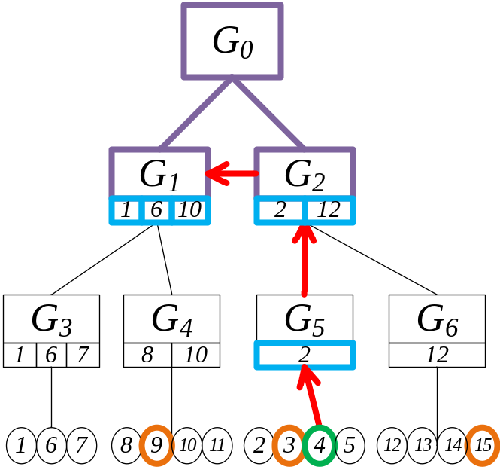
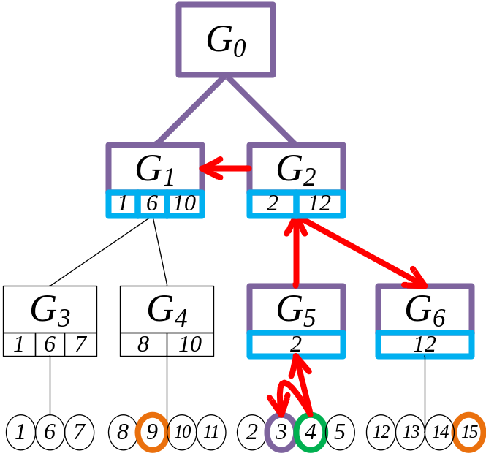
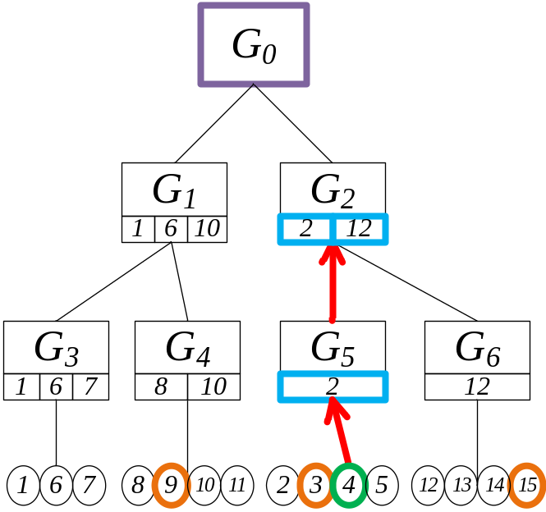
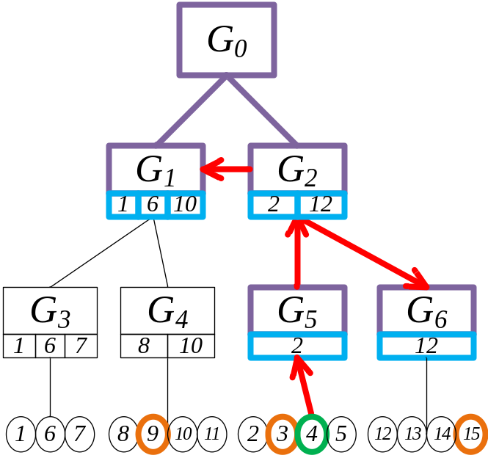
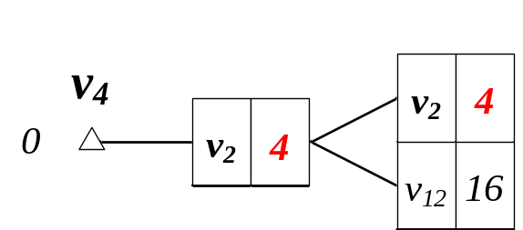


KNN Search— An Example
An example: qloc=v₄, O={v₃,v₉,v₁₅}, K=2
Queue:
Top-2 Result:
DB Training - Spatial

Slide 60
Superiority of G-tree
We maintain the intermediate result Mind(qloc,border_{i}) on each node of G-tree, hence, each tree node is accessed only once.
Our method significantly reduces the overhead for calculating minimal boundary, as we can obtain the minimal boundary from the intermediate result incidentally.
By the use of best-first-search algorithm, G-tree has significant pruning power.
DB Training - Spatial

Slide 61
Discussion
Path Recovery
  G-tree is able to recover the actual node-by-node shortest path in O(VlogV) time.
Computing Distance Matrix Efficiently
  We have developed a bottom-up method to efficiently compute the distance matrix.
G-tree Maintenance for Network Updates
  We can add/delete nodes/edges on G-tree.
Extension to Directed Graphs
  G-tree can also support directed graph.
DB Training - Spatial

Slide 62

DB Training - Spatial

