Slide 1

Course introduction
Implementing DevOps Solutions and Practices using Cisco Platforms
DevOps v1.0
Cisco learning and professional development
Notes:
Purpose: Open Course introduction and establish the subject of the deck.
Explain: Implementing DevOps Solutions and Practices using Cisco Platforms. DevOps v1.0.
Presenter cue: Briefly connect this module to the previous part of the course before discussing details.
Transition: Move to the module introduction and learning focus.

Slide 2
2
Course introduction
Course introduction
A five-day course for engineers who want to deliver automation applications through disciplined software practices.
40 hours combining explanation, demonstration, and guided practice
Knowledge equivalent to DEVASC and DEVCOR
One application evolves as the delivery platform becomes more capable
Notes:
Purpose: Establish the scope of Course introduction.
Explain: A five-day course for engineers who want to deliver automation applications through disciplined software practices.
Discuss: 40 hours combining explanation, demonstration, and guided practice Knowledge equivalent to DEVASC and DEVCOR One application evolves as the delivery platform becomes more capable
Audience question: Which point is most familiar, and which point needs the most attention?
Transition: Introduce the first model or engineering boundary.

Slide 3
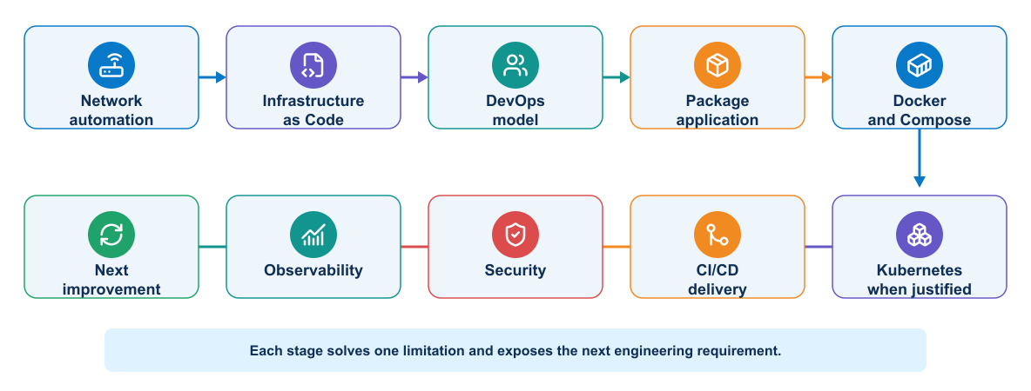
3
Course introduction
Course journey
The course follows the engineering decisions required to move an automation application into dependable operation.
Notes:
Purpose: Explain course journey through the diagram.
Reading order: Start with the main boundary or input, follow the connections, then identify the output or feedback path.
Key explanation: The course follows the engineering decisions required to move an automation application into dependable operation.
Audience question: Where would a failure become visible, and which component should own the response?
Transition: Connect the diagram to the next engineering decision.

Slide 4
4
Course introduction
Five-day learning sequence
Days 1 and 2
Days 3 to 5
1
Automation knowledge review
1
Docker, Compose, and Kubernetes
2
DevOps model and CALMS
2
GitLab pipeline design
3
Delivery lifecycle and evidence
3
Deployment validation and recovery
4
Infrastructure ownership boundaries
4
Security and operational feedback
Notes:
Purpose: Compare the two sides of five-day learning sequence.
Left side, Days 1 and 2: Automation knowledge review DevOps model and CALMS Delivery lifecycle and evidence Infrastructure ownership boundaries
Right side, Days 3 to 5: Docker, Compose, and Kubernetes GitLab pipeline design Deployment validation and recovery Security and operational feedback
Presenter cue: Explain the relationship between the columns rather than reading each line verbatim.
Audience question: Which responsibility is unclear or shared in your current environment?
Transition: Use the comparison to frame the next topic.

Slide 5
5
Course introduction
Starting knowledge
Expected foundation
Course emphasis
1
Python scripting and virtual environments
1
Team delivery practices
2
REST APIs and structured data
2
Repeatable infrastructure and runtime environments
3
Ansible and network automation workflows
3
Controlled build, test, release, and deployment
4
Git fundamentals and Linux command line
4
Security evidence and operational feedback
Notes:
Purpose: Compare the two sides of starting knowledge.
Left side, Expected foundation: Python scripting and virtual environments REST APIs and structured data Ansible and network automation workflows Git fundamentals and Linux command line
Right side, Course emphasis: Team delivery practices Repeatable infrastructure and runtime environments Controlled build, test, release, and deployment Security evidence and operational feedback
Presenter cue: Explain the relationship between the columns rather than reading each line verbatim.
Audience question: Which responsibility is unclear or shared in your current environment?
Transition: Use the comparison to frame the next topic.

Slide 6
6
Course introduction
Learning expectations
During class
Working approach
1
Participate in technical discussions
1
Read the task before changing the environment
2
Use the assigned learner identity and resource range
2
Validate each boundary before continuing
3
Keep evidence from tests and deployments
3
Record assumptions and results
4
Ask questions when observed behavior differs from intent
4
Restore shared resources after use
Notes:
Purpose: Compare the two sides of learning expectations.
Left side, During class: Participate in technical discussions Use the assigned learner identity and resource range Keep evidence from tests and deployments Ask questions when observed behavior differs from intent
Right side, Working approach: Read the task before changing the environment Validate each boundary before continuing Record assumptions and results Restore shared resources after use
Presenter cue: Explain the relationship between the columns rather than reading each line verbatim.
Audience question: Which responsibility is unclear or shared in your current environment?
Transition: Use the comparison to frame the next topic.

Slide 7
7
Course introduction
Knowledge gained
By the end of the course, learners can explain and apply the complete delivery path for a containerized automation service.
Select ownership boundaries for Terraform, Ansible, Docker, and Kubernetes
Design GitLab pipelines with meaningful validation and promotion gates
Protect credentials and runner trust boundaries
Use logs, metrics, dashboards, and alerts to evaluate service behavior
Notes:
Purpose: Establish the scope of Knowledge gained.
Explain: By the end of the course, learners can explain and apply the complete delivery path for a containerized automation service.
Discuss: Select ownership boundaries for Terraform, Ansible, Docker, and Kubernetes Design GitLab pipelines with meaningful validation and promotion gates Protect credentials and runner trust boundaries Use logs, metrics, dashboards, and alerts to evaluate service behavior
Audience question: Which point is most familiar, and which point needs the most attention?
Transition: Introduce the first model or engineering boundary.

Slide 8
8
Course introduction
Course application
Application capabilities
Delivery capabilities
1
Collect operational data through APIs
1
Provision an isolated test environment
2
Present service information through a web interface
2
Package and scan release artifacts
3
Persist application data
3
Promote through protected pipelines
4
Run consistently across environments
4
Correlate deployment and runtime evidence
Notes:
Purpose: Compare the two sides of course application.
Left side, Application capabilities: Collect operational data through APIs Present service information through a web interface Persist application data Run consistently across environments
Right side, Delivery capabilities: Provision an isolated test environment Package and scan release artifacts Promote through protected pipelines Correlate deployment and runtime evidence
Presenter cue: Explain the relationship between the columns rather than reading each line verbatim.
Audience question: Which responsibility is unclear or shared in your current environment?
Transition: Use the comparison to frame the next topic.

Slide 9
9
Course introduction
Instructor introduction
Professional background
Teaching approach
1
Current role and technical focus
1
Explain the engineering decision first
2
Relevant automation and delivery experience
2
Demonstrate the observable result
3
Platforms and tools used in production
3
Connect failures to design choices
4
What you want learners to take from the course
4
Leave time for questions and comparison
Notes:
Purpose: Compare the two sides of instructor introduction.
Left side, Professional background: Current role and technical focus Relevant automation and delivery experience Platforms and tools used in production What you want learners to take from the course
Right side, Teaching approach: Explain the engineering decision first Demonstrate the observable result Connect failures to design choices Leave time for questions and comparison
Presenter cue: Explain the relationship between the columns rather than reading each line verbatim.
Audience question: Which responsibility is unclear or shared in your current environment?
Transition: Use the comparison to frame the next topic.

Slide 10
10
Course introduction
Learner introductions
Please share
Listen for
1
Name and current role
1
Common platforms and constraints
2
Automation tools you use today
2
Shared operational risks
3
Experience with containers or CI/CD
3
Different levels of software experience
4
One delivery problem you want to solve
4
Opportunities for peer learning
Notes:
Purpose: Compare the two sides of learner introductions.
Left side, Please share: Name and current role Automation tools you use today Experience with containers or CI/CD One delivery problem you want to solve
Right side, Listen for: Common platforms and constraints Shared operational risks Different levels of software experience Opportunities for peer learning
Presenter cue: Explain the relationship between the columns rather than reading each line verbatim.
Audience question: Which responsibility is unclear or shared in your current environment?
Transition: Use the comparison to frame the next topic.

Slide 11
11
Course introduction
Course agreements
A shared environment works when every learner treats identity, scope, and cleanup as part of the engineering task.
Use only your assigned namespace, ports, and identifiers
Never place credentials in source control or terminal history
Stop when a validation gate fails
Preserve logs and pipeline evidence for review
Notes:
Purpose: Establish the scope of Course agreements.
Explain: A shared environment works when every learner treats identity, scope, and cleanup as part of the engineering task.
Discuss: Use only your assigned namespace, ports, and identifiers Never place credentials in source control or terminal history Stop when a validation gate fails Preserve logs and pipeline evidence for review
Audience question: Which point is most familiar, and which point needs the most attention?
Transition: Introduce the first model or engineering boundary.

Slide 12
12
Course introduction
Evidence of learning
Technical evidence
Engineering judgement
1
Working source and configuration
1
Explain tool ownership
2
Successful automated checks
2
Interpret failed validation
3
Identified container images
3
Select a safe recovery action
4
Deployment and runtime records
4
Connect symptoms to recent change
Notes:
Purpose: Compare the two sides of evidence of learning.
Left side, Technical evidence: Working source and configuration Successful automated checks Identified container images Deployment and runtime records
Right side, Engineering judgement: Explain tool ownership Interpret failed validation Select a safe recovery action Connect symptoms to recent change
Presenter cue: Explain the relationship between the columns rather than reading each line verbatim.
Audience question: Which responsibility is unclear or shared in your current environment?
Transition: Use the comparison to frame the next topic.

Slide 13
13
Course introduction
Course orientation complete
✓
Course orientation complete
Next: Network Automation Review
Review the key concepts before continuing.
Notes:
Purpose: Close Course introduction.
Recap: Ask learners to state one concept they can apply and one question that remains.
Next: Next: Network Automation Review
Presenter cue: Confirm the class is ready before moving to the next module.

