Slide 1

Module 0
Network Automation Review
Software foundations for automation applications
Cisco learning and professional development
Notes:
Purpose: Open Module 0 and establish the subject of the deck.
Explain: Network Automation Review. Software foundations for automation applications.
Presenter cue: Briefly connect this module to the previous part of the course before discussing details.
Transition: Move to the module introduction and learning focus.

Slide 2
2
Module 0
Module introduction
This module refreshes the programming, data, interface, and validation concepts used throughout the course.
Recognize the parts of a network automation application
Work with Python, JSON, YAML, XML, and dictionaries
Select an appropriate management interface
Use Git to record and exchange changes
Notes:
Purpose: Establish the scope of Module introduction.
Explain: This module refreshes the programming, data, interface, and validation concepts used throughout the course.
Discuss: Recognize the parts of a network automation application Work with Python, JSON, YAML, XML, and dictionaries Select an appropriate management interface Use Git to record and exchange changes
Audience question: Which point is most familiar, and which point needs the most attention?
Transition: Introduce the first model or engineering boundary.

Slide 3
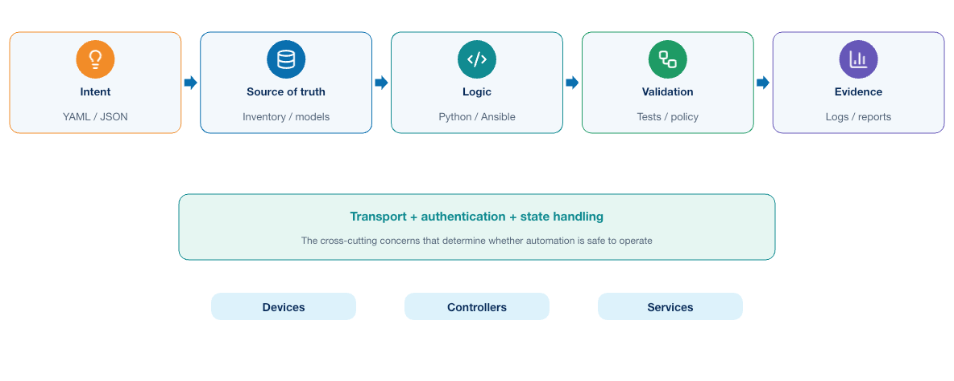
3
Module 0
Automation application structure
Automation becomes easier to reason about when input, transformation, transport, validation, and evidence have clear boundaries.
Notes:
Purpose: Explain automation application structure through the diagram.
Reading order: Start with the main boundary or input, follow the connections, then identify the output or feedback path.
Key explanation: Automation becomes easier to reason about when input, transformation, transport, validation, and evidence have clear boundaries.
Audience question: Where would a failure become visible, and which component should own the response?
Transition: Connect the diagram to the next engineering decision.

Slide 4
4
Module 0
Automation responsibility boundaries
Application responsibilities
Operational responsibilities
1
Validate input before use
1
Control target scope
2
Transform data deliberately
2
Protect access credentials
3
Handle errors and timeouts
3
Observe device and service state
4
Return a meaningful result
4
Retain evidence for investigation
Notes:
Purpose: Compare the two sides of automation responsibility boundaries.
Left side, Application responsibilities: Validate input before use Transform data deliberately Handle errors and timeouts Return a meaningful result
Right side, Operational responsibilities: Control target scope Protect access credentials Observe device and service state Retain evidence for investigation
Presenter cue: Explain the relationship between the columns rather than reading each line verbatim.
Audience question: Which responsibility is unclear or shared in your current environment?
Transition: Use the comparison to frame the next topic.

Slide 5
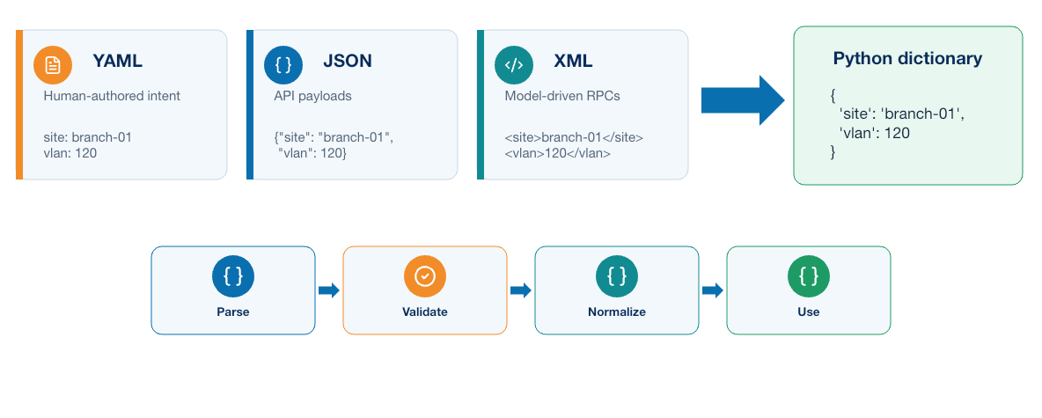
5
Module 0
Structured data contracts
JSON, YAML, XML, and Python dictionaries represent the same intent in forms suited to different consumers.
Notes:
Purpose: Explain structured data contracts through the diagram.
Reading order: Start with the main boundary or input, follow the connections, then identify the output or feedback path.
Key explanation: JSON, YAML, XML, and Python dictionaries represent the same intent in forms suited to different consumers.
Audience question: Where would a failure become visible, and which component should own the response?
Transition: Connect the diagram to the next engineering decision.

Slide 6
6
Module 0
Python review
Application logic
Common libraries
1
Functions separate responsibilities
1
requests for HTTP APIs
2
Exceptions expose failure conditions
2
ncclient for NETCONF
3
Logging records context and outcome
3
Netmiko for CLI automation
4
Virtual environments isolate dependencies
4
Flask for service interfaces
Notes:
Purpose: Compare the two sides of python review.
Left side, Application logic: Functions separate responsibilities Exceptions expose failure conditions Logging records context and outcome Virtual environments isolate dependencies
Right side, Common libraries: requests for HTTP APIs ncclient for NETCONF Netmiko for CLI automation Flask for service interfaces
Presenter cue: Explain the relationship between the columns rather than reading each line verbatim.
Audience question: Which responsibility is unclear or shared in your current environment?
Transition: Use the comparison to frame the next topic.

Slide 7
7
Module 0
API request lifecycle
Before the request
After the response
1
Select the resource and method
1
Check the status code
2
Build headers and authentication
2
Parse the declared format
3
Validate input data
3
Validate required fields
4
Set a bounded timeout
4
Log context without secrets
Notes:
Purpose: Compare the two sides of api request lifecycle.
Left side, Before the request: Select the resource and method Build headers and authentication Validate input data Set a bounded timeout
Right side, After the response: Check the status code Parse the declared format Validate required fields Log context without secrets
Presenter cue: Explain the relationship between the columns rather than reading each line verbatim.
Audience question: Which responsibility is unclear or shared in your current environment?
Transition: Use the comparison to frame the next topic.

Slide 8
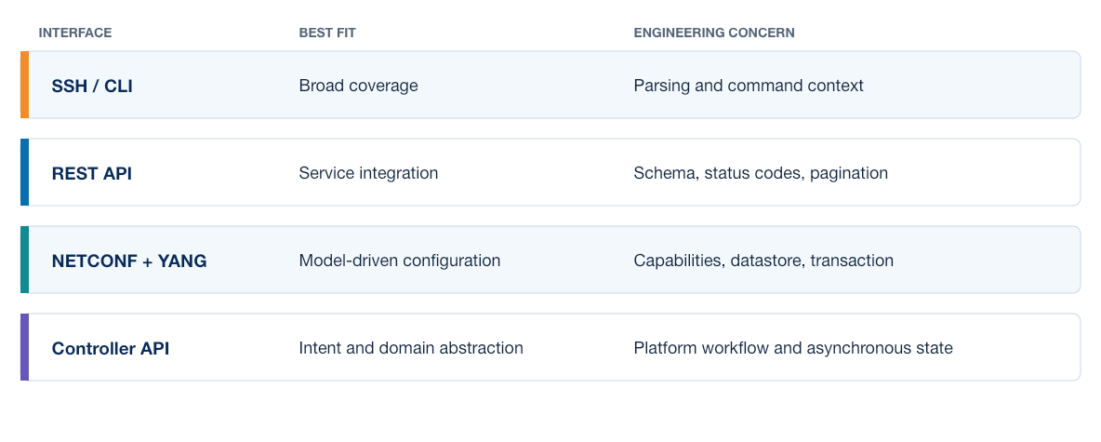
8
Module 0
Interface selection
The correct interface depends on data structure, transaction support, platform capability, and the evidence the workflow must collect.
Notes:
Purpose: Explain interface selection through the diagram.
Reading order: Start with the main boundary or input, follow the connections, then identify the output or feedback path.
Key explanation: The correct interface depends on data structure, transaction support, platform capability, and the evidence the workflow must collect.
Audience question: Where would a failure become visible, and which component should own the response?
Transition: Connect the diagram to the next engineering decision.

Slide 9
9
Module 0
Ansible review
Core objects
Operational controls
1
Inventory identifies managed targets
1
Limit the target scope
2
Variables describe desired values
2
Protect credentials
3
Playbooks coordinate tasks
3
Check idempotence
4
Roles package reusable behavior
4
Capture changed and failed results
Notes:
Purpose: Compare the two sides of ansible review.
Left side, Core objects: Inventory identifies managed targets Variables describe desired values Playbooks coordinate tasks Roles package reusable behavior
Right side, Operational controls: Limit the target scope Protect credentials Check idempotence Capture changed and failed results
Presenter cue: Explain the relationship between the columns rather than reading each line verbatim.
Audience question: Which responsibility is unclear or shared in your current environment?
Transition: Use the comparison to frame the next topic.

Slide 10
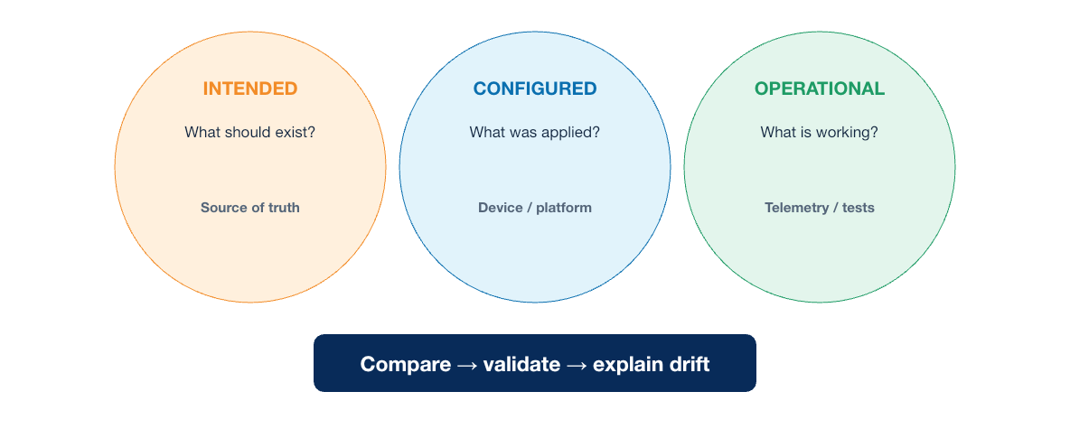
10
Module 0
Intent and state
A safe workflow distinguishes what should exist, what the tool applied, and what the service now reports.
Notes:
Purpose: Explain intent and state through the diagram.
Reading order: Start with the main boundary or input, follow the connections, then identify the output or feedback path.
Key explanation: A safe workflow distinguishes what should exist, what the tool applied, and what the service now reports.
Audience question: Where would a failure become visible, and which component should own the response?
Transition: Connect the diagram to the next engineering decision.

Slide 11
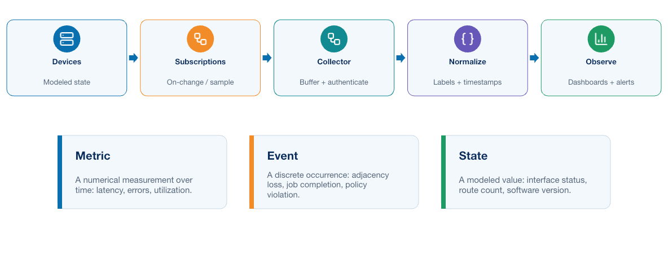
11
Module 0
Model-driven telemetry
Streaming telemetry delivers structured updates continuously, while polling asks for selected state at scheduled intervals.
Notes:
Purpose: Explain model-driven telemetry through the diagram.
Reading order: Start with the main boundary or input, follow the connections, then identify the output or feedback path.
Key explanation: Streaming telemetry delivers structured updates continuously, while polling asks for selected state at scheduled intervals.
Audience question: Where would a failure become visible, and which component should own the response?
Transition: Connect the diagram to the next engineering decision.

Slide 12
12
Module 0
Git essentials
Local workflow
Team workflow
1
git status and git diff
1
Pull before starting work
2
git add and git commit
2
Use a focused branch
3
git log and git show
3
Push reviewable commits
4
git branch and git switch
4
Resolve conflicts with context
Notes:
Purpose: Compare the two sides of git essentials.
Left side, Local workflow: git status and git diff git add and git commit git log and git show git branch and git switch
Right side, Team workflow: Pull before starting work Use a focused branch Push reviewable commits Resolve conflicts with context
Presenter cue: Explain the relationship between the columns rather than reading each line verbatim.
Audience question: Which responsibility is unclear or shared in your current environment?
Transition: Use the comparison to frame the next topic.

Slide 13
13
Module 0
Testing boundaries
Offline checks
Connected checks
1
Data parsing and validation
1
Authentication and reachability
2
Template rendering
2
API and device behavior
3
Business rules
3
Configuration state
4
Error handling
4
Service outcome
Notes:
Purpose: Compare the two sides of testing boundaries.
Left side, Offline checks: Data parsing and validation Template rendering Business rules Error handling
Right side, Connected checks: Authentication and reachability API and device behavior Configuration state Service outcome
Presenter cue: Explain the relationship between the columns rather than reading each line verbatim.
Audience question: Which responsibility is unclear or shared in your current environment?
Transition: Use the comparison to frame the next topic.

Slide 14
14
Module 0
Key takeaways
Network automation already combines software logic, structured data, device interfaces, and operational validation.
Treat input data as a contract
Choose interfaces according to the required behavior
Separate intended, applied, and operational state
Keep source and decisions in Git
Notes:
Purpose: Establish the scope of Key takeaways.
Explain: Network automation already combines software logic, structured data, device interfaces, and operational validation.
Discuss: Treat input data as a contract Choose interfaces according to the required behavior Separate intended, applied, and operational state Keep source and decisions in Git
Audience question: Which point is most familiar, and which point needs the most attention?
Transition: Introduce the first model or engineering boundary.

Slide 15
15
Module 0
Module 0 complete
✓
Module 0 complete
Next: Introducing the DevOps Model
Review the key concepts before continuing.
Notes:
Purpose: Close Module 0.
Recap: Ask learners to state one concept they can apply and one question that remains.
Next: Next: Introducing the DevOps Model
Presenter cue: Confirm the class is ready before moving to the next module.

